Slide 1
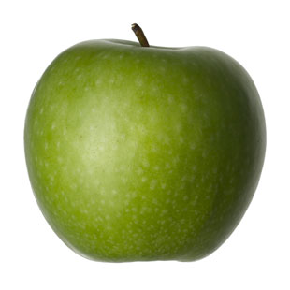

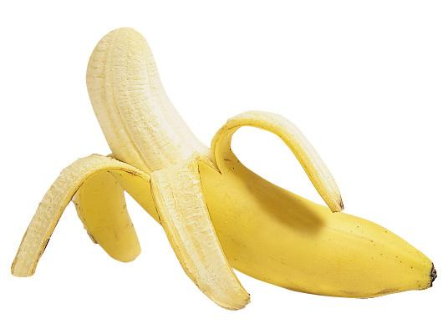
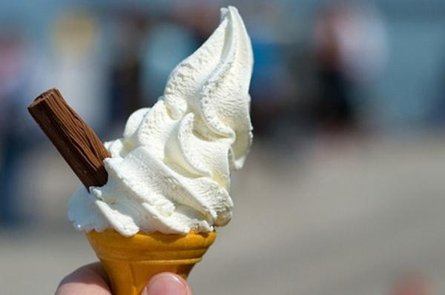


Bon app$\acute{e}$tit!
Enjoy your food!
Lesson 2

Slide 2


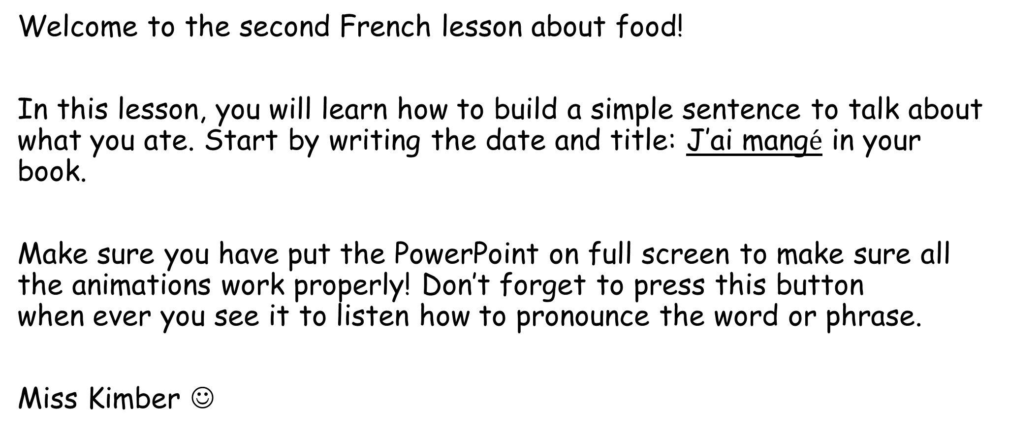
Bonjour class 3!
Welcome to the second French lesson about food!
In this lesson, you will learn how to build a simple sentence to talk about what you ate. Start by writing the date and title: J’ai mang$\acute{e}$ in your book.
Make sure you have put the PowerPoint on full screen to make sure all the animations work properly! Don’t forget to press this button when ever you see it to listen how to pronounce the word or phrase.
Miss Kimber ☺

Slide 3
Let’s start by recapping all the food words we learnt last week
You will be shown a picture of a food. Try and remember and say the French word for the food on the screen if you can! Then click again to reveal the French word.
It’s hard to remember new vocabulary in a different language so a big well done if you remember any of them!
Listen and repeat the word 5 times to get it into your memory!

Slide 4
un sandwich

Slide 5
une banane

Slide 6
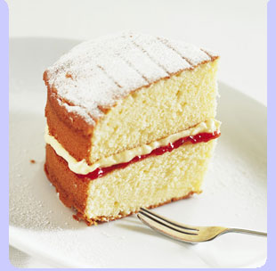
un gateau

Slide 7
une pomme

Slide 8
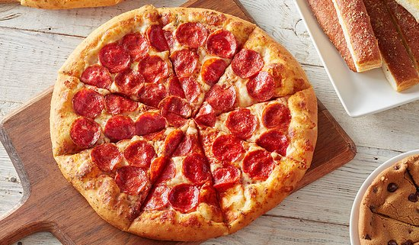
une pizza

Slide 9
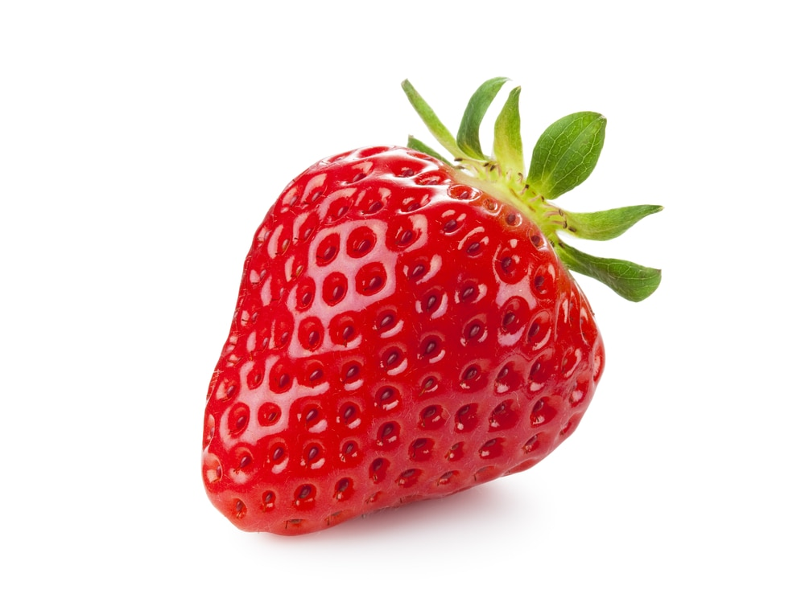
une fraise

Slide 10
une glace

Slide 11
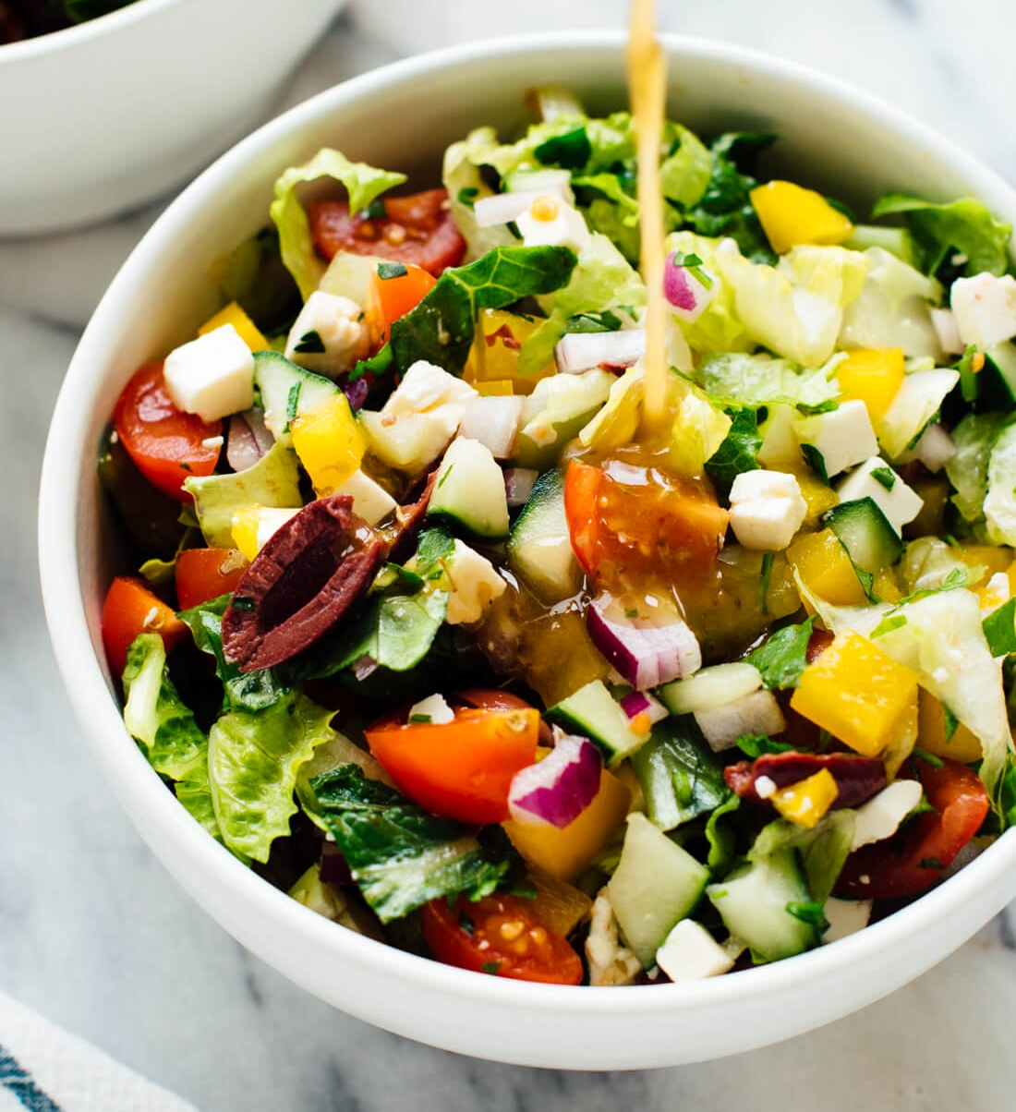
une salade

Slide 12
How did you do?
Challenge: If you think that you can remember more of the words now, go back through the PowerPoint and try again. Can you remember more than before?

Slide 13
Now, let’s learn how to put these words into a sentence!

Slide 14


J’ai mang$\acute{e}$
Key phrase:
I ate
Copy this key phrase into your book along with the English translation ‘I ate’.
Listen carefully to how this phrase is pronounced and practise saying it in these
different silly voices:
Can you say it in a squeaky voice?
Can you say it in a robot voice?
Can you say it in a whisper voice?
Can you say it in a angry voice?
Can you say it in a baby voice?

Slide 15


J’ai mang$\acute{e}$
I ate
J’ai mang$\acute{e}$ une salade
Can you work out what this sentence means? You might want to use the vocabulary in your book from this and last lesson to help you.
Answer: I ate a salad

Slide 16

Click to check your answers
In your book, translate these sentences to French – use the phrases and words in your book to help you
I ate a strawberry
2. I ate a sandwich
3. I ate an ice cream

Slide 17
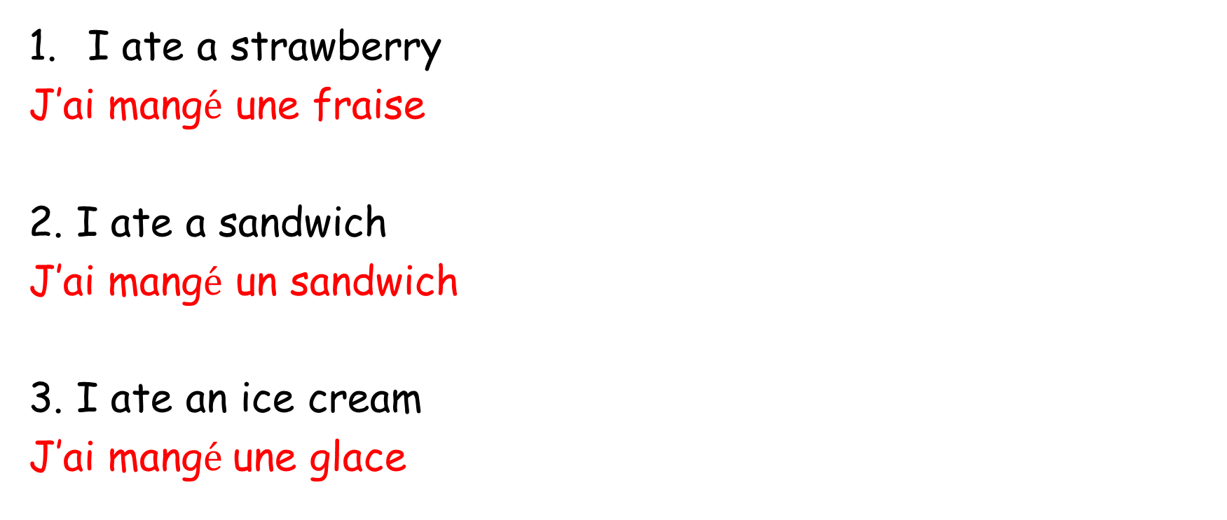
Answers:
I ate a strawberry
J’ai mang$\acute{e}$ une fraise
2. I ate a sandwich
J’ai mang$\acute{e}$ un sandwich
3. I ate an ice cream
J’ai mang$\acute{e}$ une glace
If you got them right, give them a tick. If you got some wrong, correct them.

