Slide 1
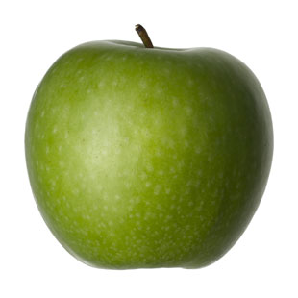

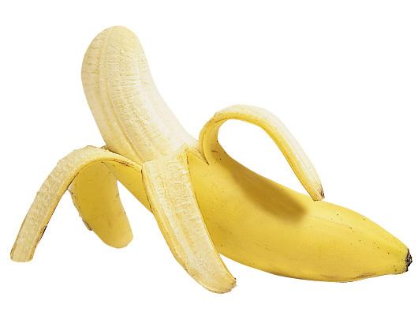
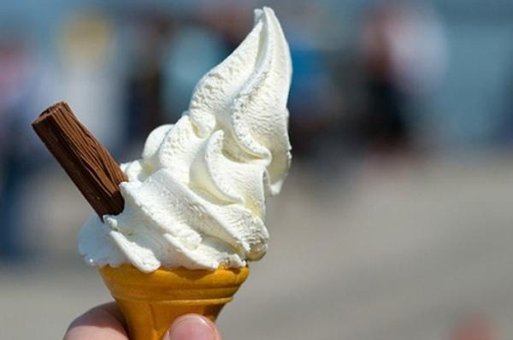


Bon app$\acute{e}$tit!
Enjoy your food!
Lesson 3

Slide 2


Bonjour class 3!
Welcome to the third French lesson about food!
In this lesson, you will use everything you have learnt so far to create and understand sentences about how many pieces of food has been eaten. Start by writing the date and title: Combien? in your book (this means ‘how many?/ how much?’).
Make sure you have put the PowerPoint on full screen to make sure all the animations work properly! Don’t forget to press this button when ever you see it to listen how to pronounce the word or phrase.
Miss Kimber ☺

Slide 3

You will need to think back to your learning on French numbers to 10
Copy and paste this link into your web browser and sing along to the numbers song to refresh your memory:
https://www.youtube.com/watch?v=3D-2fTVbukU

Slide 4
These French numbers have gotten muddled up!
In your book, write them out in the correct order.
dix
cinq
trois
deux
neuf
quatre
huit
six
sept
un
If you get stuck, listen to the French number song again to help you

Slide 5
Correct order:
un
deux
trois
quatre
cinq
six
sept
huit
neuf
dix
Give yourself a point for each number you get in the correct order. Correct any that you get wrong

Slide 6
If 1 is un, why do some of the French foods say une instead of un?
We’ve already learnt how to say 1 of each food when we learnt the food vocabulary
un sandwich
une banane
In French, nouns are either masculine or feminine.
If a noun is feminine like ‘banane’, you need to add an e onto un to make une

Slide 7
Look back at your list of food words in your book
Can you colour code the words to show which ones are masculine and which are feminine. You might want to use a key.
Remember:
un = masculine
une = feminine

Slide 8
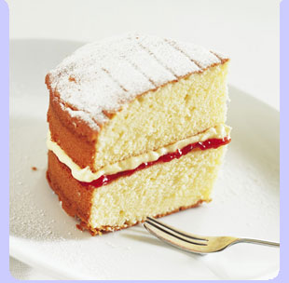
Check your answers:
Masculine:
un gateau
un sandwich

Slide 9
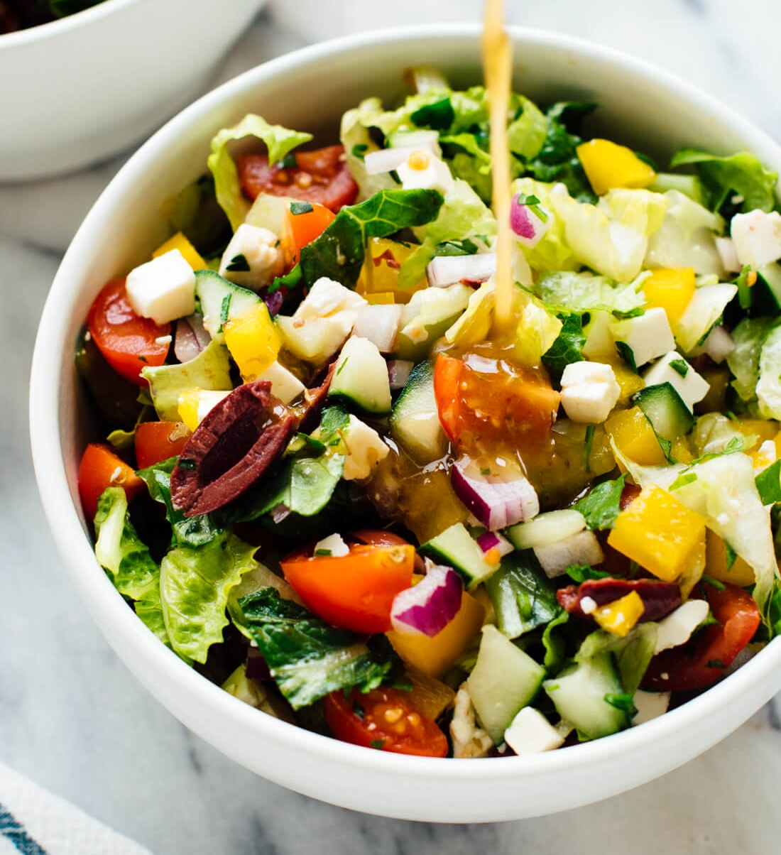
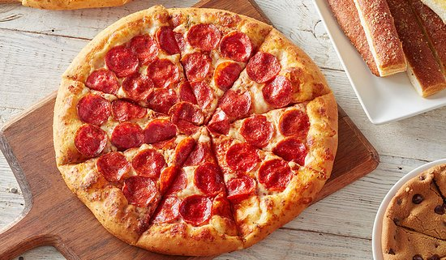
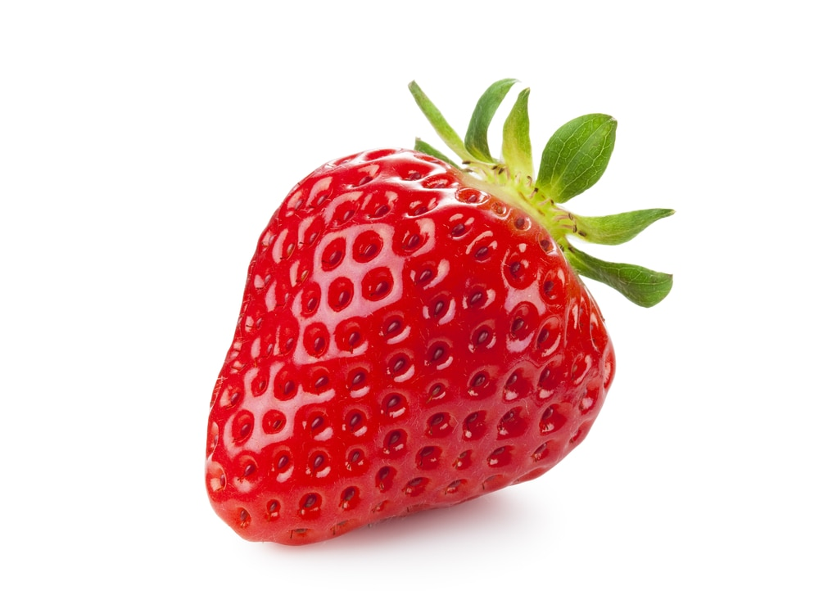
Check your answers:
Feminine:
une salade
une pizza
une pomme
une banane
une glace
une fraise

Slide 10
Luckily, you only have to add an e to un if the food is feminine. You don’t have to change any of the other numbers!

Slide 11
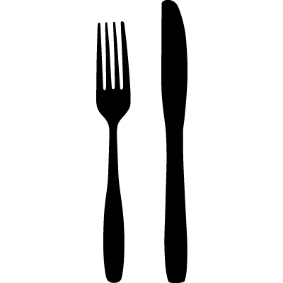

Can you remember how to say ‘I ate’?
J’ai mang$\acute{e}$
I ate

Slide 12

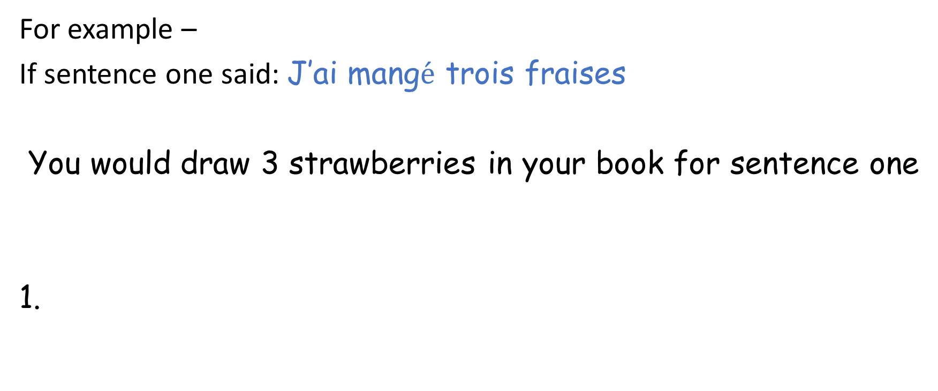
Read and listen to these sentences.
Draw a picture in your book for how many of what food they ate.
For example –
If sentence one said: J’ai mang$\acute{e}$ trois fraises
You would draw 3 strawberries in your book for sentence one
1.

Slide 13
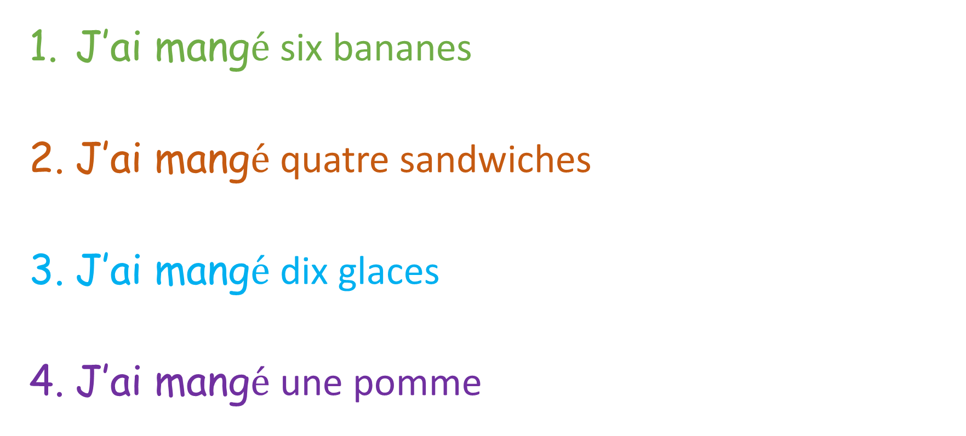
Read and listen to these sentences.
Draw a picture in your book for how many of what food they ate.
J’ai mang$\acute{e}$ six bananes
J’ai mang$\acute{e}$ quatre sandwiches
J’ai mang$\acute{e}$ dix glaces
J’ai mang$\acute{e}$ une pomme

Slide 14
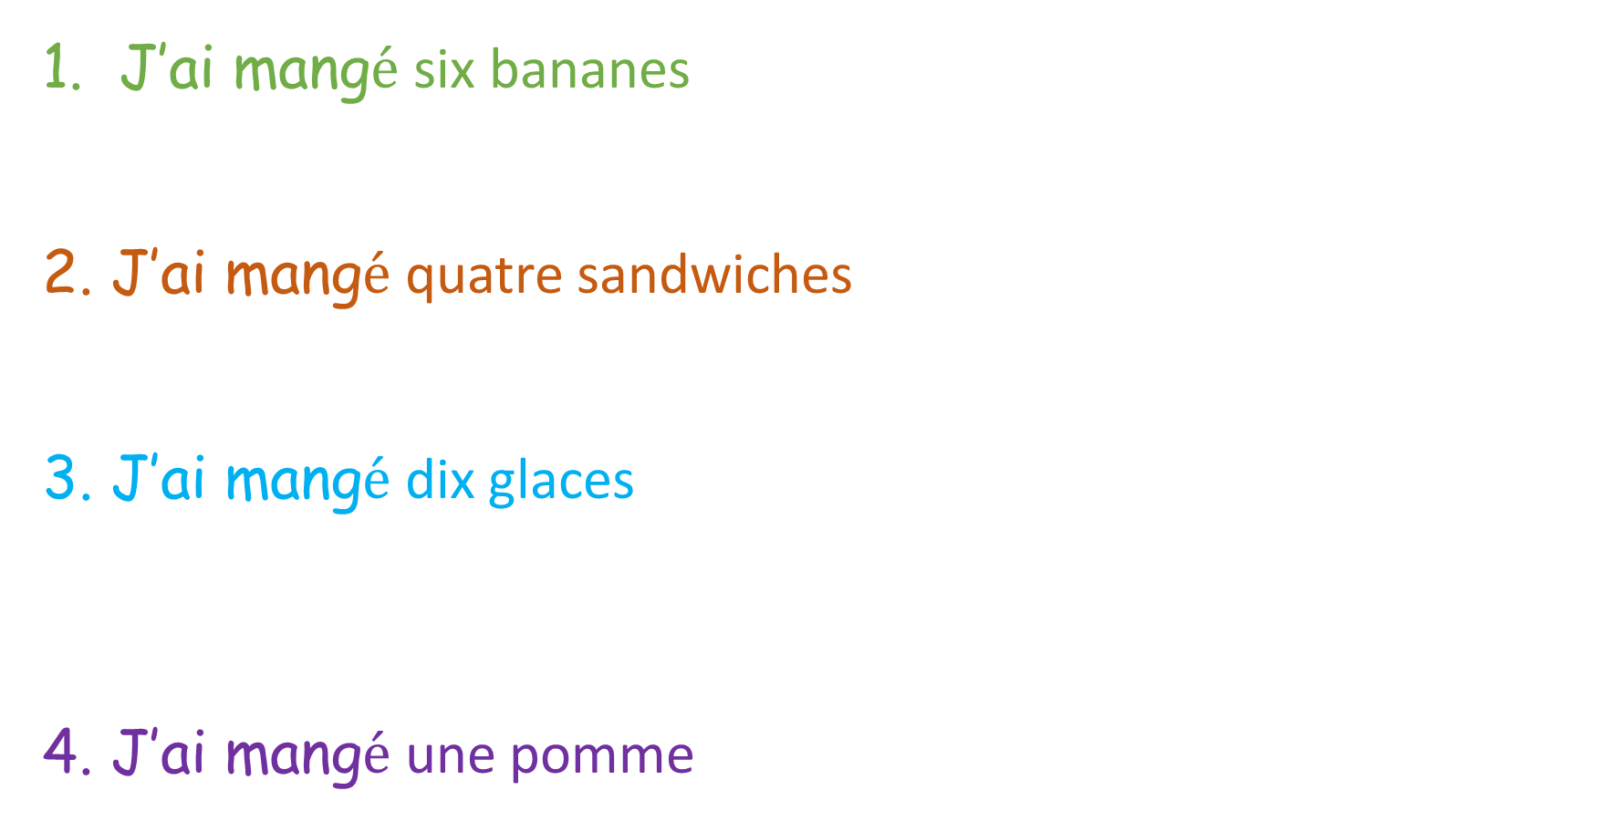
Answers: Give yourself a tick for each one you get right and correct any you get wrong
J’ai mang$\acute{e}$ six bananes
2. J’ai mang$\acute{e}$ quatre sandwiches
3. J’ai mang$\acute{e}$ dix glaces
4. J’ai mang$\acute{e}$ une pomme

Slide 15
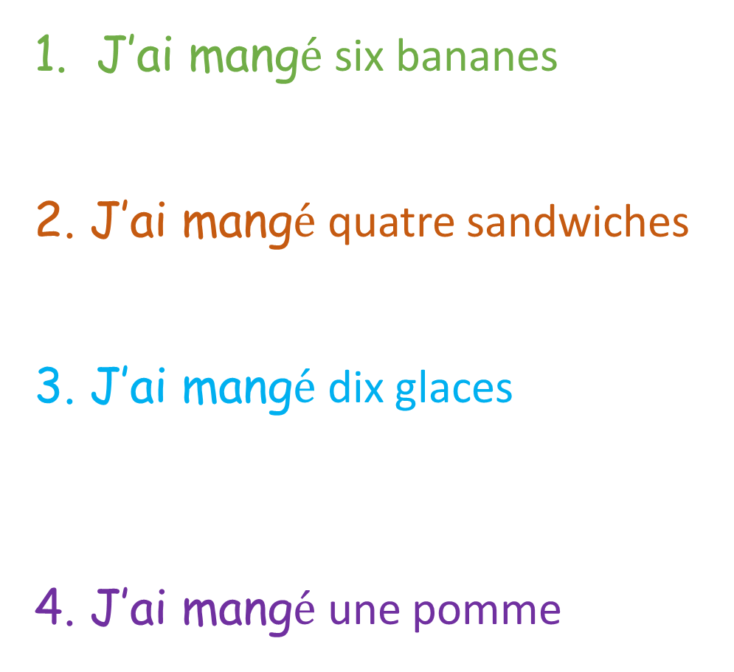
Can you spot what is added onto the end of a food word when there is more than 1?
J’ai mang$\acute{e}$ six bananes
2. J’ai mang$\acute{e}$ quatre sandwiches
3. J’ai mang$\acute{e}$ dix glaces
4. J’ai mang$\acute{e}$ une pomme
You add an s to make a verb plural (more than 1). Just like in English!

