Slide 1
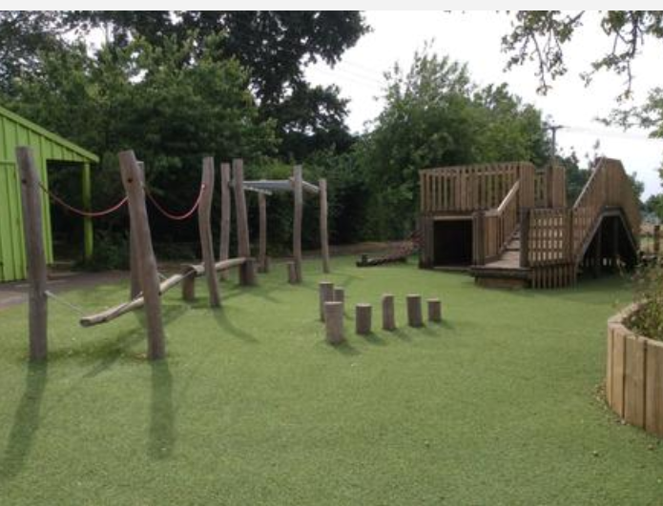
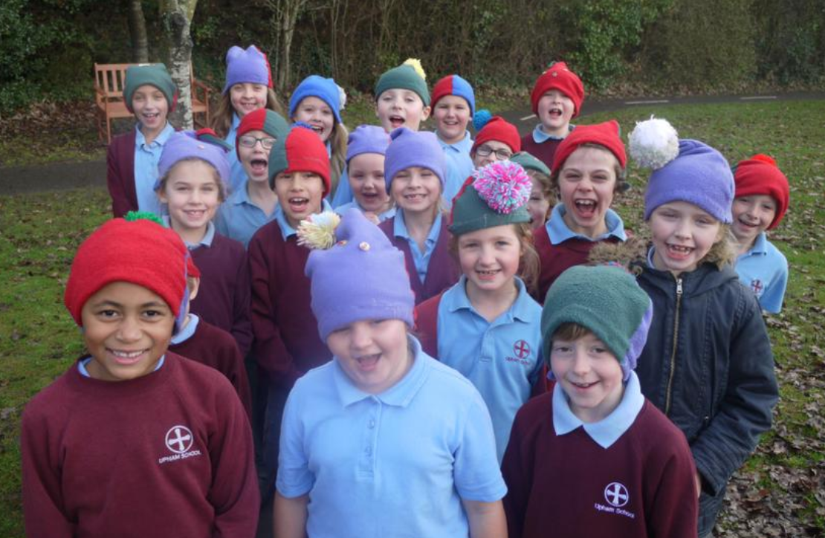
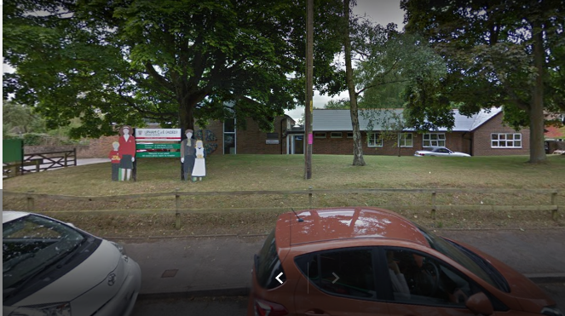
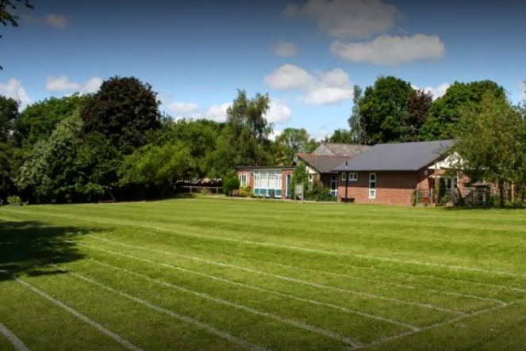

Upham C of E Primary School.
206 years old, founded in 1814.

Slide 2
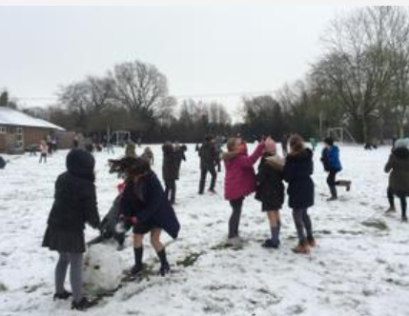
Upham school is a local school so lots of people are able to walk.
This school is also much smaller than other schools so there is only about 100 children and it is more calm.
There is four classes and they each have two years in them except for reception which is by itself.

Slide 3
Activities.
Residential.
Year 5 and 6 go on residential to do different activities that they wouldn’t usually be able to do at home or in school. They stay in cabins overnight for 3 days do activities in the day.
P.E.
Our P.E teacher Dave teaches different sports every half term and and saints run our after school sports clubs. We do sports like netball, basketball, football, athletics, tennis and more.
Swimming.
Class 3 (year 3 and 4) go to bishops Waltham school and use their swimming pool for lessons every Monday. Miss Olver is very good at teaching swimming so she teaches Class 3 the lessons.

Slide 4
Our staff.
Our teachers all have different subjects they are good at but they help with everything.
In class 1 Mrs Mason is the classteacher and is helped by Mrs Dawson the teaching assistant. In class 2 there is Mrs Sothcot who teaches on Monday and Tuseday and Mrs Pilgrim who teaches from Wednesday to Friday there is also Mrs Miller who helps every classroom on different days. In class 3 there is Mrs Bird who is always in the classroom, Mrs Lambert who teaches in the mornings and Mrs Soley who works in class 3 on some afternoons. In class 4 Miss Olver is the classteacher and Mrs Soley is her teaching assistant.
In the office Mrs Bastian is our admin assistant and works from 10am to 1pm, Mrs Bettridge is our admin officer and manages the administrative work of the school.
Mr Buckly is our caretaker and makes sure the school is clean and safe for us.Mrs Buckly also helps him with that.
We also have our dinner ladys Mrs Lowe (supervisor) Mrs Somerville and Mrs Saunders.

Slide 5
Our history.
Our school is over 200 years old though there are not many records of the founding of the school in 1814. There are records of money being secured from the national society by Revd John to enlarge and build on this date-the grand sum of £105! This means we are one of the oldest schools in the diocese of Portsmouth!
The current school is located on a site midway between lower Upham and Upham. The school was moved to this site from the original one higher up in the village in 1963. The children all walked from the old school to the new behind their headteacher who was riding a bike, which was something he apparently did every day. The children rang the bell outside which had been moved from the old school. We still use this bell when the year 6’s finish their last day at school and move on to secondary school.

Slide 6
I like Upham school because its small and the activities are always fun.
George age 9.
Upham school is a caring and lovely school and it sends the children off confident going to secondary school.
Lucy age 9.
I Like Upham school because it is close to my house.
Diana age 51.

