Slide 1
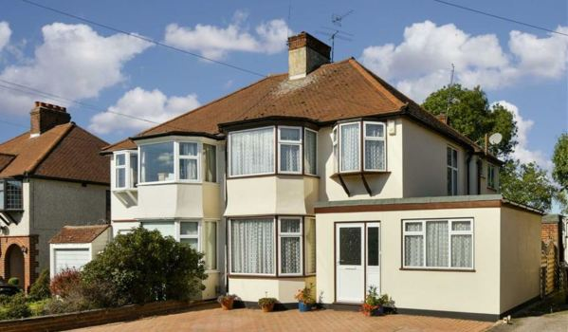

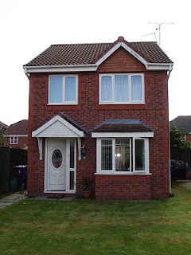

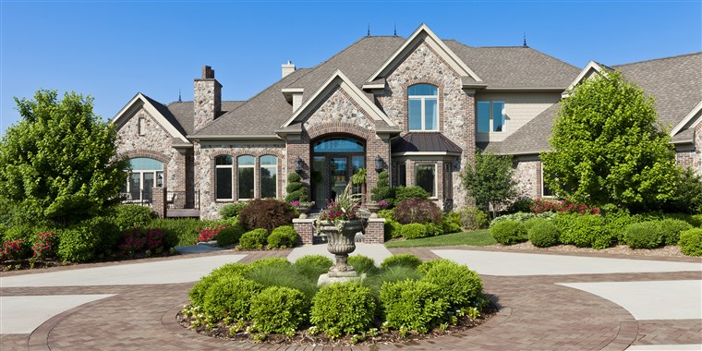
Ma Maison
My house

Slide 2

Bonjour class 4!
For the next few French lessons, I have planned for you to learn all about how to describe a house in French. All the learning will lead to an exciting activity at the end where you will need to use all your learning to describe your own house in a film, PowerPoint or poster.
In this lesson, you will be learning the names of rooms in a house in French. Start by writing the date and title: Ma Maison in your book.
Make sure you have put the PowerPoint on full screen to make sure all the animations work properly!
Miss Kimber ☺

Slide 3

The next few slides will teach you some key French vocabulary for rooms in the house.
For each word:
Press the button that looks like this to hear how the word is pronounced
Listen and repeat each word 5 times
Write down the word in your book, along with the English translation and a drawing
Then move onto the next word!

Slide 4
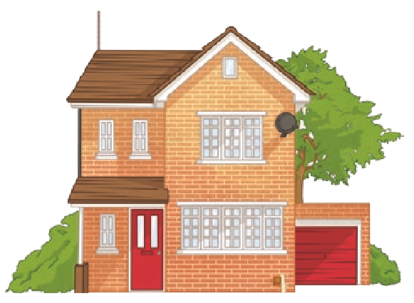
la maison
house

Slide 5
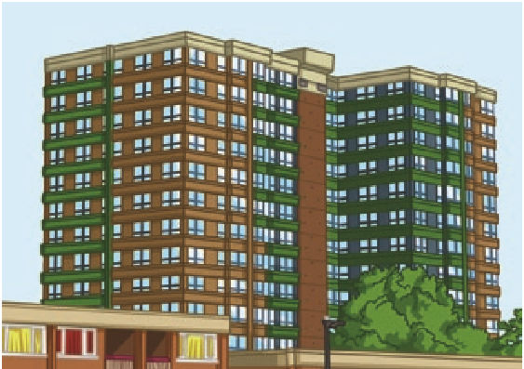
l’appartement
flat

Slide 6
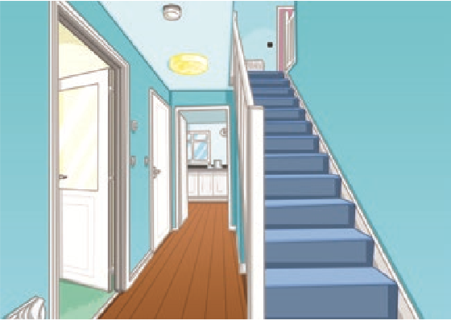

l’entr$\acute{e}$e
Hallway

Slide 7
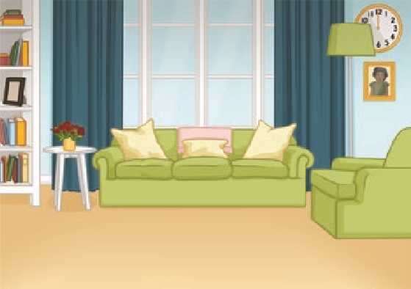
le salon
Living Room

Slide 8
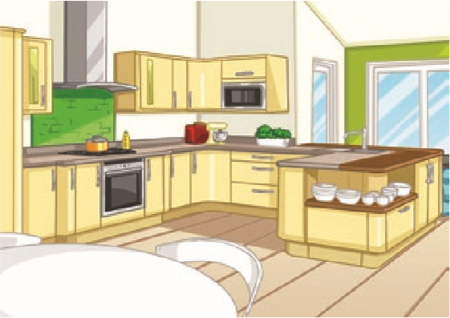
la cuisine
Kitchen

Slide 9
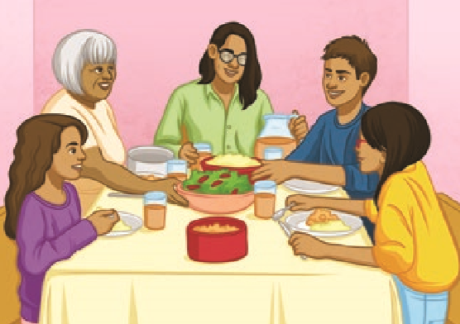

la salle $\grave{a}$ manger
Kitchen

Slide 10
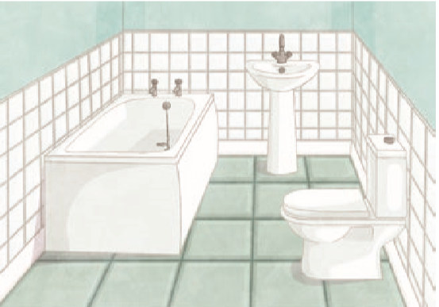
la salle de bains
Bathroom

Slide 11
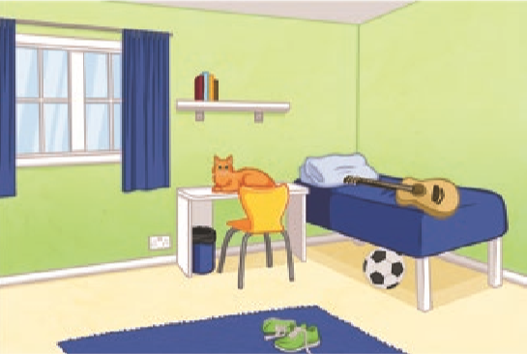
la chambre
Bedroom

Slide 12
What can you remember?
Test your memory by choosing the correct English translation for each French word.
Try not to look at your list of words to cheat!

Slide 13
la maison
or
Flat
House

Slide 14
la cuisine
or
Kitchen
Bedroom

Slide 15
le salon
or
Living room
Bathroom

Slide 16

la salle $\grave{a}$ manger
or
Bathroom
Dining room

Slide 17

l’entr$\acute{e}$e
or
Hallway
Bedroom

Slide 18
la chambre
or
House
Bedroom

Slide 19
l’appartement
or
Hallway
Flat

Slide 20
la salle de bains
or
Bathroom
Dining room

Slide 21
Flying rooms game!
Each time you click the mouse, a picture of a room will fly across the screen. Pick out the correct French word for this room from the list on the screen. Write your answer in your book – be careful with spellings!
Keep your eyes peeled- they’re quick!

Slide 22
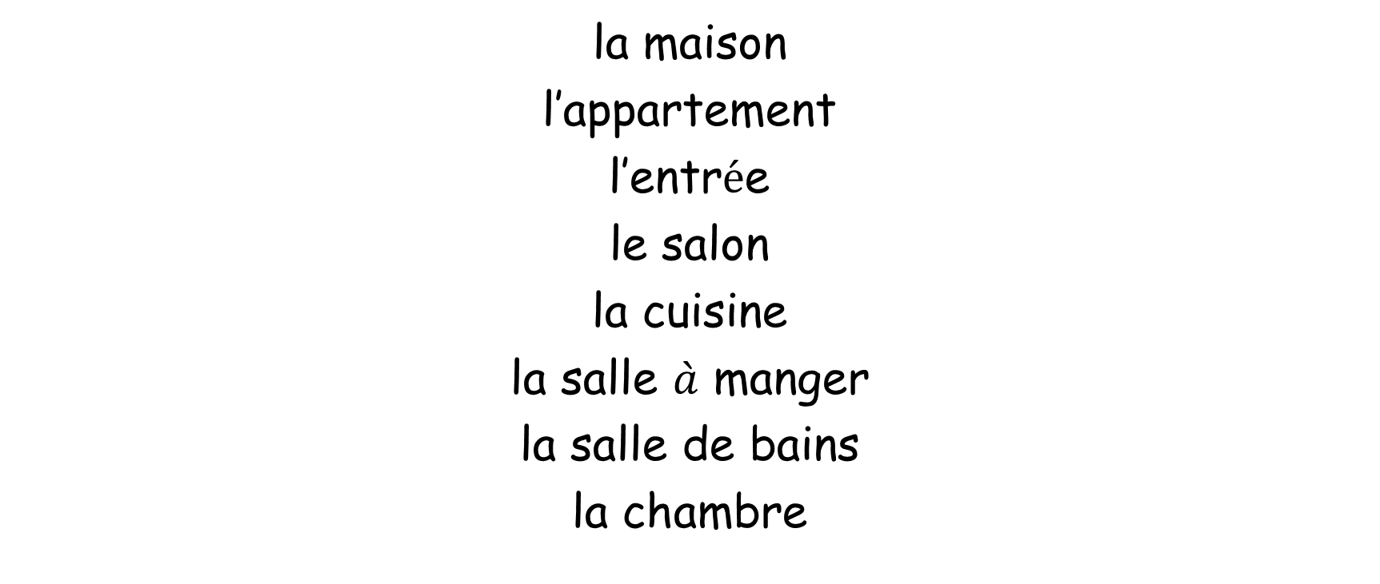
la maison
l’appartement
l’entr$\acute{e}$e
le salon
la cuisine
la salle $\grave{a}$ manger
la salle de bains
la chambre

Slide 23
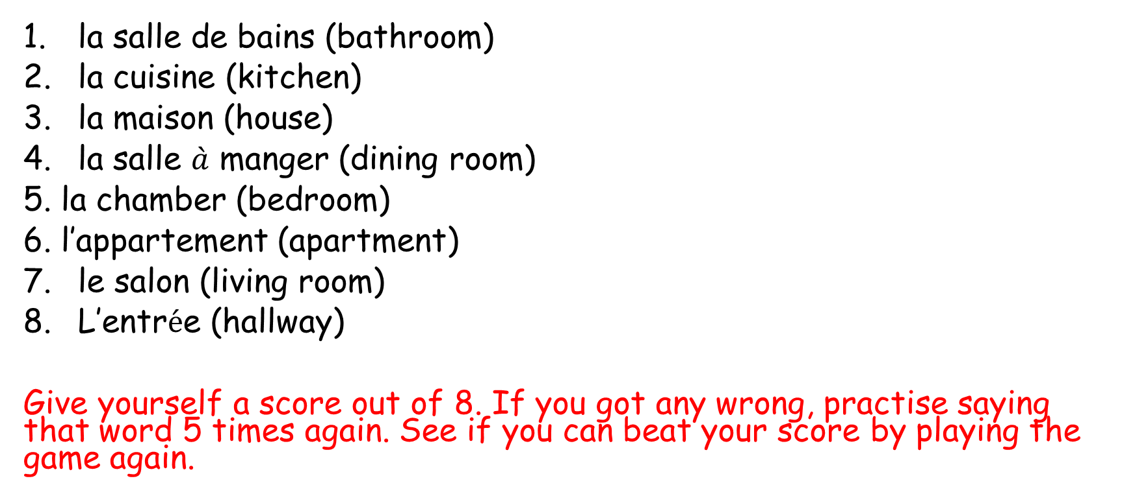
Answers:
la salle de bains (bathroom)
la cuisine (kitchen)
la maison (house)
la salle $\grave{a}$ manger (dining room)
5. la chamber (bedroom)
6. l’appartement (apartment)
le salon (living room)
L’entr$\acute{e}$e (hallway)
Give yourself a score out of 8. If you got any wrong, practise saying that word 5 times again. See if you can beat your score by playing the game again.

