Slide 1
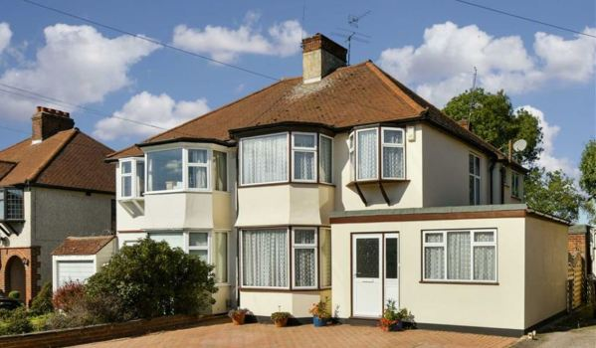

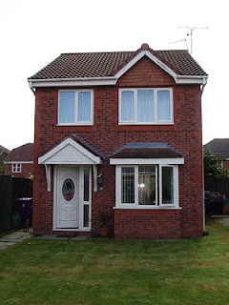

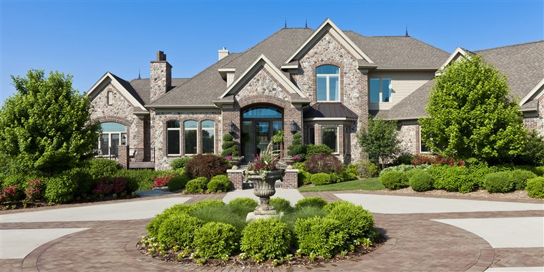
Ma Maison
My house
Lesson 4

Slide 2


Bonjour class 4!
Welcome to the final French lesson about rooms in the house.
In this lesson, you will create your own film, PowerPoint or poster to describe your house.
Make sure you have put the PowerPoint on full screen to make sure all the animations work properly! Don’t forget to press this button when ever you see it to listen how to pronounce the word or phrase.
Miss Kimber ☺

Slide 3
You will need your description of your house from last lesson. This should be in your book.
If you can’t find it, just write a new one using the key sentence structure and the words and numbers in your book.
Dans ma maison, il y a [number] [room].
Practise reading your description out loud. If you can’t remember how to pronounce some of the words, listen to them on the next slide.

Slide 4
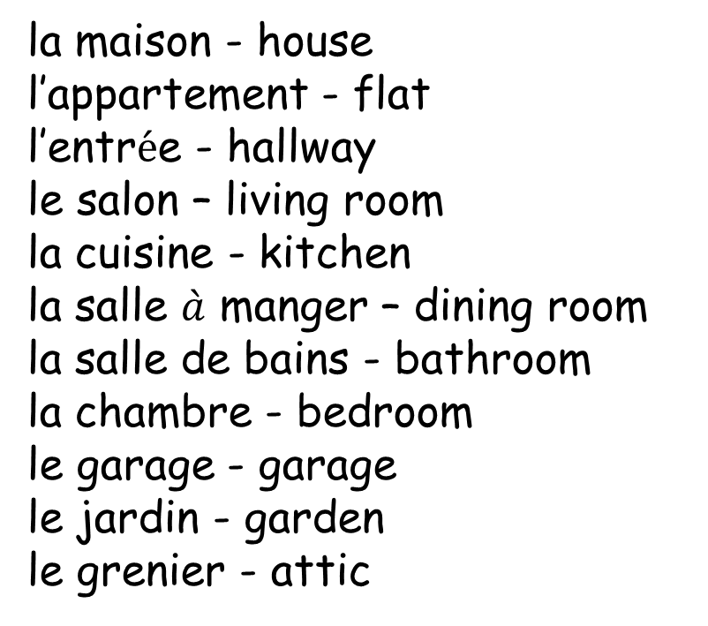
Dans ma maison
il y a
In my house
There is/ there are
la maison - house
l’appartement - flat
l’entr$\acute{e}$e - hallway
le salon – living room
la cuisine - kitchen
la salle $\grave{a}$ manger – dining room
la salle de bains - bathroom
la chambre - bedroom
le garage - garage
le jardin - garden
le grenier - attic
et
and

Slide 5
You are now going to present your description
You have 3 options:

Slide 6
Option 1: Make your own film
Record a tour around your home. You are only allowed to speak in French to describe what is in your house – No English!
Here’s a useful phrase to start your video:
Bienvenue à ma maison!
Welcome to my house!

Slide 7
Option 2: Make a PowerPoint
Describe your house in a PowerPoint. You are only allowed to use French in your PowerPoint- no English!
You might want to take pictures of the rooms in your house and add these to your PowerPoint or just use pictures from google images.
Here’s a useful phrase to start your PowerPoint:
Bienvenue à ma maison!
Welcome to my house!

Slide 8

Option 3: Make a poster
Describe your house in a poster. You are only allowed to use French in your poster- no English!
You might want to draw a cutaway picture of your house so that we can see the rooms inside.
Annotate the picture with sentences in French.
Here’s a useful phrase to put on your PowerPoint:
Bienvenue à ma maison!
Welcome to my house!

Slide 9

Be creative and have fun!

