Slide 1
Belonging – Lesson 4
Last week, you found out about the ways in which Muslims show that they belong to, and have respect for, their faith when they pray. We found out that they have a special cleaning/washing ritual that they do before they pray and that they wear certain clothes to show their respect.
Today, we are going to explore another way in which Muslims show that they belong to their faith: fasting.

Slide 2
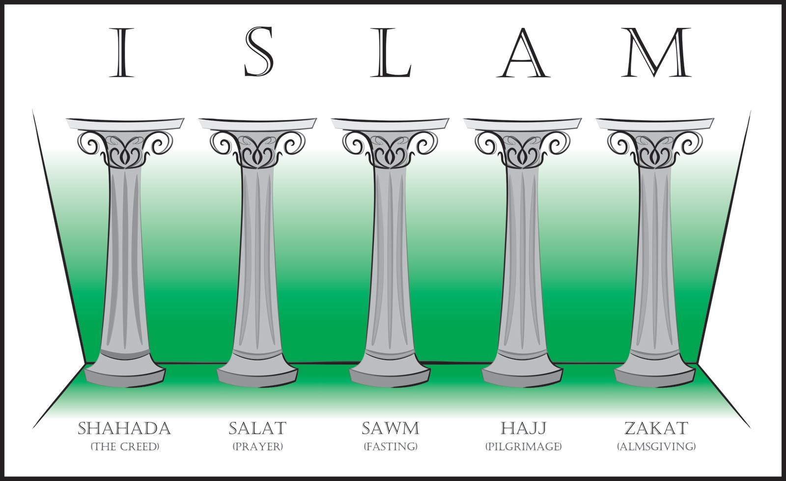
When we did our Pakistan culture week earlier this year, we found out about the five pillars of Islam and we briefly looked at Sawm: the one for fasting.

Slide 3
The month when Muslim’s fast is called Ramadan.
Did you know that it is actually Ramadan now?
Ramadan began on the 23rd April this year and will end on the 23rd May (which is this Saturday!).
Have a read through the information text on the next slide to find out a bit more about Ramadan.

Slide 4
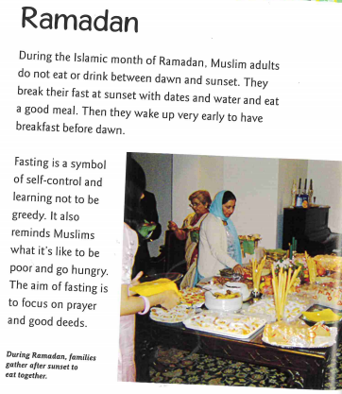
Think about how long the days are at the moment – what time does the sun rise? When does it set?
Also think about how hot it has been this week.
Can you imagine how hard it would be to have to fast at the moment? No food or drink during sunlight hours at all.

Slide 5
As you can probably imagine, the month of Ramadan is a very challenging time for Muslims because fasting is hard.
It is especially difficult if it falls in the Summer because the days are much longer and it is hotter. (The Islamic calendar is different to ours which means that the dates for Ramadan move each year)
At the end of the fasting month, there is a huge celebration called Eid-ul-Fitr (sometime spelt Id-ul-Fitr).

Slide 6
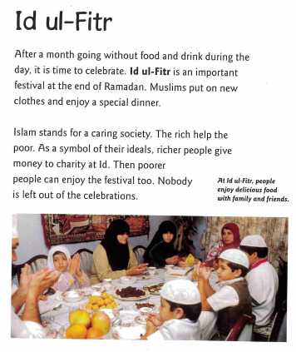
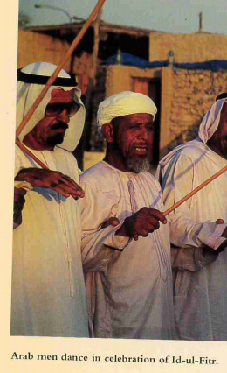
Eid-ul-Fitr is a time for celebration (and eating!), but Muslims still think about those less fortunate than them and ensure that they can join in the celebrations as well.

Slide 7
This year the Eid-ul-Fitr celebrations will take place on 23rd May – 24th May. That is this Saturday-Sunday.
If you have a look on the news this weekend, then you will probably see articles about Muslim’s taking part in this celebration.
It will be very different to how they normally celebrate though because of the lockdown restrictions.

Slide 8
For your activity today, I would like you to share your understanding of Ramadan and Eid-ul-Fitr and why taking part in these are so important in helping Muslims to feel that they belong to their faith.
You could:
Write an explanation of what Ramadan and Eid-ul-Fitr are and why they are important for Muslims
Create a poster/Powerpoint or short documentary sharing your understanding of Ramadan and Eid-ul-Fitr
Write a diary entry imagining you are a Muslim at two points in time – one in Ramadan and one during Eid-ul-Fitr
Write some thought/speech bubbles to show the thoughts a Muslim might have in Ramadan and Eid-ul-Fitr

