Slide 1
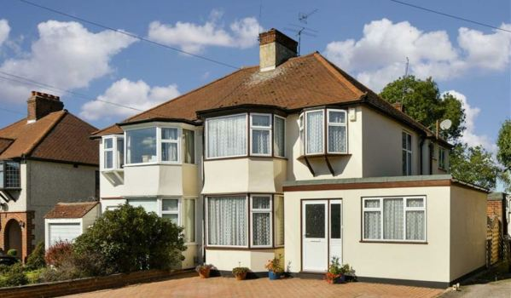
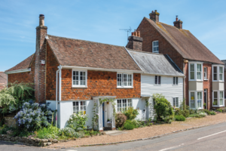
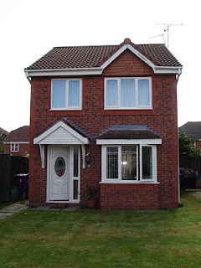

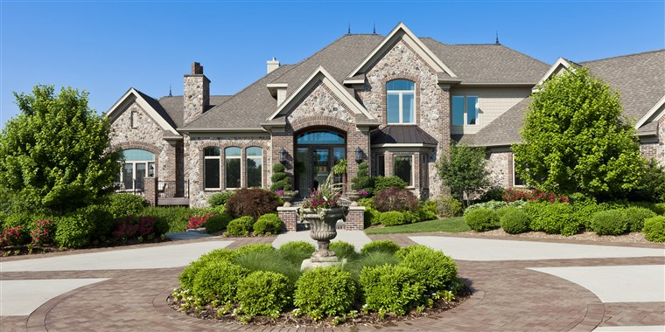
Ma Maison
My house
Lesson 3

Slide 2


Bonjour class 4!
Welcome to the third French lesson about rooms in the house.
In this lesson, you will be learning how to put the words you have learnt into a sentence to describe what's in your house. Start by writing today’s date and title: Ma Maison in your book.
Make sure you have put the PowerPoint on full screen to make sure all the animations work properly! Don’t forget to press this button when ever you see it to listen how to pronounce the word or phrase.
Miss Kimber ☺

Slide 3

You will need to think back to your learning on French numbers to 10
Copy and paste this link into your web browser and sing along to the numbers song to refresh your memory:
https://www.youtube.com/watch?v=3D-2fTVbukU

Slide 4
These French numbers have gotten muddled up!
In your book, write them out in the correct order.
dix
cinq
trois
deux
neuf
quatre
huit
six
sept
un
If you get stuck, listen to the French number song again to help you

Slide 5
Correct order:
un
deux
trois
quatre
cinq
six
sept
huit
neuf
dix
Give yourself a point for each number you get in the correct order. Correct any that you get wrong

Slide 6
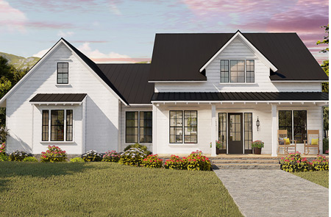
Dans ma maison
Key phrase:
In my house
Copy this key phrase into your book along with the English translation ‘In my house’.
Listen carefully to how this phrase is pronounced and practise saying it in these
different silly voices:
Can you say it in a squeaky voice?
Can you say it in a robot voice?
Can you say it in a whisper voice?
Can you say it in a angry voice?
Can you say it in a baby voice?

Slide 7
il y a
Key phrase:
There is/ there are
Copy this key phrase into your book along with the English translation ‘There is/ there are’.
Listen carefully to how this phrase is pronounced and practise saying it in these
different silly voices:
Can you say it in a nervous voice?
Can you say it in a robot voice?
Can you say it in a loud voice?
Can you say it in a sleepy voice?
Can you say it in a alien voice?

Slide 8
To tell someone what is in your house, you will need to follow this sentence structure:
Dans ma maison, il y a [number] [room].
For example:
Dans ma maison, il y a une cuisine.
Can you work out what this sentence means? Use the words in your book from the last few lessons if you need help.
Answer: In my house, there is one kitchen.

Slide 9
Dans ma maison, il y a une cuisine.
Things to notice:
If the noun you are talking about is feminine, you need to add an e onto un to make une.
You only need to do this for the number 1. All the other numbers stay the same!
In your word list, you either have le or la written next to the noun to remind you of the gender of the noun. Remember that le/ la means ‘the’. You don’t need to put the le/ la in your sentence as this wouldn’t make sense!
Go through your word list from last lesson and colour code the nouns to remind you if they are masculine or feminine. Drawing a key would help.
le = masculine
la = feminine

Slide 10
Dans ma maison, il y a quatre chambres.
Things to notice:
Just like we do in English, if there is more than 1 of a noun, you need to put an s on the end to make it plural.

Slide 11
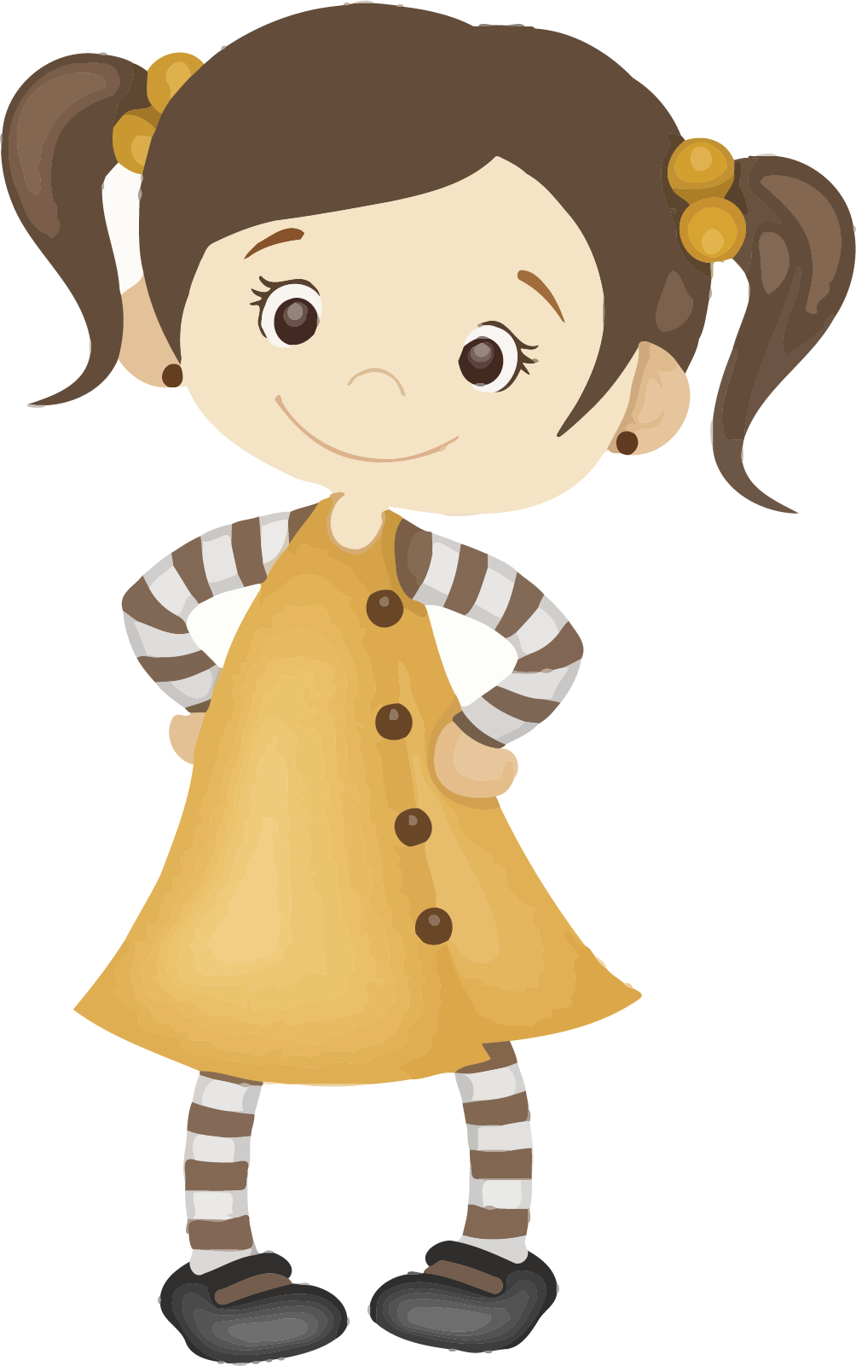
Read Belle’s description about her house. In your book, make a list of the rooms that she has in her house and how many there are of each.
Use the words and numbers in your book to help you if you are unsure
Dans ma maison, il y a un salon et une cuisine. Il y a deux salle de bains et trois chambres. Il y a deux jardins.
Belle has used the word et (which means and) to link her descriptions together. Make a note of this connective in your book as you might like to use it in your own description.

Slide 12
Answers:
In Belle’s house, there is:
1 living room
1 kitchen
2 bathrooms
3 bedrooms
2 gardens
Give yourself a tick for each one you get correct.
Correct any you got wrong.

Slide 13
Your turn to describe your house!
Use the key sentence structure and the numbers and words in your book to write a few sentences in your book to describe what rooms are in your house.
Challenge: can you use the word et (and) to link your descriptions together like Belle?
Keep this description safe because you will need it for the next lesson!
Dans ma maison, il y a [number] [room].

