Slide 1
Belonging – Lesson 3
Last week, we looked at how Muslims welcome the arrival of a new baby and the different things they do to show that the baby belongs to its family and faith.
Today we are going to be finding out about some of the things Muslims do and wear to show that they belong to their faith during prayer.

Slide 2
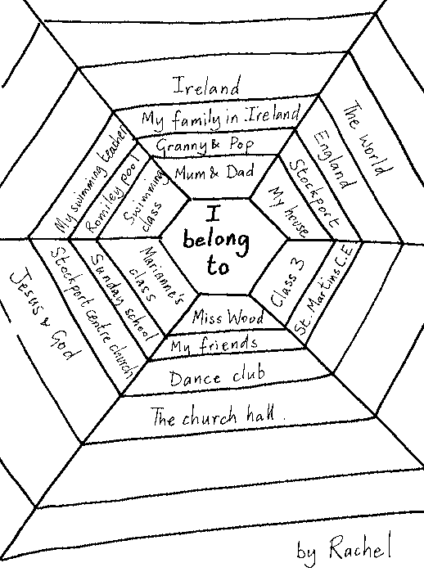
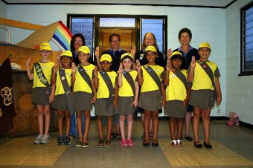
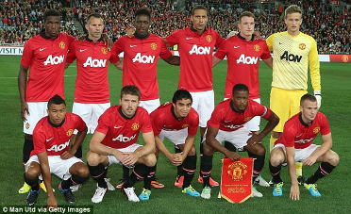
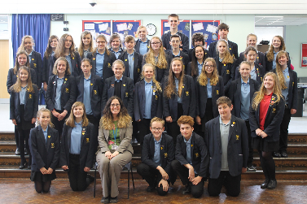
First, I want you to think back to the first lesson of
RE this half term, when you filled in your spiders web
(you might want to have a look back at this to remind
yourself).
How do you show that you belong to these
different people/groups/things?
Do you:
Wear a uniform (school, brownies, scouts, sports teams…)
Wear a badge or item to represent this (peer mentor/school council badge, jewellery…)
Own something to represent this (book bag, sports kit bag, books, certificates, trophies…)

Slide 3
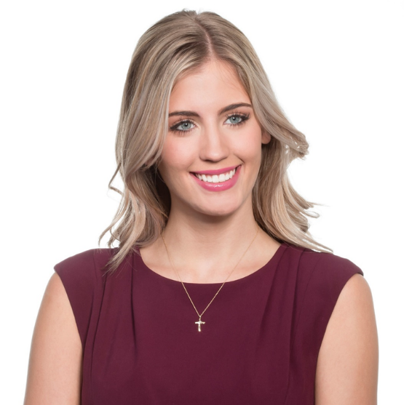

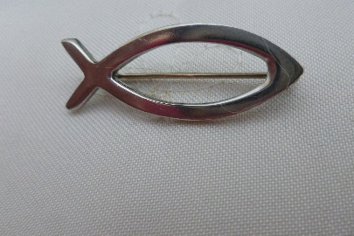
How do Christians show they belong?
Many Christians wear the symbol of the cross to show that they are a follower of this faith. A priest/vicar might wear this on their uniform. Someone else might choose to wear it as part of a piece of jewellery.
Some Christians wear the symbol of the fish instead, or as well as, the symbol of the cross.
As well as wearing these symbols, they might:
Visit a church
Read the Bible
Pray
Sing hymns
Light a candle

Slide 4
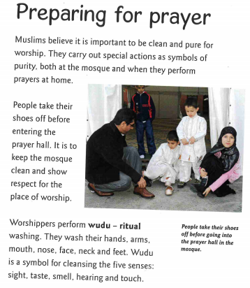
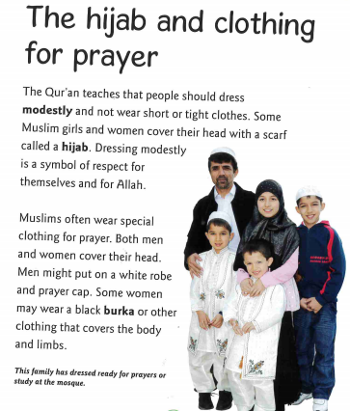
Read through the information below which talks about some of the things Muslims do and wear to make sure they are ready for prayers and to show that they belong to this faith.

