Slide 2
Classifying Living Things
Yesterday, we started looking at how living things can be classified (remember this is a scientific word for sorting) into different categories.
We sorted some animals based on their characteristics, such as: where they live, what type of skin they have and how big they are.
Today we are going to look at a very famous scientist who came up with a system for classifying living things.

Slide 3
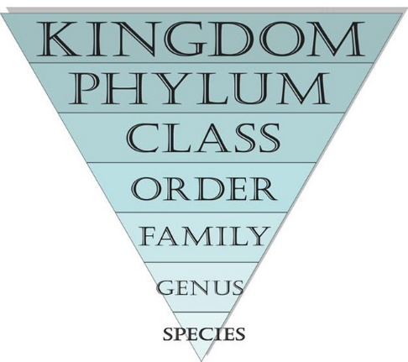
Carl Linnaeus
In 1735, a scientist named Carl Linnaeus published ‘Systema Naturae’, which explained a way to classify living things.
Linnaeus put all living things into three groups called kingdoms; plants, animals and minerals. Each kingdom was then split into smaller levels. Scientists still use this system today. More species have been discovered since Linnaeus’ lifetime so extra categories have been added. The system now looks like this:
Domain
Kingdom
Phylum
Class
Order
Family
Genus
Species
Each level gets smaller until there is only one living thing in the species section.

Slide 4
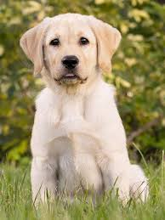
Classifying Using ‘Systema Naturae’
Over the next few slides, you will see how a normal dog would be classified using the system Linnaeus created.

Slide 5
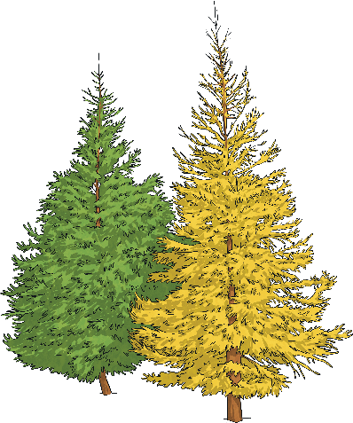
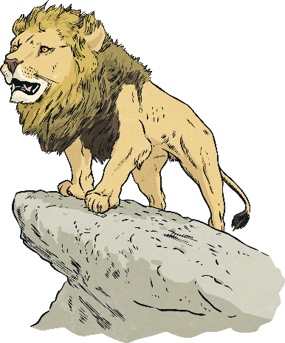
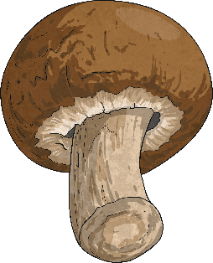
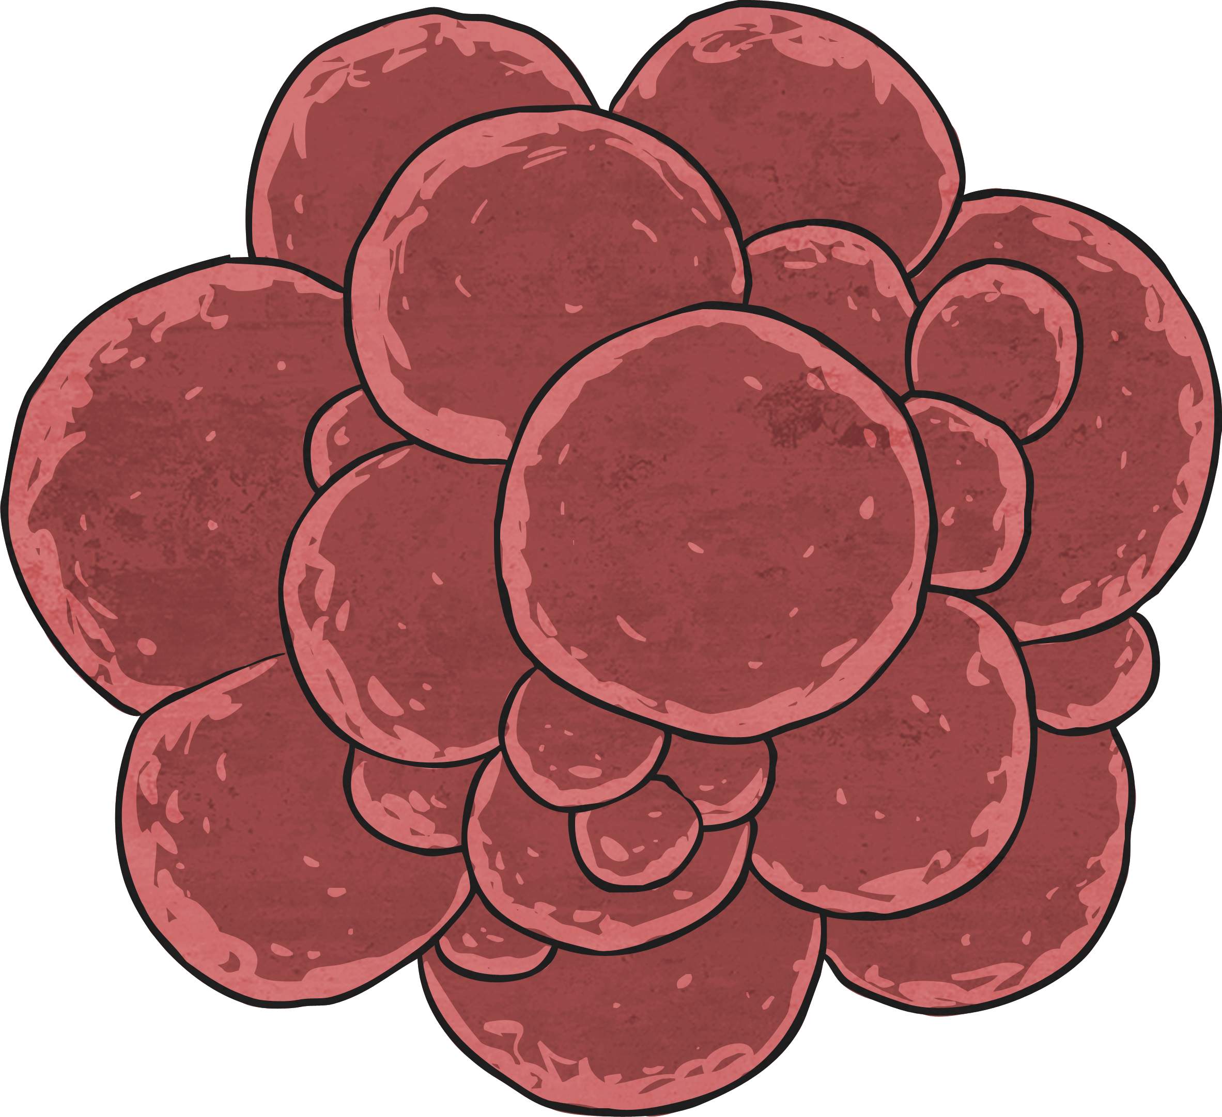
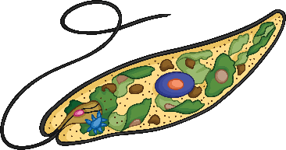
Kingdom
All living things are grouped into five large groups or kingdoms.
The five kingdoms are:
Animal kingdom
Plant kingdom
Monera kingdom (bacteria)
Protist kingdom
Fungi kingdom
A dog would belong to the Animal Kingdom (this is sometimes called Animalia).

Slide 6
Phylum
Kingdom
Once living things are grouped into a kingdom, they are organised further into groups called phyla
(one phyla is a phylum).
Phylum
Within the animal kingdom, the animals are divided into more than 30 phyla (which is the plural of “phylum”).
You might be interested in Phylum Chordata — it’s the one humans and all animals with backbones are in (do you see how “chordata” looks like the word “cord” — like spinal cord?).
A dog belongs to Phylum Chordata because dogs have a backbone.

Slide 7
Class
Kingdom
Once living things are placed into phyla, then they are organised even more into groups called classes.
Phylum
Class
The third level of classification is class. For example, Phylum Chordata has classes in it like birds, mammals (Mammalia) and reptiles.
A dog belongs to the class Mammalia because it is a mammal.

Slide 8
Order and Family
Kingdom
After living things are placed into classes, then they are placed into smaller groups called orders.
Phylum
The next level, or rank, is order. Orders are smaller groups within the different classes. Carnivora is the order within Mammalia that has the most diversity in animal size.
A dog belongs to this order because it is a carnivore.
The fifth rank of classification is family. The family for dogs is Canidae.
Class
Order
Family

Slide 9
Genus and Species
Kingdom
Next, from families, living things are
placed into groups called genera
(one genera is called a genus).
Phylum
This rank looks like “genius,” doesn’t it? It’s the second-to-last rank, and a genus may have only one or two animals in it. If animals are in the same genus, they are really closely related. In fact, you may not be able to tell them apart just by looking at them! When we write the name of the genus, we capitalize it and italicize it. For example, the genus of dogs (and wolves, too!) is Canis.
If animals can breed together successfully, they are a species. When an animal is called by its scientific name, then that means it is being identified by its genus and species. We use a lowercase letter and italics for the species. The scientific name of dogs is Canis familiaris; however, the scientific name of wolves is Canis lupus.
Class
Order
Family
Genus
Species

Slide 10
Taxonomy
Classification and taxonomy help scientists to group living things to make comparisons and learn more about them.
Here is the complete classification for dogs:
Kingdom: Animalae
Phylum: Chordata
Class: Mammalia
Order: Carnivora
Family: Canidae
Genus: Canis
Species: Canis familiaris

Slide 11
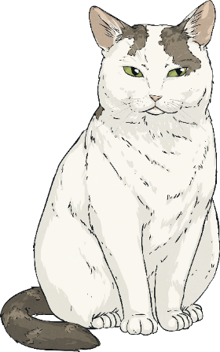
The Linnaean System
Below is how a cat is classified using the Linnaean system.
Kingdom: | Animalia
Phylum: | Chordata
Class: | Mammalia
Order: | Carnivora
Family: | Felidae
Genus: | Felis
Species: | Sivestris
You can see that the classification for a cat is the same as a dog until you get to the Family level.

