Slide 2
Sorting
Have a think…
  Imagine you had to sort these things into two groups. How would you decide on the groups? What would you call
  each group?

Slide 3
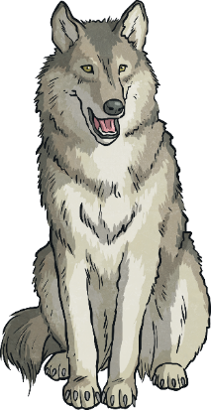
Sorting
  plastic and non-plastic
  green things and red things
  living things and non-living things
  edible things and non-edible things
  animals and non-animals
There are lots of ways the objects could be grouped:

Slide 4
Sorting
Grouping the things would be useful if:
  you wanted something to eat;
  you needed to work out what things needed to be cared for.
Living things can be grouped. We call this classifying and each group is called a class. Classifying living things is called taxonomy and people who do this classifying are called taxonomists.
Have a think…
  Why would putting the things into groups be useful?

