Slide 1
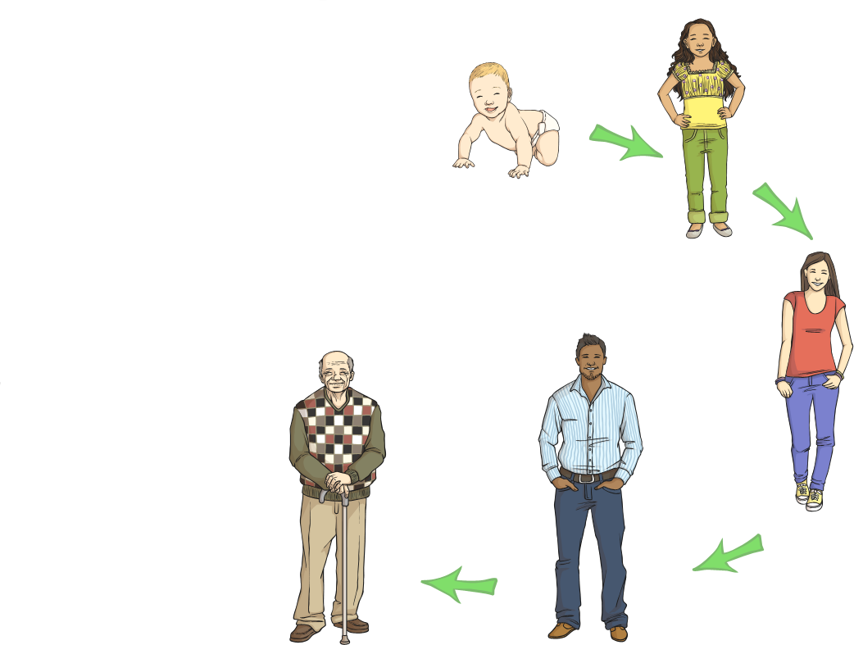
Life Cycles
What Is a Life Cycle?
A life cycle simply means the stages of life.
For example, a human life cycle would look like this:
Baby
Child
Adolescent
Elderly
Adult

Slide 2
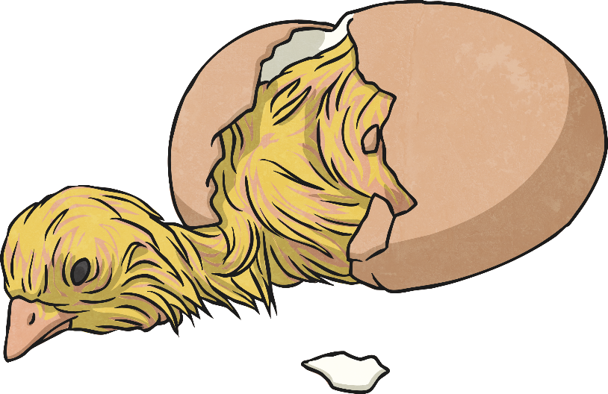
Do All Animals Have the Same Life Cycle?
Not all animals go through the same changes throughout their life cycle, but most animals go through what’s called the simple life cycle. The simple life cycle has just three steps!
They are born (birthed or hatched).
They are young.
They are adults

Slide 3

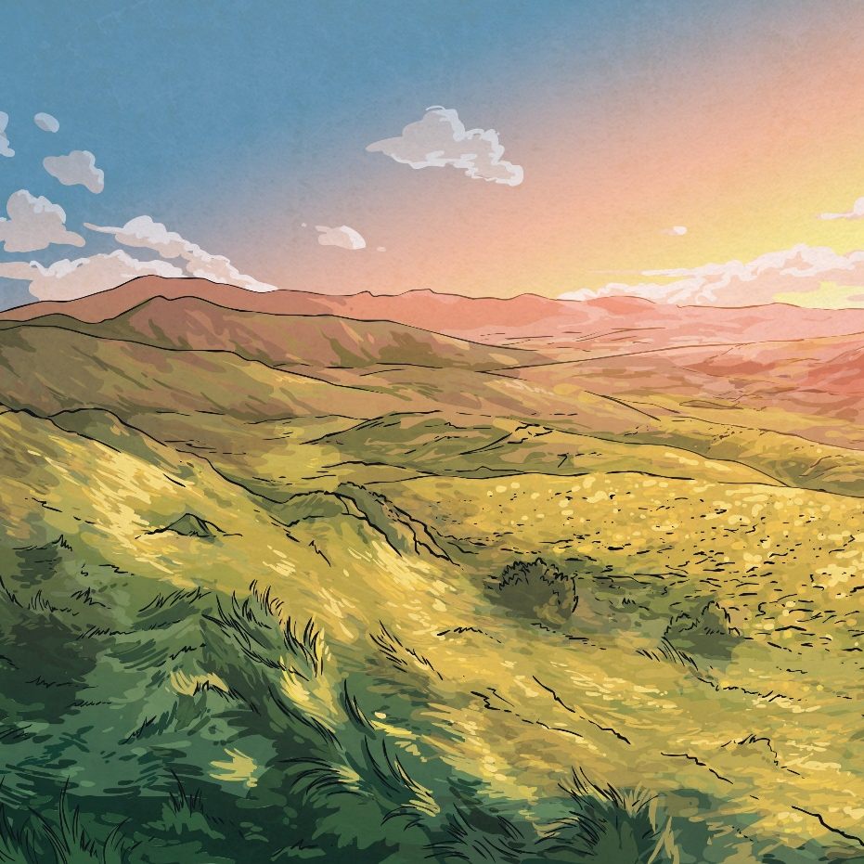
What Do You Know About…
amphibians?

Slide 4
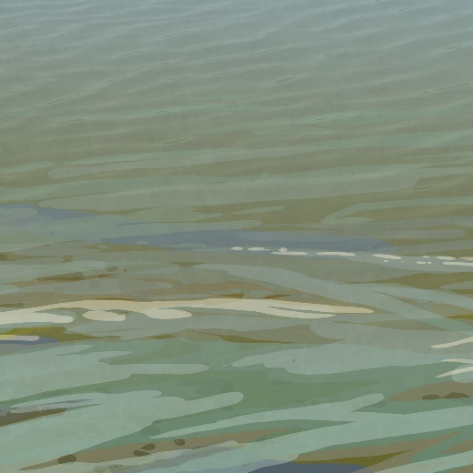
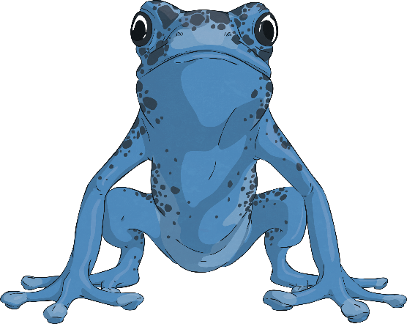
What Is…
an amphibian?
An amphibian is a cold-blooded creature. Amphibians can breathe in and out of water. Frogs and toads are amphibians.
Click on the picture to find out more.

Slide 5
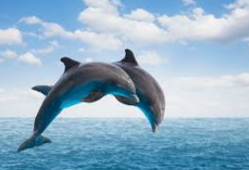
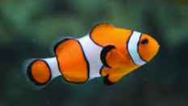
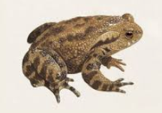
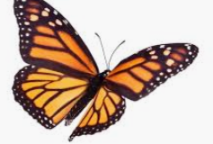
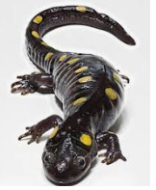
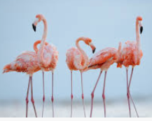

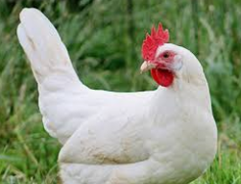
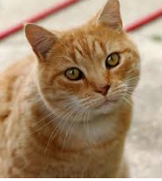
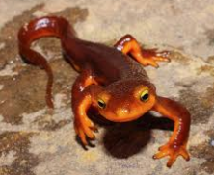
Which of these are amphibians?

Slide 6
Which of these are amphibians?
These three are all amphibians.

Slide 7
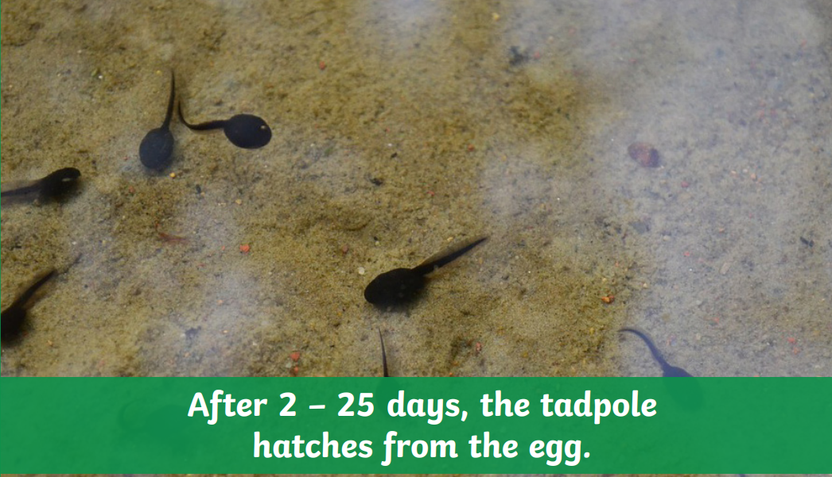
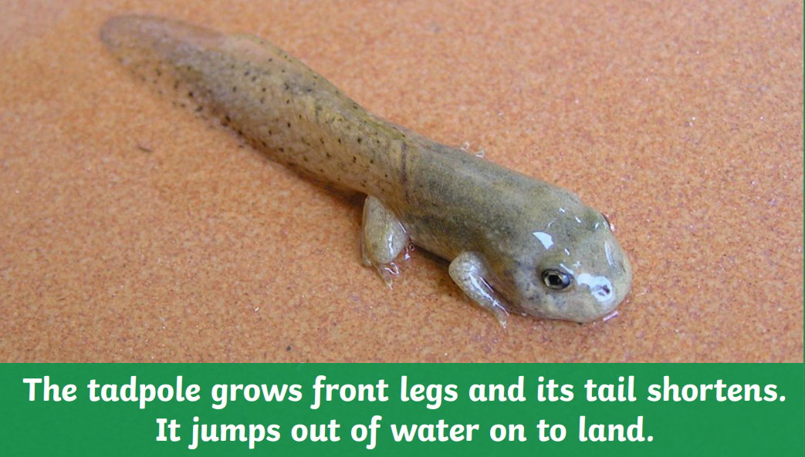
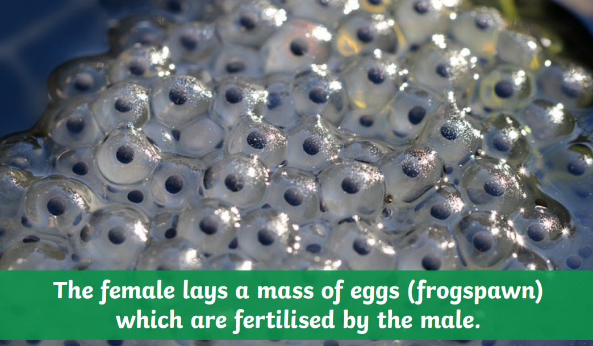
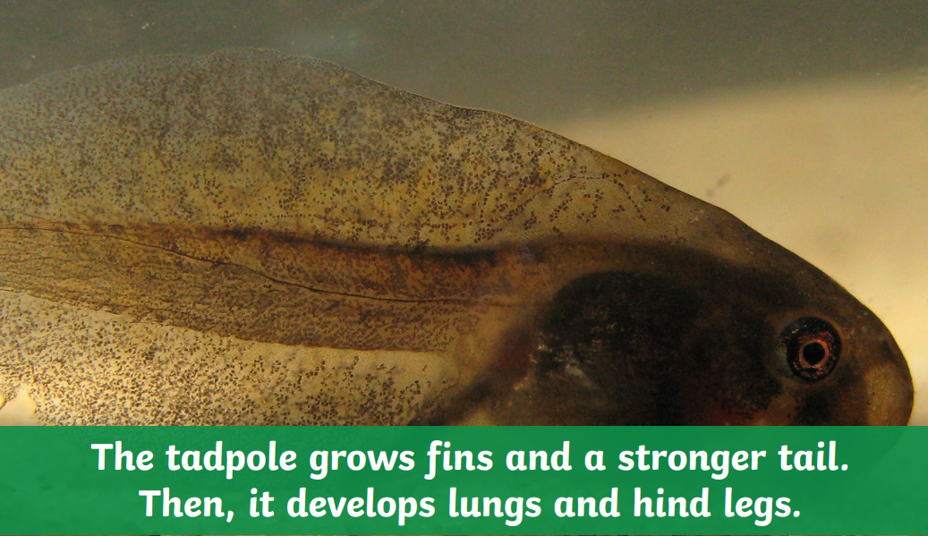
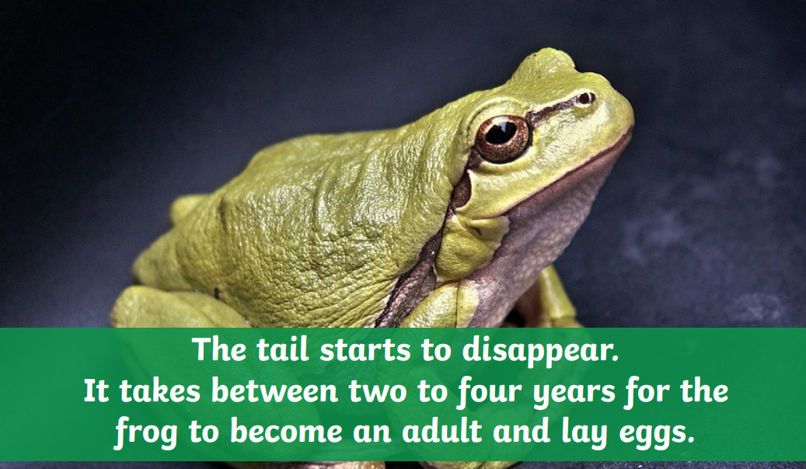
Here are some of the stages in the life cycle of a frog. Can you put them in the right order?

Slide 8
Did you get them correct?
1.
4.
2.
5.
3.

Slide 9
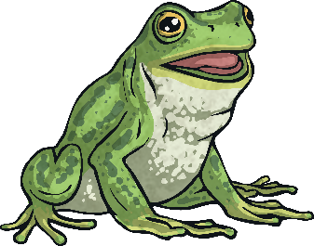
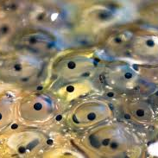
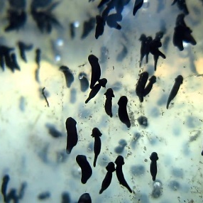
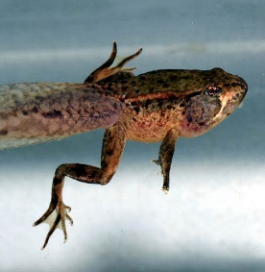

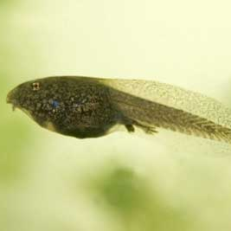
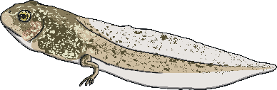
The Life Cycle of a Frog
The tail disappears and it starts to eat insects instead of plants. It takes 2-4 years to become an adult, when it can lay eggs.
The female lays a mass of eggs which are fertilized by the male.
6
1
The tadpole grows front legs and its tail shortens. It uses nutrients in its tail as food. It jumps out of the water on to land.
After 2-25 days
the tadpole
hatches from
the egg.
2
5
The tadpole grows fins and a
stronger tail. Then, it develops
lungs and hind legs.
It swims and eats
plants. It breathes
through gills.
4
3

