Slide 1

Affect or effect?
This week the homophone we are concentrating on in our spelling sentences is affect and effect.
This is one which adults often get confused about!

Slide 2
How do I know if I need affect or effect?
Affect – this word is a verb. It is making or causing something to happen.
Effect - this word is a noun. It is the result of something which has happened.
Here is a little tip from Mrs Kimble:
A noun often has the word ‘the’ in front of it. For example, the child, the table, the apple… So if you are using the word as a noun, then you need effect (the effect).

Slide 3
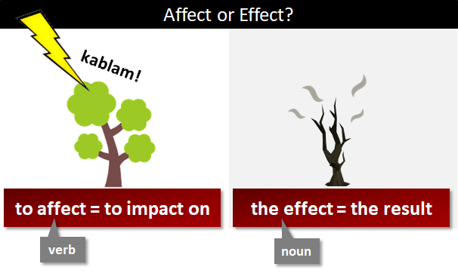

Slide 4
Can you think of some sentences using affect and effect you could write to match these pictures?

Slide 5
I came up with:
The lightning is affecting the tree.
The tree is affected by the lightning.
The lightning affects the tree.
The lightning had an awful effect on the tree.
The effect of the lightning on the tree was that it was now burnt.

Slide 6
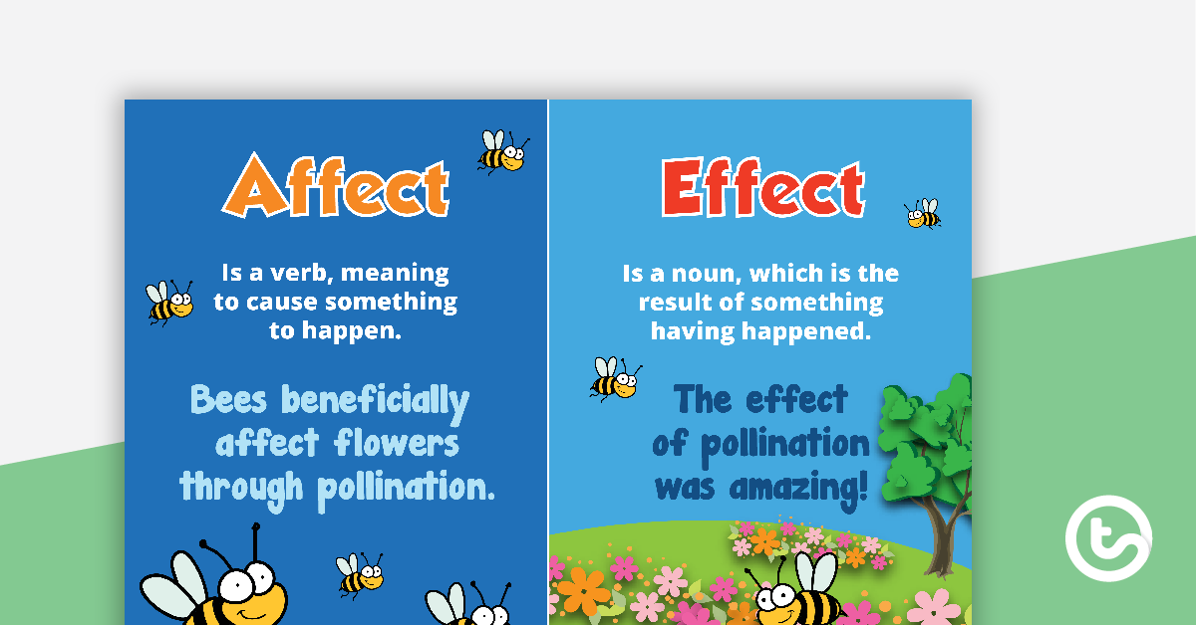
Here are some other examples:

Slide 7
Which one is correct?
Lockdown has affected/effected everyone.
I wonder what the affect/effect will be of doing extra times tables practice every day.
The affect/effect of lockdown on pollution levels is amazing.
If I’m hungry, it can affect/effect my mood.

Slide 8
Which one is correct?
Lockdown has affected everyone.
I wonder what the effect will be of doing extra times tables practice every day.
The effect of lockdown on pollution levels is amazing.
If I’m hungry, it can affect my mood.

