Slide 1
What can you remember from yesterday?
See if you can answer these questions based on yesterday’s topic work:
What are the three stages in the ‘simple’ life cycle?
2. What are some of the features of amphibians?
3. Can you name three different animals which are amphibians?
4. What are the main stages in the life cycle of a frog?

Slide 2
Answers!
What are the three stages in the ‘simple’ life cycle?
They are born, they are young, they are an adult.
2. What are some of the features of amphibians?
They are cold-blooded, they come from eggs, they can breathe in and out of water.
3. Can you name three different animals which are amphibians?
Frogs, toads, newts, salamanders…
4. What are the main stages in the life cycle of a frog?
Eggs, tadpoles, grows fins and stronger tail, develops lungs and back legs, grows front legs and tail shortens, jumps on land and is an adult.

Slide 3

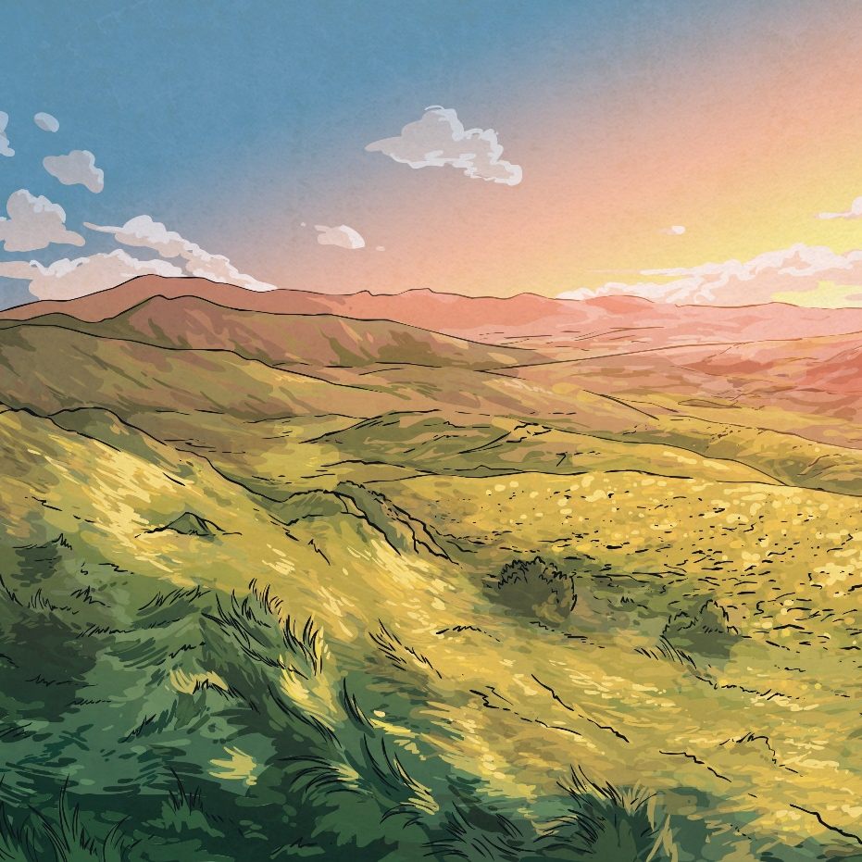
What Do You Know About…
insects??

Slide 4

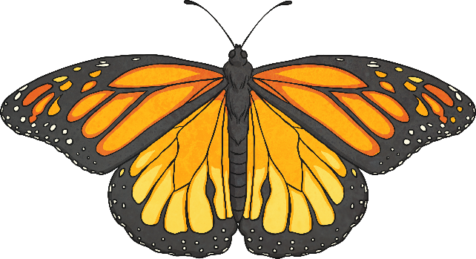
What Is…
an insect?
An insect is a creature whose body is split into three
sections called the head, the thorax and the abdomen.
Insects have an exoskeleton. There are around one million species of insects, including ants, bees and butterflies.
Click on the picture to find out more.

Slide 5

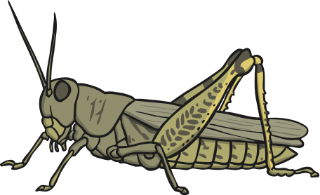
Insects
Insects come under two categories. ‘Metamorphosis’ means ‘to change’. Click on a heading to find out more.
Complete Metamorphosis
Incomplete Metamorphosis
The life cycle of these insects has four stages: egg, larva, pupa and adult. Insects in this category include beetles, butterflies and flies.
The life cycle of these insects has three stages: egg, nymph and adult.
Insects in this category include grasshoppers, crickets and cockroaches.

Slide 6
Watch the video below to find out more about these two different life cycles.
https://www.youtube.com/watch?v=XNImo2oyhew

Slide 7
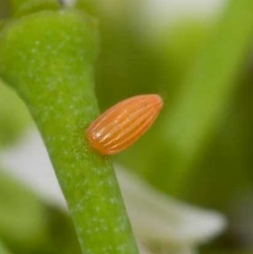
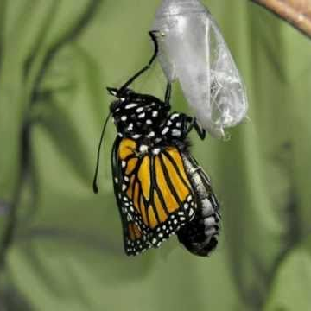
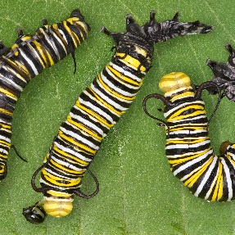
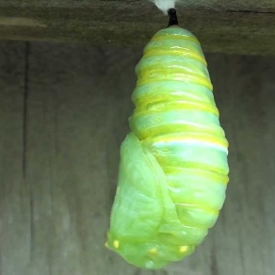
The Life Cycle of an Insect (Complete Metamorphosis)
Eggs are laid by the female insect.
It metamorphoses into
an adult which breaks
out of the pupa, matures
and lays eggs.
1
4
Egg hatches into a larva. This varies depending on
species. Common forms are caterpillars, maggots, grubs.
2
The pupa is usually where a hard case is formed around the larva.
3

Slide 8
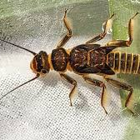
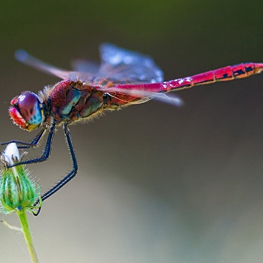
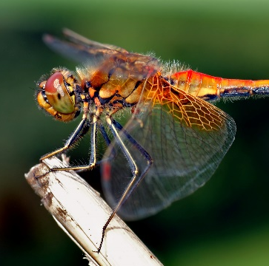
The Life Cycle of an Insect (Incomplete Metamorphosis)
Eggs are laid by the female insect. Sometimes this is in water.
Egg hatches into a nymph. This varies depending on species. Nymph looks like small adult. In some cases, it lives in water.
1
The nymph grows into the adult form, sometimes shedding skin. Adults sometimes fly. Adult females lay eggs.
3
2

