Slide 1

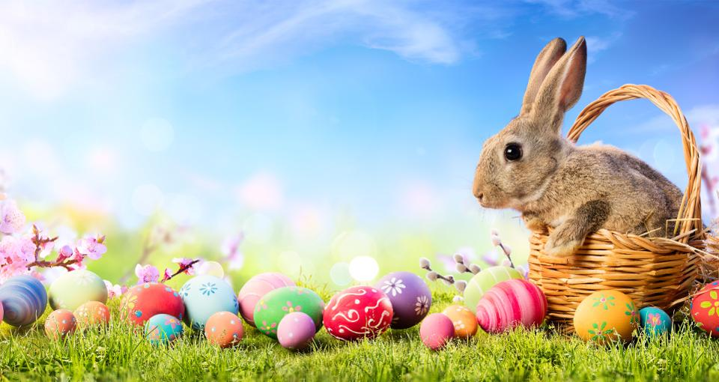
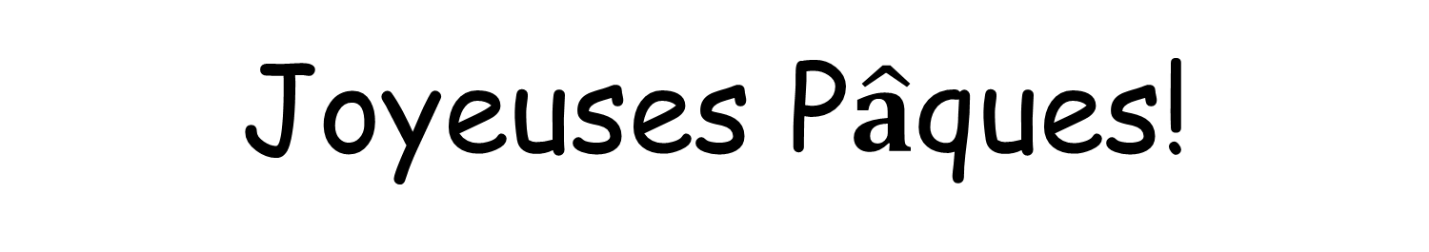
Joyeuses P$\hat{a}$ques!
Happy Easter!

Slide 2
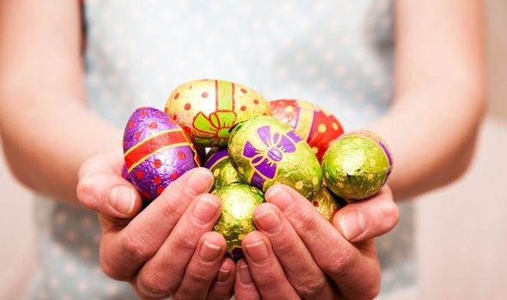

P$\hat{a}$ques = Easter

Slide 3
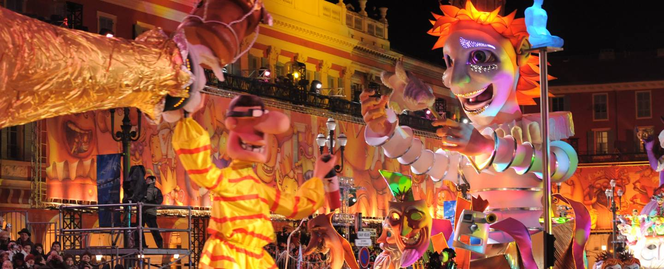
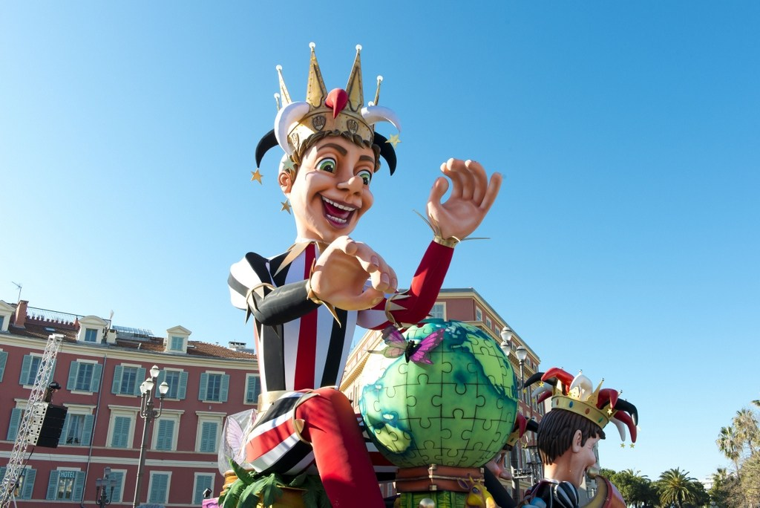
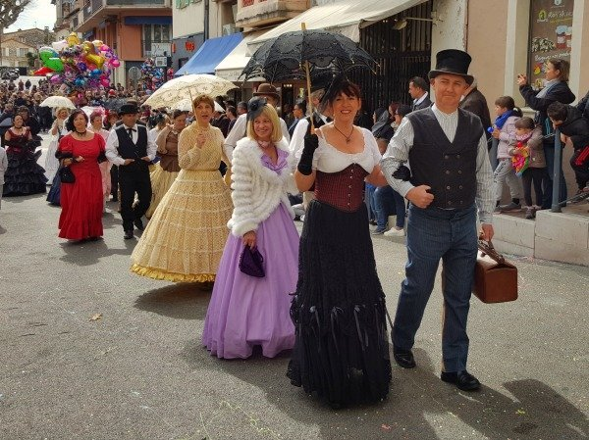
le carnaval = carnival
Easter activities in France begin more than a month before Easter itself.
Many cities celebrate carnival, when there are street parties, dressing up, parades and lots of fun during a period of two or even three weeks!
The tradition of carnival is thought to have originated in the city of Nice, in the south of France.

Slide 4
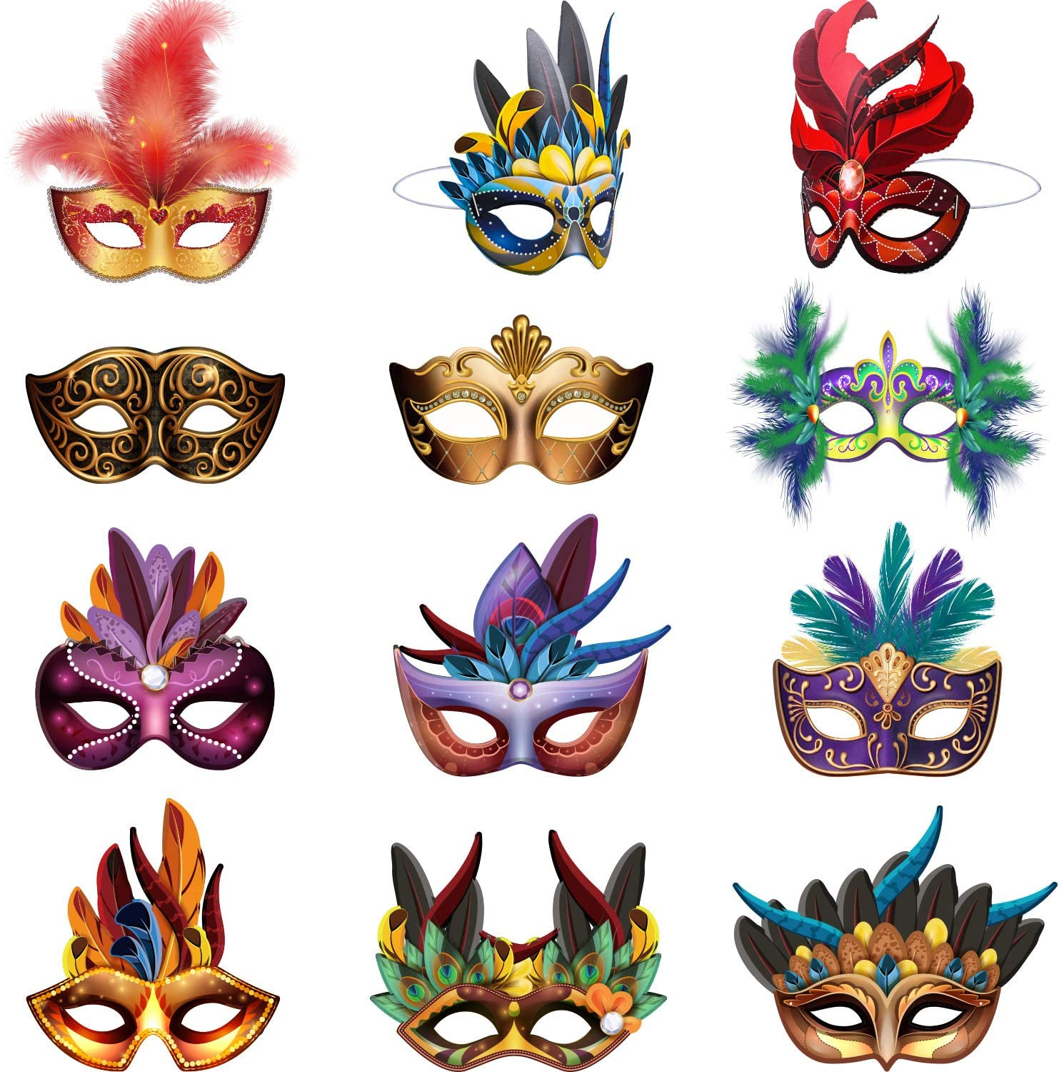
une masque = mask
French people wear masks to the carnivals

Slide 5
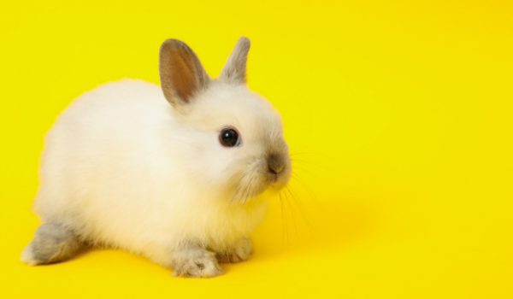
un lapin = rabbit

Slide 6
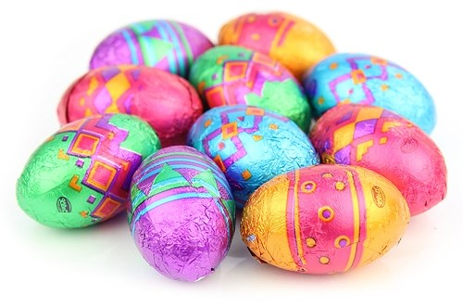
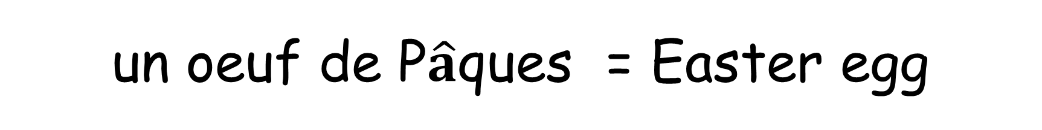
un oeuf de P$\hat{a}$ques = Easter egg

Slide 7
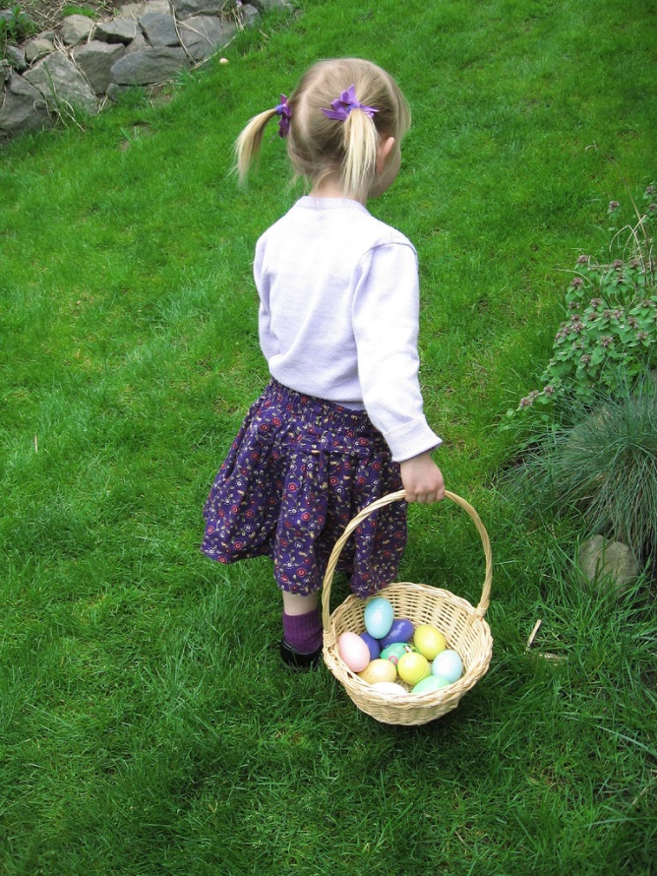
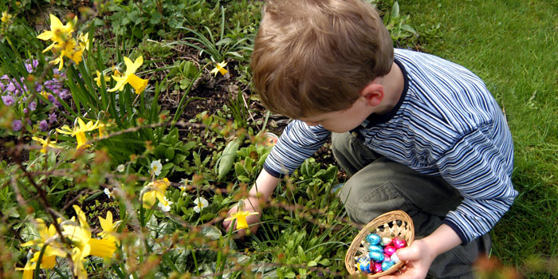
la chasse = hunt
Just like us, children in France usually have an Easter egg hunt on Easter Sunday.

