Slide 1
What can you remember from last week?
When talking about the life cycle of an insect, we often use the word ‘metamorphosis’. What does this word mean?
2. There are two different types of insect lifecycles. These are ________ metamorphosis and __________ metamorphosis.
3. Name the four stages in the life cycle of a butterfly.
4. Name the three stages in the life cycle of a grasshopper.

Slide 2
Were you right?
When talking about the life cycle of an insect, we often use the word ‘metamorphosis’. What does this word mean?
This term means it changes into something different
2. There are two different types of insect lifecycles. These are complete metamorphosis and incomplete metamorphosis.
3. Name the four stages in the life cycle of a butterfly.
1. Egg, 2. Larva, 3. Pupa (in the cocoon), 4. Adult
4. Name the three stages in the life cycle of a grasshopper.
1. Egg, 2. Nymph (little version of the adult), 3. Adult

Slide 3

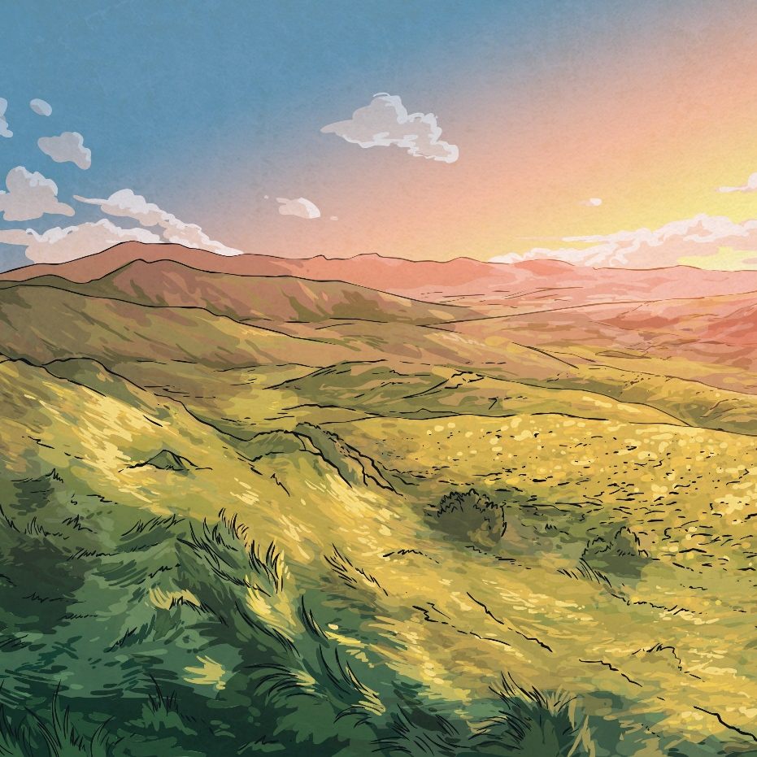
What Do You Know About…
mammals?

Slide 4
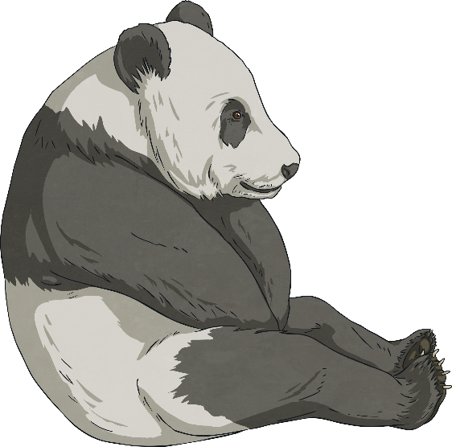
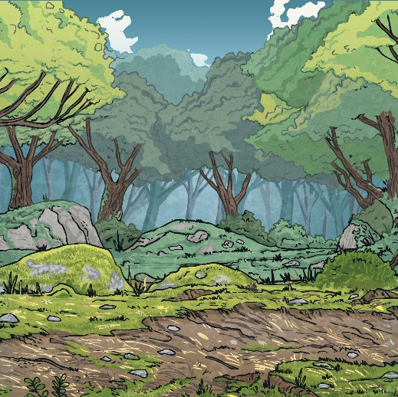
What Is…
a mammal?
A mammal is a warm-blooded creature that gives birth to
live babies. A mammal has fur or hair. The largest
mammal in the world is the blue whale and the smallest
is the bumblebee bat.
Click on the picture to find out more.

Slide 5
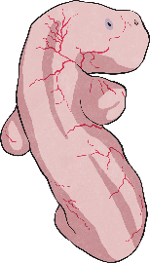
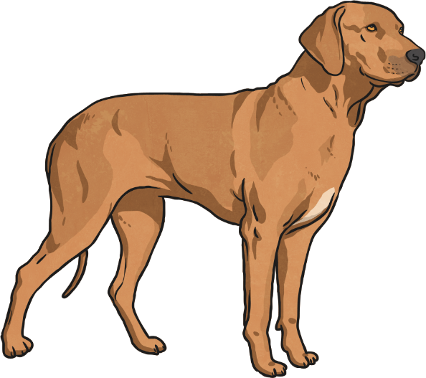
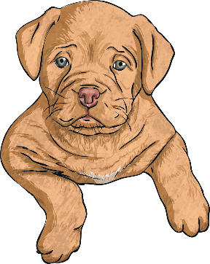
The Life Cycle of a Mammal
Independent adult usually
seeks company from the opposite sex and mates. Adult female nurses their young.
Embryo growing inside the mother, where it is completely reliant upon the mother.
1
Main period of growth and
developing independence
from the parents.
3
2

Slide 6
What Do You Know About…
birds?

Slide 7
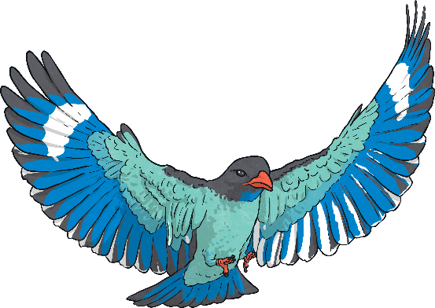

What Is…
a bird?
A bird is a vertebrate. It has a beak, feathers and wings, although not all birds can fly. Owls, swans and sparrows are all species of birds.
Click on the picture to find out more.

Slide 8
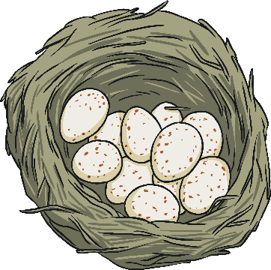
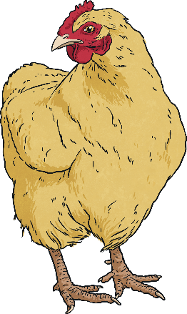
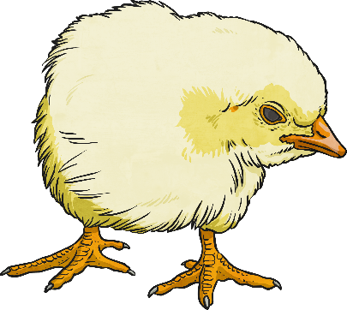
The Life Cycle of a Bird
Independent adult usually
seeks company from the opposite sex and mates.
Eggs are laid by the mother and the mother and father care for the egg until it hatches.
1
Mother and father feed the
young bird until it is old
enough to fly and find its
own food.
3
2

