Slide 1
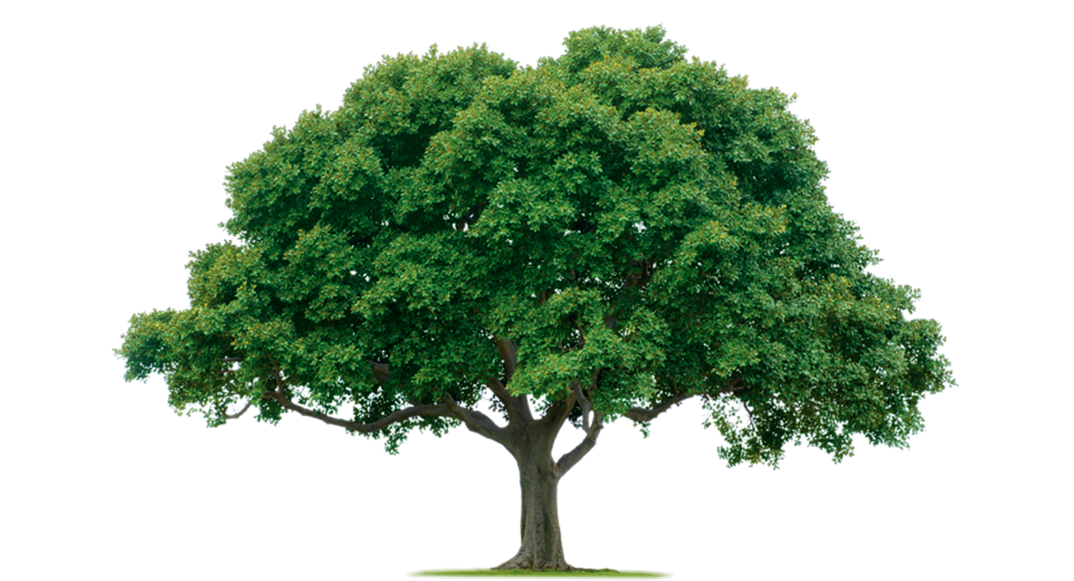
Think of as many words as you can to describe a tree…

Slide 2
Questions to consider…
What is a tree for?
What does a tree need?
What does a tree provide?

Slide 3

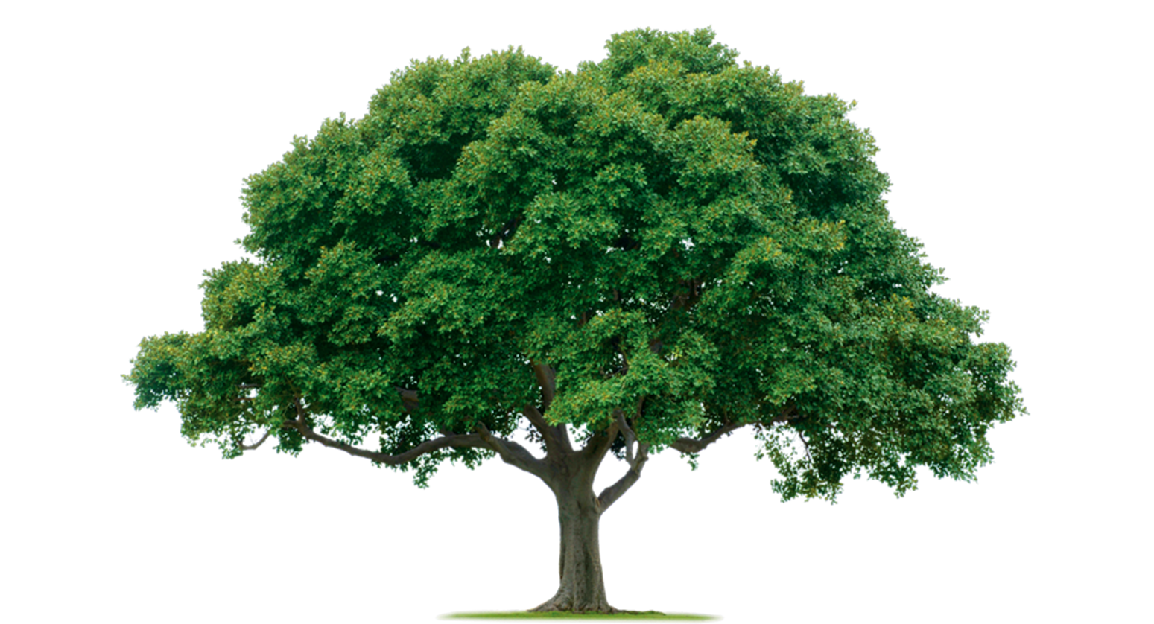
What might connect these ideas together?
Anger
Trees and Nature

Slide 4
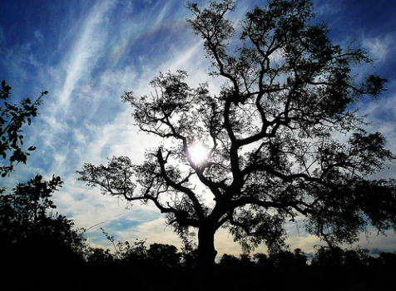
The title of this poem is ‘A Poison Tree’ by William Blake…
Predict what you think this poem could be about…

Slide 5
Read the poem…
After reading it, what did you find the poem was about?
Were your predictions correct?
How did they poem make you feel?
What do you think the message of the poem might be? What does the poem teach you?

Slide 6
Plenary: If ‘A Poison Tree’ represents the negative emotion of anger, what positive emotions might a tree represent instead? Why?

Slide 7
How do you want to grow when you are a student at Wyvern College in September?

