Slide 1

Where do the homophones go?
_______ going out but we are making a fuss of what we shall ______ and _________ we shall go!
Where
We’re
Wear

Slide 2
Answer
____ going out but we are making a fuss over what we shall ___ and ____ we shall go!
We’re
wear
where
How many did you get correct?

Slide 3
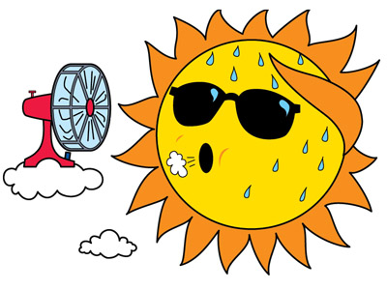
It was ___ hot outside.
too
to
two

Slide 4
It was ___ hot outside.
The correct answer is...
too
to
two

Slide 5
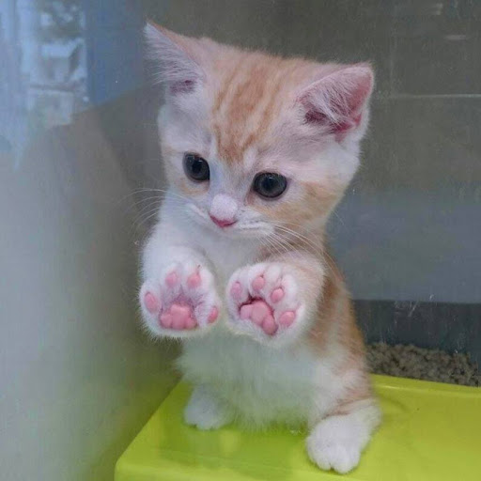
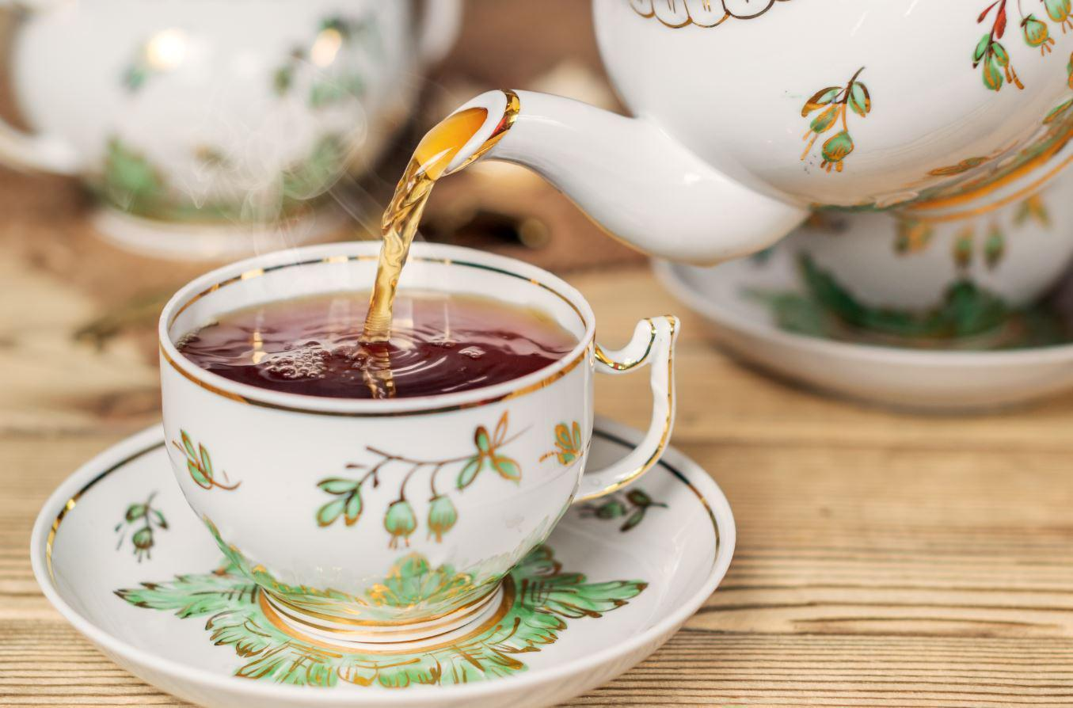
Please go and _____ the queen a cup of tea.
The kitten’s ____ is very small and has sharp claws.

Slide 6
Please go and _____ the queen a cup of tea.
The kitten’s ____ is very small and has sharp claws.
POUR
PAW

Slide 7
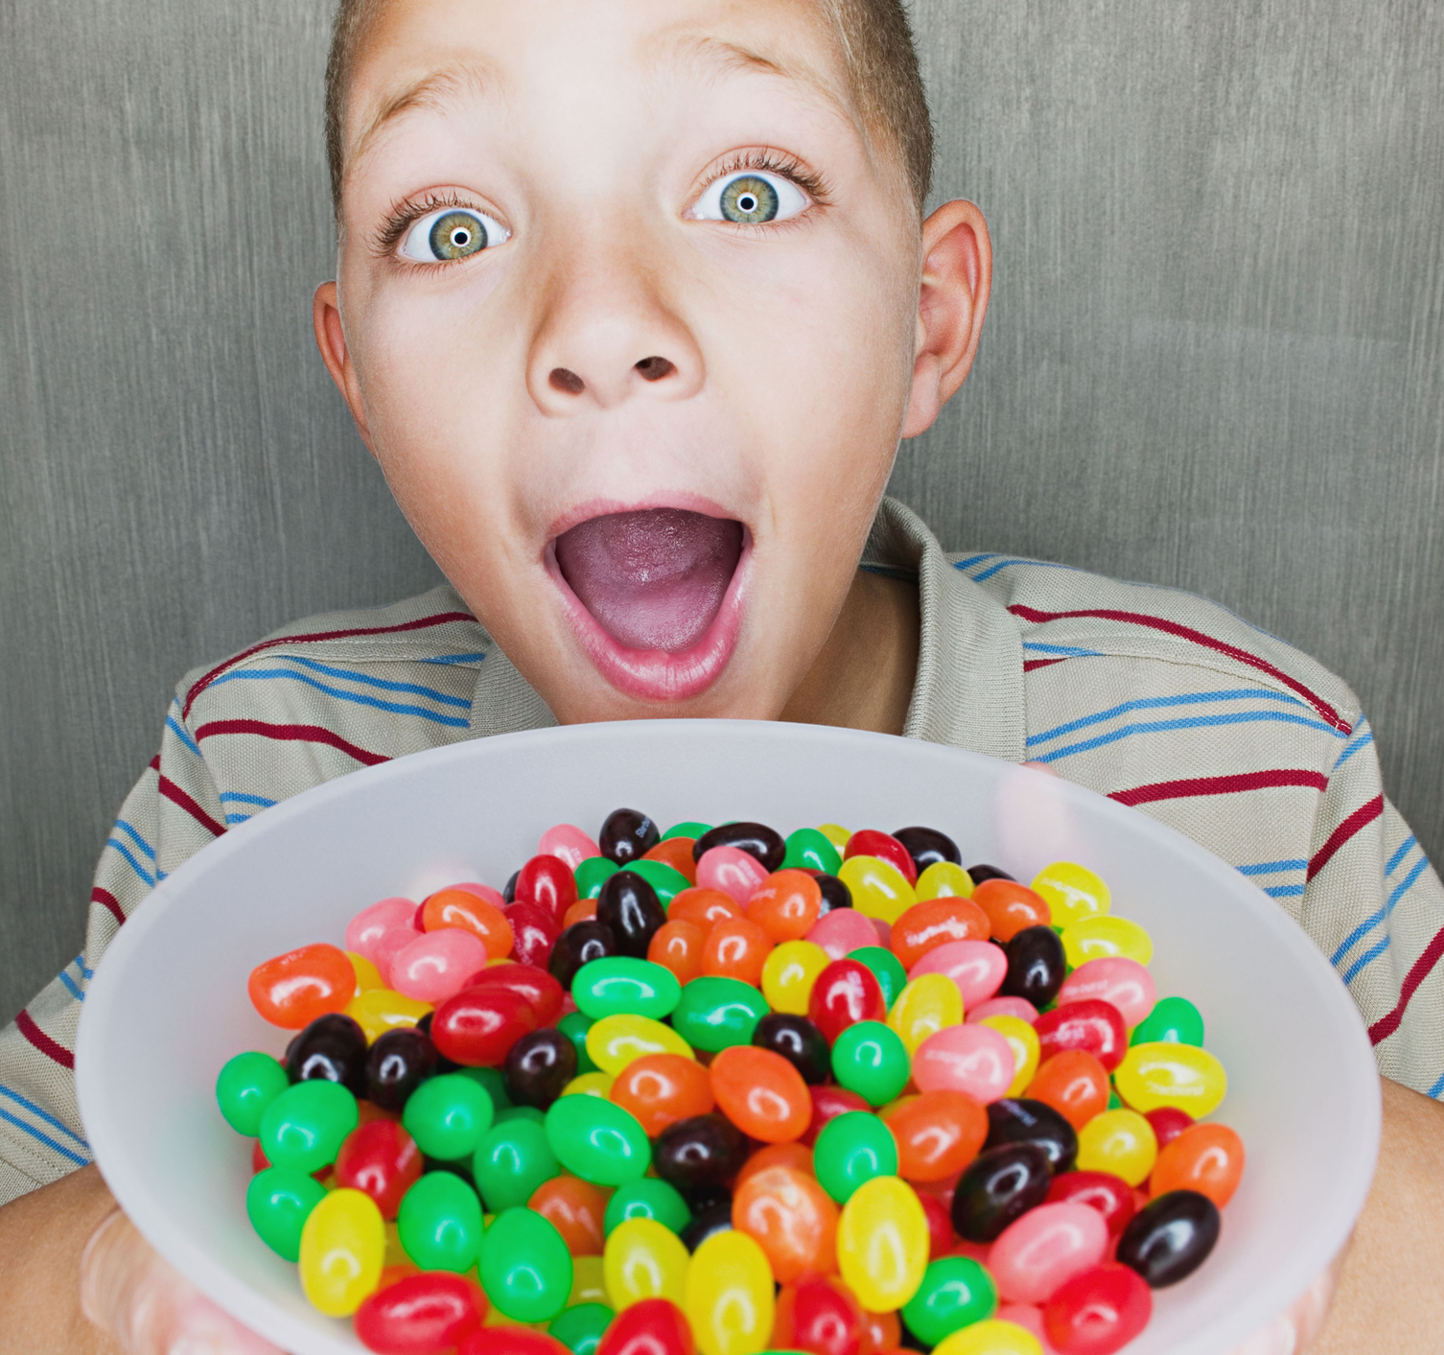
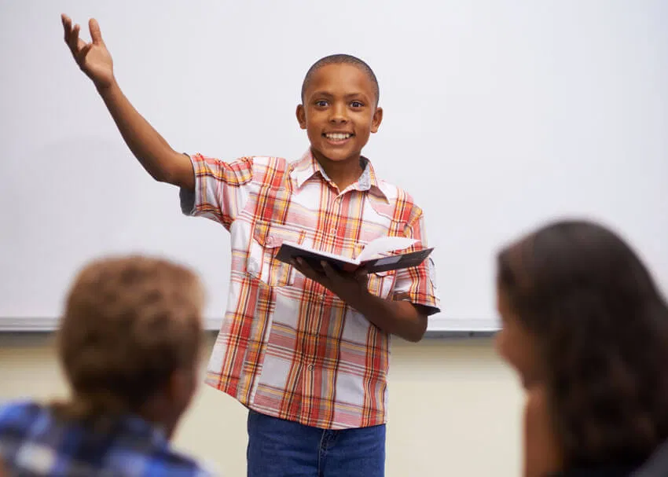
You are ______ to eat that sweet.
The boy spoke _____ in class .

Slide 8
You are ______ to eat that sweet.
The boy spoke _____ in class .
aloud
allowed

Slide 9
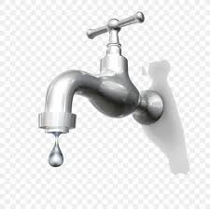
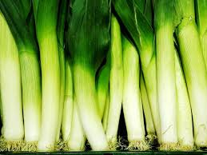
The ----- grew quickly because of the ---- in the tap

Slide 10
The leek grew quickly because of the leak in the tap.

Slide 11
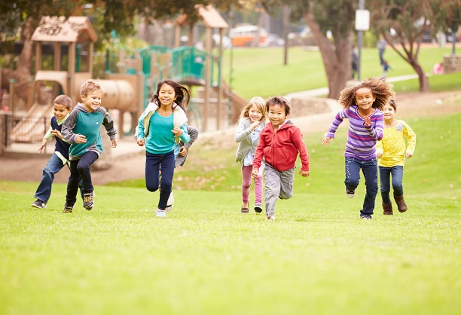
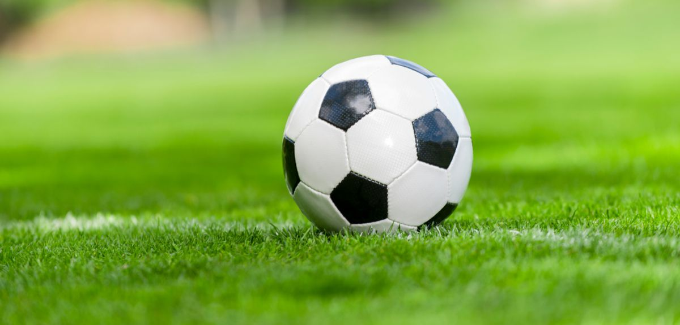
They played with _______ football. ______ going to the park.

Slide 12
They played with _______ football. ______ going to the park.
their they’re

Slide 13

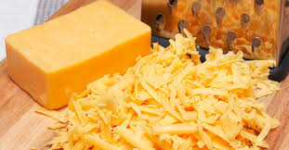
____ kids ate cheese. I like __ eat cheese.

Slide 14
Two kids ate cheese. I like to eat cheese.

Slide 15
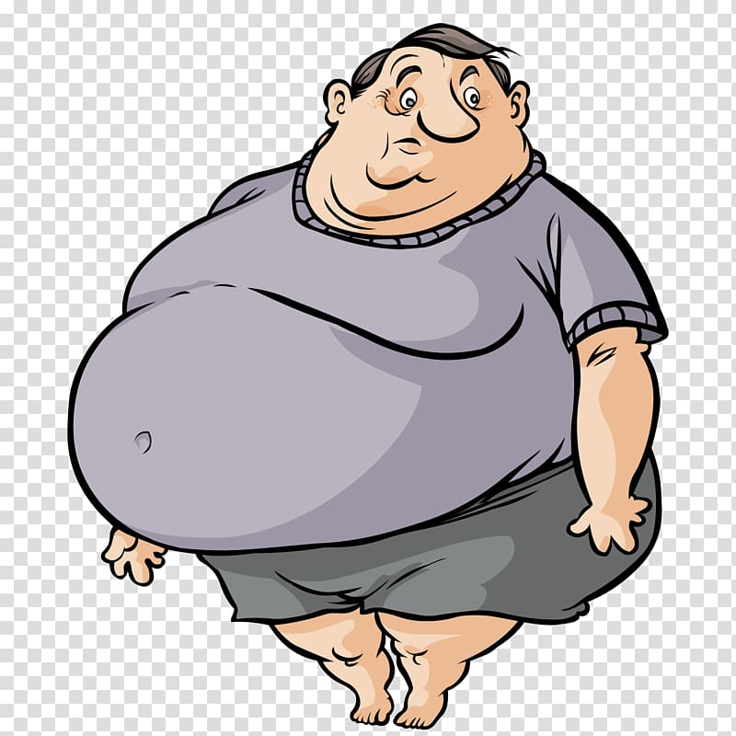

I am very worried about my _____. ____ there!

Slide 16
I am very worried about my _____. ____ there!
WEIGHT
WAIT

