Slide 1
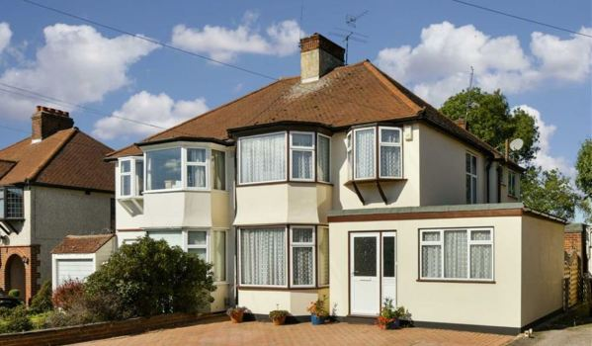

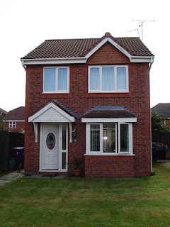

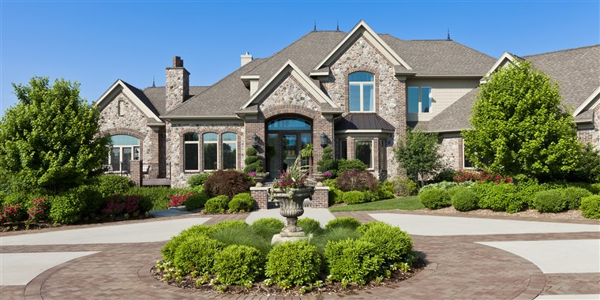
Ma Maison
My house
Lesson 2

Slide 2


Bonjour class 4!
Welcome to the second French lesson about rooms in the house.
In this lesson, you will be recapping the words that you learnt in the last lesson, as well as learning some new vocabulary. You will not need a new date and title in your book- just carry on from last lesson.
Make sure you have put the PowerPoint on full screen to make sure all the animations work properly! Don’t forget to press this button when ever you see it to listen how to pronounce the word or phrase.
Miss Kimber ☺

Slide 3
Let’s start by recapping all the words we learnt last week
You will be shown a picture. Try and remember and say the French word for the room on the screen if you can! Then click again to reveal the French word.
It’s hard to remember new vocabulary in a different language so a big well done if you remember any of them!
Listen and repeat the word 5 times to get it into your memory!

Slide 4
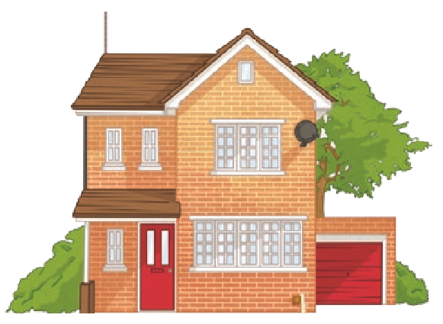
la maison
house

Slide 5
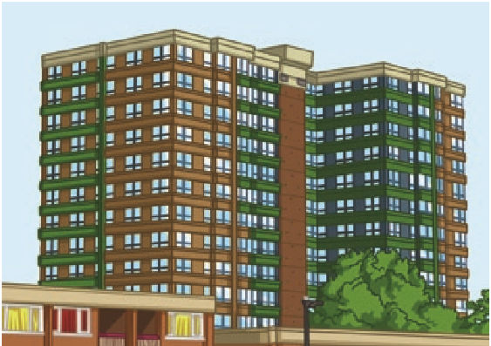
l’appartement
flat

Slide 6
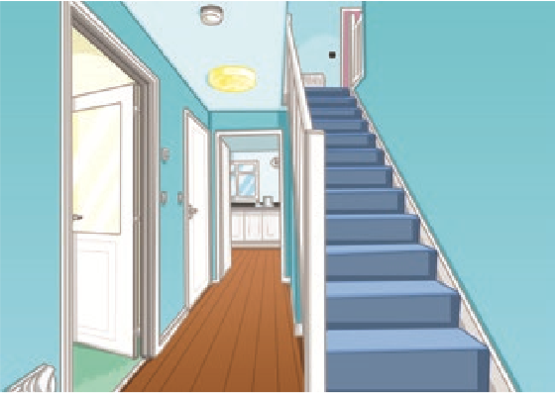

l’entr$\acute{e}$e
Hallway

Slide 7
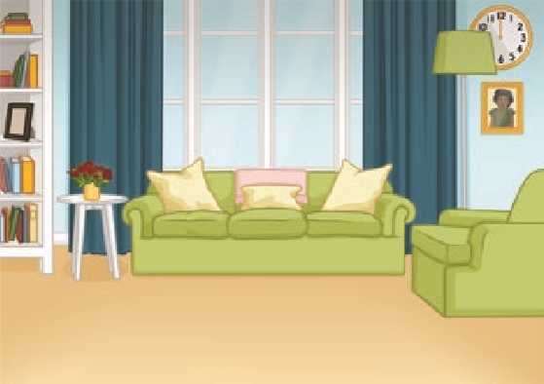
le salon
Living Room

Slide 8
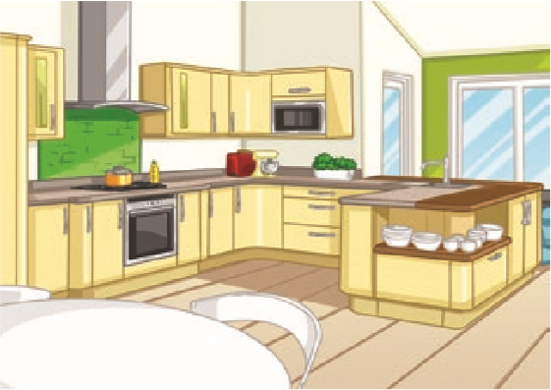
la cuisine
Kitchen

Slide 9
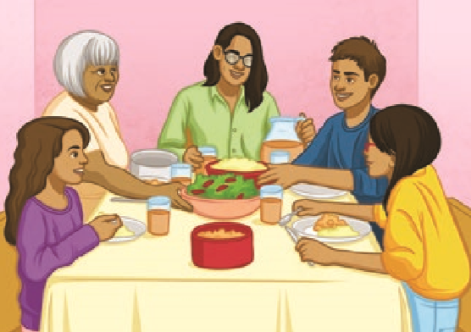

la salle $\grave{a}$ manger
Oops! I realised that I told you that this meant ‘kitchen’ in the last PowerPoint. My mistake! This really means dining room. Make sure you have the correct translation of this in your book.
Sorry!
Dining Room

Slide 10
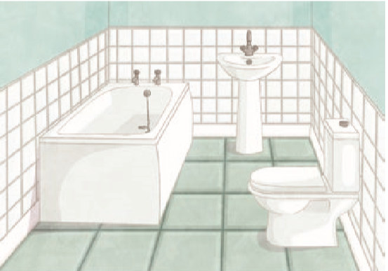
la salle de bains
Bathroom

Slide 11
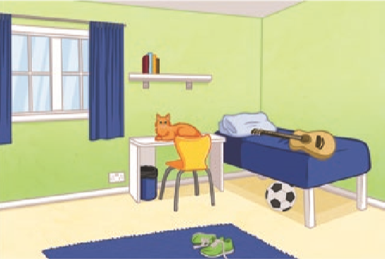
la chambre
Bedroom

Slide 12
Here are a few more useful words
Add these to the list of words you created in your book in the last French lesson.
Make sure you write the English translation and a drawing for each word.
Listen to and repeat each word 5 times in silly voices!

Slide 13
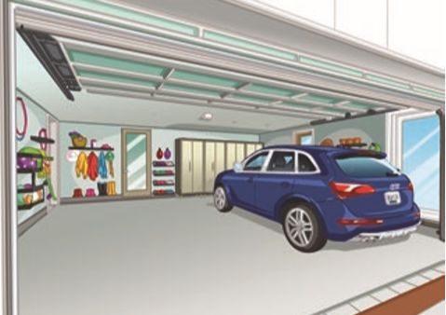
le garage
garage
Can you say it in a squeaky voice?
Can you say it in a robot voice?
Can you say it in a whisper voice?
Can you say it in a angry voice?
Can you say it in a baby voice?

Slide 14
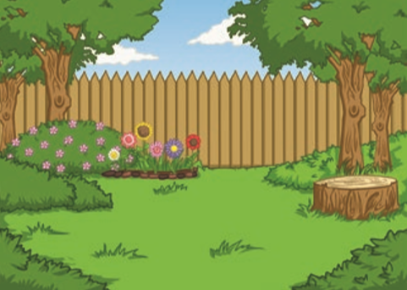
le jardin
garden
Can you say it in a big voice?
Can you say it in a robot voice?
Can you say it in a shy voice?
Can you say it in a sad voice?
Can you say it in a alien voice?

Slide 15
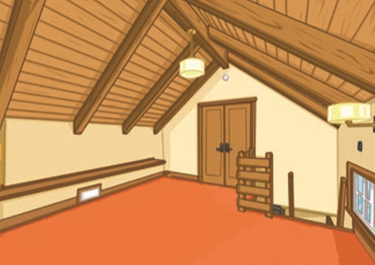
le grenier
Attic
Can you say it in a deep voice?
Can you say it in a robot voice?
Can you say it in a high voice?
Can you say it in a happy voice?
Can you say it in a slow voice?

Slide 16
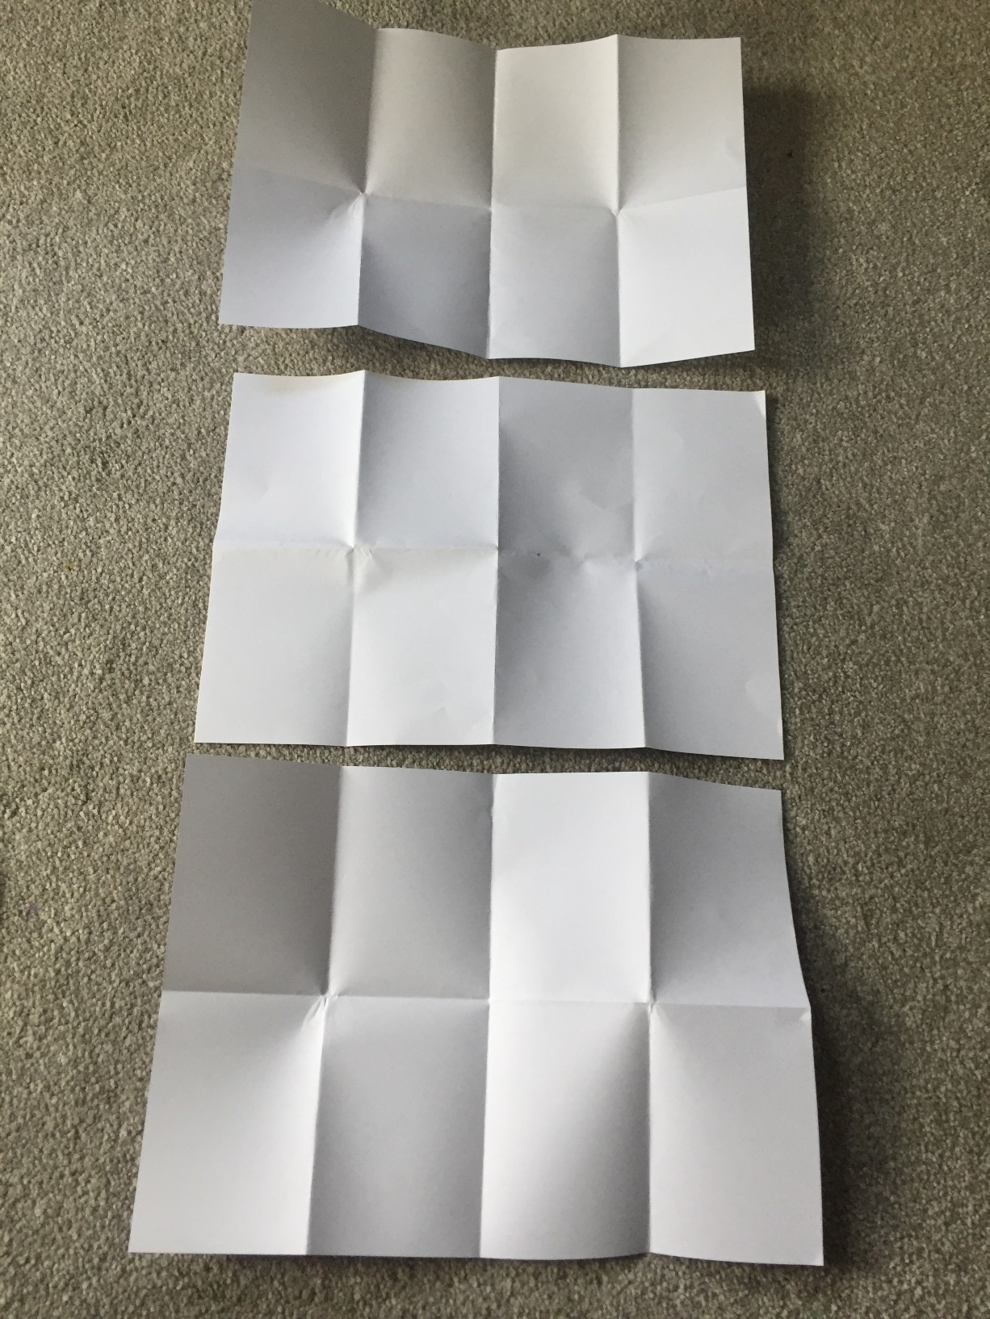
How to make your own house pairs game:
You will need 3 pieces of paper.
Fold each piece of paper into 8 (fold it in half 3 times).

Slide 17
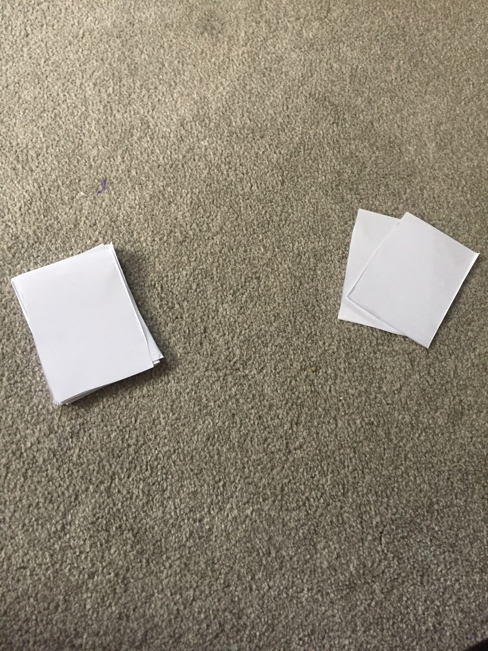
How to make your own house pairs game:
Cut each piece of paper along the folds that you have made (into 8 rectangles per piece of paper).
This will leave you with 24 cards. You only need 22 so get rid of 2.
Get rid of 2
22 cards

Slide 18
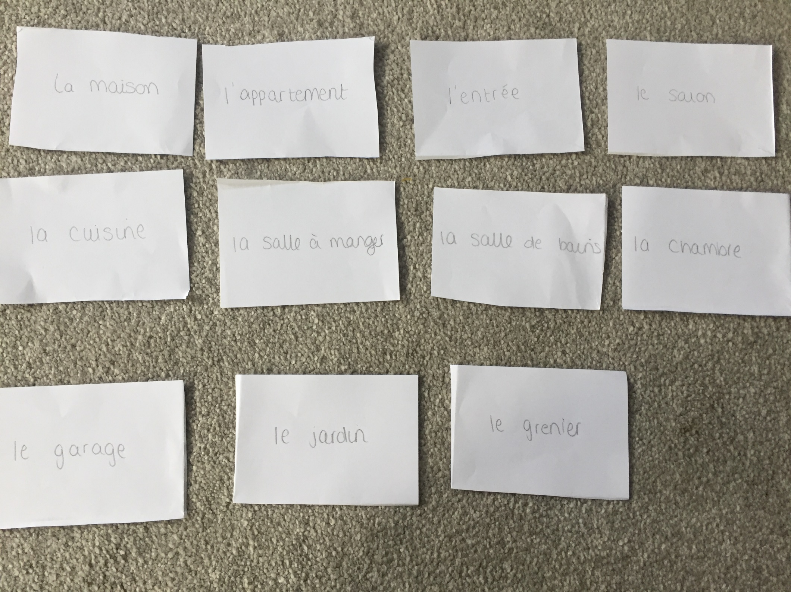
How to make your own house pairs game:
In pencil (so you can’t see it through the paper), write each of the French words you have learnt from the past 2 lessons. You need one word per card. Don’t write the English translations on these cards!

Slide 19
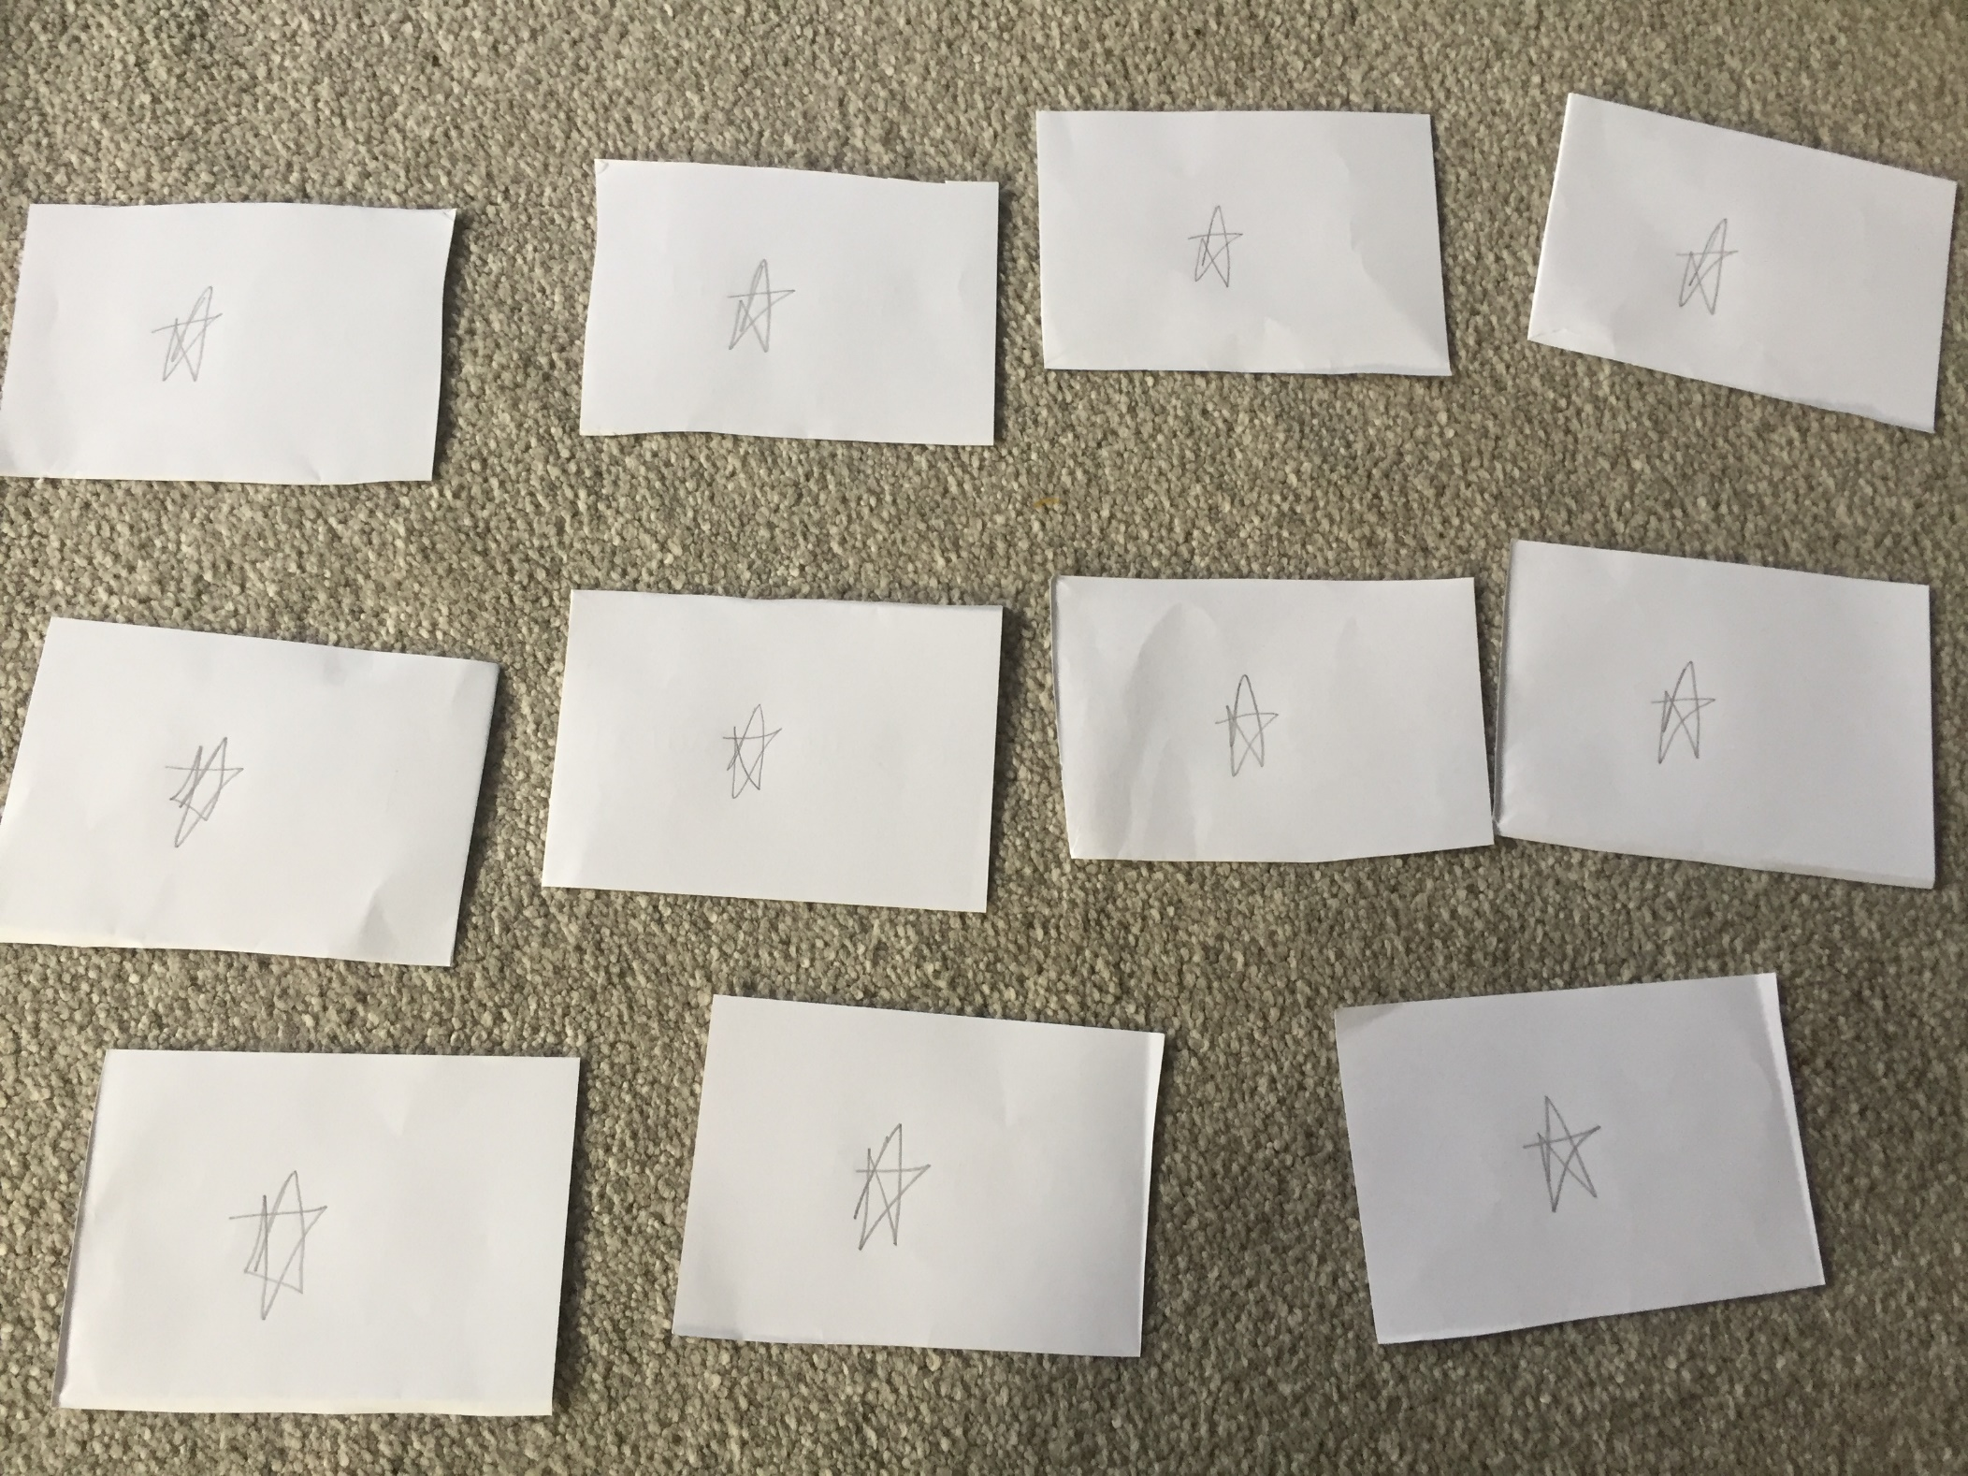
How to make your own house pairs game:
Draw a star on the back of these French cards so that you know they are the French cards when you are playing the game.
Set these cards aside for now.

Slide 20
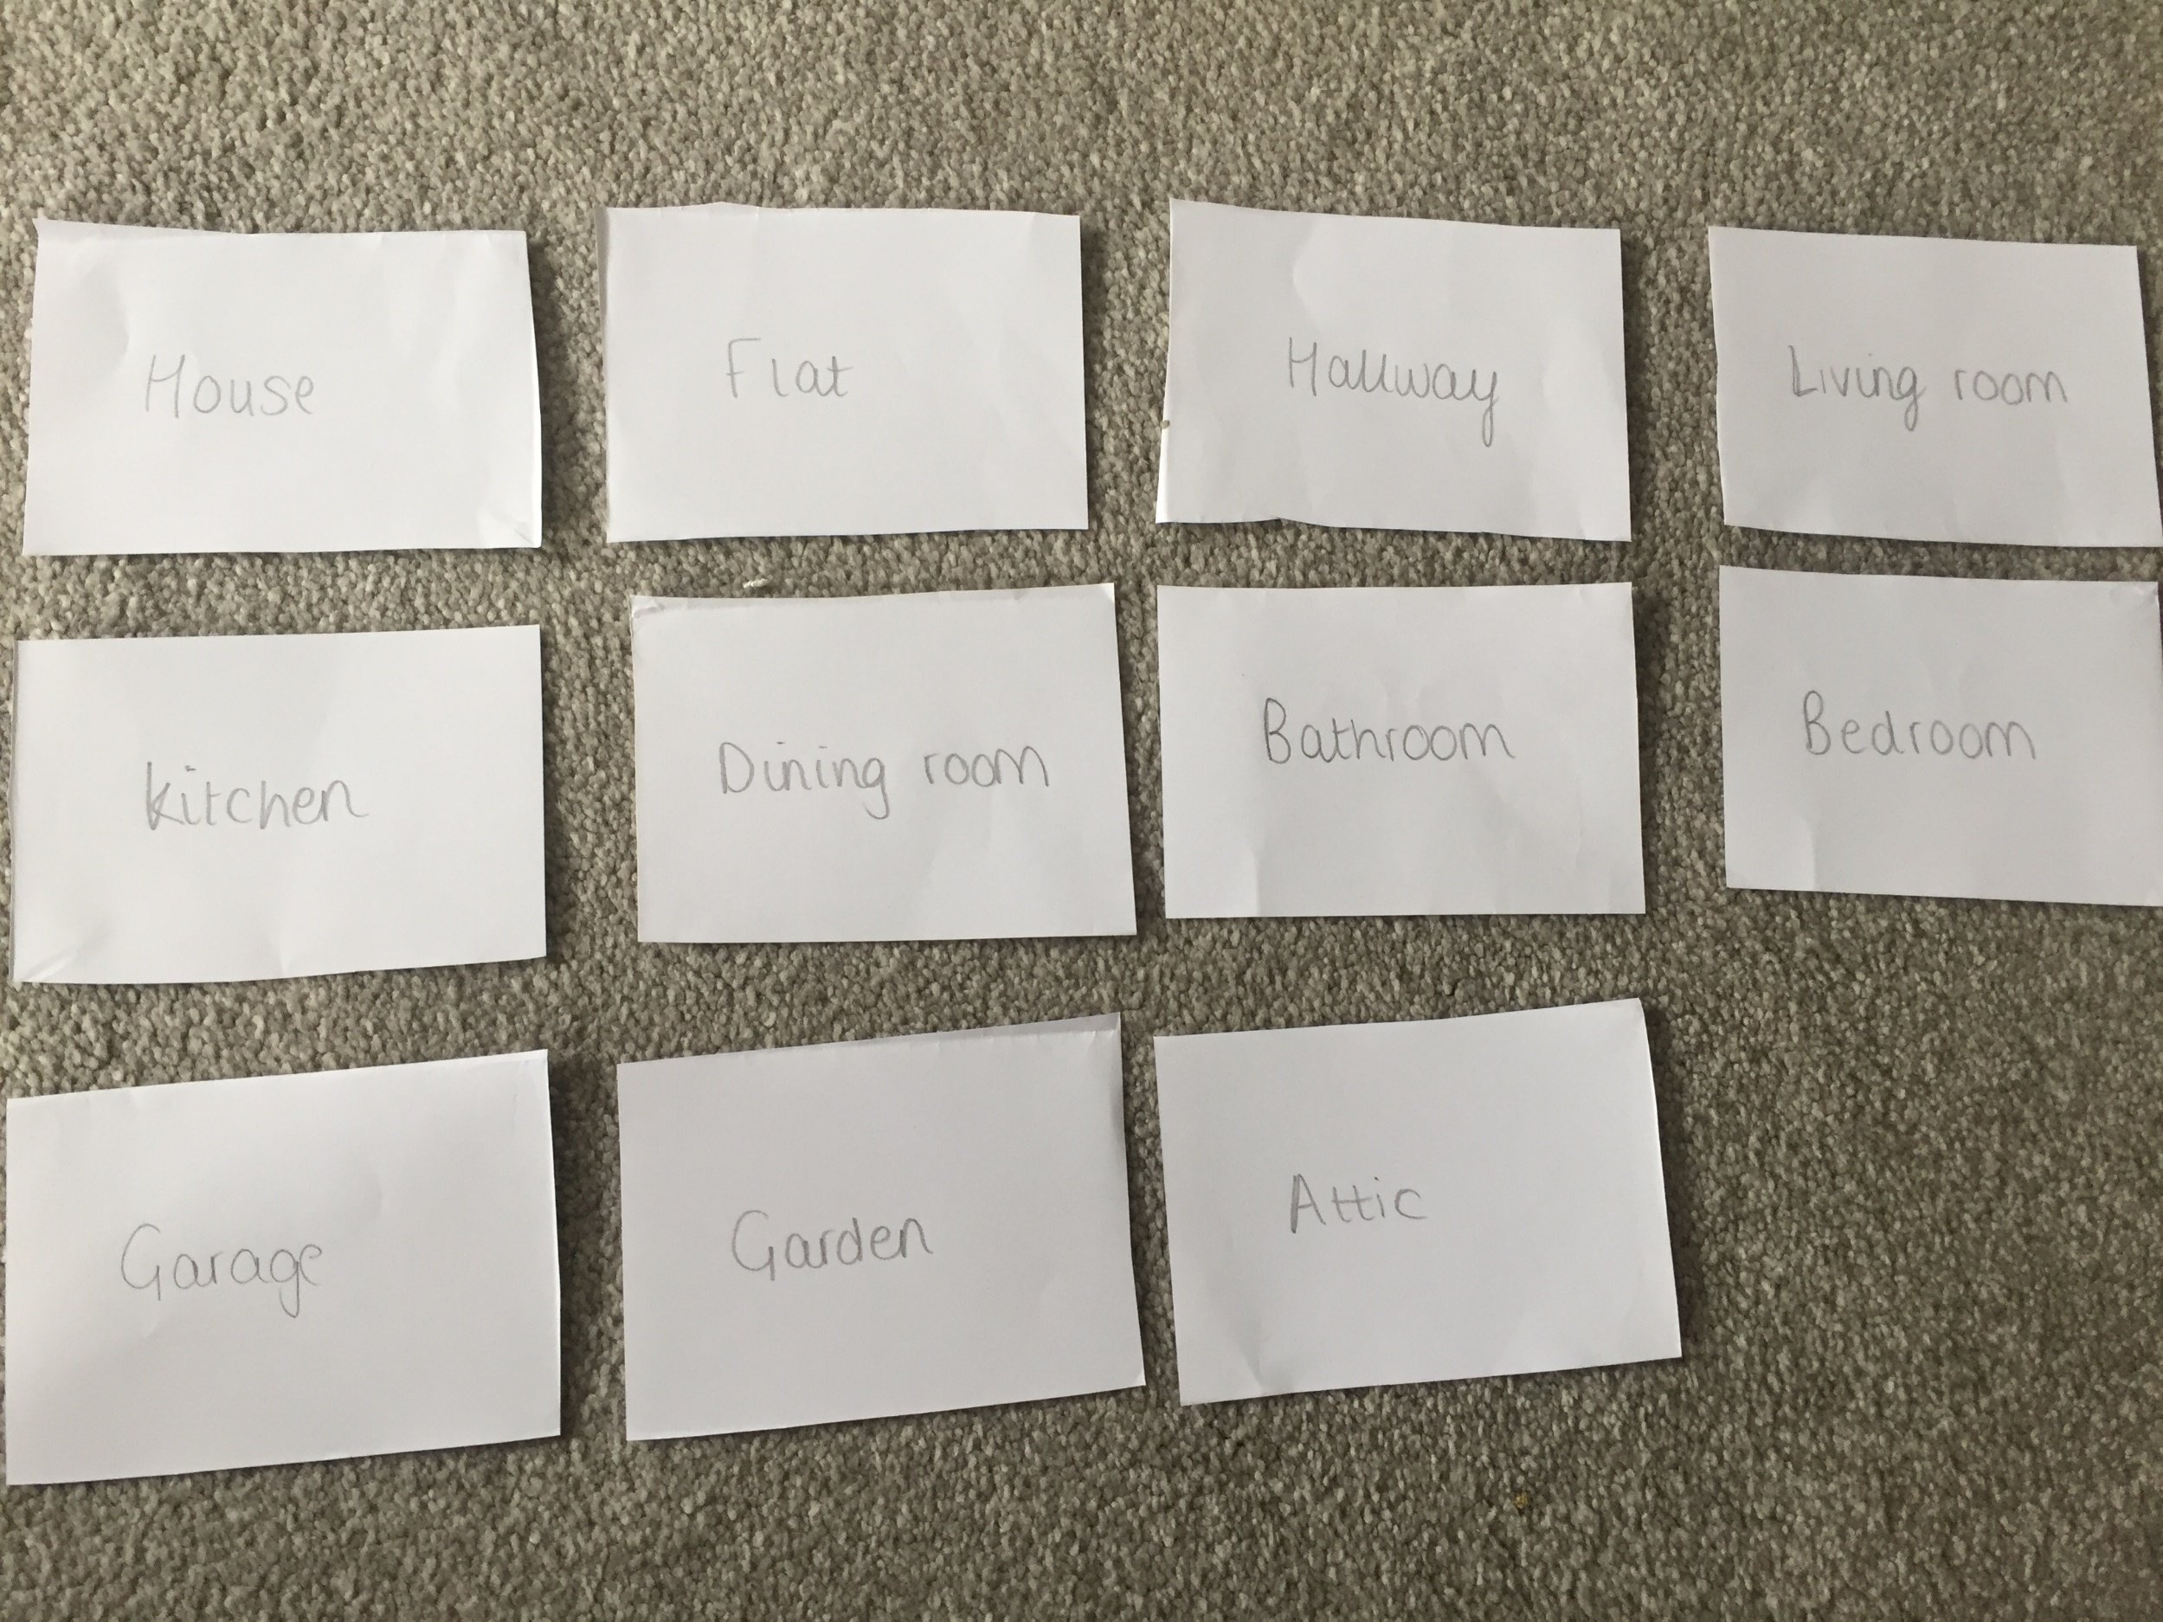
How to make your own house pairs game:
On the remaining 11 cards, write the English words to match. You need one word per card.

Slide 21
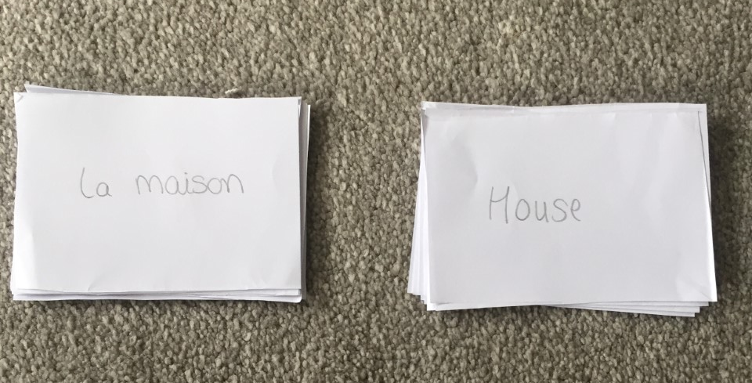
How to make your own house pairs game:
You should now have 11 cards with French words on and 11 cards with English words on to match.

Slide 22
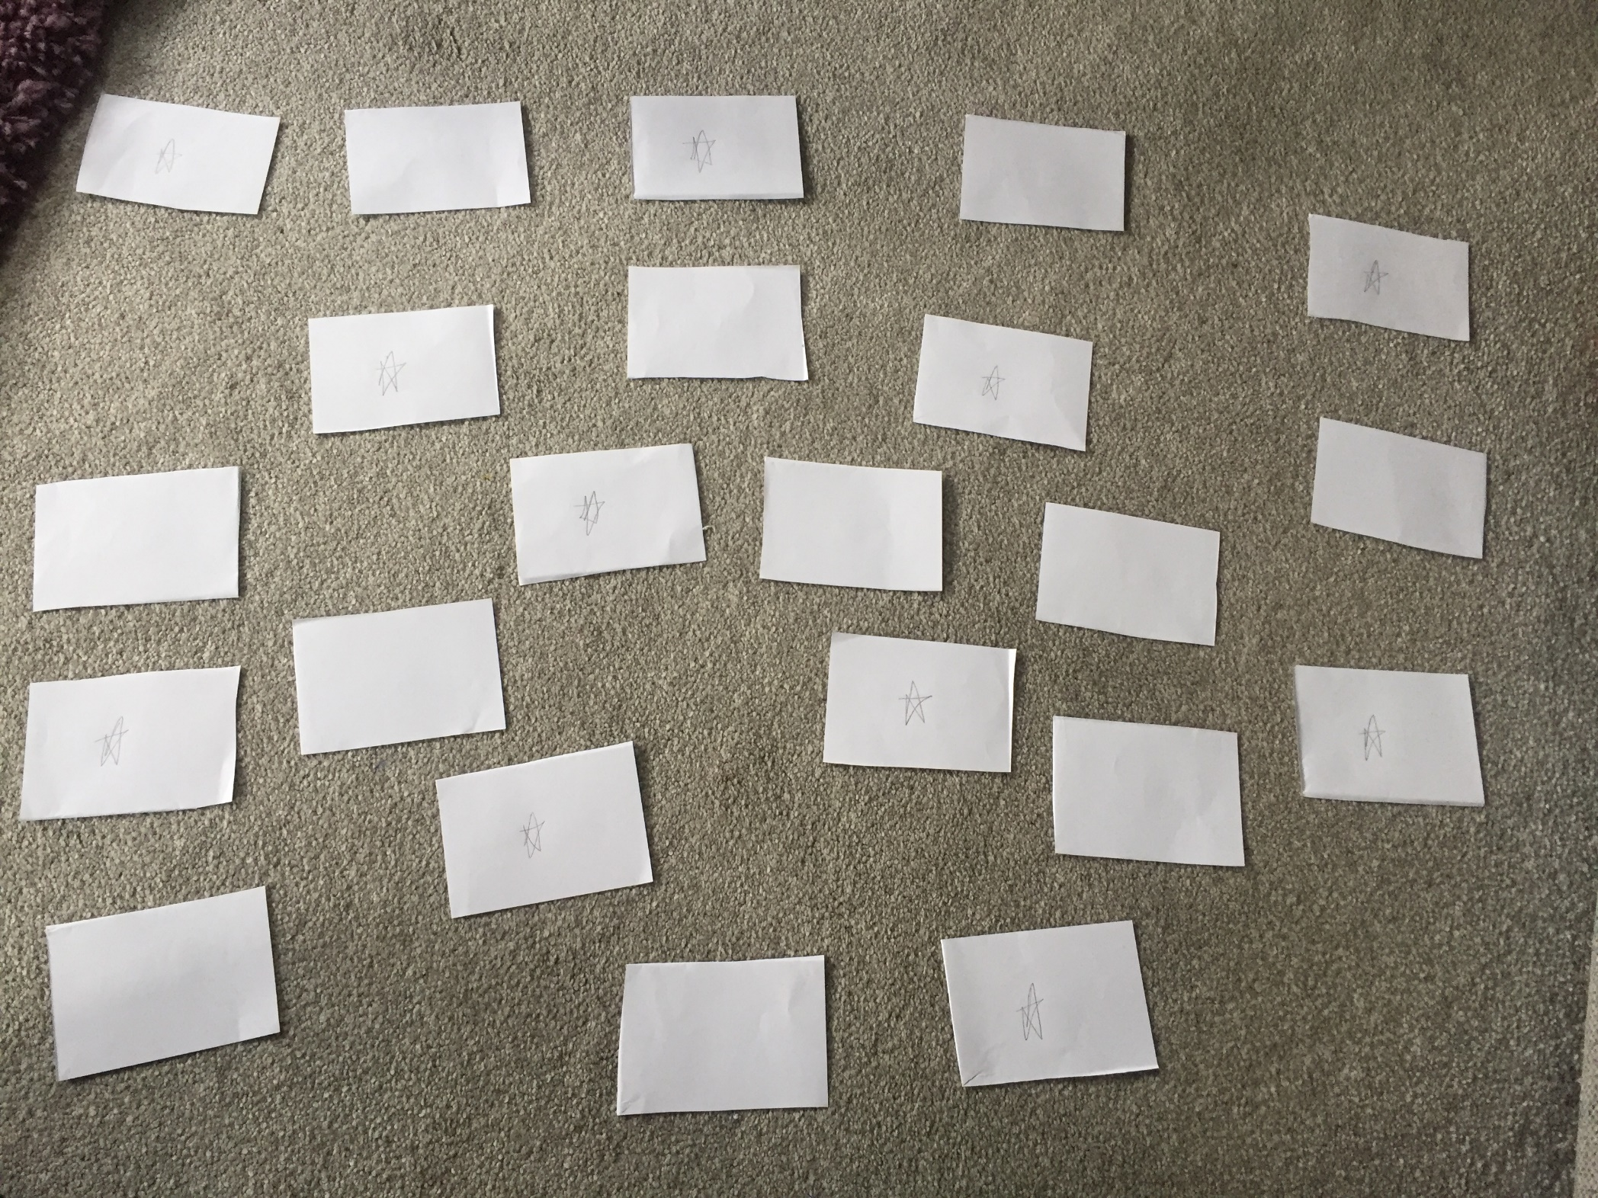
How to play:
-Turn all the cards over and spread them out randomly.
-Turn over 1 French card (with a star on it) and 1 English card (without a star).
-If it’s a match, take the cards out.
-If it’s not a match, turn them back over.
-Try and match all the pairs of cards as quickly as you can!
If you are unsure, use the word list in your book to check if they match.

