Slide 1


Keep Calm and
Make Music
Lower KS2 – Years 3 and 4
In the Hall of the Mountain King

Slide 2

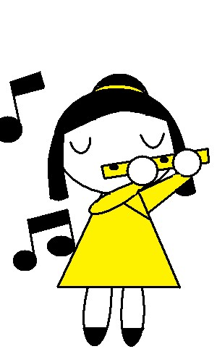
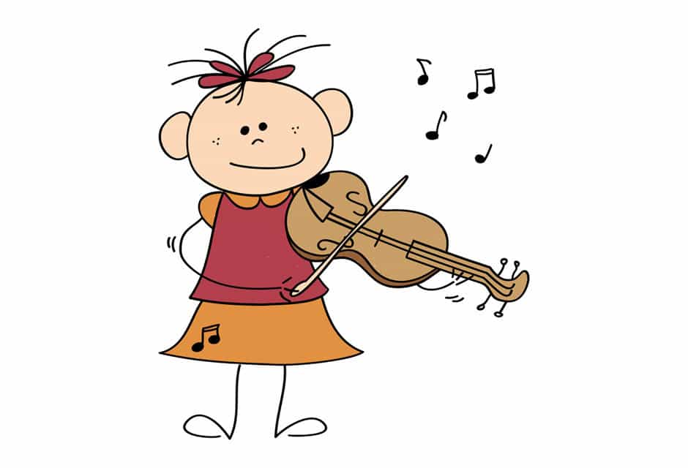
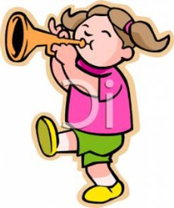
In the Hall of the Mountain King
Listen to the music – click on the speaker icon to hear the music. What do you think the music is about? How does it make you feel?
Watch the orchestra play “In the Hall of the Mountain King”
Follow the link to the BBC Ten pieces film of the piece
  https://www.bbc.co.uk/programmes/p02b5bwl
  How many instruments can you name?
Notes:
Check you have the MP3 file in the same folder as this PPT to ensure that it plays! If you have problems with the internet to watch the film of the orchestra – there maybe a Ten Pieces DVD in school as many were distributed in 2014 when Ten Pieces 1 came out. The audio MP3 can also be found on the Ten Pieces website
The DVD version (even if you don’t actually watch it) has quite a bit of talking over the start which gives away the story and some of the excitement and tension is lost

Slide 3
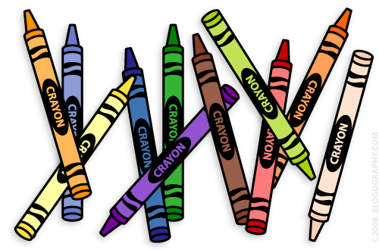
Listen and draw
Draw as you listen again
Which colours will you choose?
What sort of lines or shapes are you going to draw?
Share your “drawings” with a partner and tell them about what you have drawn and why?
Notes:
Listening for maybe the third time as the pupils to draw / make marks, shapes, lines etc rather than a picture. Adults in the room can do it as well and share and talk about what you have drawn. There are no wrong choices / answers but always ask for the children to give a reason for the colour / mark they have made

Slide 4
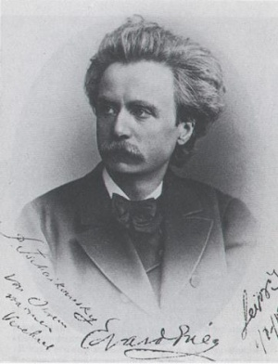

Who was Edvard Greig?
He was a born in 1843 and died in 1907 (how old was he when he died?)
He was from Norway
Notes:
Brief info about the composer – pupils are often ver surprised to discover that the music was written in 1875 almost 150 years ago!

Slide 5
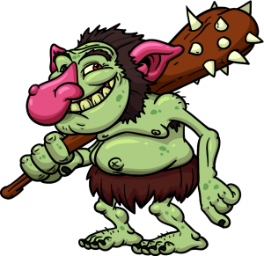

The story of the music……
In the Hall of the Mountain King is part of the music that Grieg wrote to accompany a play all about a young boy called Peer Gynt who falls in love with a girl. He is not allowed to marry her and he runs away into the mountains where he is captured by trolls who take him to their King.
Peer Gynt escapes from the trolls, runs
into the troll King but eventually gets
away to safety - phew!
Notes:
This is a very brief outline of the story that Grieg wrote the “incidental music” for

Slide 6

Crescendo and Accelerando
Keep the beat along to the music
What happens?
How does it make you feel?
Can you say the Italian musical terms with an Italian accent?
Notes:
Listen again and keep the beat to discover that the music gets faster and louder. Introduce the terms crescendo and accelerando and practice saying them with an Italian accent. The children often get very excited and “vocal” towards the end of the piece. Ask them why its exciting and how did the music have that effect.

Slide 7

What’s my metre?
What is the metre of the music?
(how many beats are there in each group?)
Let’s make up a body percussion pattern to show the metre
Try keeping a body percussion
pattern along to the music
Notes:
Identify the metre of the music. It is in 4 metre. Keep a body percussion pattern that illustrates 4 metre e.g. stamp on 1 and tap knees on beats 2, 3 and 4. Match the body percussion pattern to the gradual increase of dynamics and tempo.

Slide 8


What’s my rhythm?
Can you clap the rhythm of the first phrase after the long first note?
Here’s the rhythm of the first bar to get you started “a- pple a - pple a - pple pear”
Notes:
You are going to identify the rhythm of the first section (i.e 4 bars / 4 x 4 beats) and clap along to the music. The next slide shows it in grid form

Slide 9
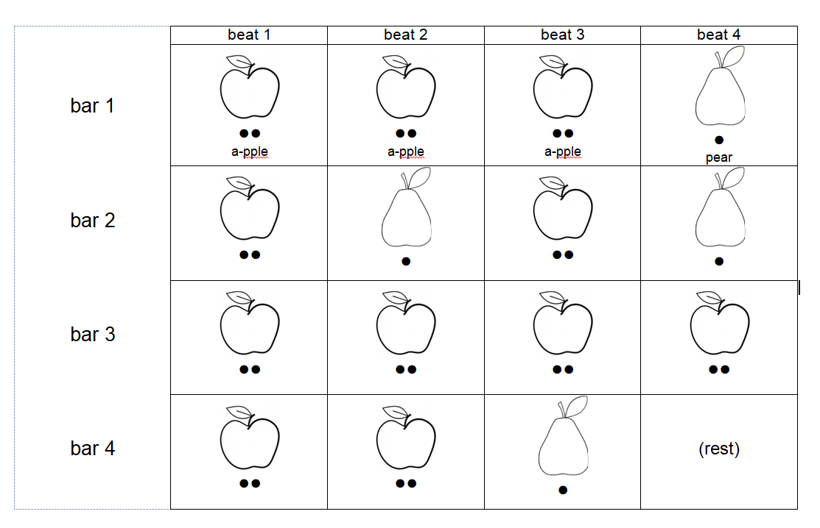
Here is the first section

Slide 10

Can you chant or sing along to the music?
Notes:
This slide is an alternative representation of the first section, called A. It is played through twice then a second section (B) is played which starts of the same but then line 3 is the same as line 1 and line 4 is a-pple pear pear. This could be an extension activity for more able pupils but is not necessary to continue

Slide 11

Can you make up your own apples and pears rhythms?
Here is one idea
Can you clap your pattern?
Share your pattern with your partner.
Can you play it using body percussion or untuned percussion instruments.
Can you play your pattern along to the music? (Warning - this is tricky as you know the original so well!)
Notes:
Give the pupils a 4 x 1 grid to draw their apple and pear pattern or just ask them to draw on paper (but not too small so everyone can see it)

Slide 12


Can you write music?
(Yes you can!)
Turn your apples and pears into music notation
Notes:
If you think your pupils could do this then please go ahead – every pear (one syllable is a one beat note or crotchet) i.e. a single blob with a stalk) and every a - pple two syllables is a pair of quavers) i.e. two blobs with a stalk which are joined together) This slide is optional

Slide 13
Can you play your pattern to show Peer Gynt running away from the Troll King?
Play your pattern 8 times
Start slowly and quietly to show Peer Gynt tiptoeing away from the trolls
Gradually get faster and louder to show Peer Gynt’s footsteps getting bigger and faster as he runs away from the Troll King!
Notes:
Rehearse playing different patterns 8x together with a crescendo and accelerando. Ask individuals to do a solo. You can help by playing a beat that speeds up and gets louder if you can. Which instruments are the most effective?

Slide 14


Can you draw?
You could draw some footsteps that get “louder” and “faster” to go with your music (how can you show this????)
or
Draw a picture of Peer Gynt running away from the Troll King to go with your music
Notes:
To show the music getting louder and faster the footsteps could get bigger and further apart???

