Slide 1


Keep Calm and
Make Music
Upper KS2 – Years 5 and 6
Music of the Planets

Slide 2

Music of the Planets

Slide 3


Listen
Listen to this piece of music
How does it make you feel?
What do you think might be happening?
If it was a colour, what colour would it be?

Slide 4
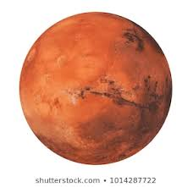
Introducing the info!
This piece of music is
Mars from The Planets
by Gustav Holst
Other planets Holst included in The Planets
are: Jupiter, Venus, Uranus, Mercury, Saturn,
Neptune (he did not compose music for Earth)
Watch the DVD of Dick and Dom introducing this piece of music from the BBC Ten Pieces website:
https://www.bbc.co.uk/teach/ten-pieces/KS2-gustav-holst-mars-from-the-planets/zf6hsrd

Slide 5
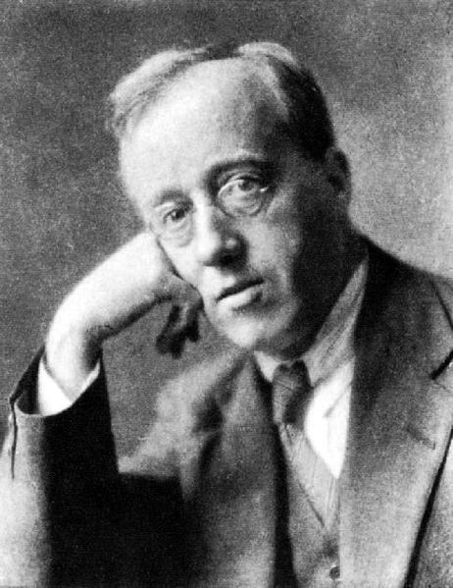
Find out about the composer
Gustav Holst
Lived from 1874 - 1934
He was a British composer
He was really interested in
space and astrology

Slide 6

Identify the metre
This music is counted in 5’s
Enjoy counting quietly up to 5 in time to the music
Try tapping your thighs on beat number 1
If this is easy try tapping on beats 1 and 4

Slide 7
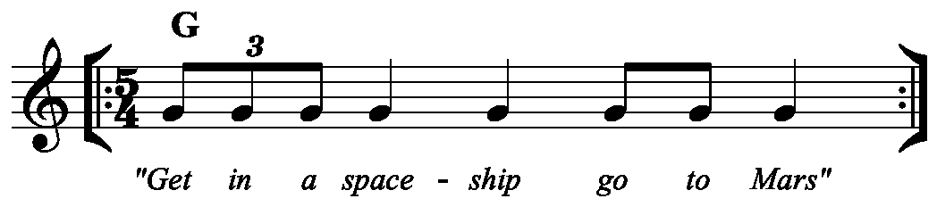
Identify the ostinato
An ostinato is a short repeated pattern
Here is the ostinato Holst used in Mars
Try whispering this ostinato/ words along to the music whenever it is heard
Get in a | space | ship | go to | Mars

Slide 8
Create your own ostinato
Create your own ostinato in 5 metre
Draw yourself a 5 box grid to use
You could use a word pattern or music notes
to create your ostinato
You can perform this ostinato as
part of your planet music later on

Slide 9

Get colourful!
Create a sponge painting inspired by this piece of music, start on the left side of your paper and move across to the right as the music progresses
What colours will you choose?
Will any of the colours overlap?

Slide 10
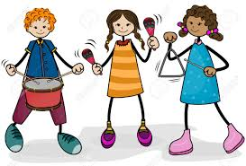
Finding your own sounds
Explore creating sounds to go with your painting, these could be vocal sounds, body sounds or instrumental sounds
Choose sounds for each part of your painting e.g. a different sound for each colour

Slide 11

Develop a performance
Share your picture and the sounds you have chosen to go with it with your friends
Do you want to include an ostinato in your performance? If so you will need to decide who will perform that.
Describe to them what each sound should be like – they are going to become your orchestra!

Slide 12
Putting it all together
Join together with your friends and take it in turns to play each others compositions.
Use your painting as a score
Find a long stick and move this slowly across your painting from left to right, the performers play their sound as the stick moves over it.

Slide 13
Perform your music
Perform your music to the rest of your friends
Record your performance so you can listen to your own performance.

Slide 14
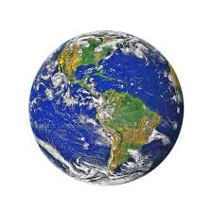
Still got time?
Compose your own music for Earth

Slide 15
Plan your Earth composition
Choose three words to describe the sort of music you intend to create e.g. gentle, spinning, fiery etc…
Identify key musical features you intend to include e.g. an ostinato, a strong steady beat, a row of notes to repeat (called a tone row)
Plan how to start and finish – will you include an introduction and a coda?
How will you remember your musical ideas?

Slide 16
Rehearse, perform and record your Earth music

Slide 17
Enjoy listening to Hans Zimmer’s composition about Earth
https://www.bbc.co.uk/teach/ten-pieces/classical-music-ks2-hans-zimmer-earth/zvg4vk7

