Slide 1

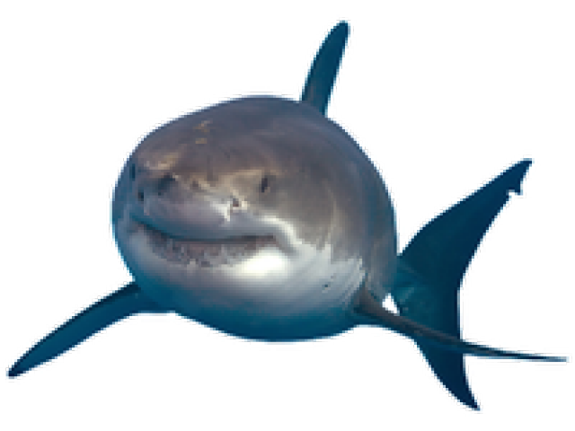

Keep Calm and
Make Music
Weekly Wonder
Aquarium - KS2

Slide 2




Click the image to listen to this piece of music
Can you think of three words to describe it?
Bubbly?
Calm?
Twinkly?
Rippling?
Quiet?

Slide 3


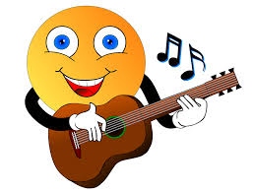
Use your voice to create a sound to match your first word
Use your body to create a sound match your second word
Use an instrument (or anything else you can find)
to create a sound match your third word
Word 1
Word 2
Word 3

Slide 4
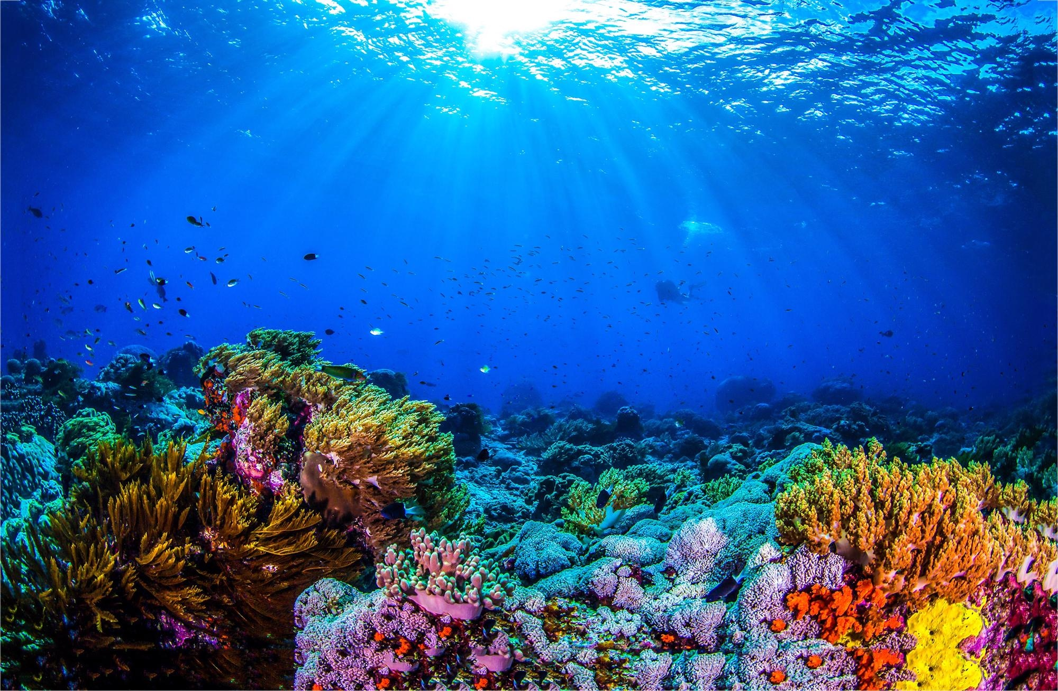
Let’s find out about the music we listened to
It’s called Aquarium
It was composed by a French man called Saint Saens
It is one of a set of pieces called
Carnival of the Animals

Slide 5
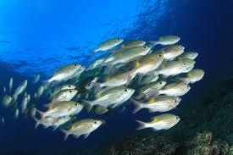
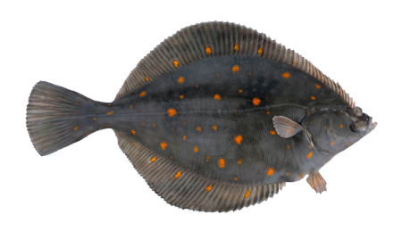
What types of fish might you see if you visited an aquarium?
Click the shark to visit The Sea Life Centre in London

Slide 6
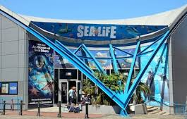
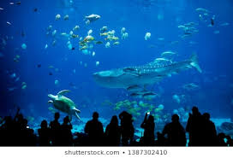
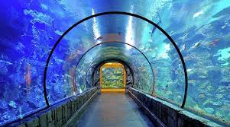
Imagine you are going on a trip to an aquarium

Slide 7
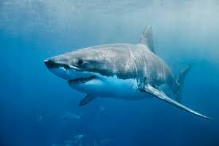
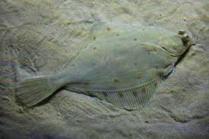
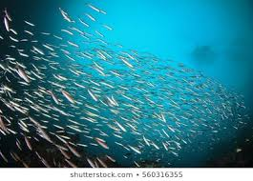
Imagine stopping and looking at the following types of fish:
The next three slides will help you to find
a sound to represent each of these
Predators
Camouflaged
fish
Shimmering
shoals

Slide 8
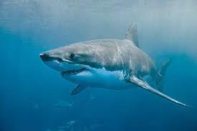
Create sounds to represent predator fish
Choose three words to describe a predator fish
e.g. a shark
Create a sound to go with each of your words. You could use your voice, body, an instrument or something else
Make a note of the sounds you have chosen so you can remember them

Slide 9
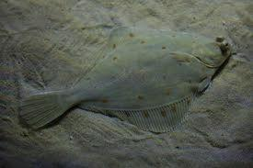
Create sounds to represent camouflaged fish
Choose three words to describe a camouflaged fish e.g. a plaice
Create a sound to go with each of your words
You could use your voice, body, an instrument or something else
Make a note of the sounds you have chosen so you can remember them

Slide 10
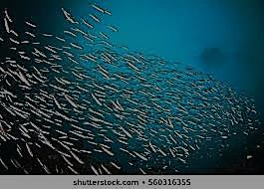
Create sounds to represent a shimmering shoal of fish
Choose three words to
describe a shimmering shoal
of fish e.g. a sardines
Create a sound to go
with each of your words.
You could use your voice,
body,
an instrument
or something else
Make a note of the sounds
you have chosen so you
can remember them

Slide 11

Create a sound journey about a visit to an aquarium
First you need to create some walking sounds
You could do this by:
walking on a hard floor so you can hear your own footsteps
Saying (and/ or tapping) the words wal-king, wal-king
Playing a steady beat on an instrument or something else

Slide 12


Next you need to structure your piece of music e.g.
Start by walking into the aquarium (play walking sounds)
Stop and admire some fish (play the sounds for your first fish)
Walk to the next tank (play walking sounds)
Stop and admire some different fish (next fish sounds)
Walk to the next tank (walking sounds)
Stop and admire some more different fish (last fish sounds)
Walk out of the aquarium (walking sounds)

Slide 13
Share your aquarium visit
Share your sound journey through an aquarium with someone else, you could either perform your journey live or record it to play to someone later or send to a relative or friend

Slide 14

Listen to this song …

Slide 15
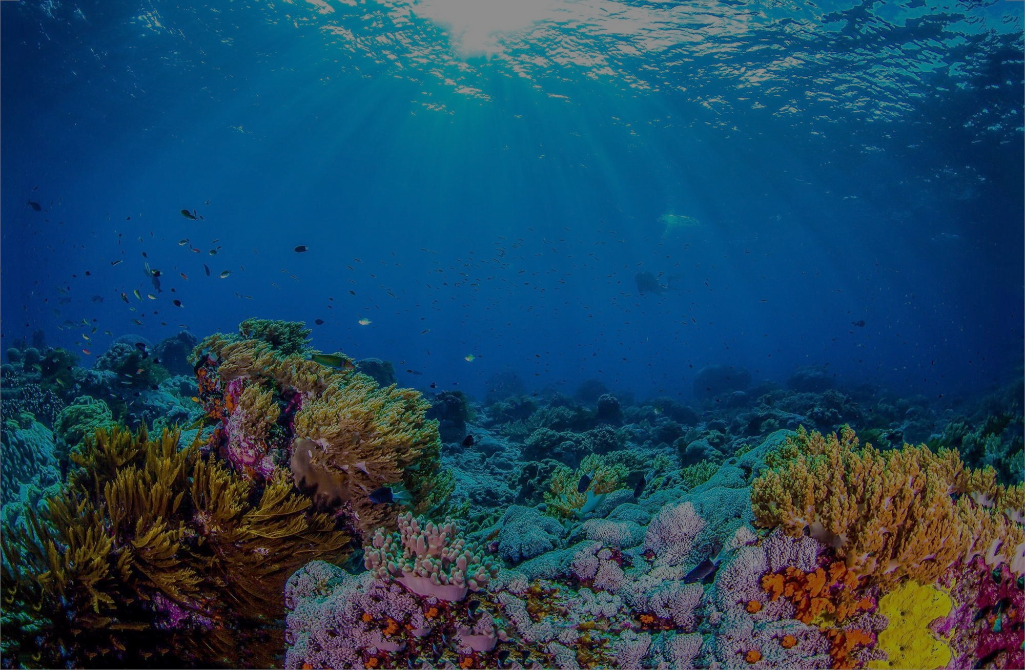
Listen to this song… what does it sound like?
Can you hear the voice singing underwater, underwater
Try joining in
Listen again and draw/write what else you hear in the song
Bubbles
Seaweed
Whales
Did you get them all?
Notes:
The underwater vocal line doesn’t stop throughout the song – it is an ostinato (if you want a posh musical word!)

Slide 16
Listen and sing
Try singing the words
Bubbles underwater, ripple way down deep
Seaweed underwater, floating way down deep
Whales underwater,, swimming way down deep
Try singing underwater, underwater all the way through the song……
Find someone to help you sing the song – one of you could sing all the words and the other could sing underwater all the way through
add some actions to the song

Slide 17
Well done!
Your music is
tanktastic!

