Slide 1


Keep Calm and
Make Music
Weekly Wonder
Grab the Rhythm
Y4 – Y6

Slide 2
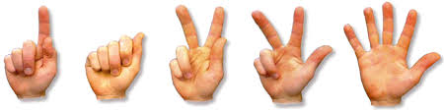
Grab the Rhythm!
Hand and body percussion

Slide 3
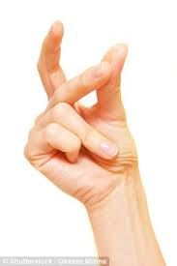

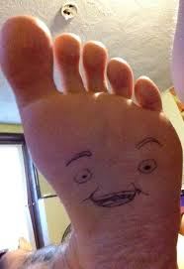
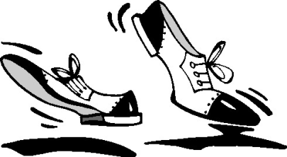
How many sounds…
can you make with your hands?
can you make with your feet?
Try them out
Make a note
Record them if you can
What other sounds can you make ?

Slide 4



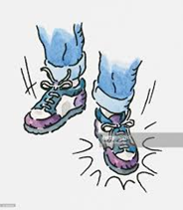
Hands and feet
Watch this clip clapping music
How many musicians?
What were your first impressions?
What does it make you want to do?
Listen again and make a note of ..
different and sounds / effects
Listen again – can you work out what the metre is for the music?
(Psst answers on the next page but don’t peep until you’ve had a go working it out!)

Slide 5
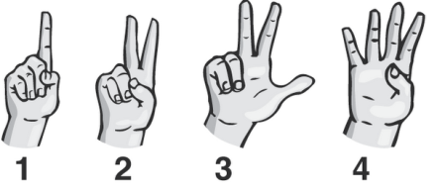
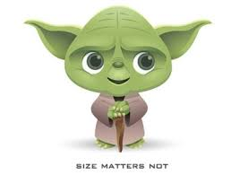
Counting in 4
The music you have just listened to is counted in groups of 4 beats To get into the 4 beat vibe try out these rhythm games
All in (see how good the grown ups are with this game too)
- count 1 2 3 4 and repeat, clap the 1 and tap the 2 3 4,
keep repeating
- call out a number to make silent – still count it just don’t make a sound
- call “all in” and put all the sounds back in
- choose different numbers to drop out
- try dropping 2 numbers
- try playing this with your favourite song
All out (bet you can catch the grown ups out with this one…)
- count 1 2 3 4 aloud (and when you can, just in your head)
- call out a number, clap on that number only
- call “all out” and it goes back to no claps
- try calling 2 numbers
- try with your favourite music
Are you feeling the 4s yet?

Slide 6
Music counting in 4
Watch this clip and keep the steady beat counting in 4 (first aloud then in your head)
Hall of the Mountain King
What happens to the music ? (see below*)
Can you copy any of the sequences that the body percussionists are using?
The opening phrase is:
chest/chest, lap/lap, click/click, clap, lap/lap, click, lap/lap, clap
You could try making up your own sequence which fits into 4 beats then perform it along with the clip
(*the music gets faster and faster)
It could be notated like this
 | 1 | 2 | 3 | 4 | 1 | 2 | 3 | 4
chest | xx
lap |  | xx |  |  | xx |  | xx
click |  |  | xx |  |  | x
clap |  |  |  | x |  |  |  | x
Notes:
The music gets faster and louder

Slide 7

You can do it too
Watch this clip of a 4 metre hand clapping game – listen to the explanation and see if you can play it too
hand clapping game
Break it down into manageable chunks
Which are the tricky bits?
Give them a bit of extra practise
Can you do it all the way through?
Can you teach it to someone else?

Slide 8

Hands, feet, action…
Watch this clip: Tarambe Percusion Corporal
It is also a piece of body percussion music in 4 metre
Watch it again and see if you can count 4 along with their music
The opening sequence could be notated like this – can you work out what the sounds are? (stamps / claps)
Try it out yourself
How many times do they repeat this phrase at the beginning of the piece?
If you enjoyed watching it, see if you can find out any more about the group
1 | 2 | 3 | 4 | 1 | 2 | 3 | 4
xx | xx | xx | xx | xx | xx | xx | xx
xx | xx | xx | xx | x |  | x | x

Slide 9
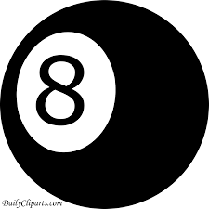


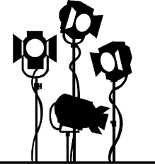
Now try 8s
Watch this clip clapping game…..
(no prizes this time for guessing it is counted in 8)
  Play the clip again and count the 8 beats
  Play it again and join in with the table taps around the circle
  See if you can work out the clap/tap/click sequence and have fun practising it until you can do it really well
      Show your parents or make a recording of it to share with someone else

Slide 10
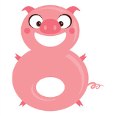






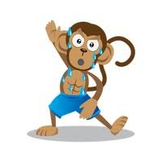

you need someone to play these with, and the more people, the better the game so see how many people you can convince to play
Try these games…
What’s my number?
- everyone chooses a number between 1 and 8 (keep it secret)
- count to 8 and repeat, everyone clapping on their chosen number
keep it going and see if anyone has chosen the same number as you
- try choosing a second number to stamp on and add it in with your
repeated clapped number
- try it with your favourite music or click below for “counting in 8”
Body bounce (use the music below the monkey to keep a steady 8beat count)
  - count to 8 with actions:
  1,2 stamp, stamp 3,4 tap thighs, tap thighs
  5,6 tap chest, tap chest 7,8 spread arms out, clap above head
- keep it going until you can perform the sequence without thinking
- try dropping out one of the actions but still count those
numbers e.g. 1 2 hold, hold 5 6 7 8
- have fun with the sequence
- see if you can make up your own version
- record it and send it to a friend so they can try yours
  counting in 8

Slide 11

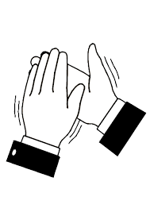
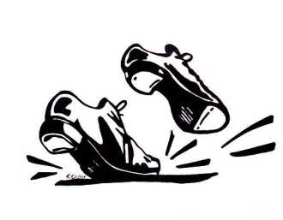

Lets go for the 7s challenge
Count to 7 aloud 4 times in a loop, emphasizing the 1st beat
Now add a stamp on beat 1 and keep repeating the count
Now add a clap on beat 2, so it goes stamp/clap 3 4 5 6 7 and repeat 4 times
Now try this:
the pattern goes:
stamp/clap/stamp/clap/stamp/clap/clap
Try repeating it over and over until it feels comfortable
…and now you’re ready….
 | 1 | 2 | 3 | 4 | 5 | 6 | 7
stamp | x |  | x |  | x
clap |  | x |  | x |  | x | x

Slide 12
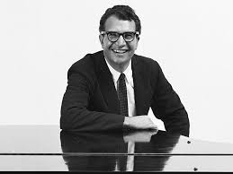

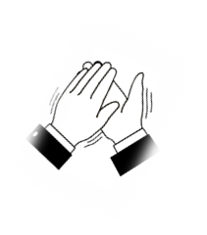

Unsquare Dance
Dave Brubeck
This piece of music was written by Dave Brubeck, a jazz composer in 1961
Watch this clip Unsquare Dance
What do you hear?
You should be able to hear your 7 metre stamp/clap pattern
Listen again and try performing the pattern along with the clip
You could try creating your own 7 metre stamp / clap pattern to try along with the clip. Print off the 7 metre grid on p13 if you would like to notate it
What else can you find out about Dave Brubeck?

Slide 13



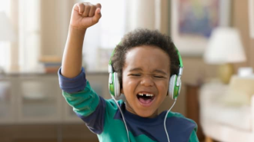

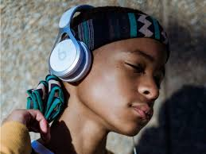


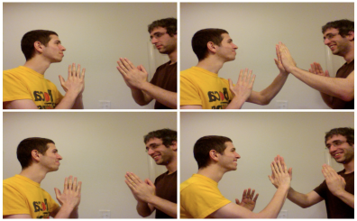
Have a listen…
And if you would like to investigate more body percussion music, here are a few more clips….but don’t stop here if you are interested, there are SOOO many more!
You will probably recognise this one… Bet you know this!
Notice how the performers link the drama of the song with the music
What do you like about it? Is there anything you might change?
This is a fun “end of year performance by a group of students finishing school to enjoy watching Hand Clap Skit
This is a piece which just uses clapping written by Steve Reich
Notice the notation underneath each pair of hands – it shows the pattern that each person is clapping. Clapping
Pause the clip and see if you can try some of the patterns out using the notation
If you haven’t had enough of counting in 7, try out this game – it is really fun and once you have got it you could make a video of it to send to someone else to cheer them up…or try teaching it and see how rhythmic your parents / carers are!
Sevens game

Slide 14
Grid in 7 metre
 | 1 | 2 | 3 | 4 | 5 | 6 | 7
stamp
clap

