Slide 1
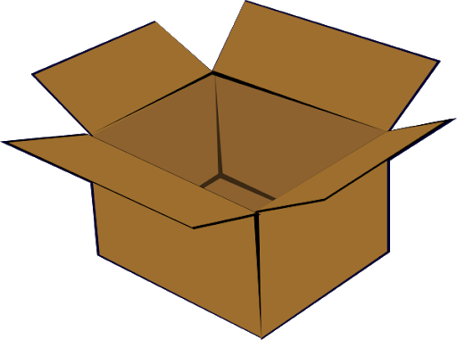
This is a box. True or false

Slide 2
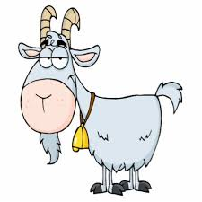
This is a bag. True or false

Slide 3

This is a bin. True or false

Slide 4
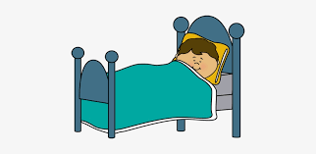
This is a bed. True or false

