Slide 1
ch, sh, th
Look at the pictures and write down if they begin with a ch, sh or th.
If you can do that easily, why not write the whole word for each picture

Slide 2
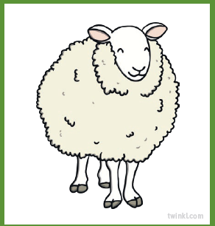

Slide 3
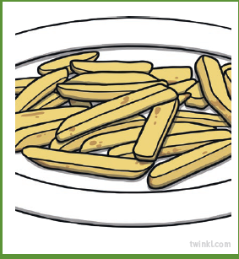

Slide 4


Slide 5


Slide 6


Slide 7


