Slide 1
Fill in the missing word

Slide 2
sheep
The
______
can run.

Slide 3
vet
A ________
helps ill pigs.

Slide 4
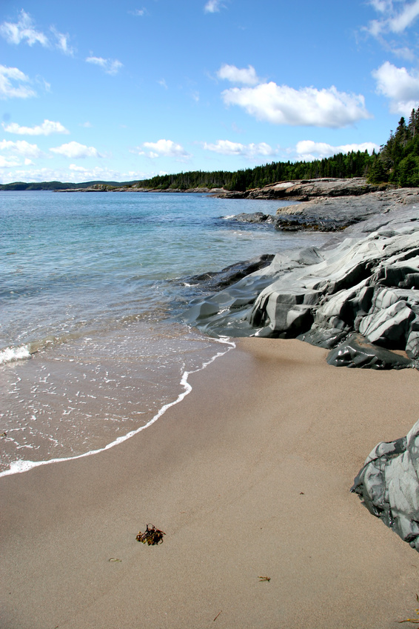

shell
That is a _______
in the sand.

Slide 5
shop
The chip _______
sells fish and chips.

