Slide 1
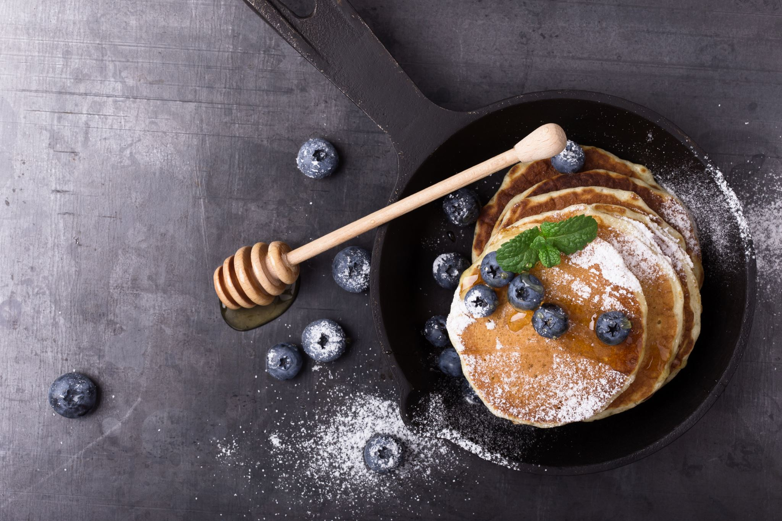

Shrove Tuesday
(Pancake Day)

Slide 2
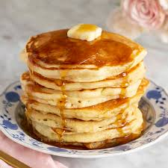
Shrove Tuesday is a Christian festival that has been celebrated for over 1000 years. It is also known as Pancake Day.
Shrove Tuesday marks the start of Lent. Lent is the time before Easter and lasts for 40 days (not including Sundays). During Lent, Christians historically gave up treats and rich food to help them focus on Jesus’ sacrifice.
Shrove Tuesday was the last chance to use up rich foods, such as milk and eggs. In the UK there are lots of traditions linked to what we now call Pancake Day.

Slide 3
England
Did you know?
’Shrove’ means to be forgiven for doing wrong.
Legend has it that in 1445, a woman heard the church bells ringing as she was making pancakes. Rather than be late, she ran to church still holding the frying pan and pancake!
Today, you can take part in a pancake race, wearing an apron, a hat or scarf and carrying a pan containing a pancake. You must flip your pancake three times during the race. The first person to cross the finish line at the church wins the race!

Slide 4
Northern Ireland
In the past, the eldest unmarried daughter would toss the first pancake. If it landed back in the pan, then she would be married that year; but if it didn’t or if she dropped it, she would stay unmarried.

Slide 5
Wales
On the evening before Shrove Tuesday, tin cans were kicked up and down the streets, to remember the task of putting away all the pots, pans and utensils. The Welsh make Crempogs, also known as ‘ffroes’, they are thicker than traditional pancakes.

Slide 6
Scotland
Scottish pancakes are smaller and thicker than traditional pancakes. They are called ‘drop scones’ or ‘dropped scones’.

Slide 7
How to make Pancakes
Ingredients
Flour
Eggs
Milk
Water
Salt
Butter or oil (to fry)
Method
First, mix all the ingredients together in a bowl to make a batter.
After that, put a little butter or oil into a frying pan.
Next, pour a little of the batter into the pan and fry it until golden.
Finally, choose a delicious topping.

