Slide 2
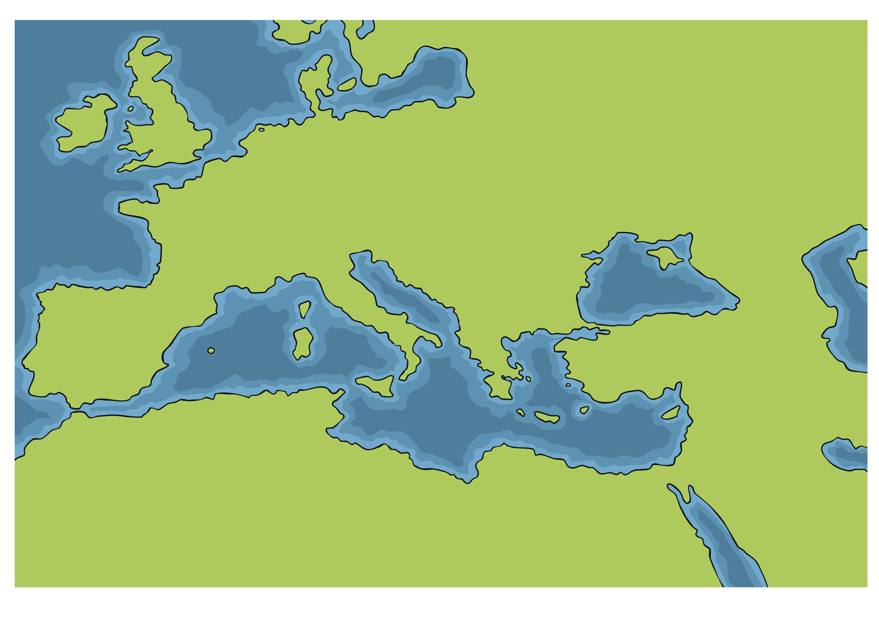
The Expansion of the Roman Empire
See how the land controlled by the Romans expanded from 800 BC to AD 305.

Slide 3
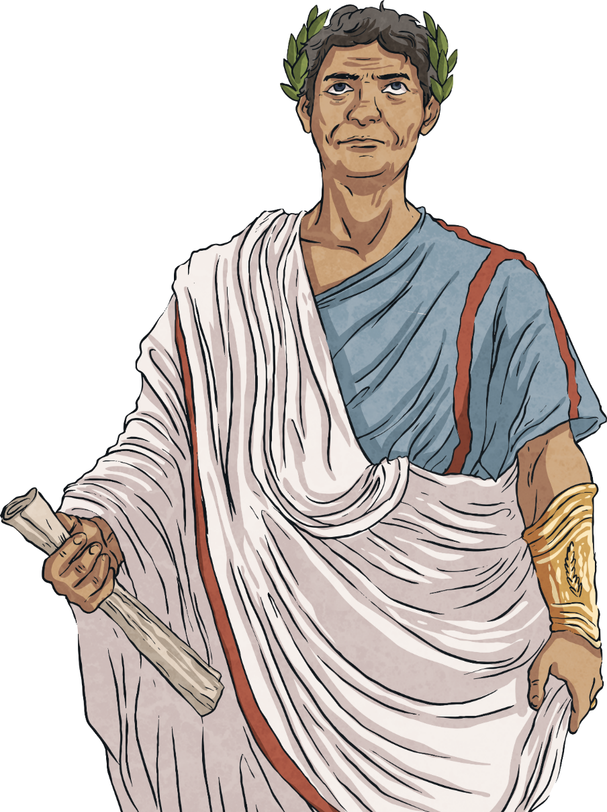
The Expansion of the Roman Empire
This expansion relied on the ability to move soldiers, weapons and equipment around the Empire. They needed to establish good trading routes and be able to communicate between different areas of the Empire. Because of this, the Romans became experts at building roads. In fact, their roads were so well built that some still exist today.

Slide 4
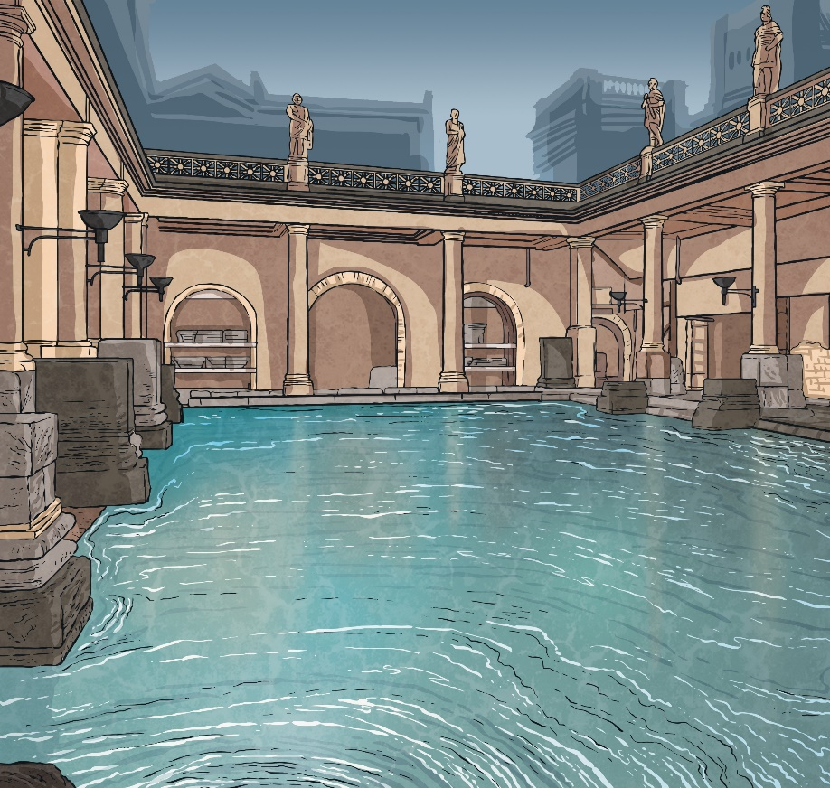
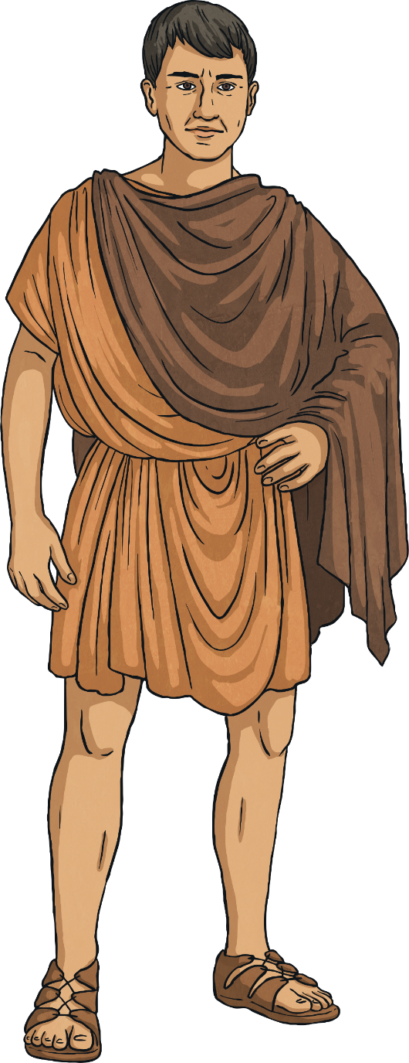
Roads before the Romans
It used to be thought that before the Romans, most roads in Britain were paths or muddy tracks linking local areas. However, recent archaeological discoveries have shown that while this is generally true, there are some examples of pre-Roman road building.
In 2011, archaeologists discovered the remains of a cobbled road in Shropshire. It is thought to have been built by the Cornovii tribe in the first century BC. This was one hundred years before the Romans arrived in Britain.
Click a word in bold to find out its meaning.

Slide 5
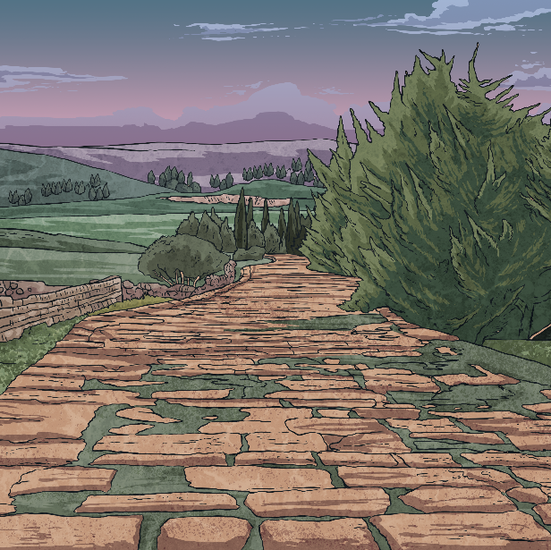
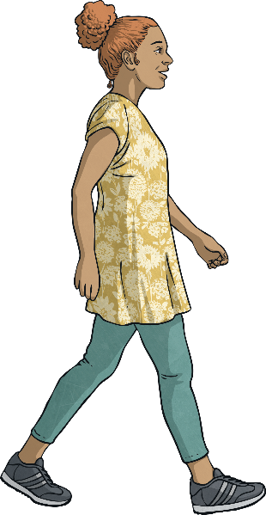

The Best Way to Travel
Choose someone to walk from the back of your classroom to the front twice. The first time, they should aim to walk in a straight line from back to front. The second time they should turn left and right a few times on their way to the front. Which way was the quickest?
Try It
Just like you have discovered, the Romans knew that the most efficient way to travel was in a straight line. A feature of Roman roads was how straight they were.

Slide 6
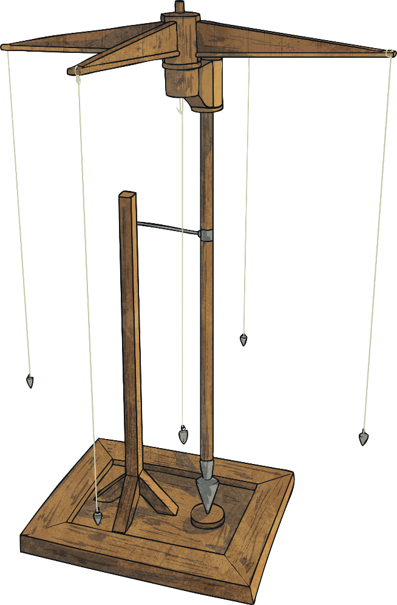
How Did the Romans Build Roads?
People who planned Roman roads were called agrimensores. Agrimensores used some simple tools to help them.
The decempeda, was a measuring stick. It was ten feet, and decempeda means 'ten feet’ in Latin.
To ensure their roads were straight, the Romans used a tool called a groma. This was made from pieces of wood nailed together to form a cross with right angles. On the end of each piece of wood was string with weights at the end. The agrimensore would send an assistant out with the decempeda and some wooden poles. The assistant would measure out a distance and then put a wooden pole sticking up from the ground. The agrimensore would then look to see if the wooden pole was in line with the piece of string hanging from the groma. If it was, the argrimensore knew that the line was straight and the road could be built.

Slide 7
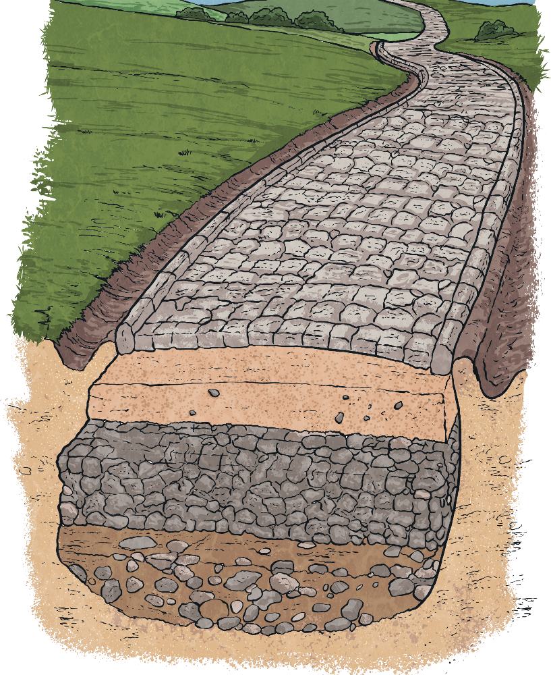
How Did the Romans Build Roads?
After the straight lines had been marked, 2 feet ditches were dug on either side for drainage.
A bank of earth called an agger was then built. The earth was built up more in the middle to create a curved surface called a camber. This meant rain falling on the road would drip down into the ditches.
Broken stones and gravel were then spread on top of the agger.
Flint, stone or any other available hard surface was then put on top of the gravel and then compacted (pressed down heavily).

Slide 8
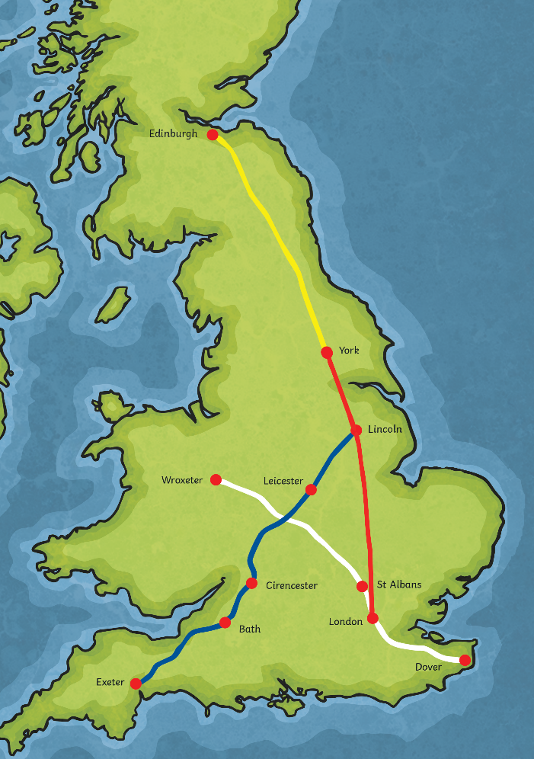
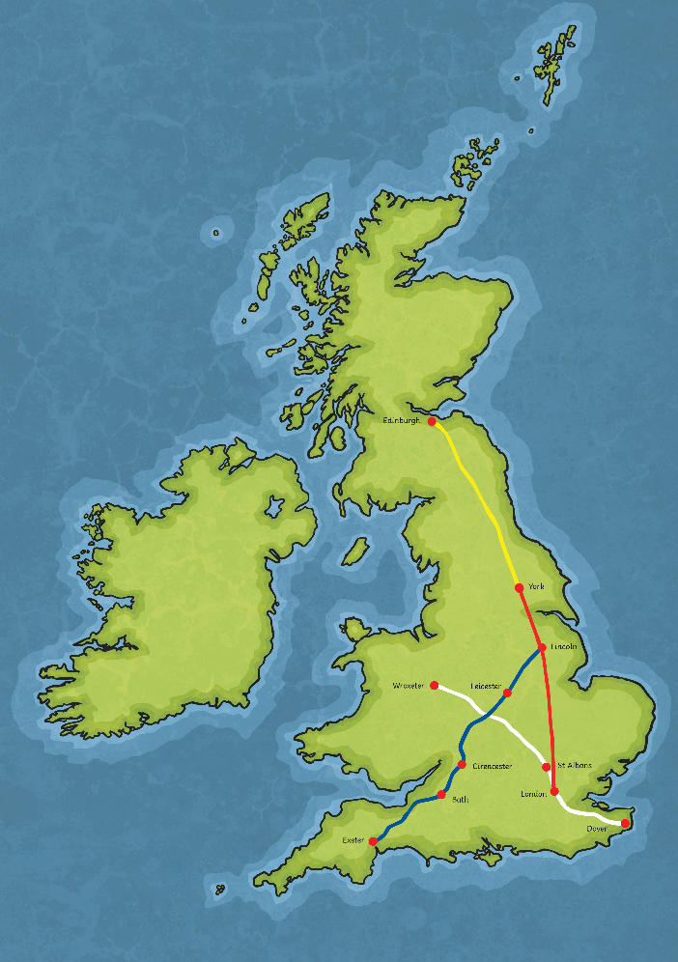
British Roman Roads

Slide 9

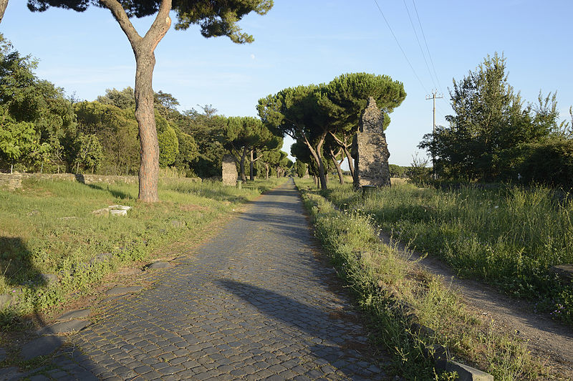
Roman Roads Today
Because they were so well built, some sections of Roman roads still exist today. Some of the best examples are the Devil’s Causeway in Northumberland, Wheeldale Moor in Yorkshire and Blackstone Edge, Greater Manchester. Part of Ermine Street south of Lincoln is a public footpath.
The routes chosen by the Romans for some of their roads were so good that they have been used for modern motorways. Part of the A38 in the Midlands follows the route of Icknield Street. Fosse Way in-between Lincoln and Leicester is now the A46. Parts of the A2 and the A5 follow Watling Street. Dere Street in York is the A1.
Appian Way, a Roman road in Italy.
A clue to whether a place had a Roman road is the word ‘street’ at the start of its name as in Streatley, or Streatham
Did You Know?
Roman road Italy by Livioandronico2013 is licenced by CC.2.0

Slide 10
Glossary
archaeological – The study of history and ancient history, often through digging on sites to find objects.
archaeologists – The people who study archaeology.

