Slide 1
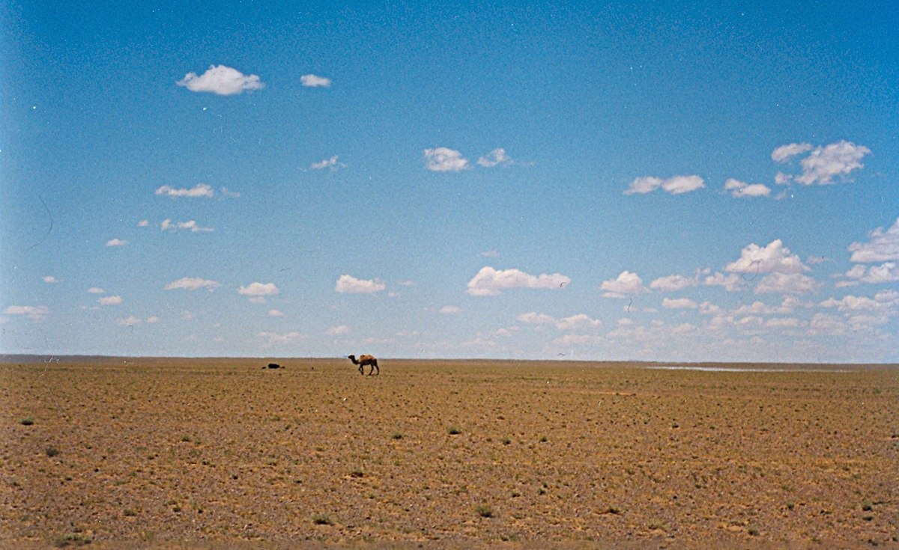


Lent:
Jesus tempted in the desert

Slide 2
Do you remember what Lent is?
Lent begins on Ash Wednesday, which is the day after Pancake Day.
It is the start of a very important time in the Christian Calendar.
What does Lent lead up to?
Lent leads up to Easter, the time that Christians remember Jesus’ death and resurrection.
Lent is 40 days long (not including Sundays).
Let’s explore why Lent is 40 days long.

Slide 3

Jesus Goes into the Wilderness
Before Jesus began His teaching, He was led into the desert by the Holy Spirit and spent 40 days and 40 nights alone to be with God.
During this time, He had no food (fasting) and was very tired.
Whilst Jesus was in the desert, the Devil
appeared, trying to test the strength of Jesus.

Slide 4





Jesus tempted in the desert
The Devil knew that Jesus was hungry. He told him that if he was indeed the Son of God, to turn the rocks nearby into bread.
The Devil knew Jesus could do this,
but Jesus knew that the Devil
was tempting Him and that it
was a trap and told him,
“Man shall not live on bread
alone, but on every word
that comes from the mouth
of God.”
No!

Slide 5




Next, the Devil took Jesus to the Holy City of Jerusalem and to the highest point of the temple. He told Jesus to throw himself off the temple.
“If you are the Son of God,” he told Jesus, “then God will protect you from harm.” But Jesus knew it was a trick and he told the Devil,
“Do not put the Lord your God to the test.”
No!

Slide 6



Finally, the Devil took Jesus to a very high mountain and told him “All the kingdoms of the world will be yours if you bow down and worship me.”
But Jesus said “Away from me Satan!
For it is written:
‘Worship the Lord your God,
and serve Him only’.”
God was very pleased with Jesus
and how he resisted the Devil’s
temptations. God sent his angels to care for him.
Jesus was ready to start teaching.
No!

Slide 7

Jesus resisted temptation
Jesus spent 40 days and 40 nights in the desert. He had no food. Whilst he was in the desert, the Devil tried to tempt him with food. The Devil made Jesus many promises, but each time Jesus told him ‘No!’.
Lent lasts 40 days, to remind Christians of Jesus’ sacrifices when he was in the desert and also of his refusal to be tempted by the Devil.

Slide 8
Why do Christians give
something up during Lent?
Today, many Christians mark Lent by trying to ‘give up’ something they like. It might be chocolate or something like video games.
They do this to remember Jesus was tempted by the devil just like we are and He resisted – this made God happy.
Christians can show God that they can also say no to temptation, just as Jesus did.

Slide 9

When does Lent finish?
Lent ends on Easter Sunday.
All of Jesus’ life He resisted temptation and obeyed God, even when He was on the cross. At Easter, Christians remember
Jesus’ sacrifice, His death on the cross and His resurrection.

Slide 10
This Photo by Unknown Author is licensed under CC BY-SA

