Slide 1

What does God think of me?

Slide 2

Psalm 139
Click on the video link below
https://www.youtube.com/watch?v=7eQ7D-A00Bw

Slide 3
O Lord, You have searched me and you know me.

Slide 4
You know when I sit down and when I get up.

Slide 5
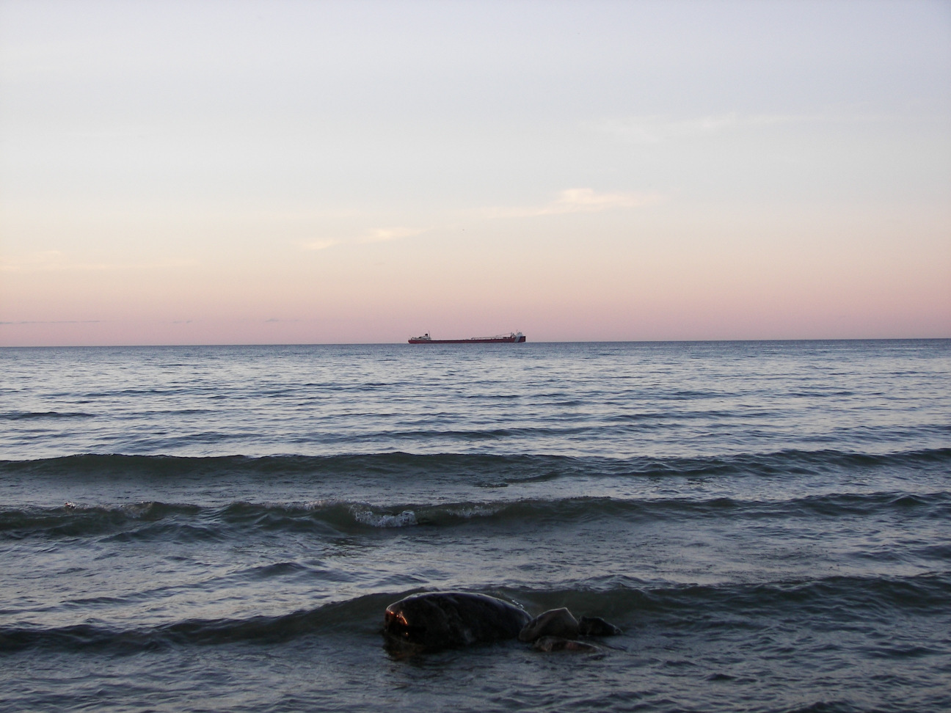
You understand my thoughts
from a long way off.

Slide 6
You know when I go out and when I lie down; You know everything about me.

Slide 7
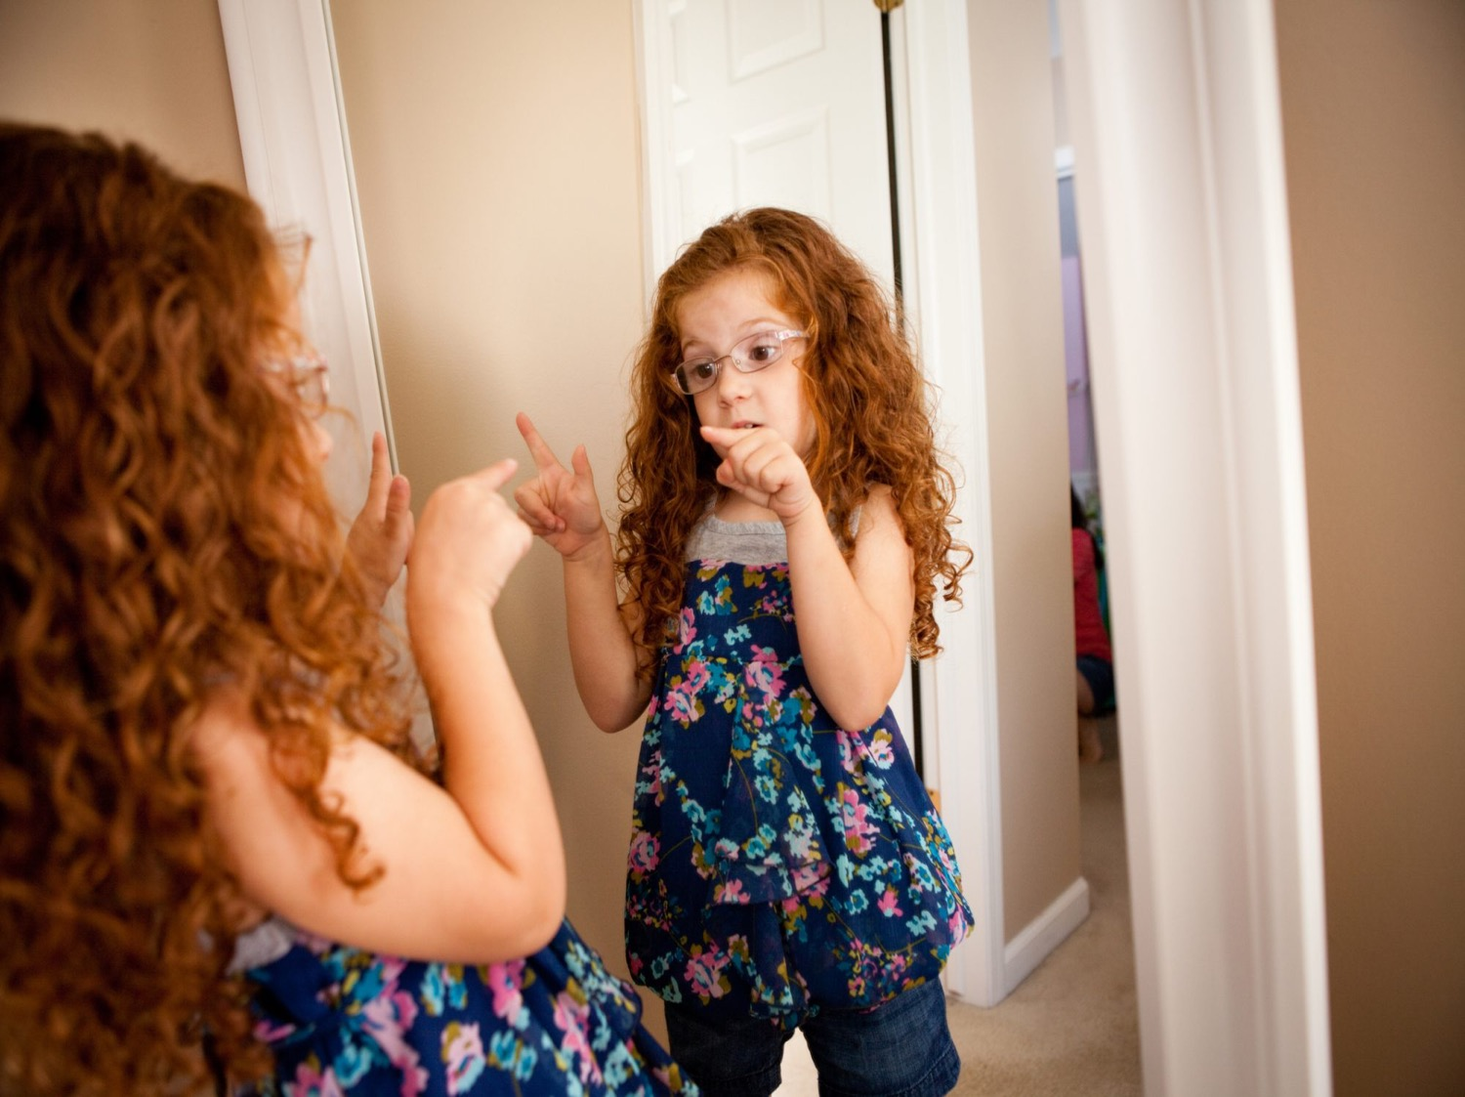
You know what I’m going to say before I say it.

Slide 8

You are all around me;

Slide 9

You hold my hand.
It’s too amazing to think about.

Slide 10

You are with me wherever I go-
You are up in the heavens.

Slide 11

You are at the bottom of the sea.

Slide 12
If I rise on the wings of the dawn, you are still there.

Slide 13

You are still with me even if I cross the sea.

Slide 14

You knit me together in my mother’s womb.
I am fearfully and wonderfully made.

Slide 15

Every day of my life was planned by you before it even happened.

