Slide 1
Cvcc words with vowel digraphs

Slide 2
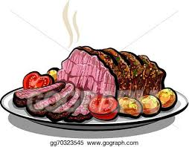
roast

Slide 3
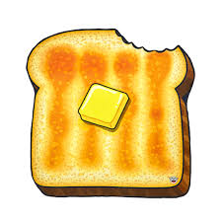
toast

Slide 4

boost

Slide 5
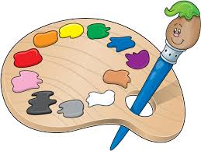
paint

Slide 6
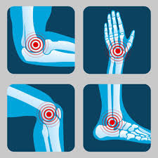
joint

Slide 7
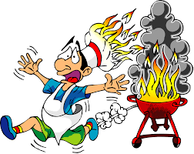
burnt

