Slide 1


Slide 2
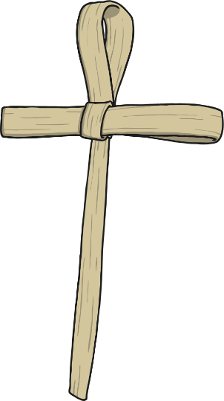
When Is Lent?
Lent begins on Ash Wednesday.
(The day after Shrove Tuesday/Pancake Tuesday.)
Lent lasts for 40 days. It starts on Ash Wednesday and ends on Easter Sunday. However, if you look at a calendar and count the days, there are more than 40 days. Lent is actually 46 days, however the six Sundays are excluded because there is no requirement to fast on Sundays in Lent.

Slide 3

What Does Lent Mean?
Lent comes from the Middle English word ‘lenten’ or the Old English ‘lencten’, both of which mean the season of spring.
For Christians, Lent is the time of reflection and remembering when Jesus was tempted by Satan in the desert.
By sacrificing eating something or giving something up, we remember Jesus’ sacrifice and prepare for the time of Easter.

Slide 4

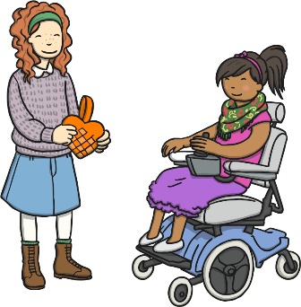
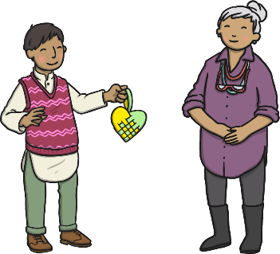
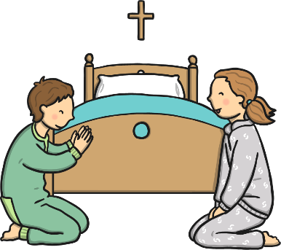
What Three Things Do Christians Do During Lent?
Fasting
Giving
Praying

Slide 5
What is Fasting?
Fasting in the Bible means to break from eating food and drink.
Jesus taught His disciples to fast and many Christians do this during lent.
Some Christians find this very hard to do and choose to give something else up instead.
What could you give up for Lent?

Slide 6
What is Giving?
What could you give to the poor?
In the New Testament God Himself gave us His only Son because He loves us so much; and His Son died for us on the cross.
This demonstrates God’s sacrificial giving to all people.
Christians show their love for God by giving money, gifts and time to the poor.

Slide 7
What is Praying?
Prayer is the human mind seeking the mind of God.
Jesus taught His disciples how to pray by teaching the ‘Lord’s Prayer’.
As part of praying, Christians can ask God for things that would please Him. The Bible tells us that God loves to give good gifts to His children. So, if we have faith in God, He will hear our prayers.
What could you pray to God for?

Slide 8
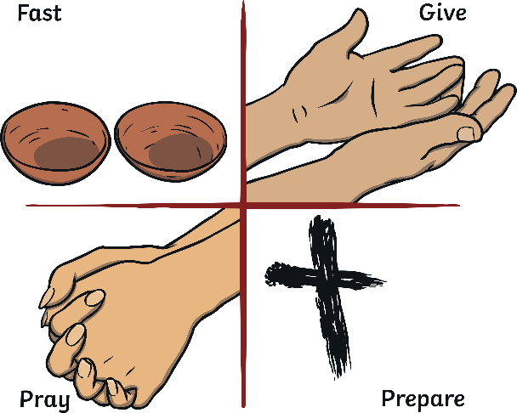
How Can People Remember What God Sacrificed?
Giving up some treats or home comforts helps Christians to remember how much Jesus sacrificed.
When they can’t have what they want, Christians spend that time in prayer remembering what Jesus did on the cross and thanking God for His sacrifice.
How could you remember Jesus’ sacrifice?

Slide 9



