Slide 1
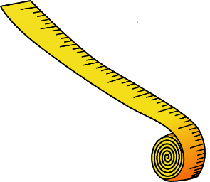
suffix -sure
suffix -ture
_sure _ture
[zh]
[ch]
measure
vulture

Slide 2
suffix -sure
leisure
[zh]

Slide 3
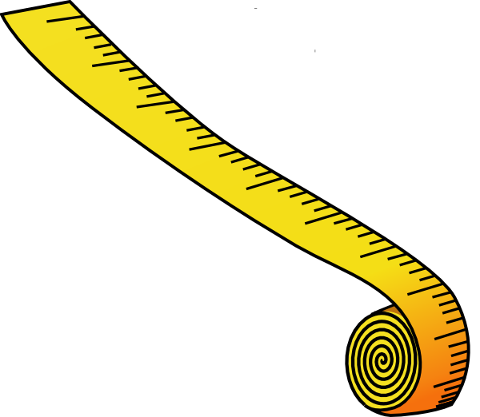
suffix -sure
measure
[zh]

Slide 4

suffix -sure
pleasure
[zh]

Slide 5

suffix -sure
closure
[zh]

Slide 6
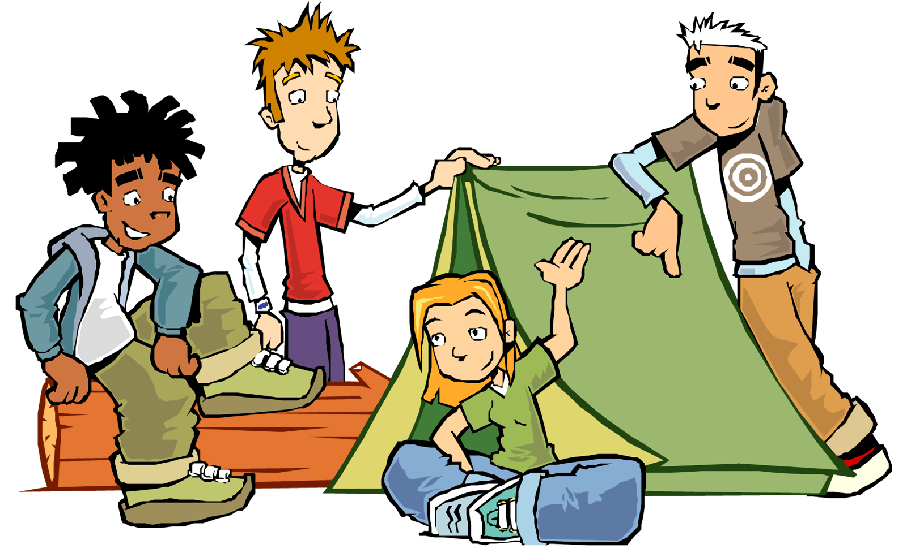
suffix -ture
adventure
[ch]

Slide 7
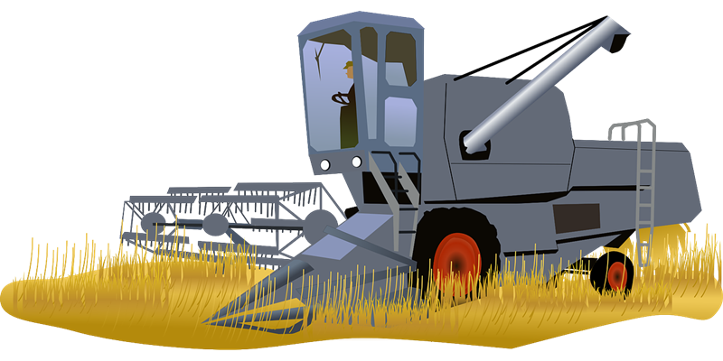
suffix -ture
agriculture
[ch]

Slide 8
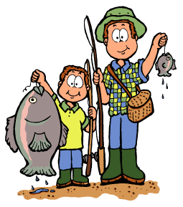
suffix -ture
capture
[ch]

Slide 9
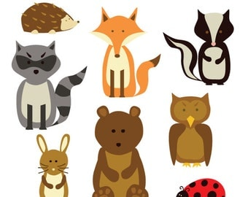
suffix -ture
creature
[ch]

Slide 10

suffix -ture
culture
[ch]

Slide 11
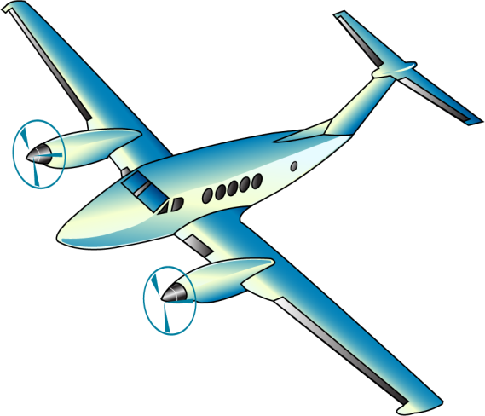
suffix -ture
departure
[ch]

Slide 12

suffix -ture
feature
[ch]

Slide 13
suffix -ture
fracture
[ch]

Slide 14
suffix -ture
furniture
[ch]

Slide 15

suffix -ture
future
[ch]

Slide 16

suffix -ture
gesture
[ch]

Slide 17

suffix -ture
immature
[ch]

Slide 18

suffix -ture
lecture
[ch]

Slide 19

suffix -ture
literature
[ch]

Slide 20
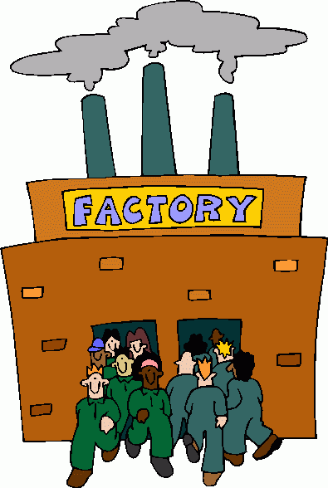
suffix -ture
manufacture
[ch]

Slide 21
suffix -ture
mature
[ch]

Slide 22
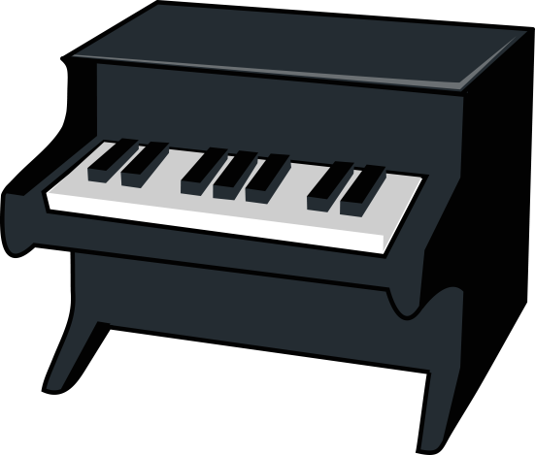
suffix -ture
miniature
[ch]

Slide 23
suffix -ture
mixture
[ch]

Slide 24
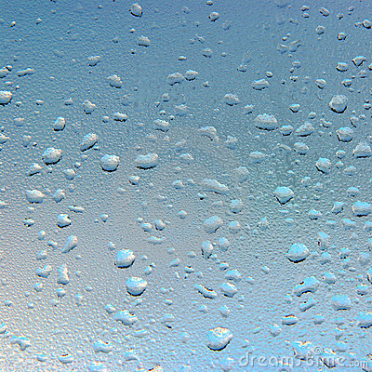
suffix -ture
moisture
[ch]

Slide 25

suffix -ture
nature
[ch]

Slide 26
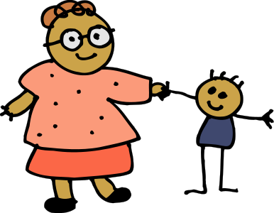
suffix -ture
nurture
[ch]

Slide 27
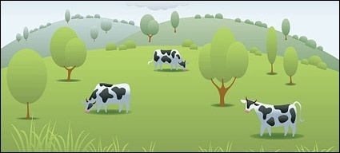
suffix -ture
pasture
[ch]

Slide 28
suffix -ture
picture
[ch]

Slide 29
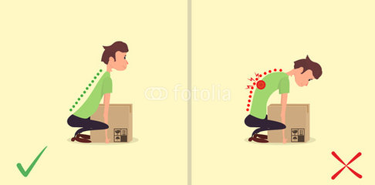
suffix -ture
posture
[ch]

Slide 30
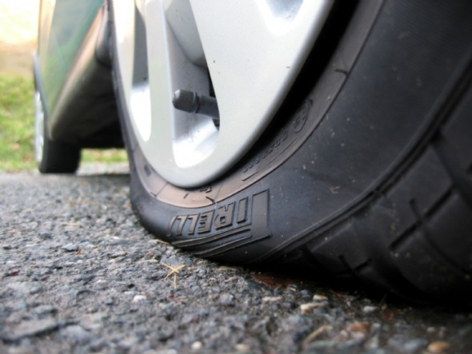
suffix -ture
puncture
[ch]

Slide 31
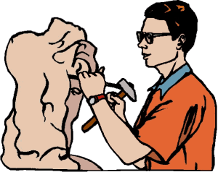
suffix -ture
sculpture
[ch]

Slide 32
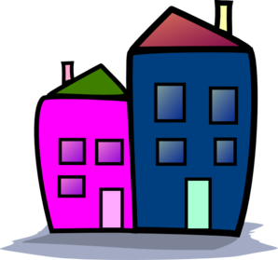
suffix -ture
structure
[ch]

Slide 33
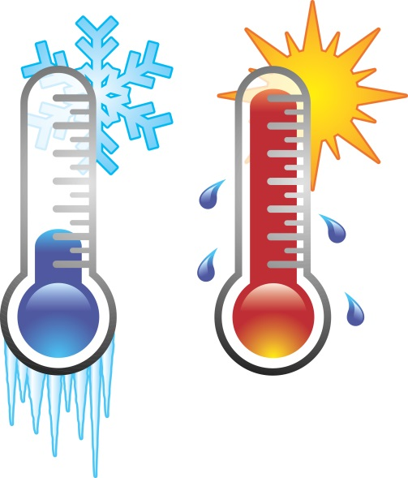
suffix -ture
temperature
[ch]

Slide 34
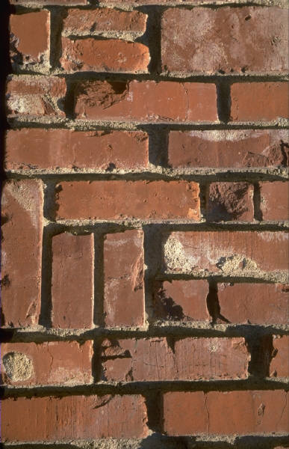
suffix -ture
texture
[ch]

Slide 35

suffix -ture
venture
[ch]

Slide 36
suffix -ture
vulture
[ch]

