Slide 1

How do Tom and Tess use crosses to celebrate Easter at home and at church?

Slide 2
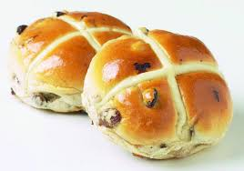
Do you recognise the shape on top of the bun?
Hot cross buns are traditionally eaten on Good Friday, the day Jesus died.
What do you remember about Jesus and the cross?

Slide 3
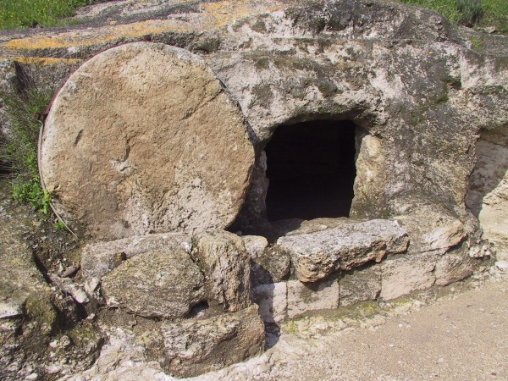
The bible says that after Jesus died on a cross, he was buried in a cave with a big round stone in front of it.

Slide 4

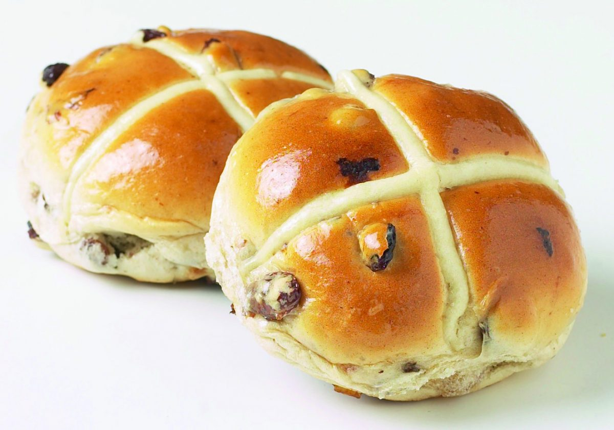
Easter is an exciting time for Tom and Tess. On Good Friday they make hot cross buns with Mummy.
Whilst they eat their buns they look at the crosses and remember that Jesus died on a cross and was buried in a tomb (cave).
Tom – it’s like the cave Jesus was buried in
Tess- its like the stone door of the cave.
What do you think?

Slide 5
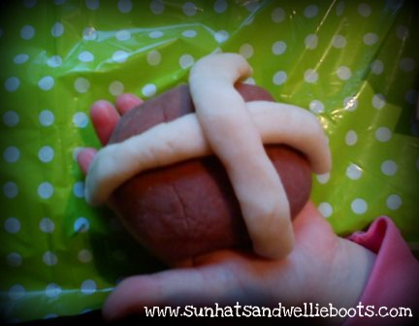
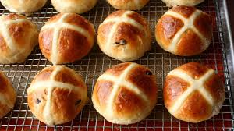
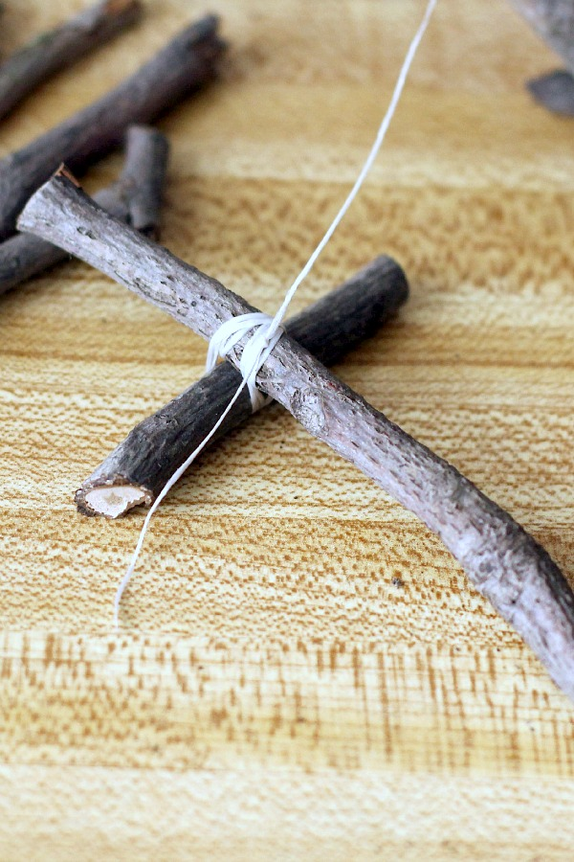
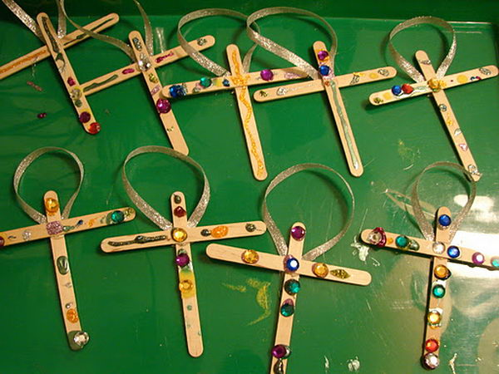
Have a go at making some hot cross buns yourself – you can use playdough or ingredients. If you don’t have any of the above, why not draw some or make some crosses using sticks.

Slide 6
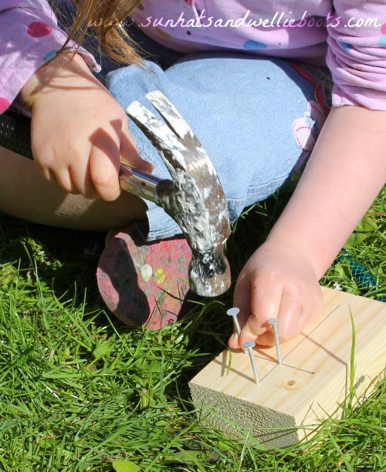
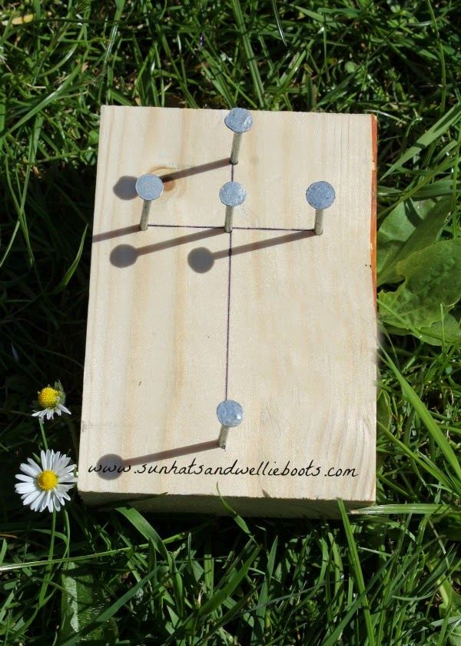
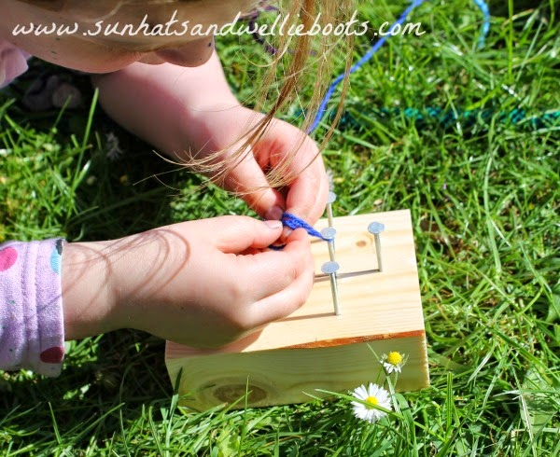
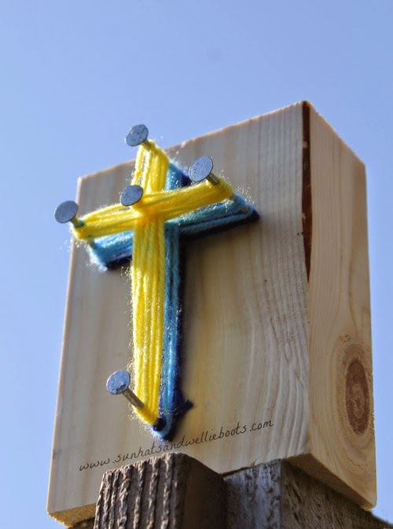
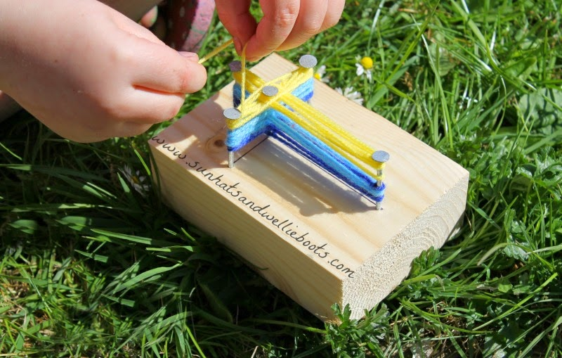
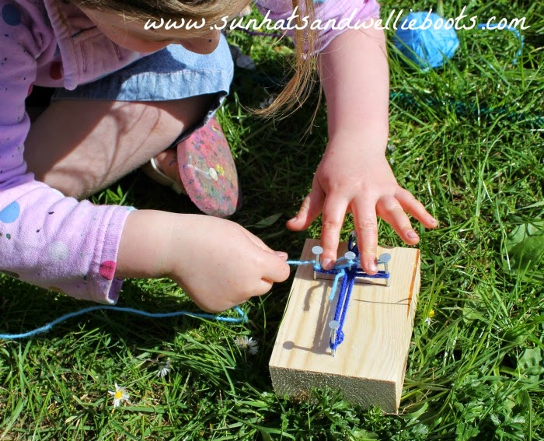
Or you could try a string cross like below!

