Slide 1
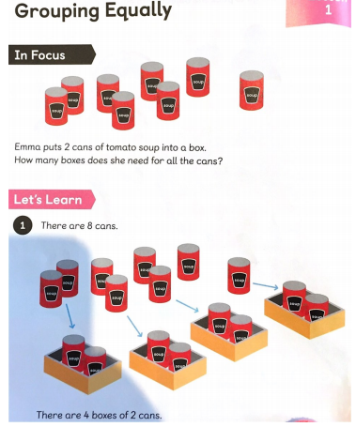
Emma needs to put her cans into groups of 2.
How many groups will she have?
Emma puts 2 cans of soup into each box until there are no cans left.
There are 4 groups.
Why don’t you try it with objects to check!

Slide 2
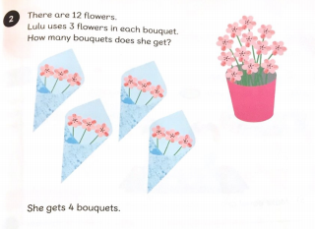
Lulu needs to put her flowers into groups of 3.
How many groups will she have?
She has 4 groups.

Slide 3
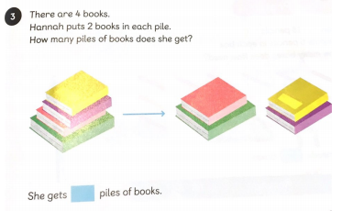
2
Can you fill in the blank? How many groups does Hannah have?

