Slide 1


Geography
Sensational Safari
Year One
Geography | Year 2 | Sensational Safari | Marvellous Maasai | Lesson 5

Slide 2
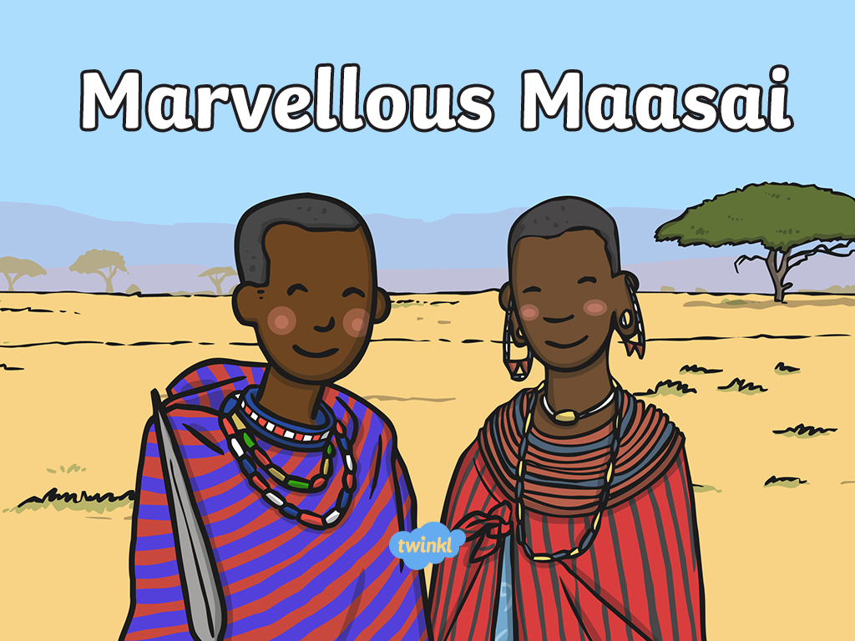

Slide 3
Aim
I can understand what the Maasai culture is like.
Success Criteria
I can describe 3 things about the Maasai people and culture.
I can begin to understand some similarities and differences between the Maasai culture and my own culture.

Slide 4

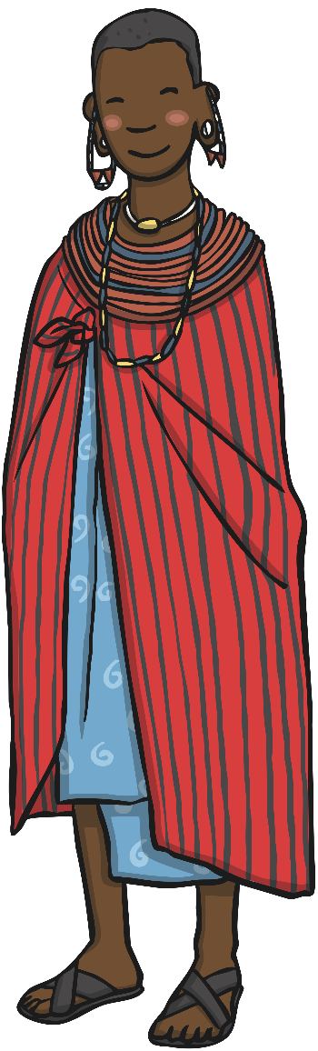
Key Words
Maasai tribe
culture
tradition
jumping dance
warriors
competitive
mud huts

Slide 5


Match It!
A protected area of land, but humans can live there and carry out other activities such as fishing, road
building, mining and gathering wood.
savannah
migrate
A protected area of land where only tourism and
research is allowed. No humans live there.
Big Five
The natural home of a plant or animal.
habitat
Grassland with shrubs and trees.
Not much rain falls.
national park
A species of animal or plant that is at risk of becoming extinct because their habitat is being destroyed, hunting or climate change.
game reserve
To move from one place to another.
endangered
A group of animals – African lion, African elephant, Cape buffalo, African leopard and white/black rhinoceros.

Slide 6
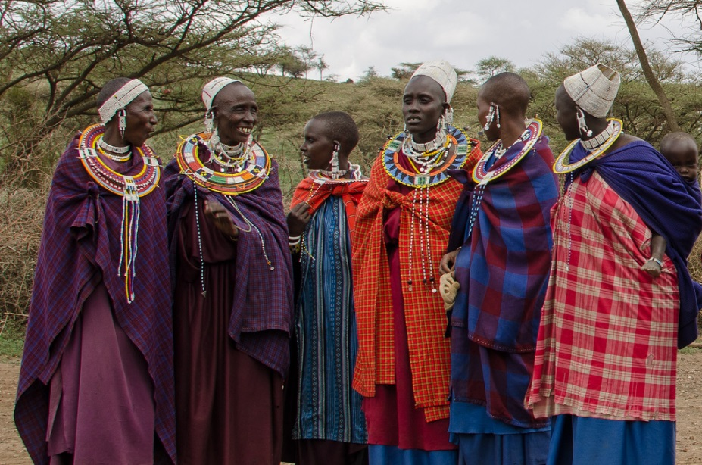
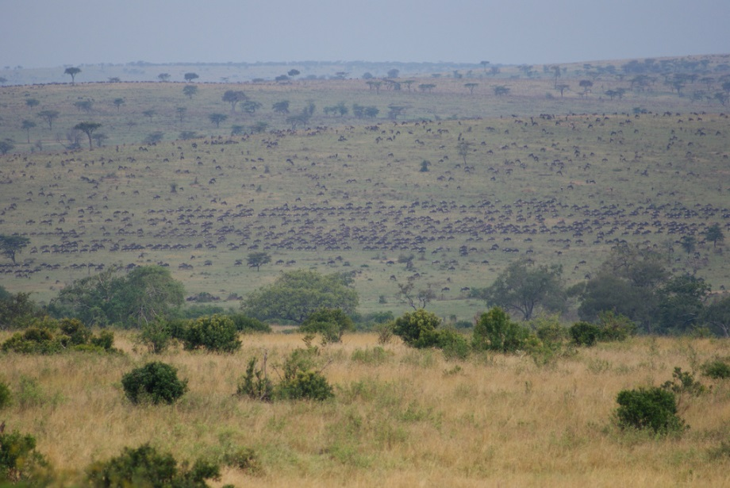
The Marvellous Maasai
The most popular reserve in Kenya is the Maasai Mara National Reserve, which can be found in the south west of the country. It is named in honour of the Maasai tribe who live in the area.
The Maasai Mara National reserve is famous world over for its large amount of wildlife, including all members of the ‘Big Five’.
The name ‘Mara’ means ‘spotted’, which is what the land looks like from a distance with trees, clouds and grass!
Photo courtesy of QuakeUp! And JULIAN MASON (@flickr.com) - granted under creative commons licence - attribution

Slide 7
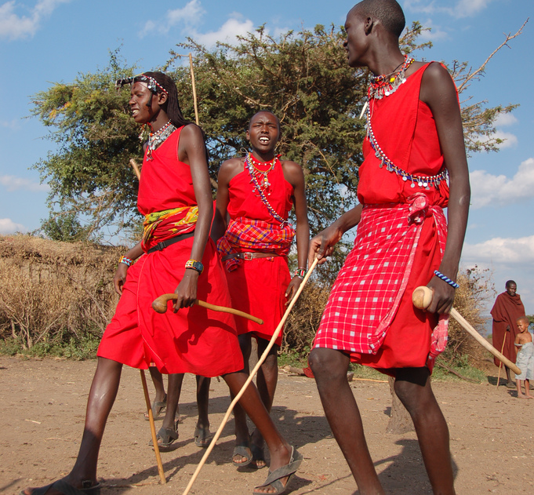
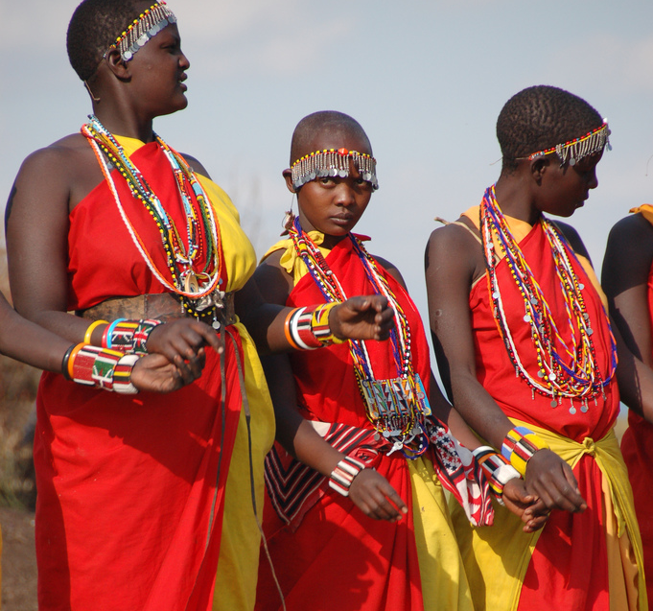
The Marvellous Maasai
What is culture? Can you describe some things about your own culture?
We are going to look at what the Maasai culture is like…
Photo courtesy of The Dilly Lama (@flickr.com) - granted under creative commons licence - attribution

Slide 8
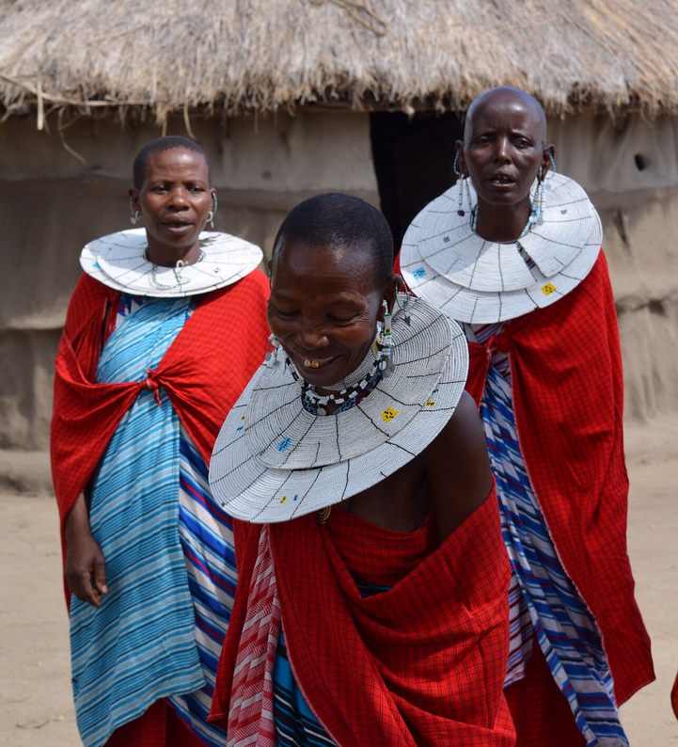
All About the Maasai
Who are the Maasai people?
The Maasai tribe live in the African savannahs.
The Maasai tribe share the same ideas and way of life.
They use the land as their home and all live together.
Photo courtesy of Chrissy Olson (@flickr.com) - granted under creative commons licence - attribution

Slide 9
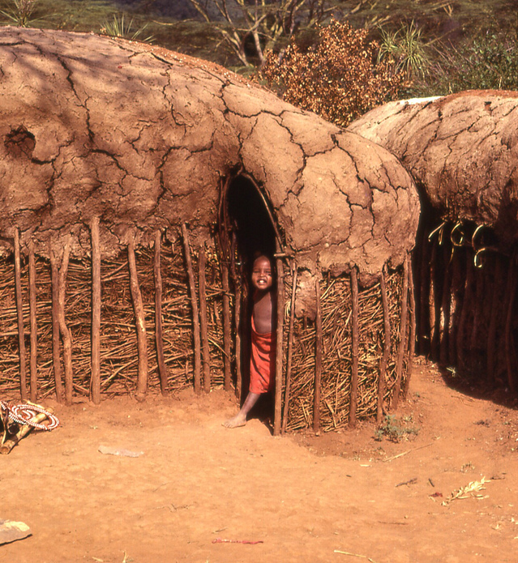
All About the Maasai
Where do they live?
The Maasai tribe live in the Maasai Mara, which is a very large savannah and home to many of the great species of wildlife and plants.
The Maasai people traditionally
live in mud huts made by the
Maasai women.
They are made from mud, sticks, grass and cow dung.
The Maasai families often live with their animals too. They are very careful to protect them from the big predators that roam the savannah.
Photo courtesy of gbaku (@flickr.com) - granted under creative commons licence - attribution

Slide 10
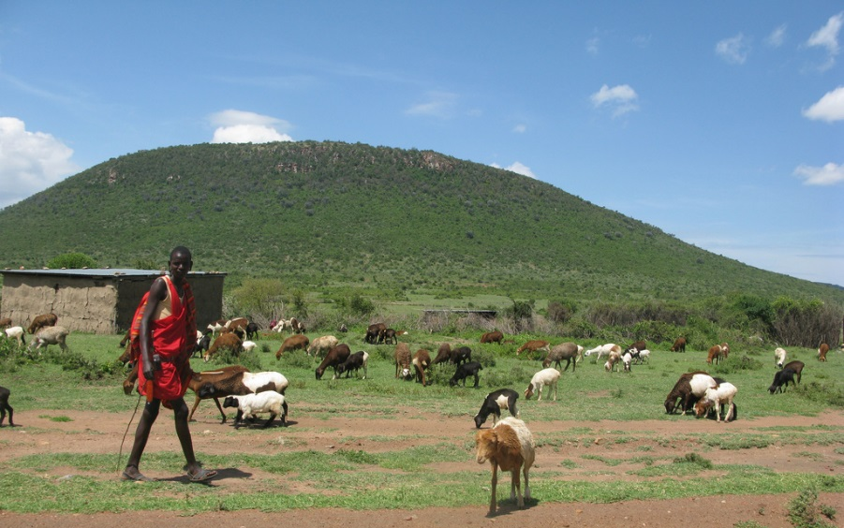
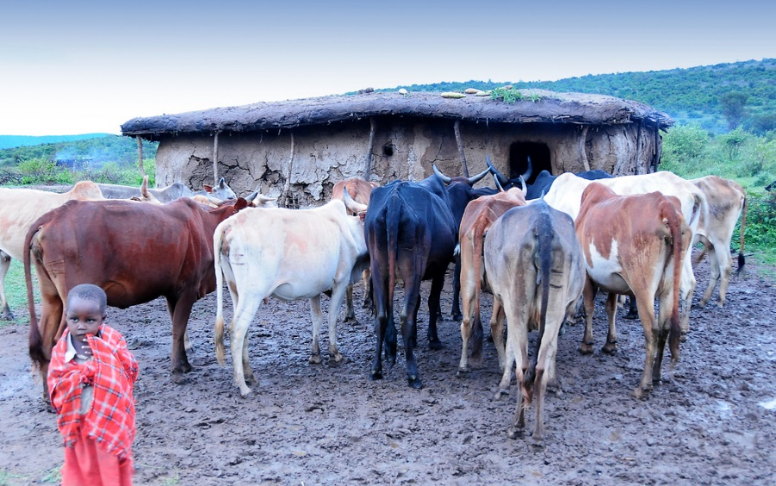
All About the Maasai
Ways of Life: Farming
Many Maasai people own large herds of cows, goats and sheep.
Animals are very important to the Maasai people. They often drink the blood and milk from the animals and use them for meat too.
Photo courtesy of VSmithUK and henribergius (@flickr.com) - granted under creative commons licence - attribution

Slide 11
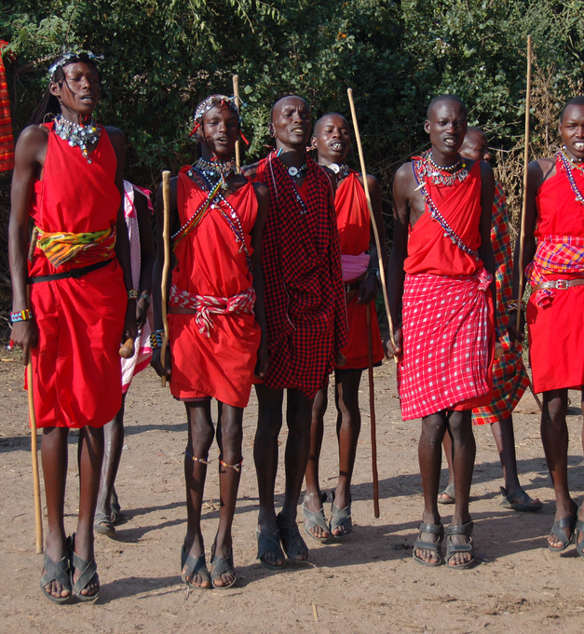
All About the Maasai
Ways of Life: Leading the Tribe
Maasai men are traditionally in charge of their tribe.
They wear bright red clothes. Red is one of their favourite colours.
Traditionally, the Maasai men go out to hunt animals to provide food for their families.
Photo courtesy of The Dilly Lama (@flickr.com) - granted under creative commons licence - attribution

Slide 12
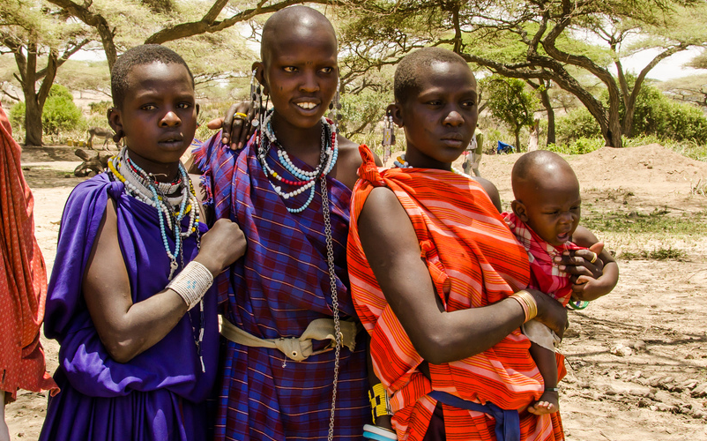
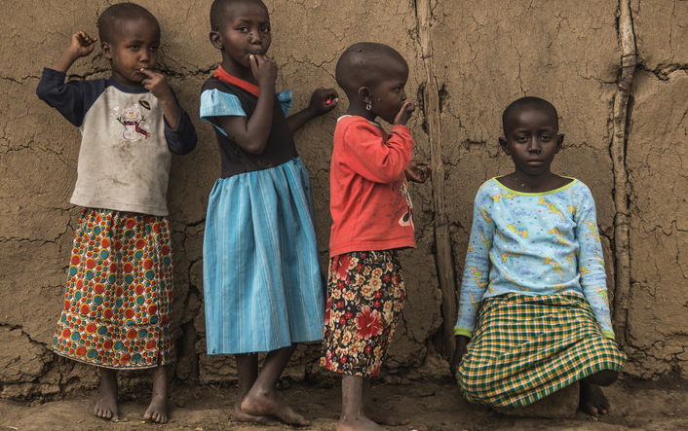
All About the Maasai
Ways of Life: Maasai Women and Children
Maasai women traditionally look after the children in their families.
They wear lots of jewellery, such as beads. The more beads that they wear, the richer they appear to look.
Photo courtesy of Illustrated in Blue and QuakeUp! (@flickr.com) - granted under creative commons licence - attribution

Slide 13
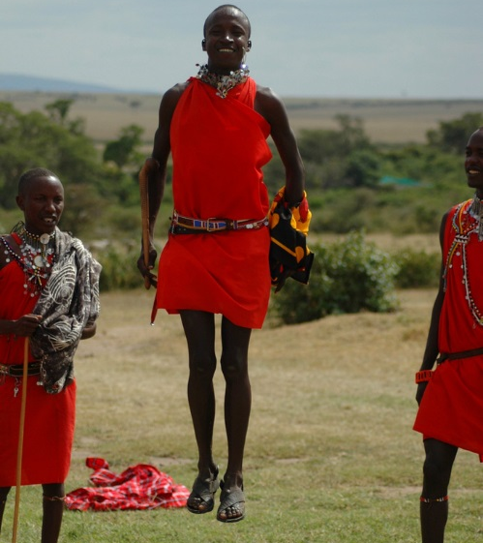
All About the Maasai
Ways of Life: The Jumping Dance
The Maasai tribe love music and dance; both are very special in the Maasai culture. They sing lots of songs together and wear their
best clothes.
The Maasai men perform a special dance, called the jumping dance, when they are showing off
to women!
Tourists that visit the reserve often enjoy watching the jumping dance.
Photo courtesy of Jess & Kate (@flickr.com) - granted under creative commons licence - attribution

Slide 14
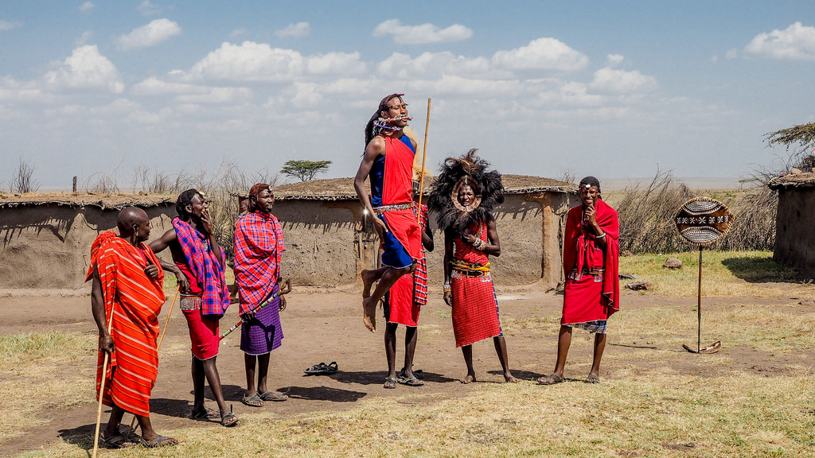
All About the Maasai
Watch this video clip about the jumping dance.
Photo courtesy of fotopamas (@flickr.com) - granted under creative commons licence - attribution

Slide 15

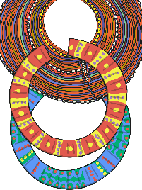
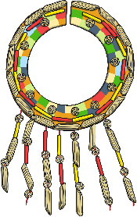

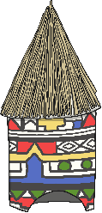
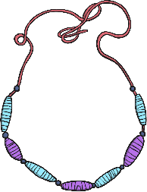
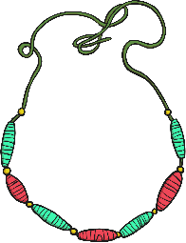
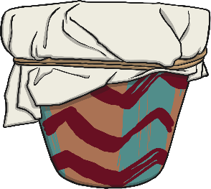
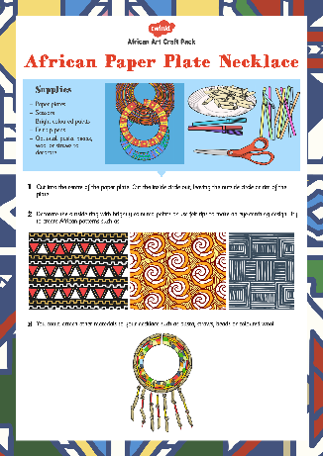
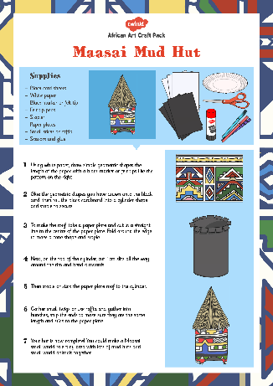
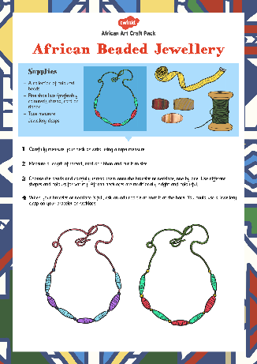
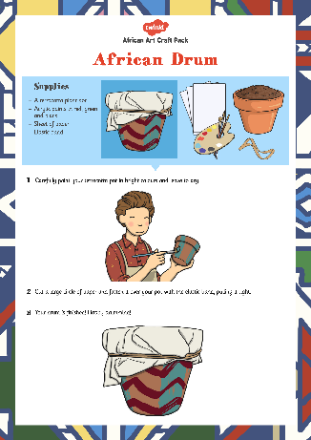
Amazing African-inspired Crafts
These instructions will help you to take part in some African-inspired crafts.
Maasai paper
plate necklace
Maasai mud huts
African bead jewellery
African drum

Slide 16
Jump to It!
You are going to try the Maasai jumping dance. How high can you jump?
Photo courtesy of fotopamas (@flickr.com) - granted under creative commons licence - attribution

Slide 17

Aim
I can understand what the Maasai culture is like.
Success Criteria
I can describe 3 things about the Maasai people and culture.
I can begin to understand some similarities and differences between the Maasai culture and my own culture.

Slide 18


