Slide 1
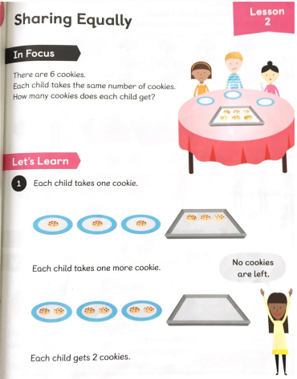

Slide 2
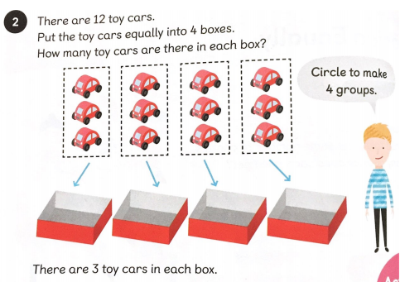

Slide 3
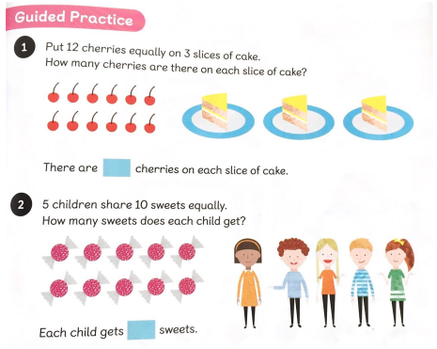


This time try and have a go too!
4
2

Slide 4
Did you see that I shared out the cherries and the sweets one at a time to make sure I shared them out equally?
Then did you see I crossed them off as I shared them to help me. When you complete your worksheet you need to remember to do it like I did this.

