Slide 1
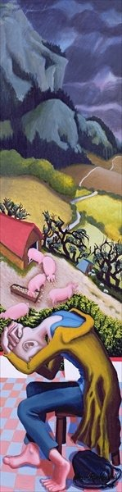
Really looking…..
Do you like this painting? Why? Why not?
Who is the man?
How is he feeling? How can you tell?
What objects can you see in the picture?
What do you notice about the colours used in this painting?

Slide 2
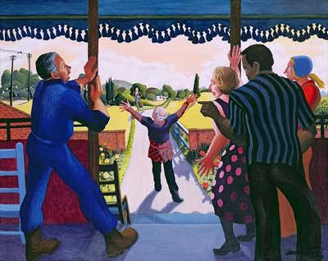

Slide 3
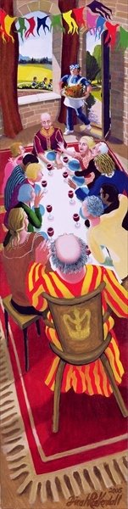

Slide 4

Dinah Roe Kendall’s Triptych of The Prodigal Son’s Return (2005)

