Slide 1


Slide 3
3 tens is equal to
2) 5 tens is equal to
3) 1 ten is equal to
4) 9 tens is equal to

Slide 4
3 tens is equal to
2) 5 tens is equal to
3) 1 ten is equal to
4) 9 tens is equal to
30
50
10
90

Slide 6



How many ladybirds are there?
There are a lot!
There must be an easier way

Slide 7
How many ladybirds?

Slide 8
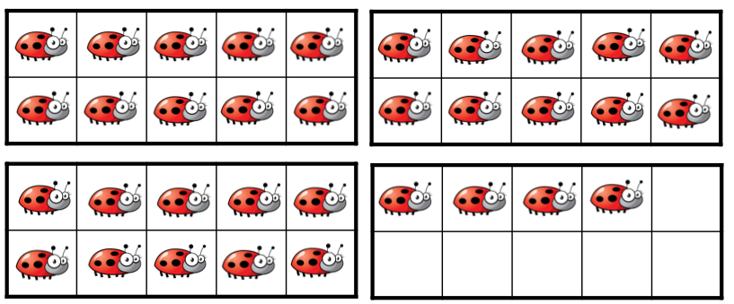
There are ___ tens and ___ ones.
There are ____ ladybirds.
3
4
34

Slide 9



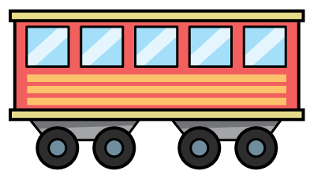
Have a think
4
6
There are ___ tens and ___ ones.
The number is ____
46
2
3
There are ___ tens and ___ ones.
The number is ____
23
There are ___ tens and ___ ones.
The number is ____

Slide 10
Have a go at questions 1 and 2 on the worksheet

Slide 11
Have a think
Which of these images represents 32?

Slide 12
Which of these images represents 32?

Slide 13

$=$
10 ones is equal to 1 ten
We can exchange 10 ones for 1 ten

Slide 14
Have a go
How many ways can we
build 41 using base 10?

Slide 15
How many ways can we
build 41 using base 10?

Slide 16
Have a go at the rest of the worksheet

