Slide 1
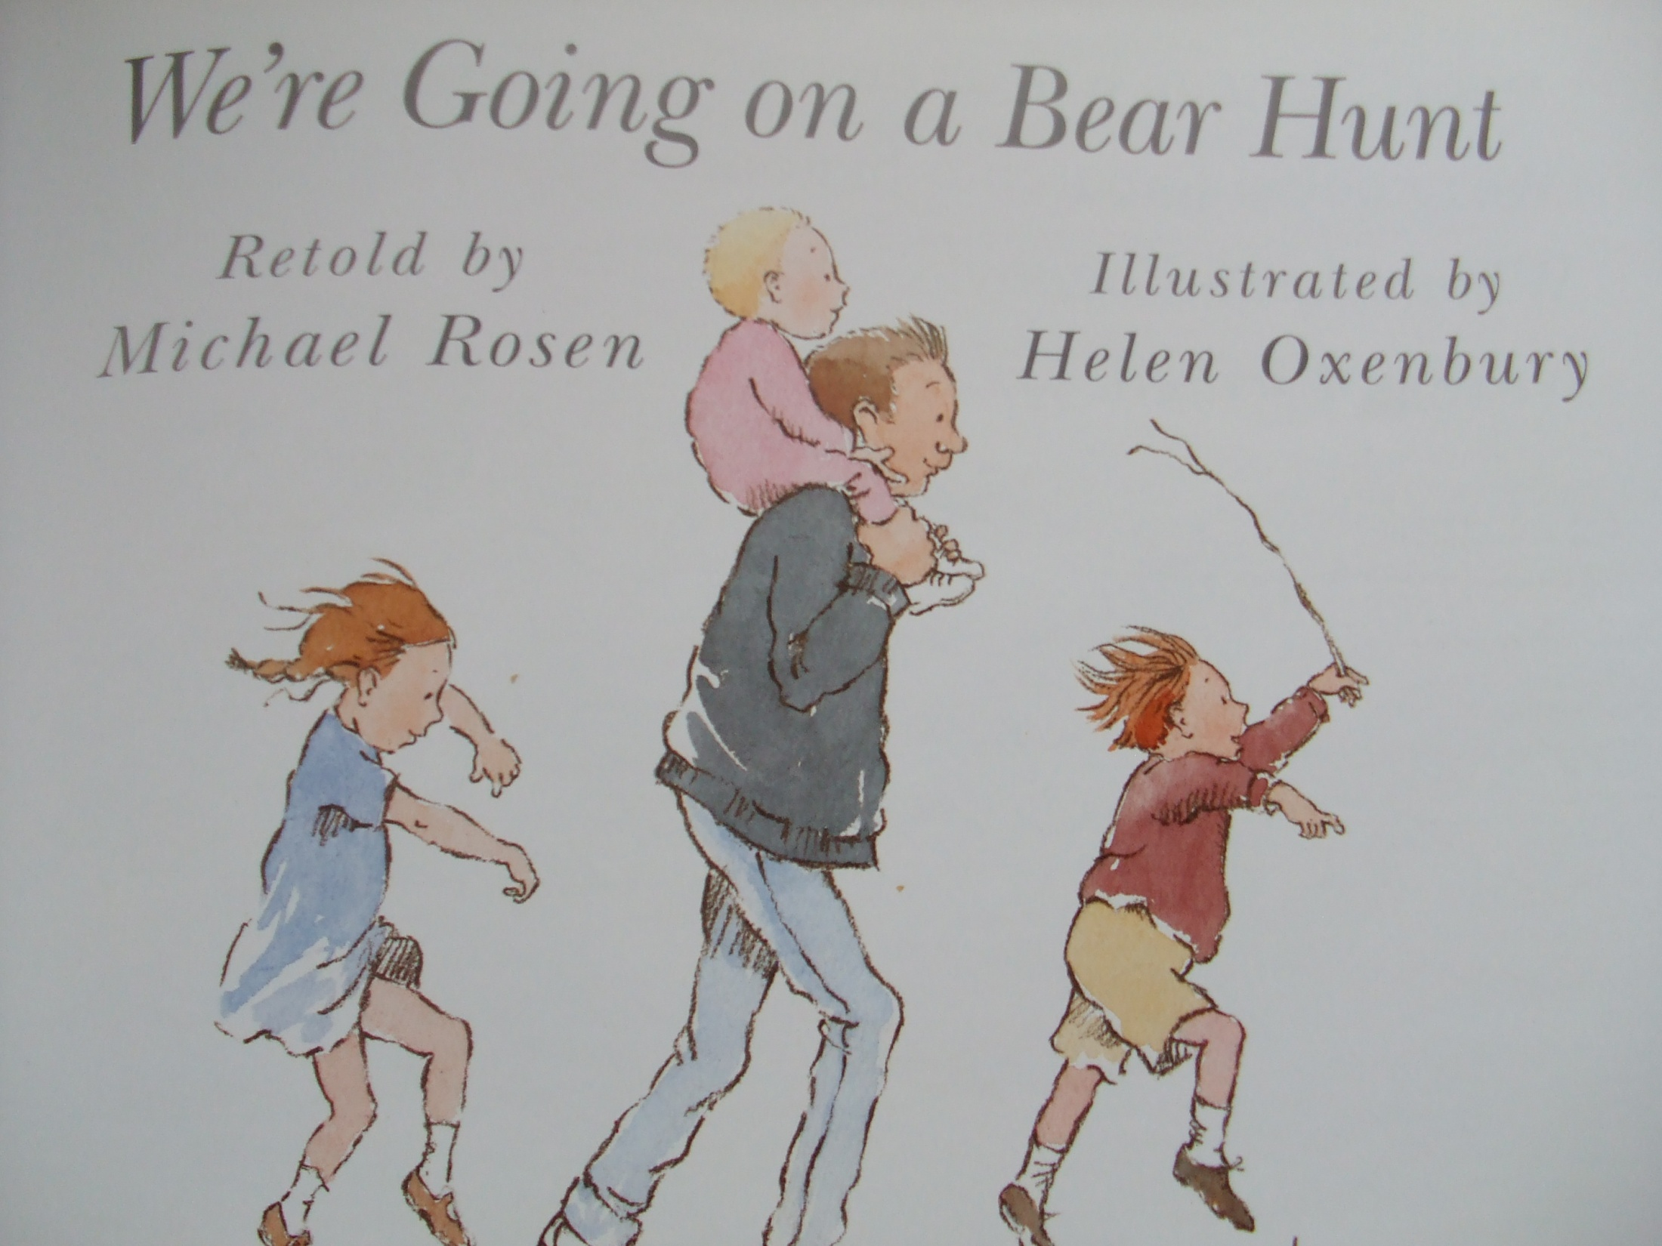

Slide 2
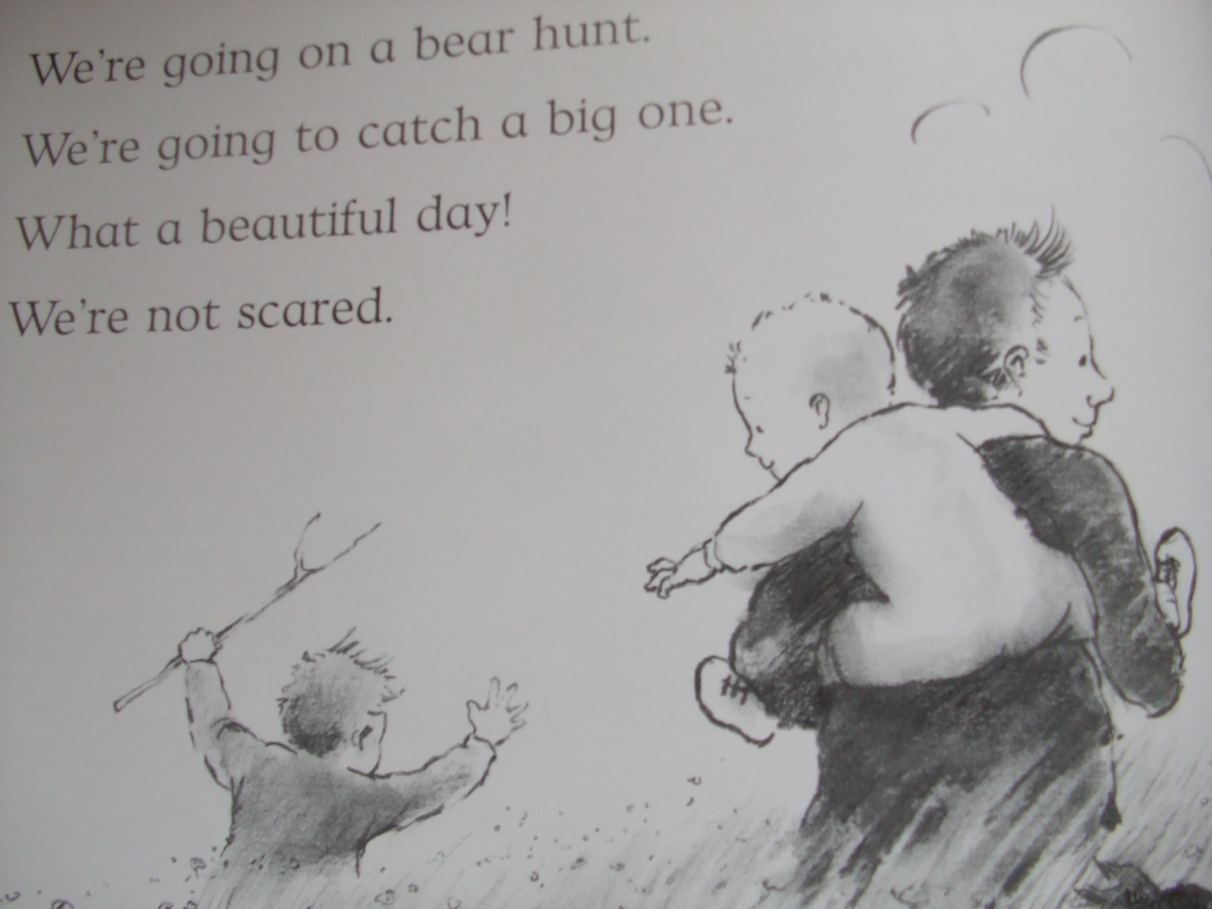

Slide 3
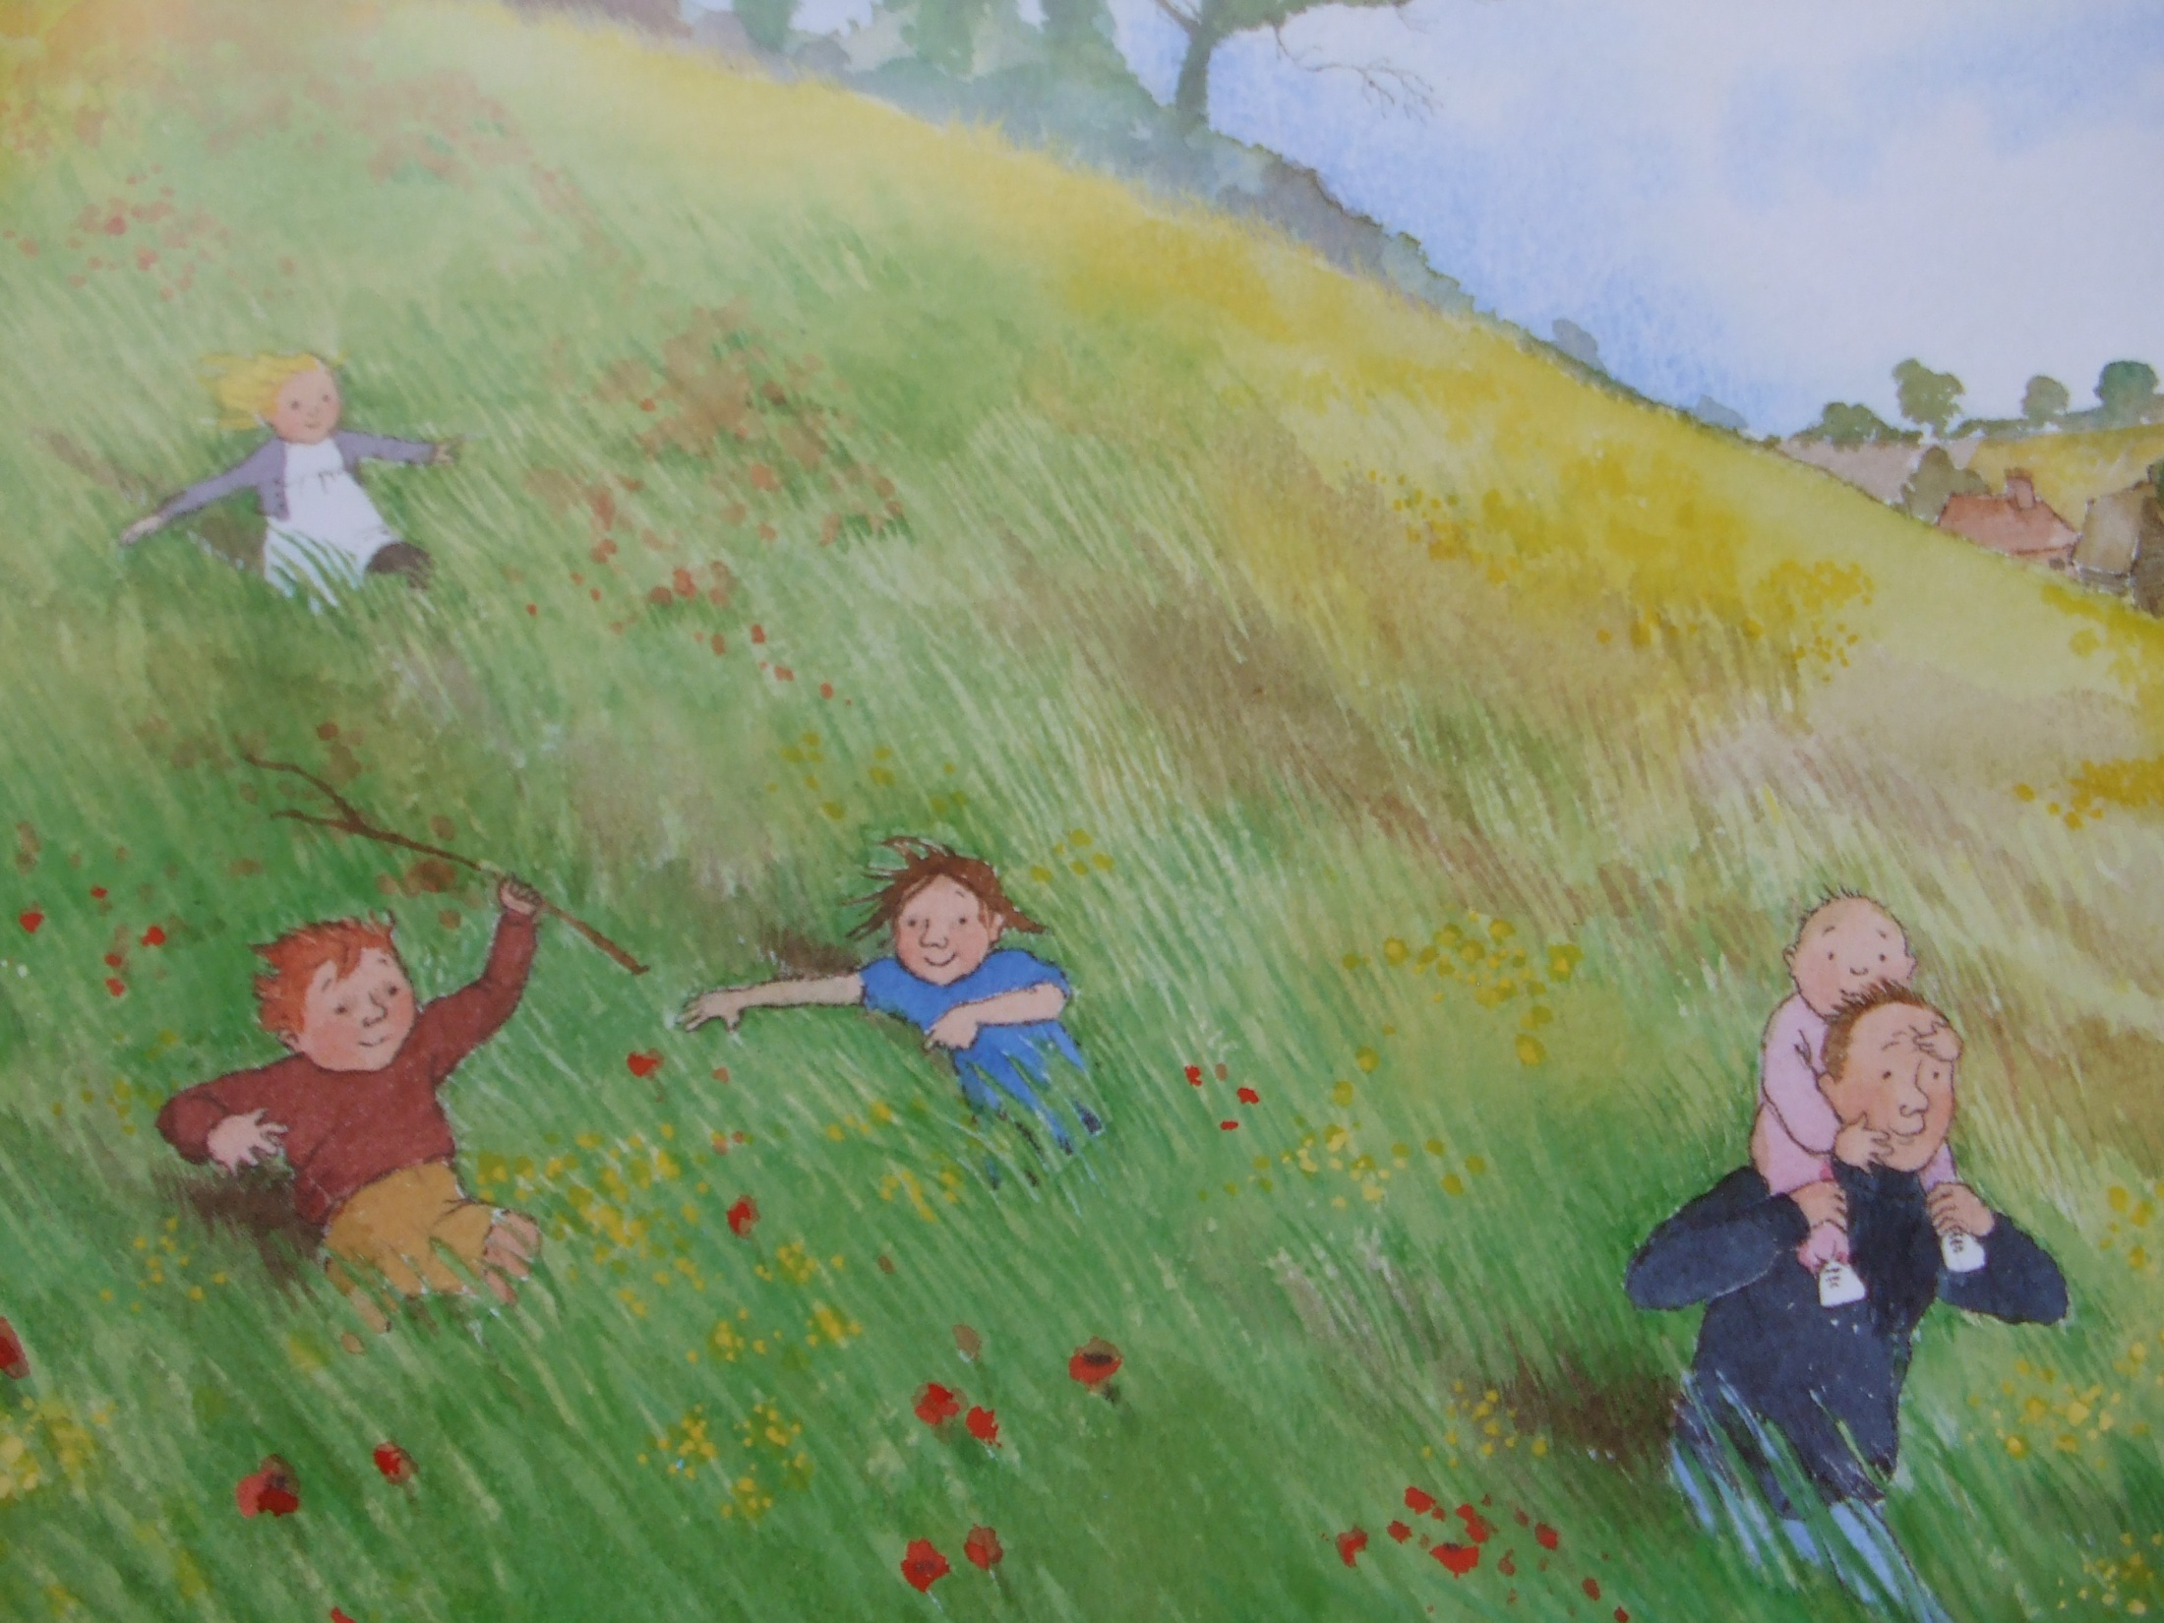
Long wavy grass.
We can’t go over it.
We can’t go under it.
Oh no!
We’ve got to go through it!

Slide 4
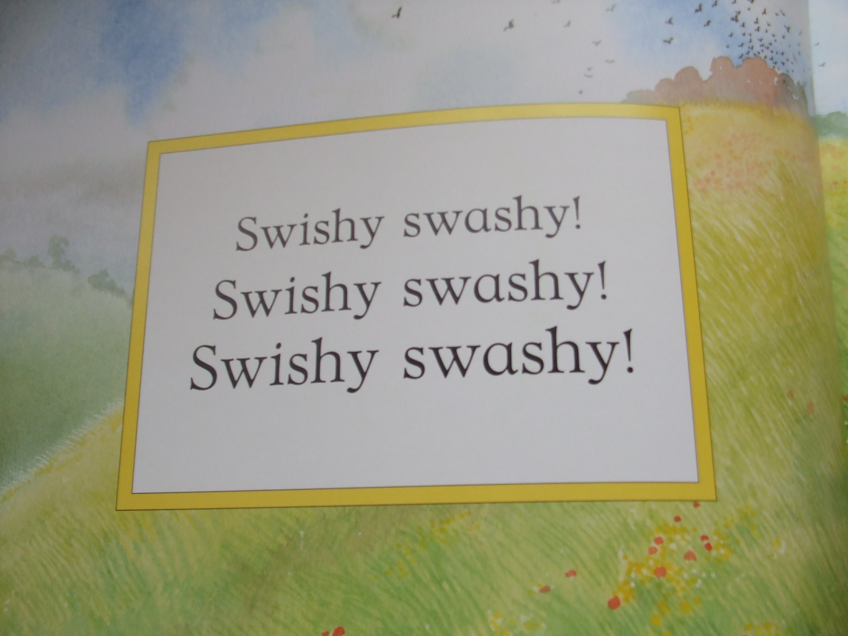

Slide 6
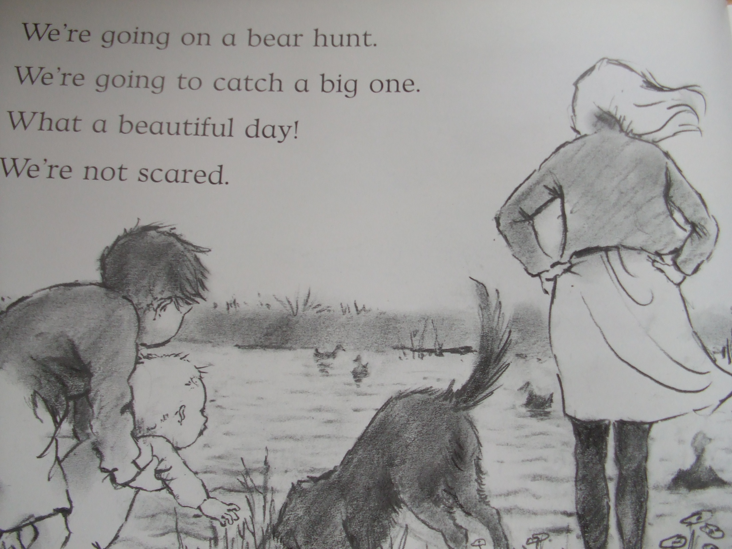

Slide 7
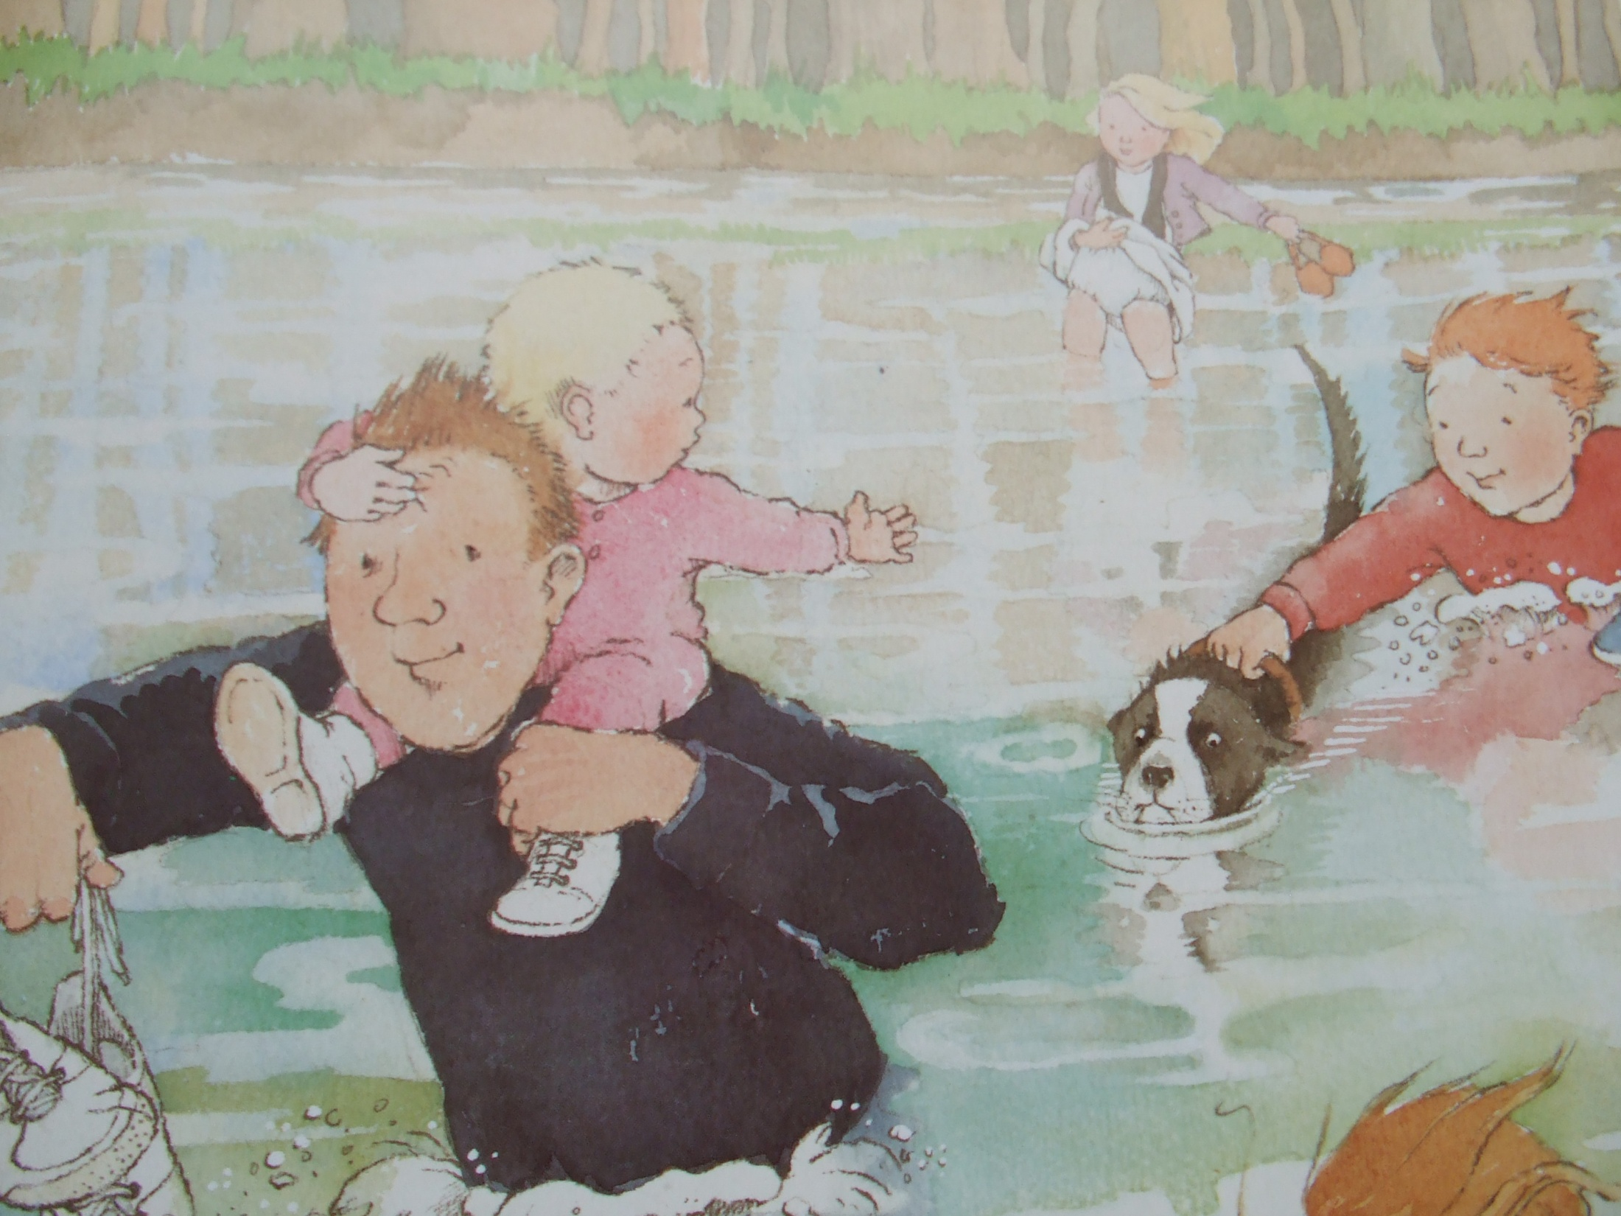
Uh- Oh! A river!
A deep cold river.
We can’t go over it.
We can’t go under it.
Oh no!
We’ve got to go through it!

Slide 8
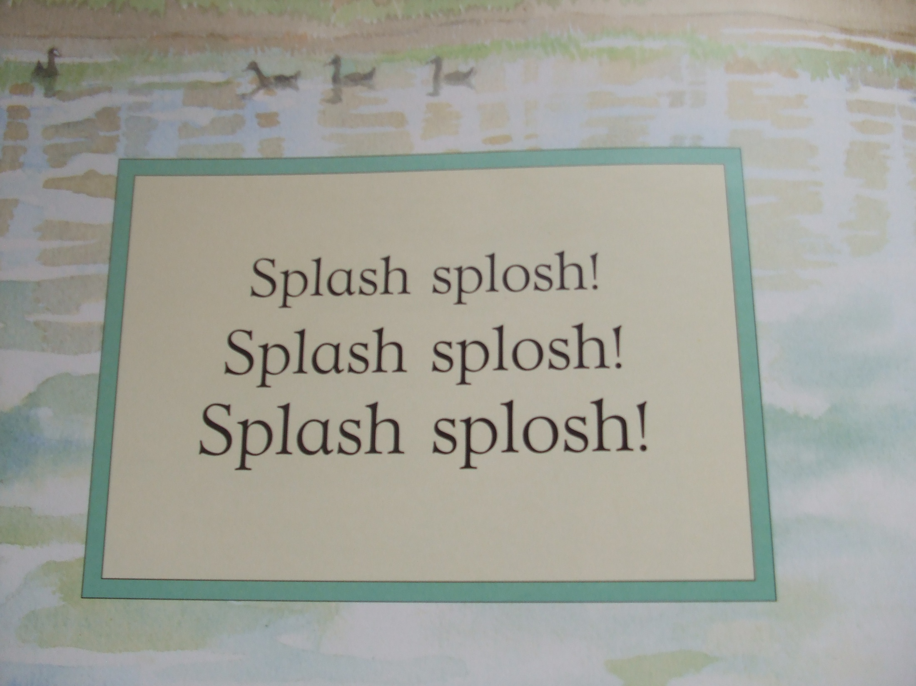

Slide 10
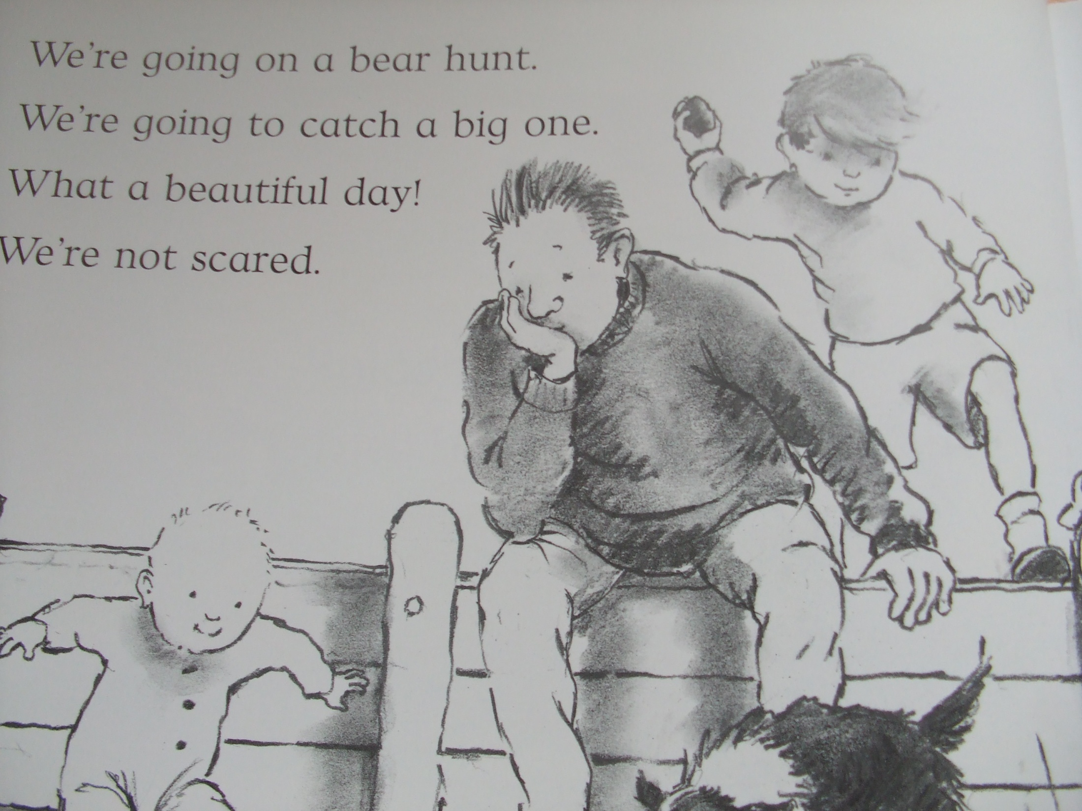

Slide 11
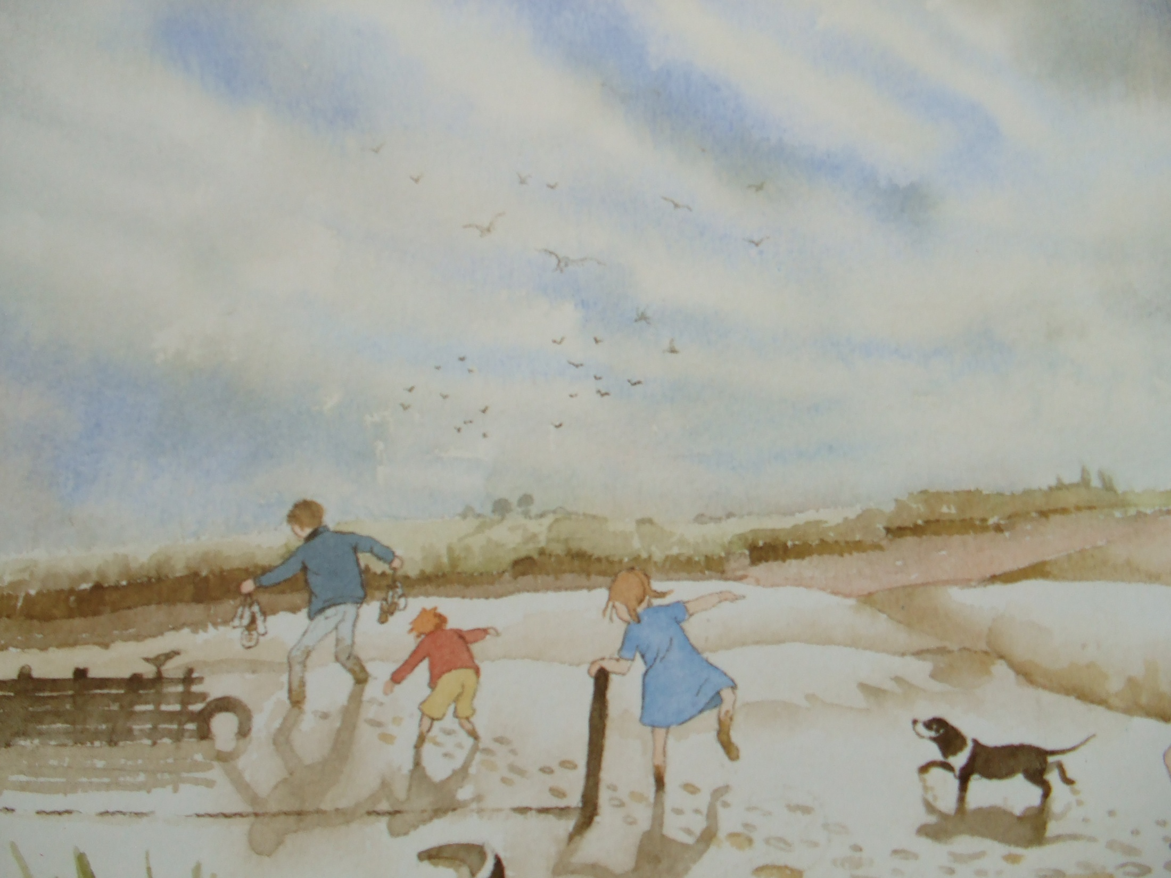
Uh-oh! Mud!
Thick oozy mud.
We can’t go over it.
We can’t go under it.
Oh no!
We’ve got to go through it!

Slide 12
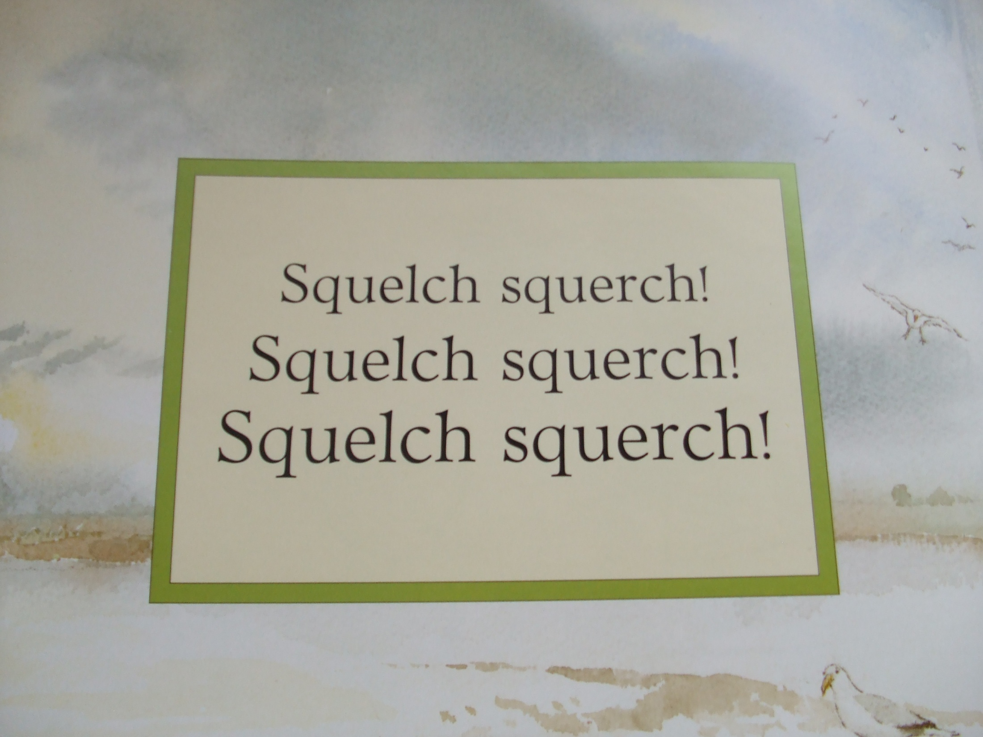

Slide 14
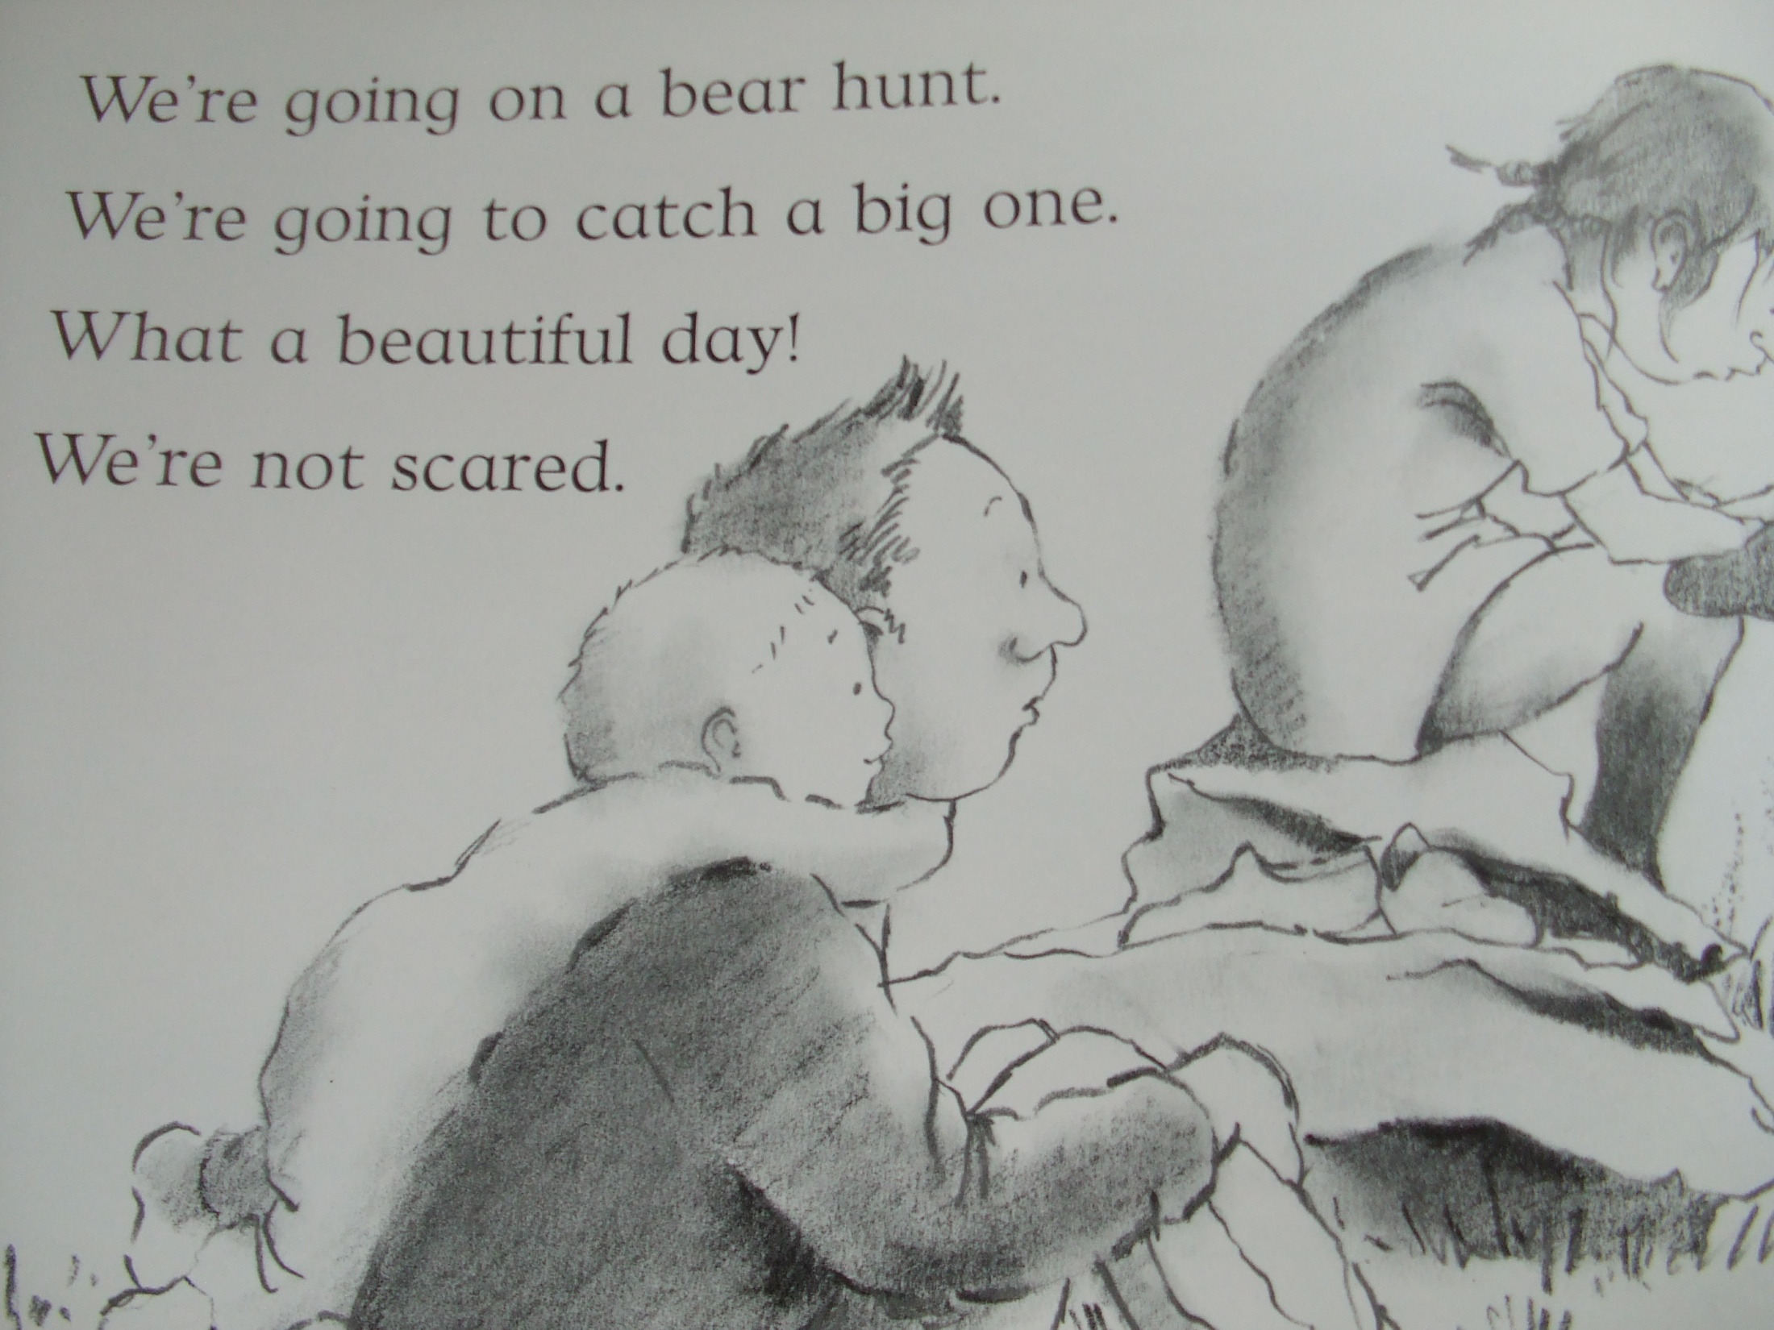

Slide 15
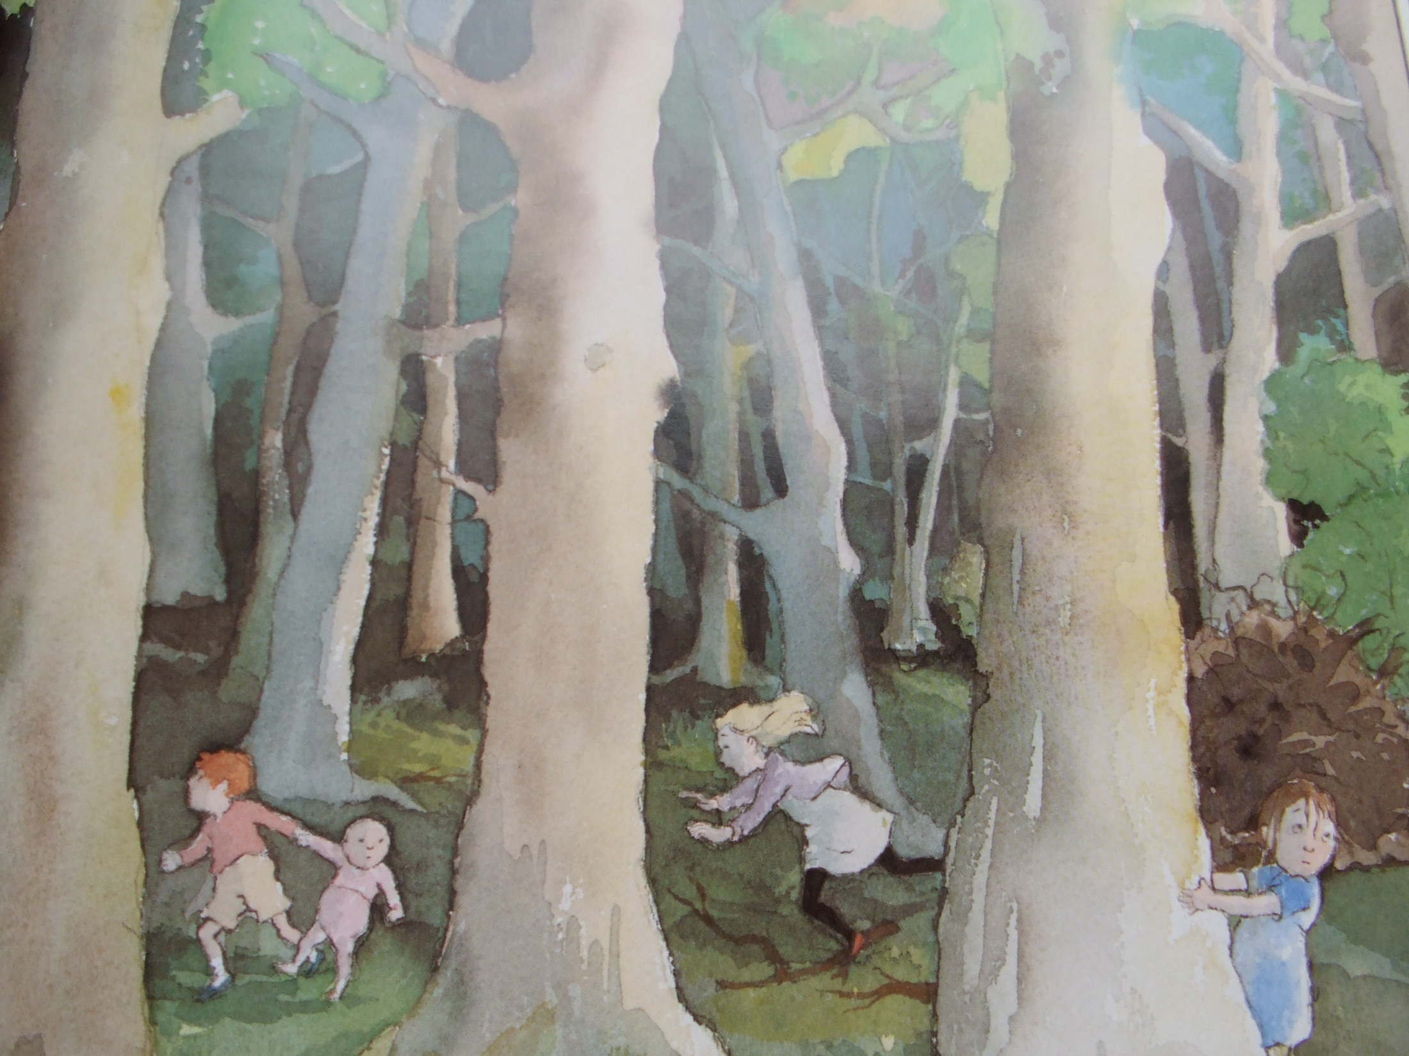
Uh-oh! A forest!
A big dark forest.
We can’t go over it.
We can’t go under it.
Oh no!
We’ve got to go through it!

Slide 16
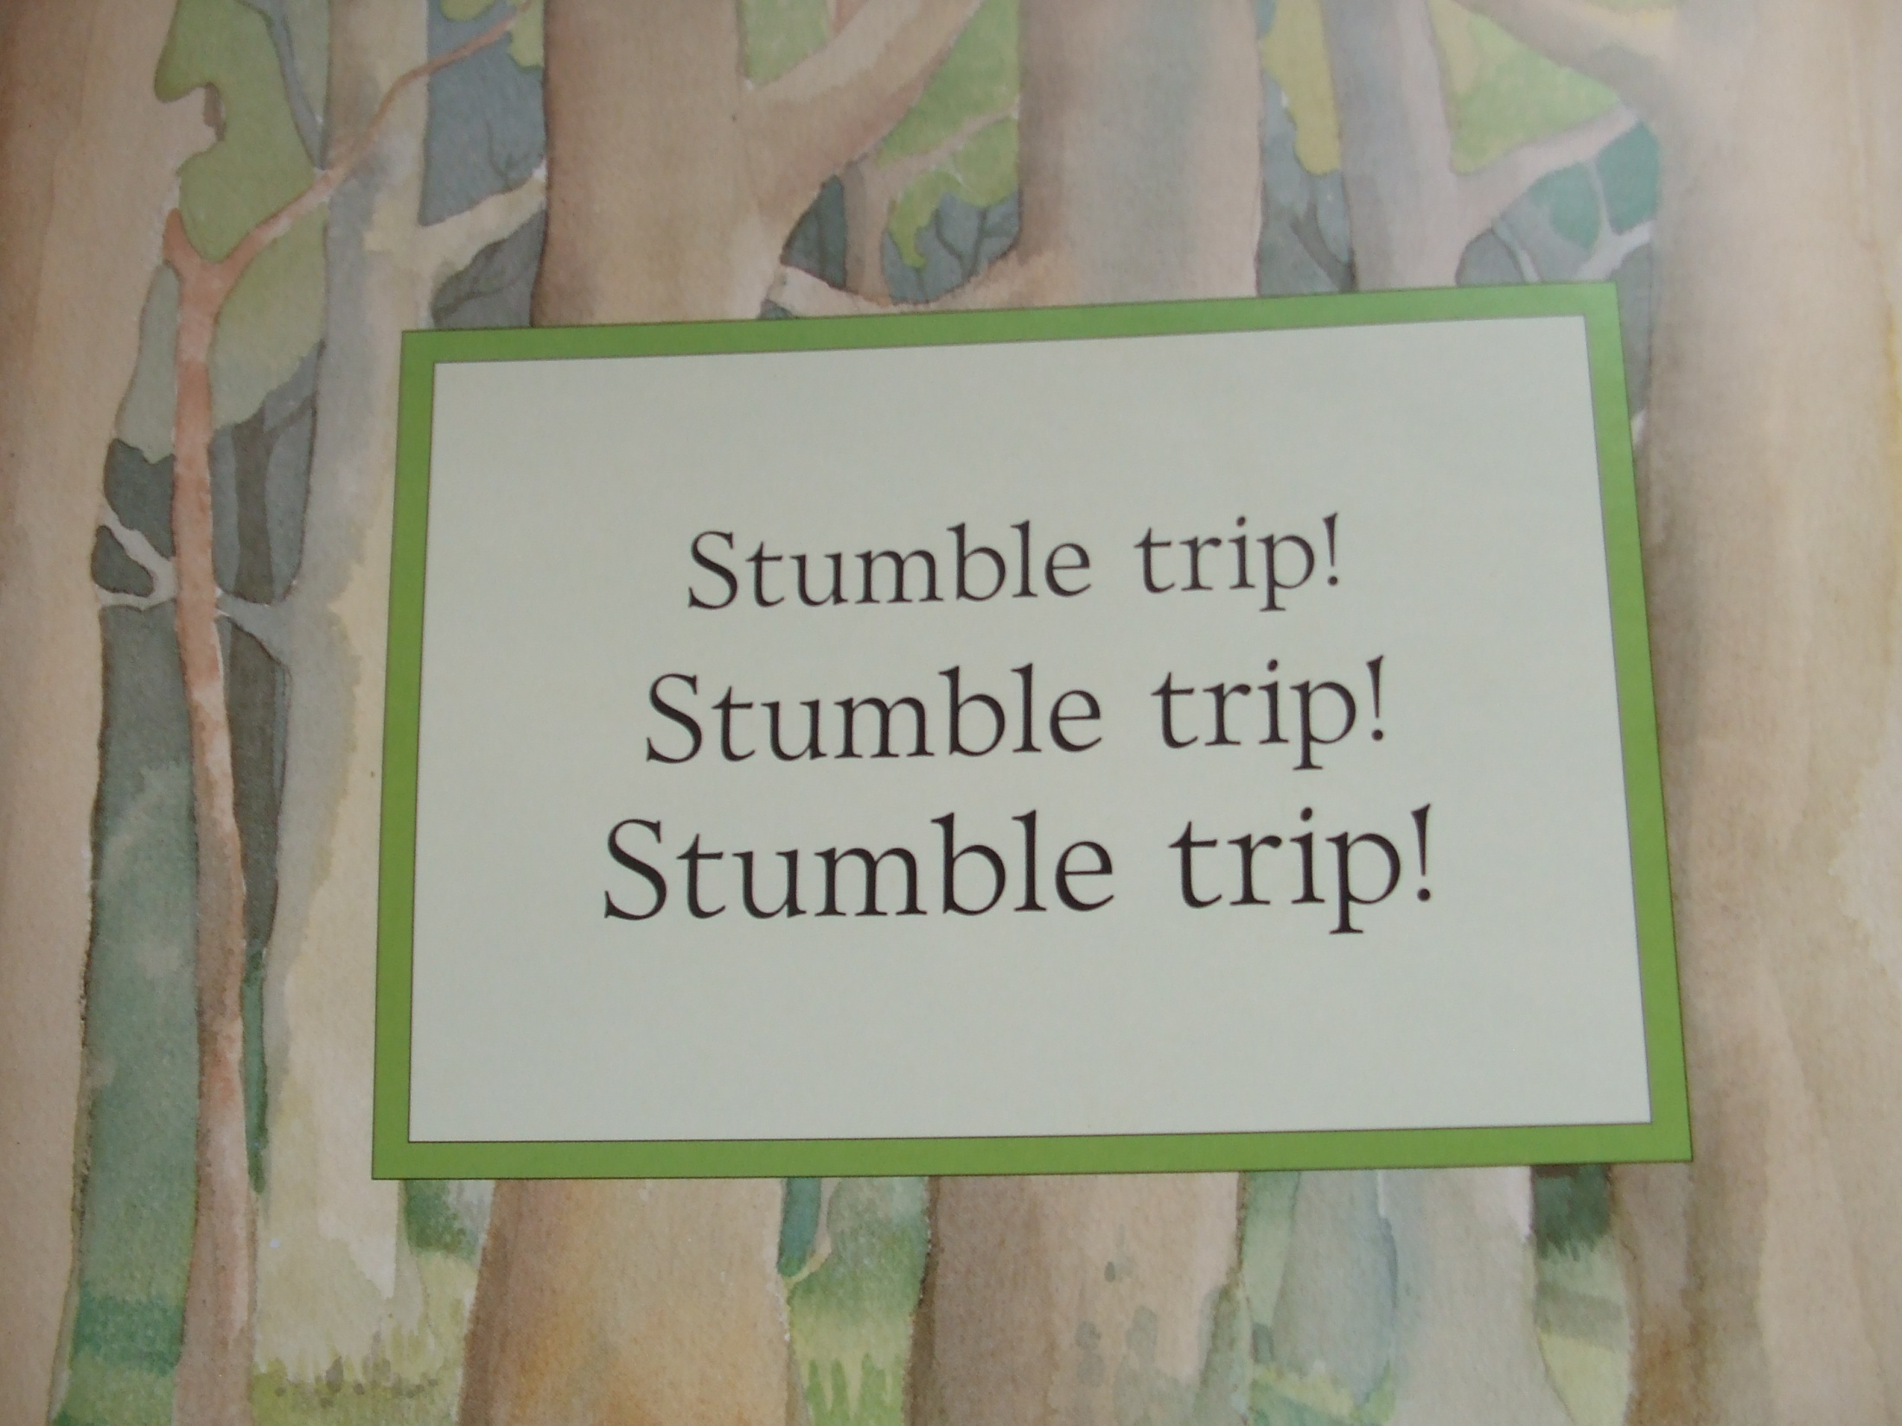

Slide 18
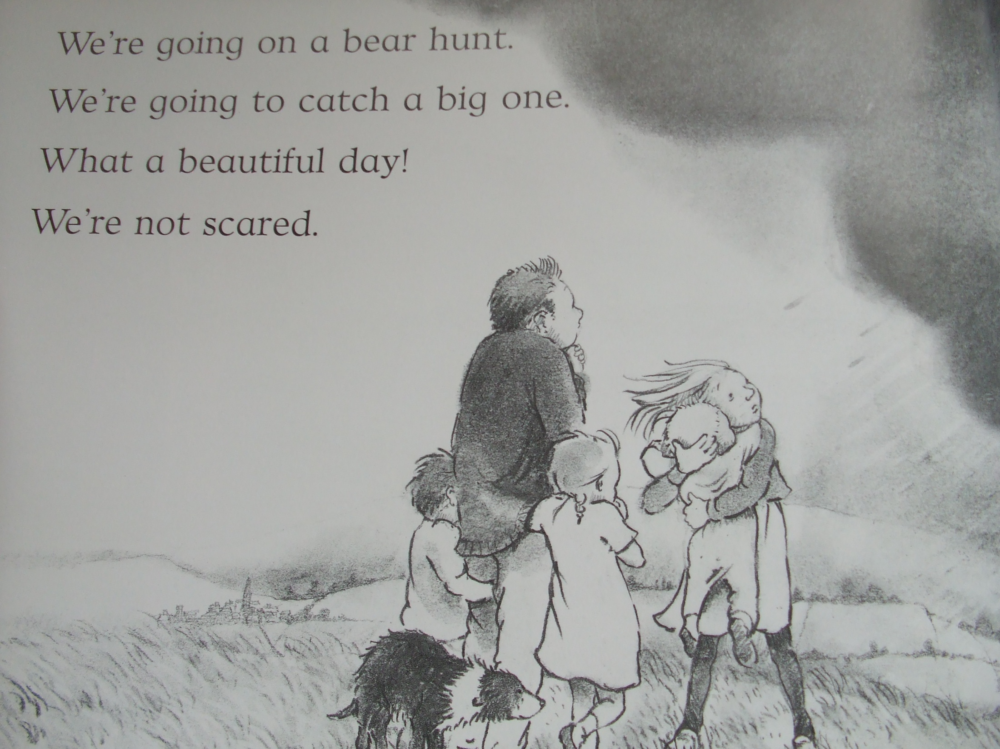

Slide 19
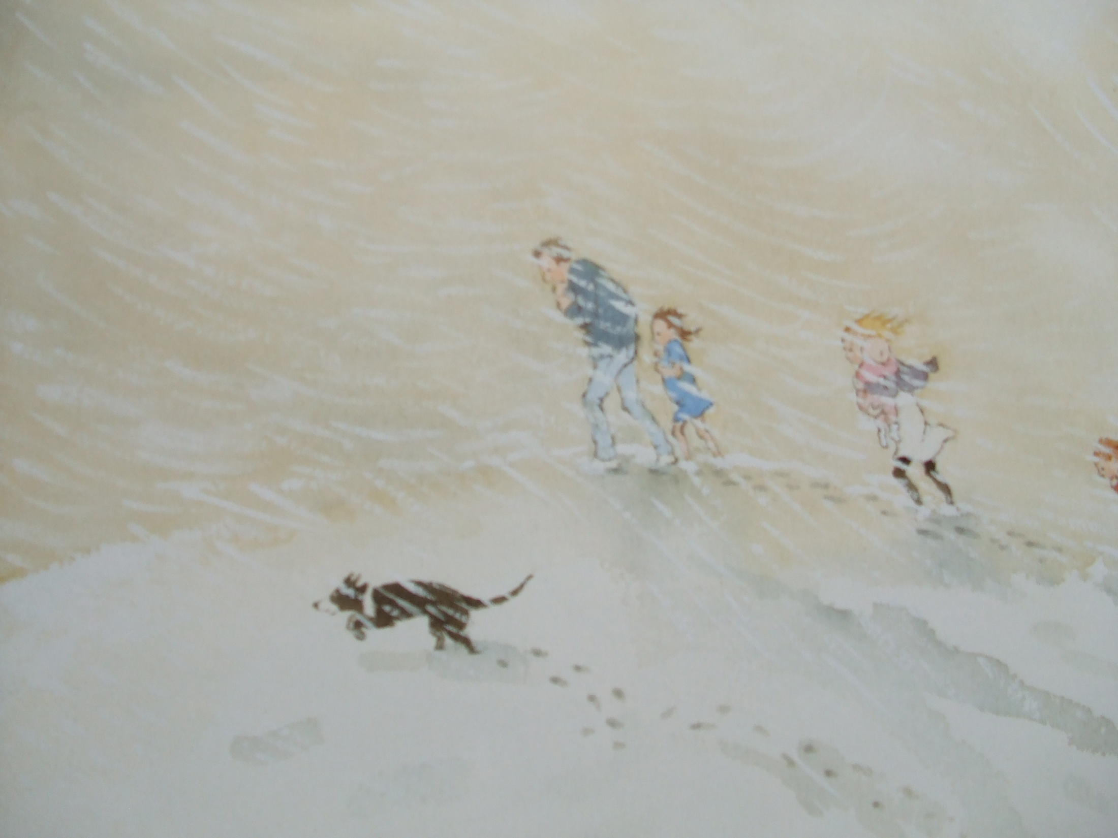
Uh-oh! A snowstorm!
A swirling whirling snowstorm.
We can’t go over it.
We can’t go under it.
Oh no!
We’ve got to go through it!

Slide 20
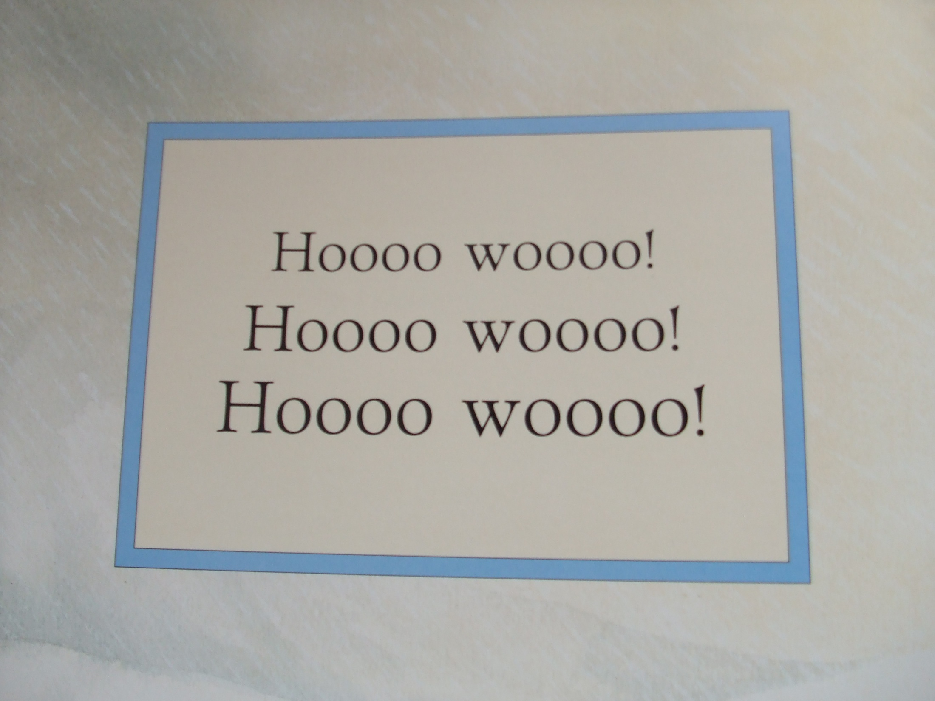

Slide 22
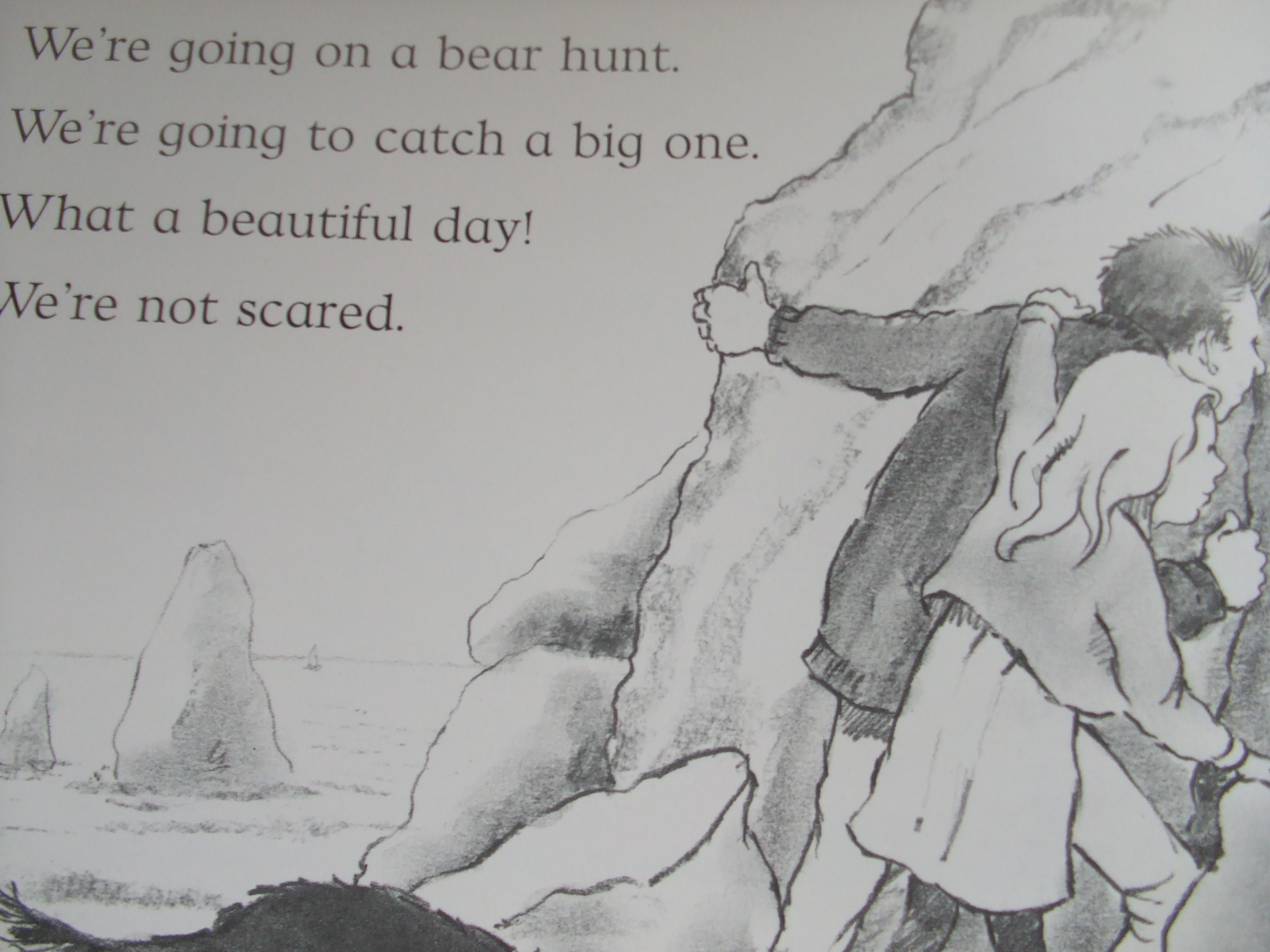

Slide 23
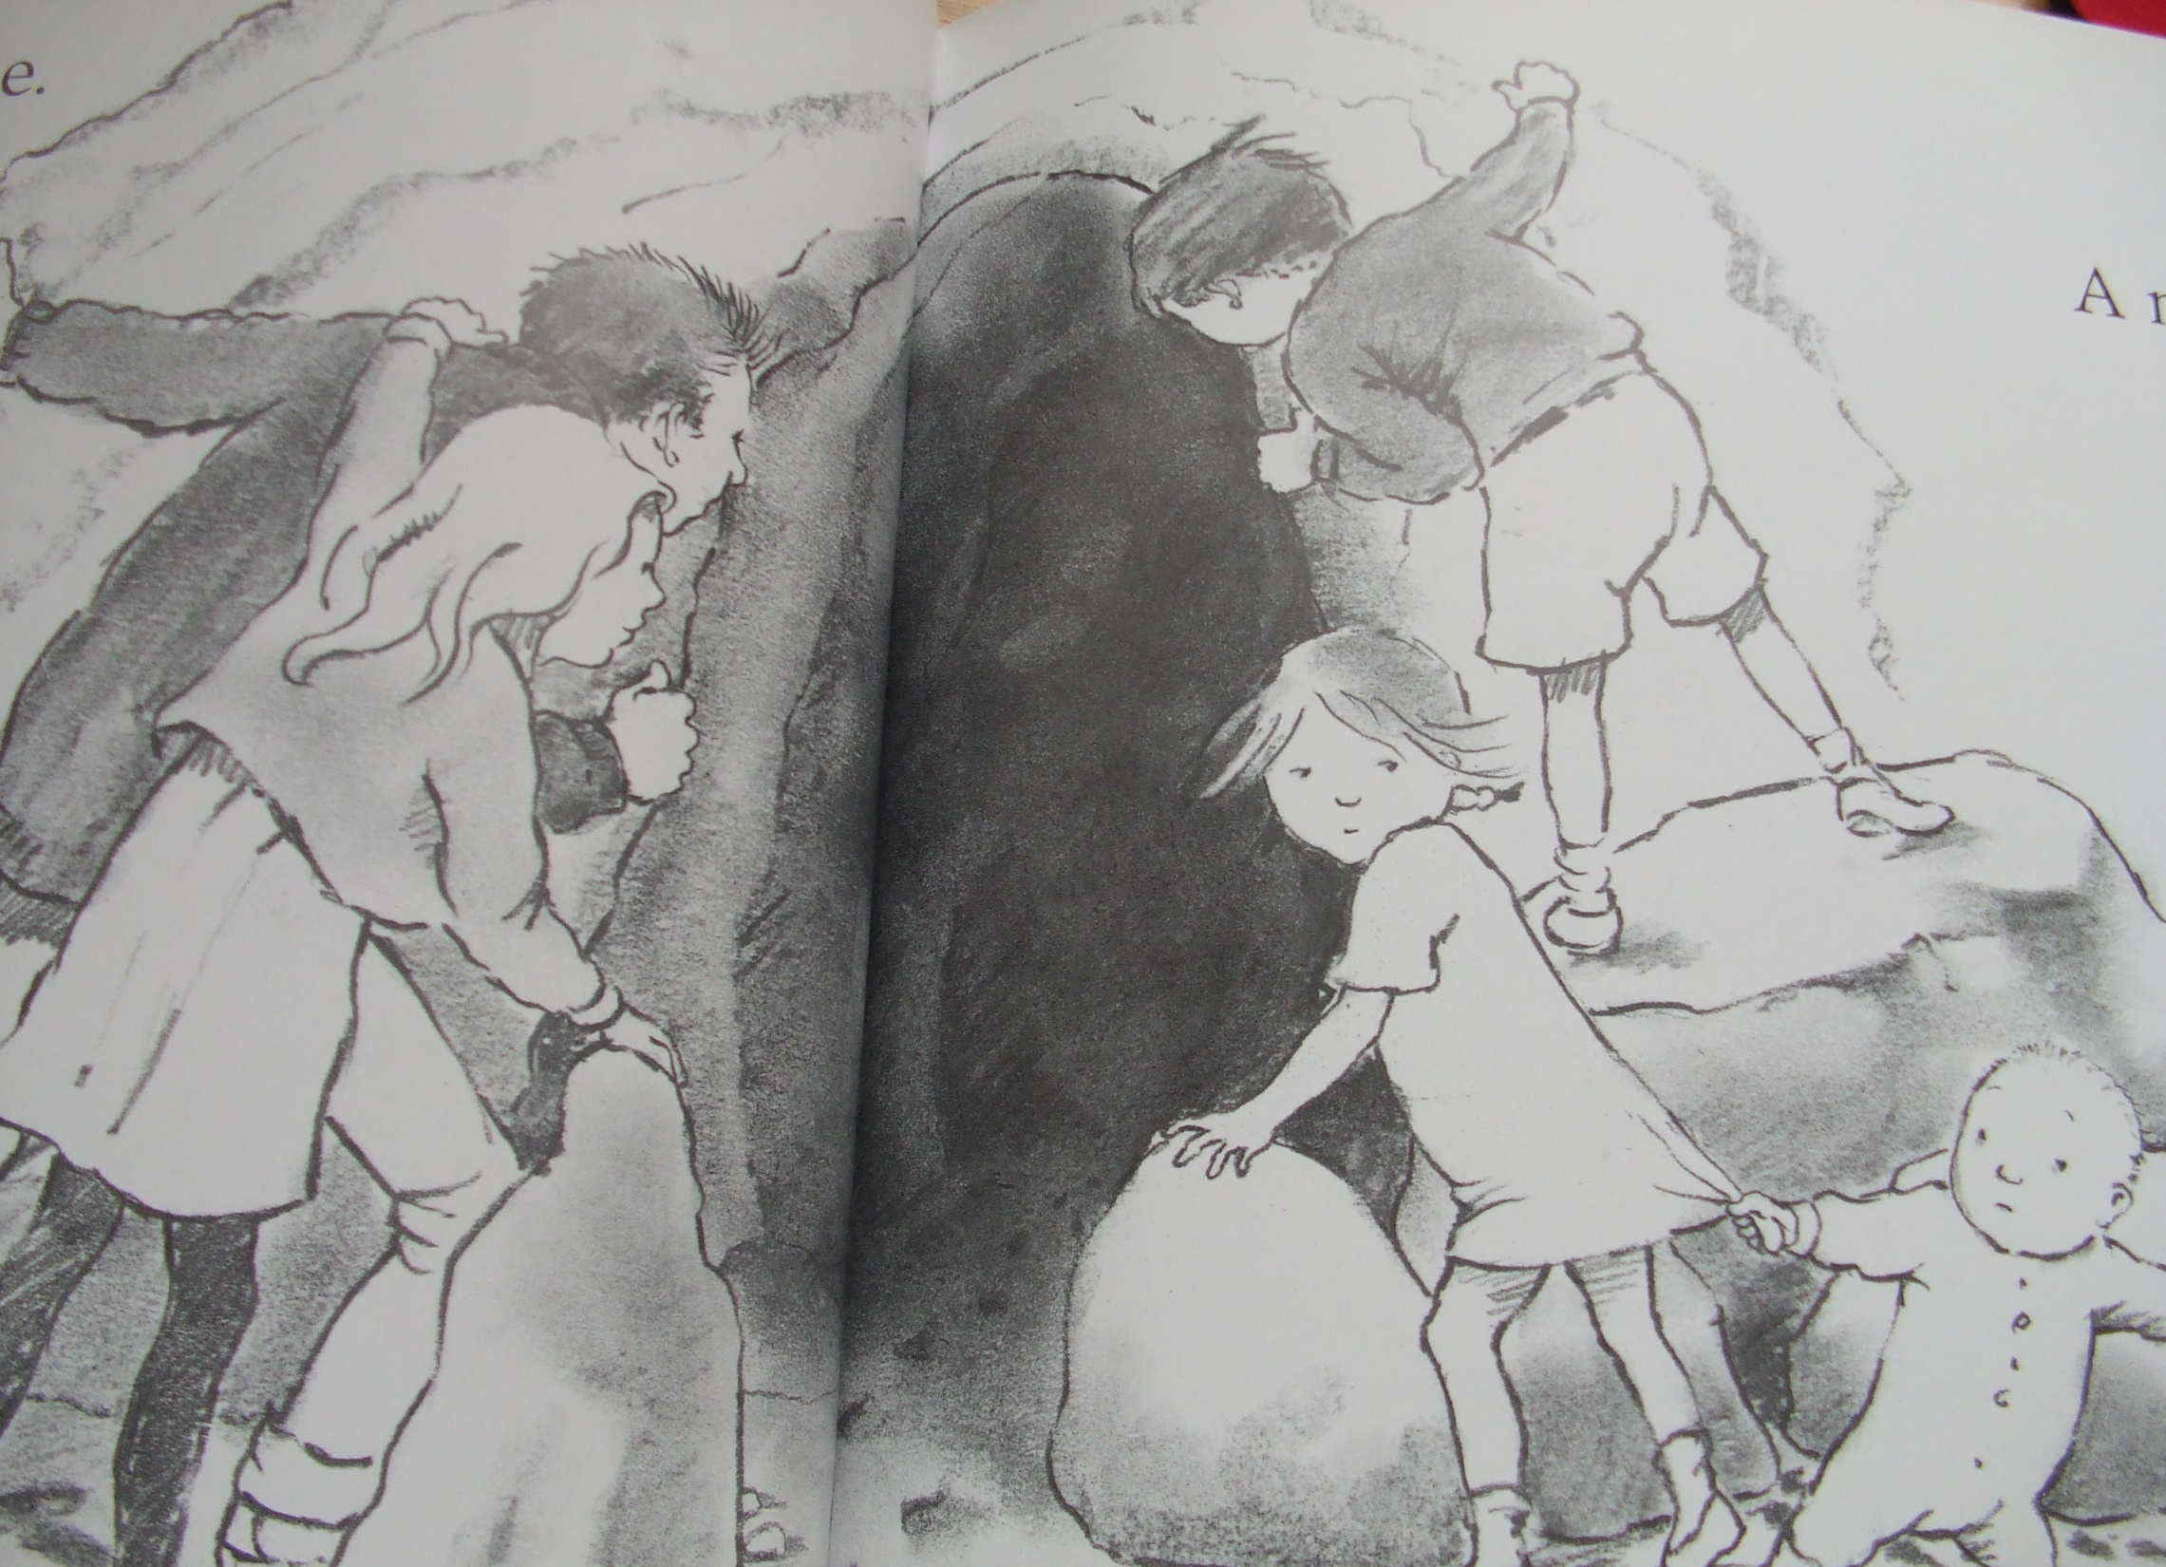
Uh oh! A cave!
A narrow gloomy cave.
We can’t go over it.
We can’t go under it
Oh no!
We’ve got to go through it!

Slide 24
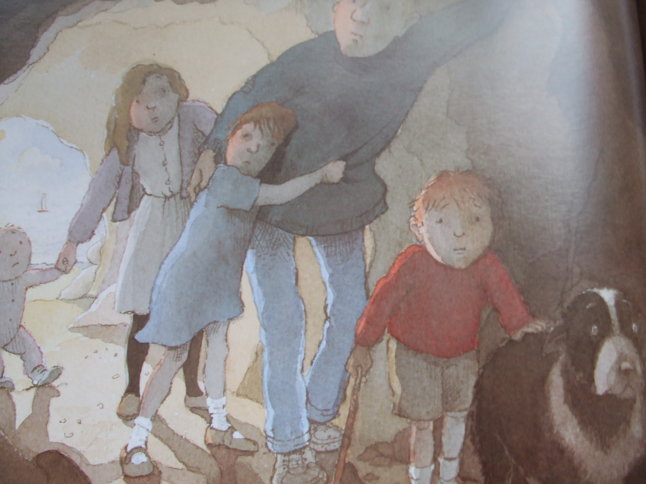

Slide 25
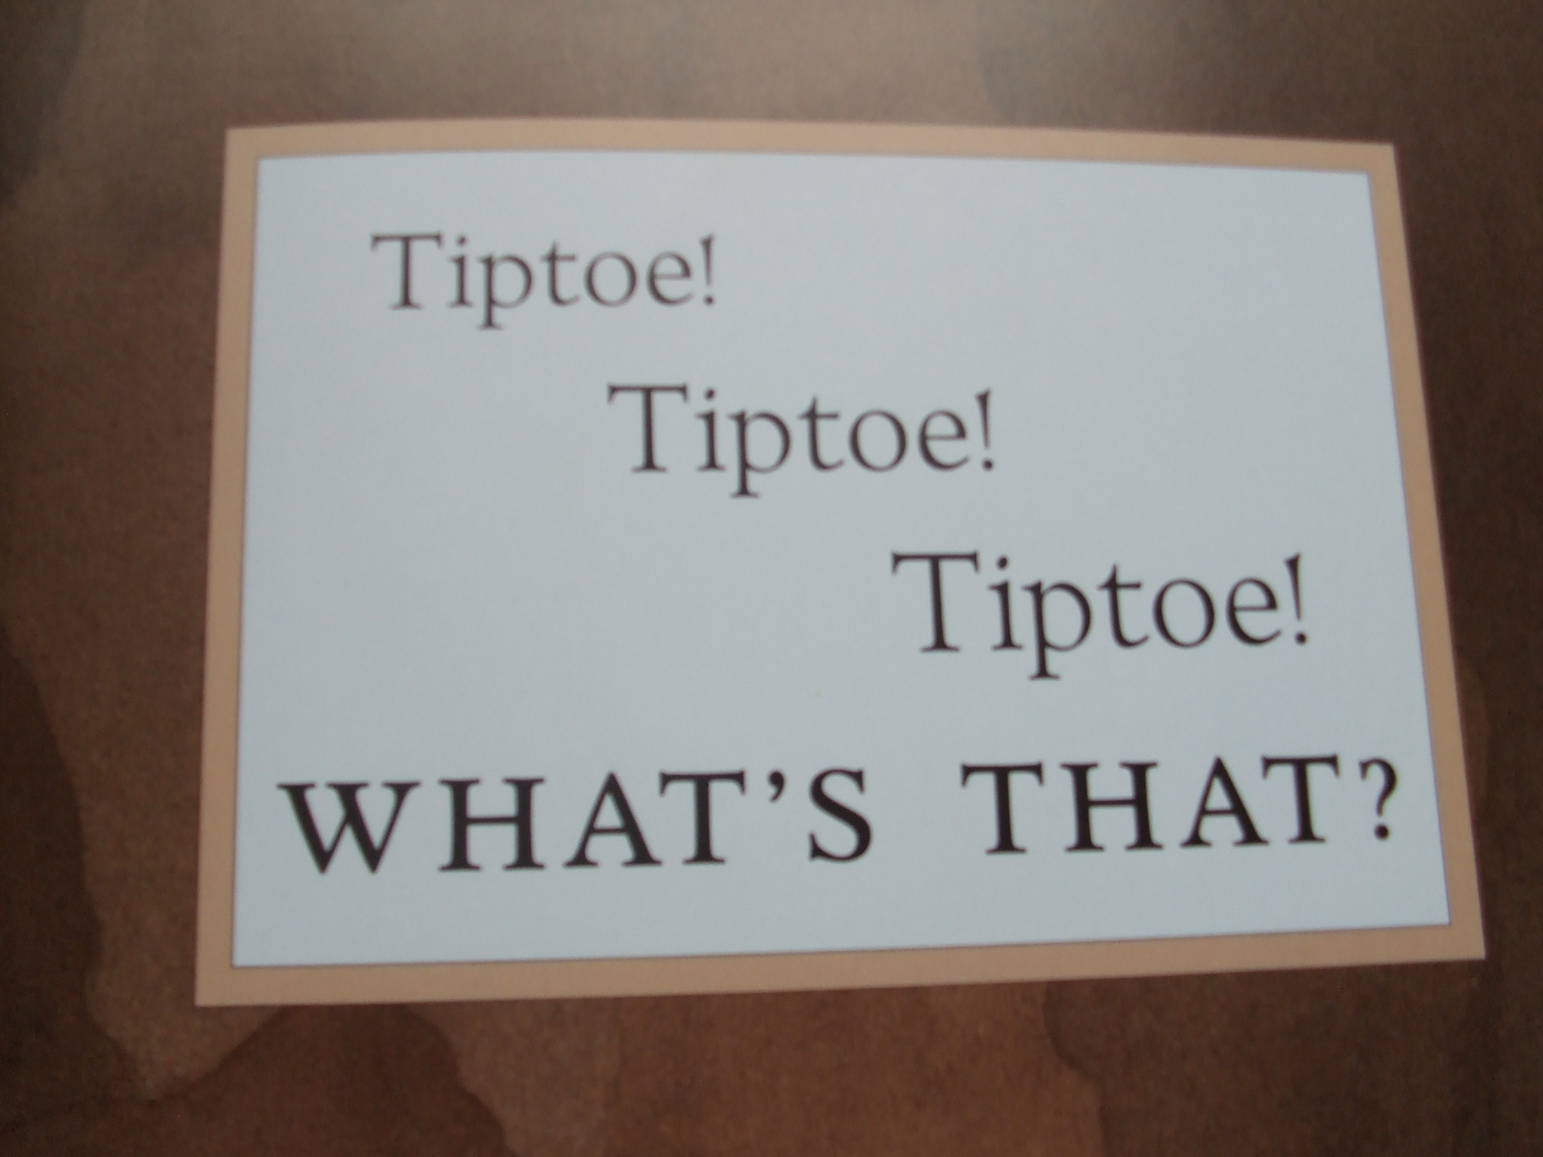

Slide 26
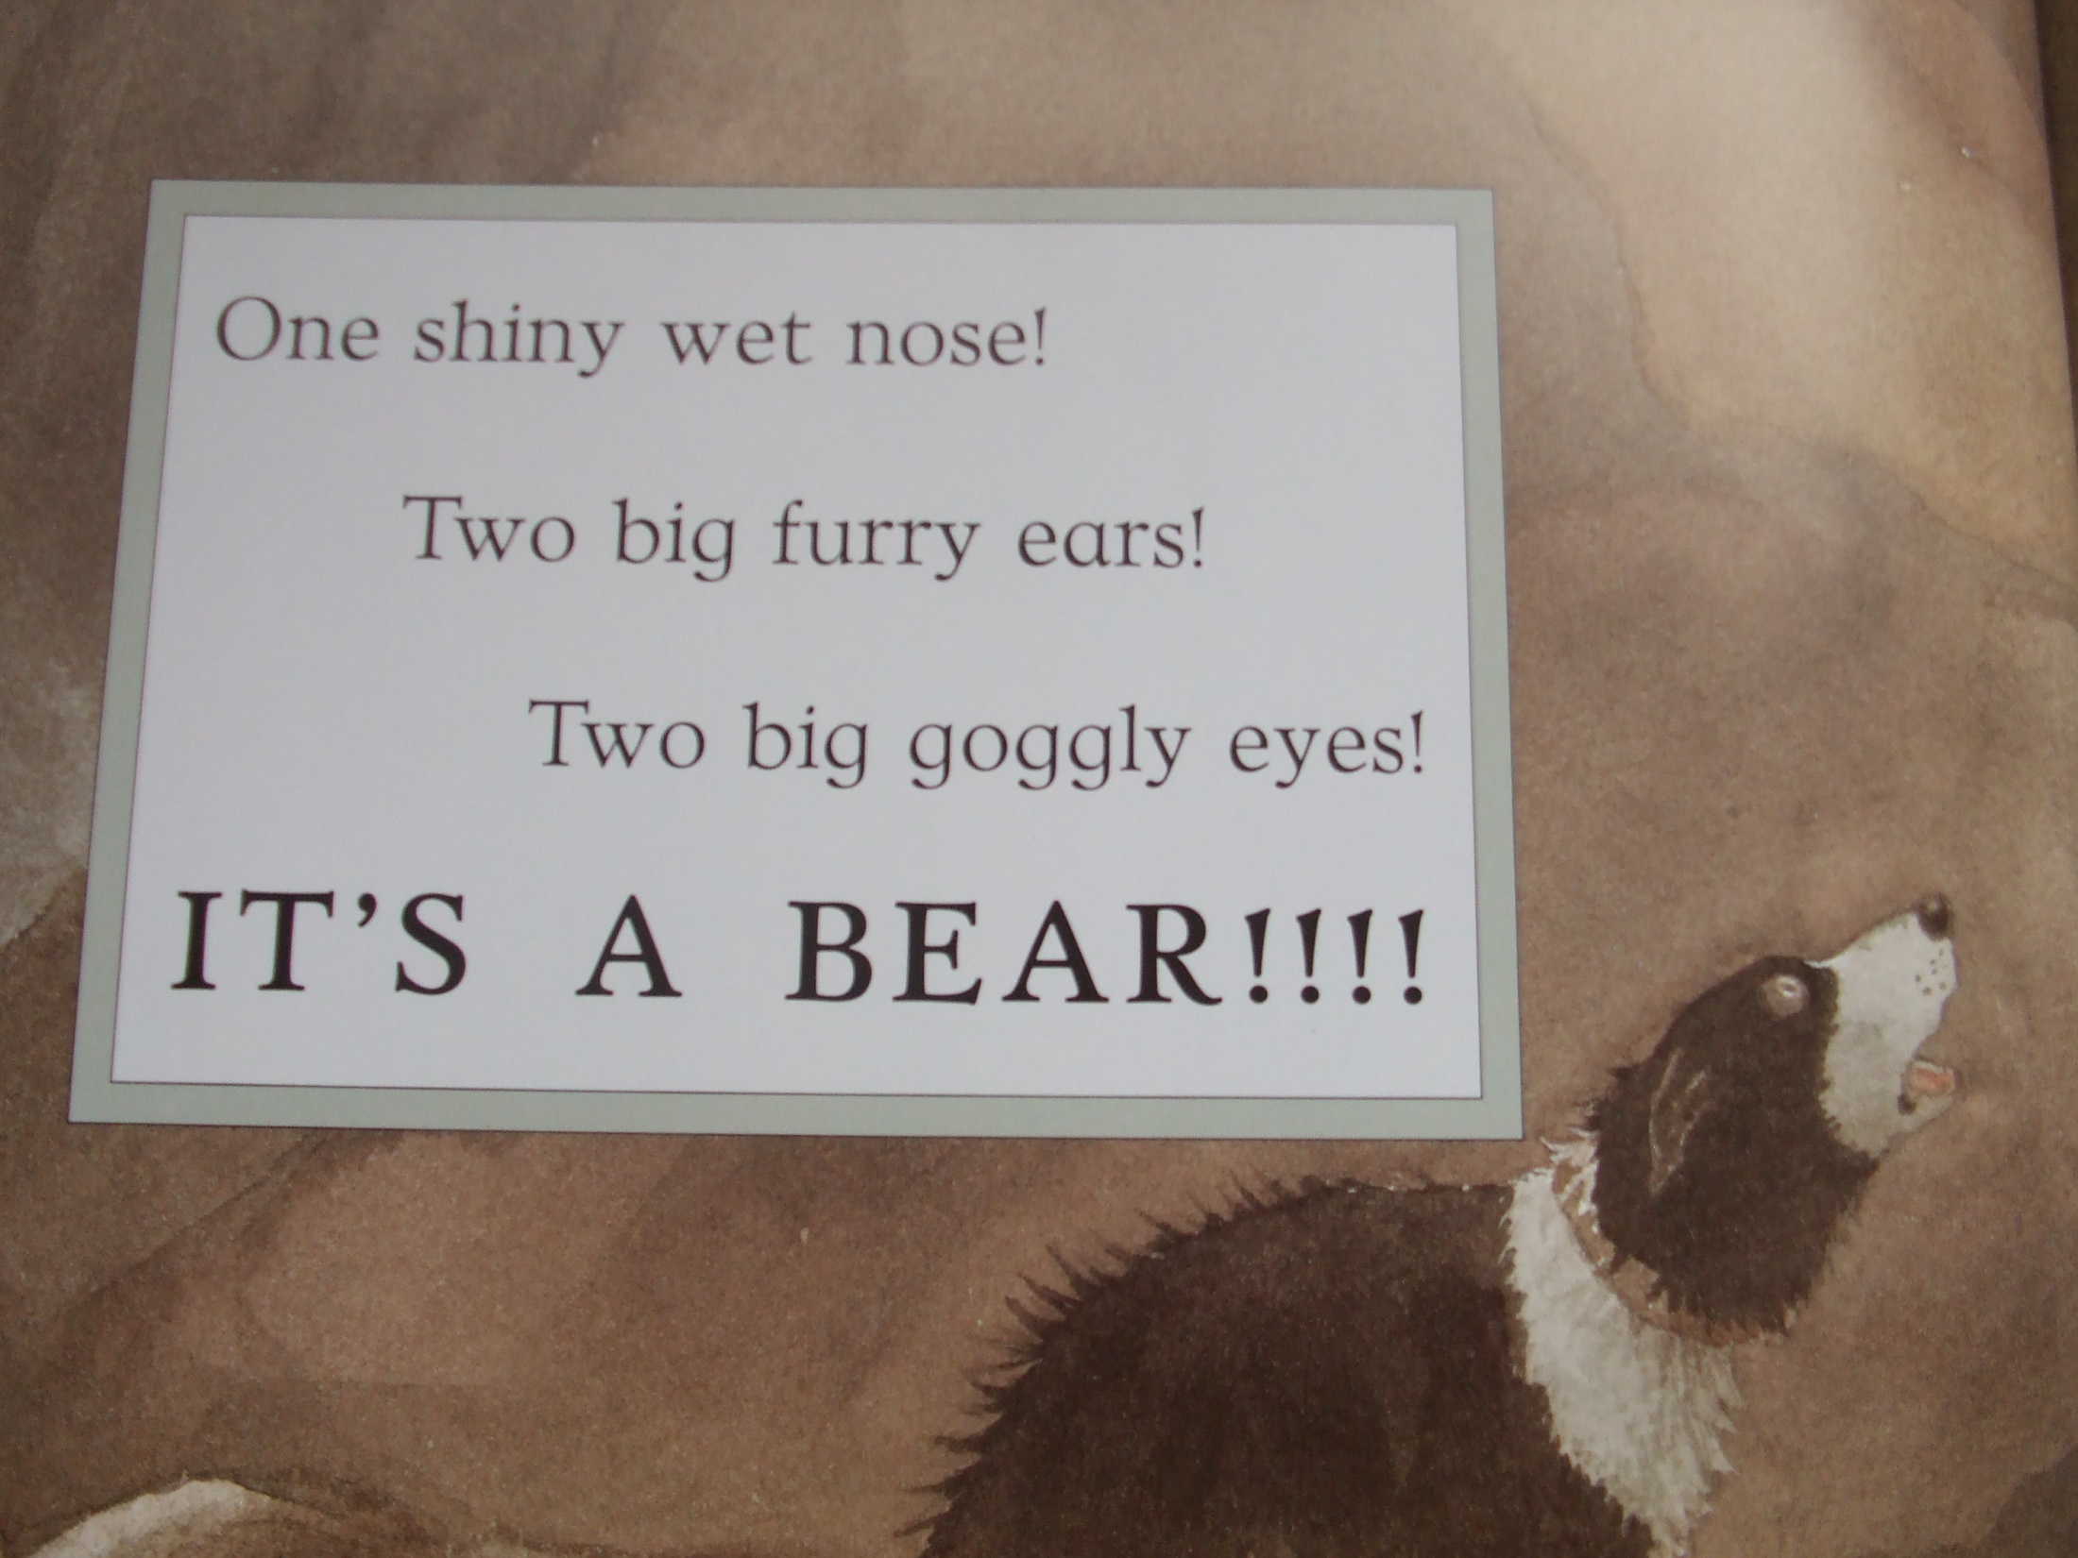

Slide 27
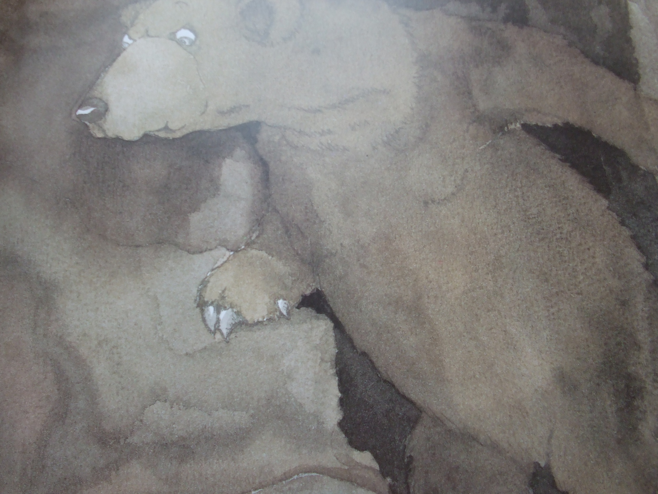

Slide 28
Quick! Back through the cave! Tiptoe Tiptoe! Tiptoe!

Slide 29
Quick! Back through the snowstorm! Hooooo Wooooo! Hooooo Wooooo!

Slide 30
Quick! Back through the forest! Stumble trip! Stumble trip! Stumble trip!

Slide 31
Quick! Back through the mud! Squelch squerch! Squelch squerch!

Slide 32
Quick! Back through the river! Splash splosh! Splash splosh! Splash Splosh!

Slide 33
Quick! Back through the grass! Swishy swashy! Swishy swashy!

Slide 34
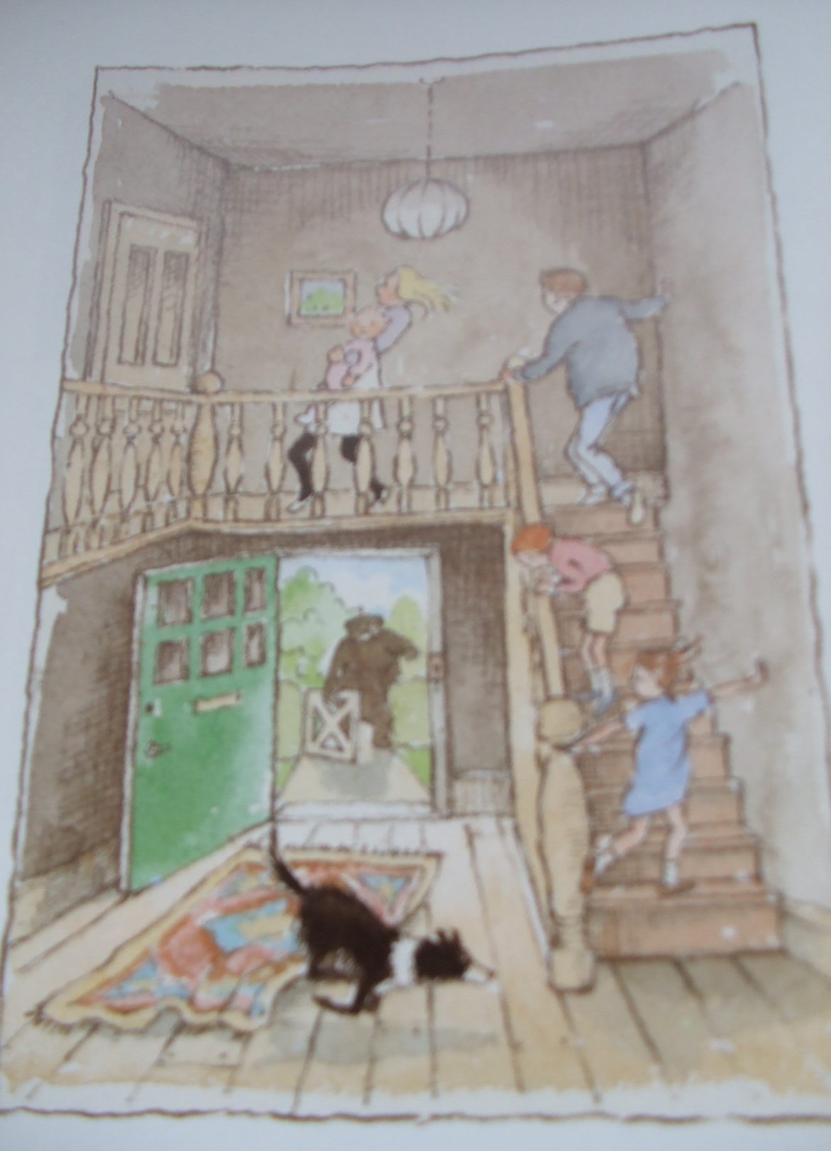
Get to our front door.
Open the door.
Up the stairs.

Slide 35
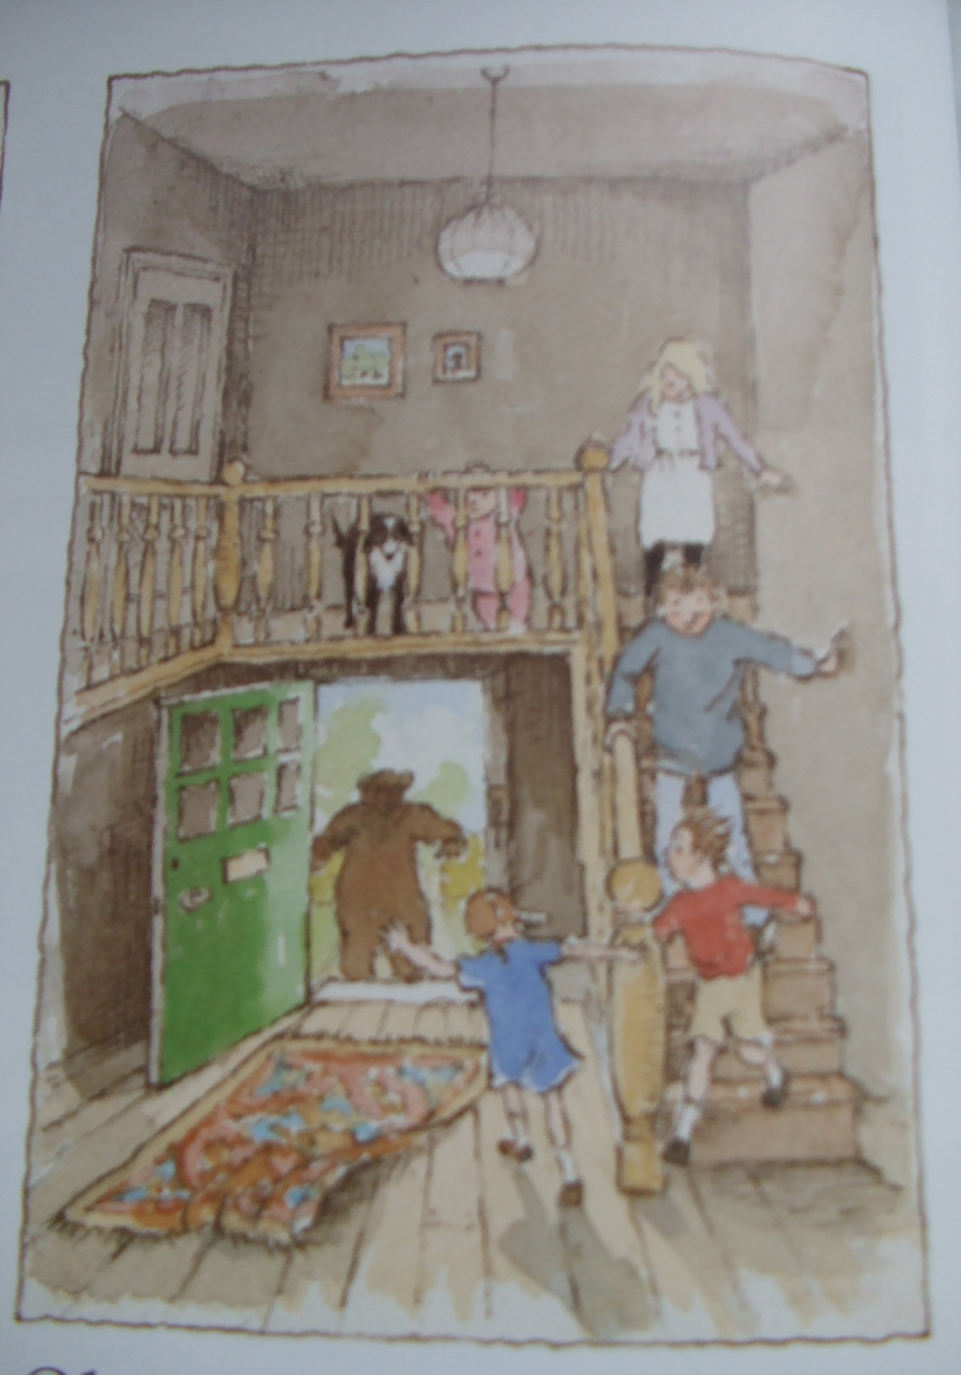
Oh no!
We forgot the shut the door.
Back downstairs.

Slide 36
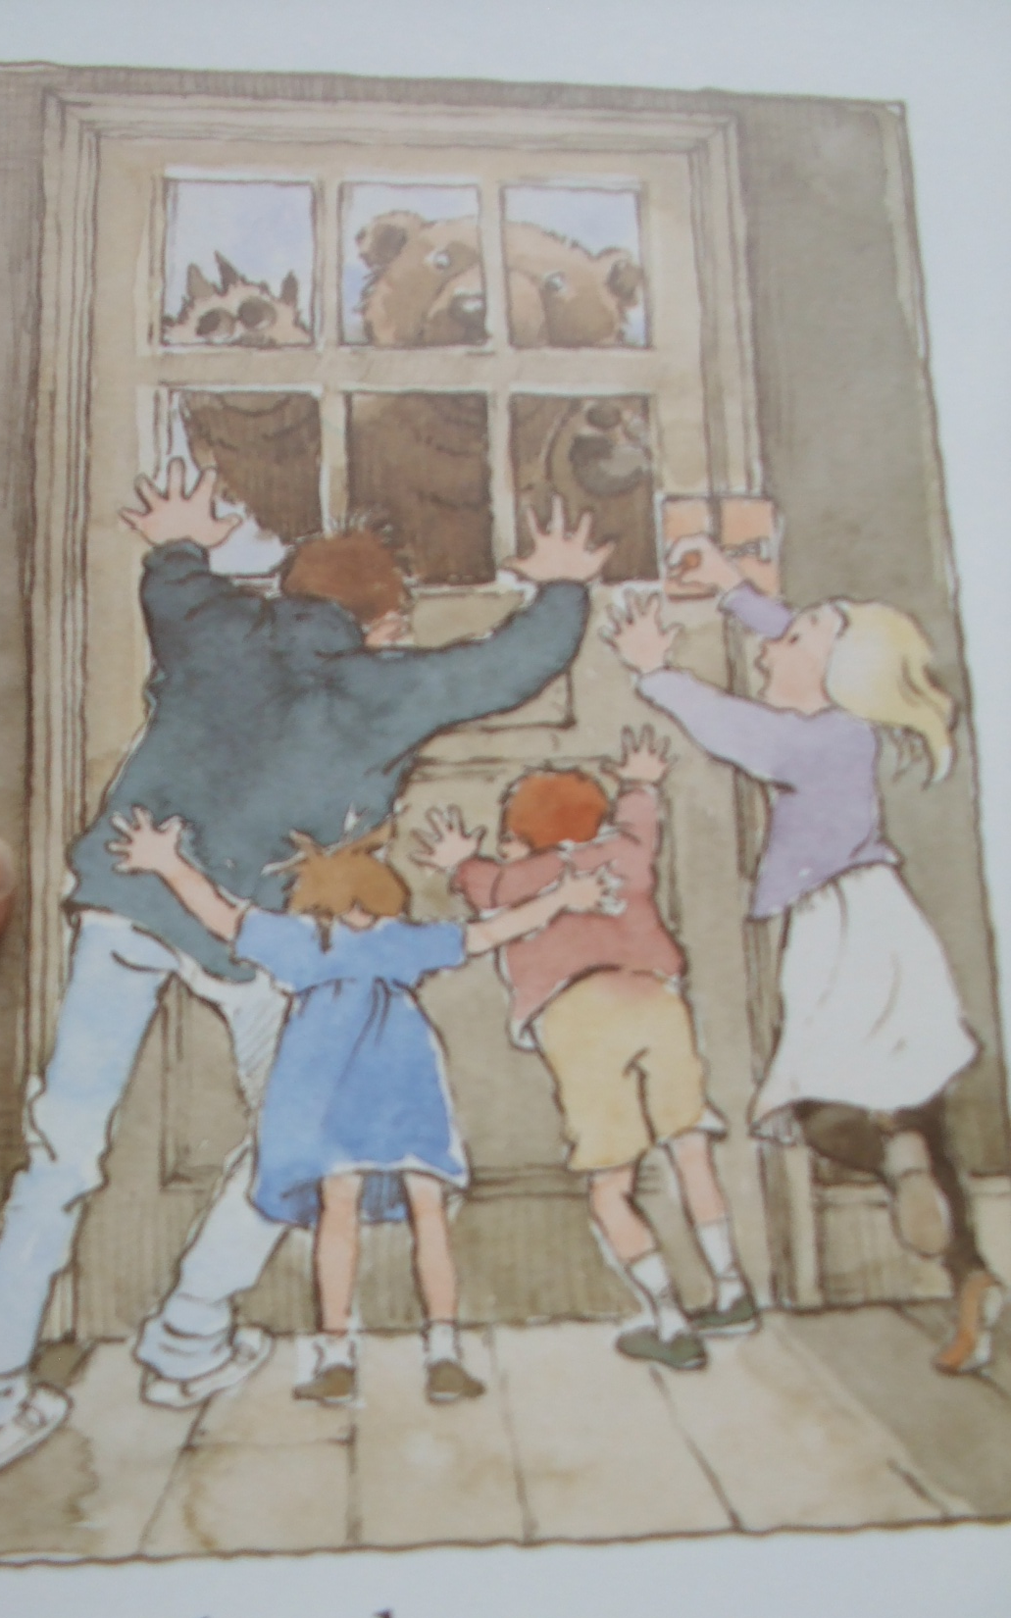
Shut the door.
Back upstairs.
Into the bedroom

Slide 37
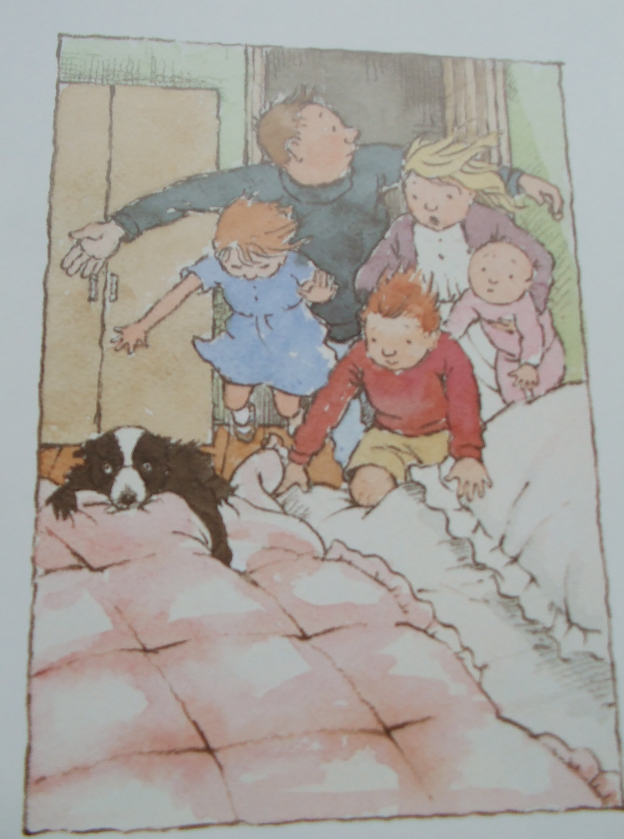
Into bed.
Under covers.

Slide 38
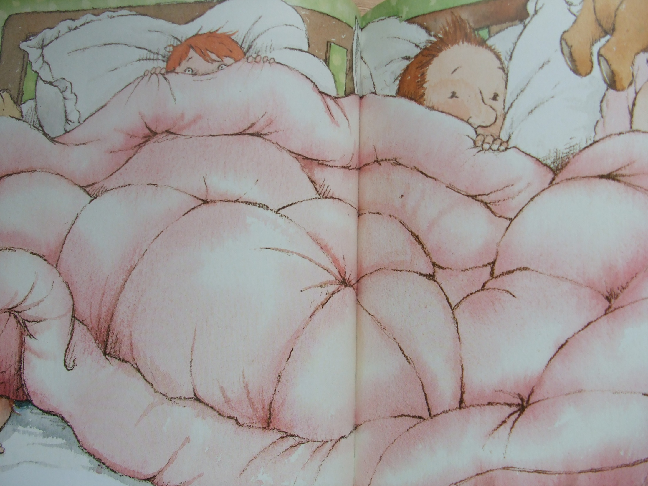
We’re not going on a bear hunt again!

Slide 39
The End

