Slide 1


Slide 3






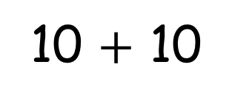
Which represents more?
1)
or
2)
or
3)
or
10 $+$ 10

Slide 4
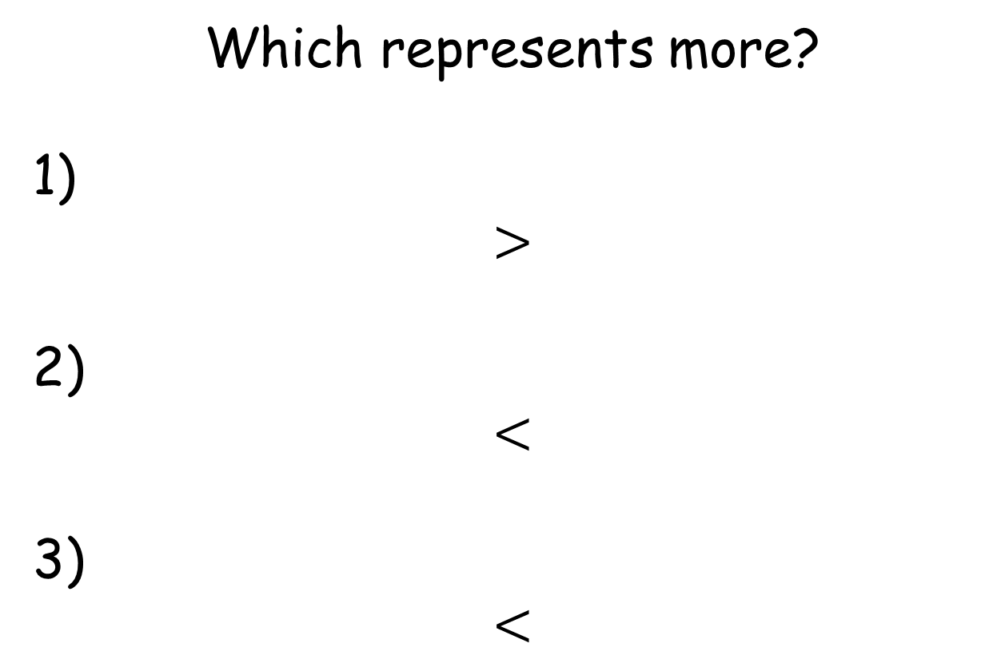
Which represents more?
1)
or
2)
or
3)
or
Which represents more?
1)
$$>$$
2)
$$<$$
3)
$$<$$
10 $+$ 10

Slide 5


Slide 6





Have a think
25
30

Slide 7

Have a think
25
30
33

Slide 8
Have a go at questions 1 and 2 on the worksheet

Slide 9



Have a think
10
ten

Slide 10
Have a think
19
nineteen

Slide 11
Have a think
twenty
25
twenty six
26

Slide 12
Have a think
53
fifty three

Slide 13
Have a think
eighty three
53
fifty three
83

Slide 14
Have a go at questions
3 and 4 on the worksheet

