Slide 2

steam
Start Timer
Start Timer
Next
Use Timer
Show Answer

Slide 3
deab
Start Timer
Start Timer
Show Answer
Use Timer
Next

Slide 4
feap
Start Timer
Start Timer
Show Answer
Use Timer
Next

Slide 5

Easter
Start Timer
Start Timer
Next
Use Timer
Show Answer

Slide 6
glead
Start Timer
Start Timer
Show Answer
Use Timer
Next

Slide 7

bead
Start Timer
Start Timer
Next
Use Timer
Show Answer

Slide 8
zeav
Start Timer
Start Timer
Show Answer
Use Timer
Next

Slide 9
heack
Start Timer
Start Timer
Show Answer
Use Timer
Next

Slide 10

leaf
Start Timer
Start Timer
Next
Use Timer
Show Answer

Slide 11

meat
Start Timer
Start Timer
Next
Use Timer
Show Answer

Slide 12
eap
Start Timer
Start Timer
Show Answer
Use Timer
Next

Slide 13

repeat
Start Timer
Start Timer
Next
Use Timer
Show Answer

Slide 14
breag
Start Timer
Start Timer
Show Answer
Use Timer
Next

Slide 15
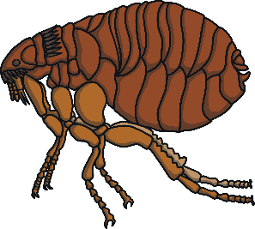
flea
Start Timer
Start Timer
Next
Use Timer
Show Answer

Slide 16
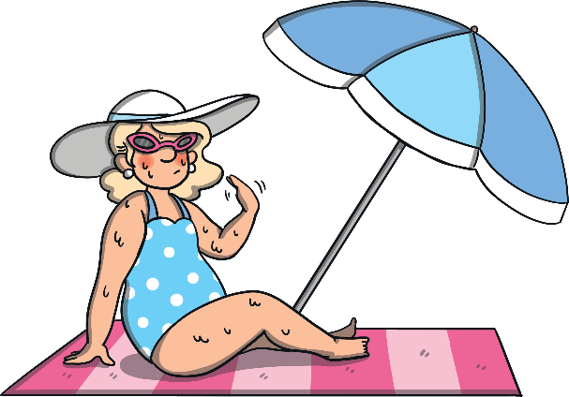
beach
Start Timer
Start Timer
Next
Use Timer
Show Answer

Slide 17
teash
Start Timer
Start Timer
Show Answer
Use Timer
Next

