Slide 1


Slide 3
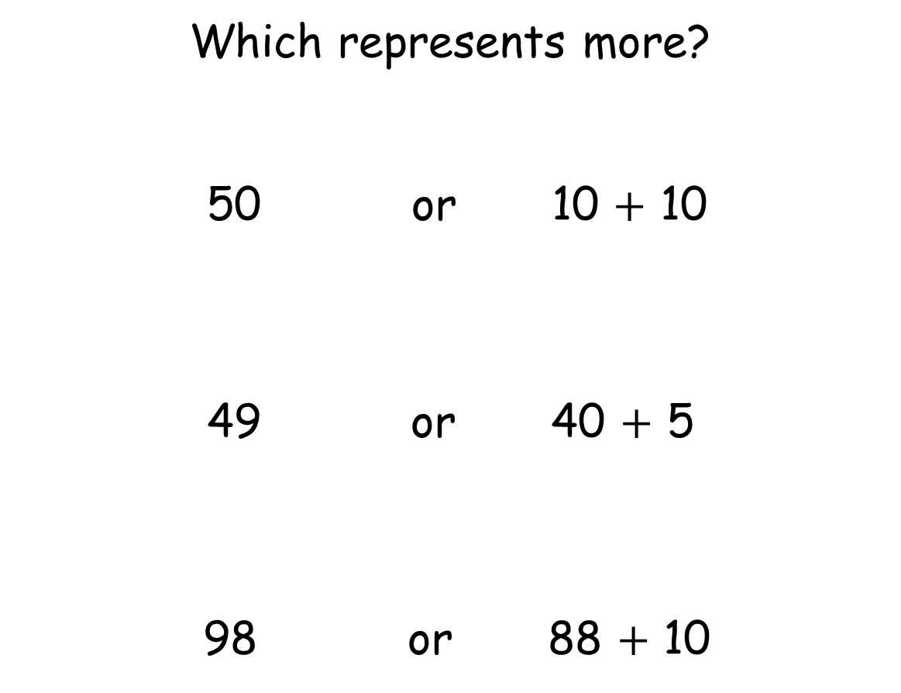
Which represents more?
50 or 10 $+$ 10
49 or 40 $+$ 5
98 or 88 $+$ 10

Slide 4
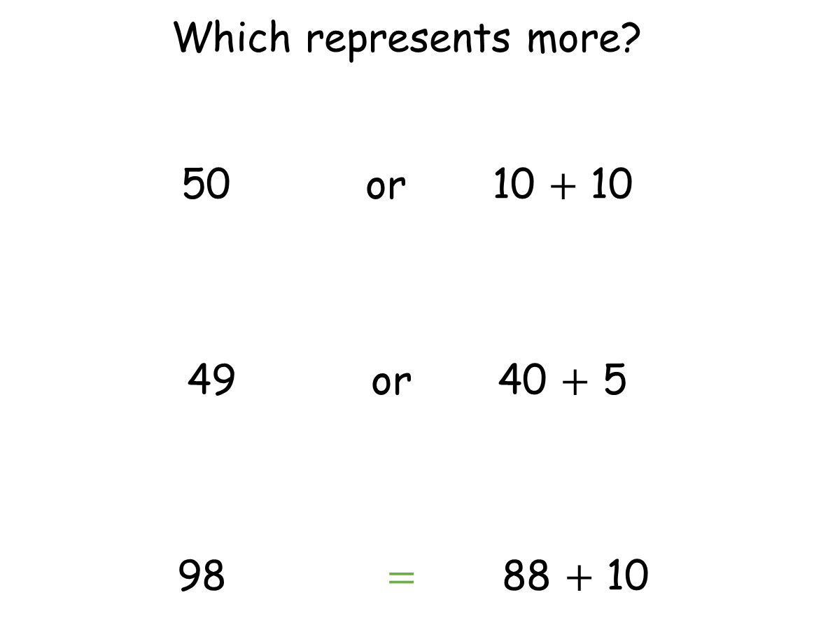
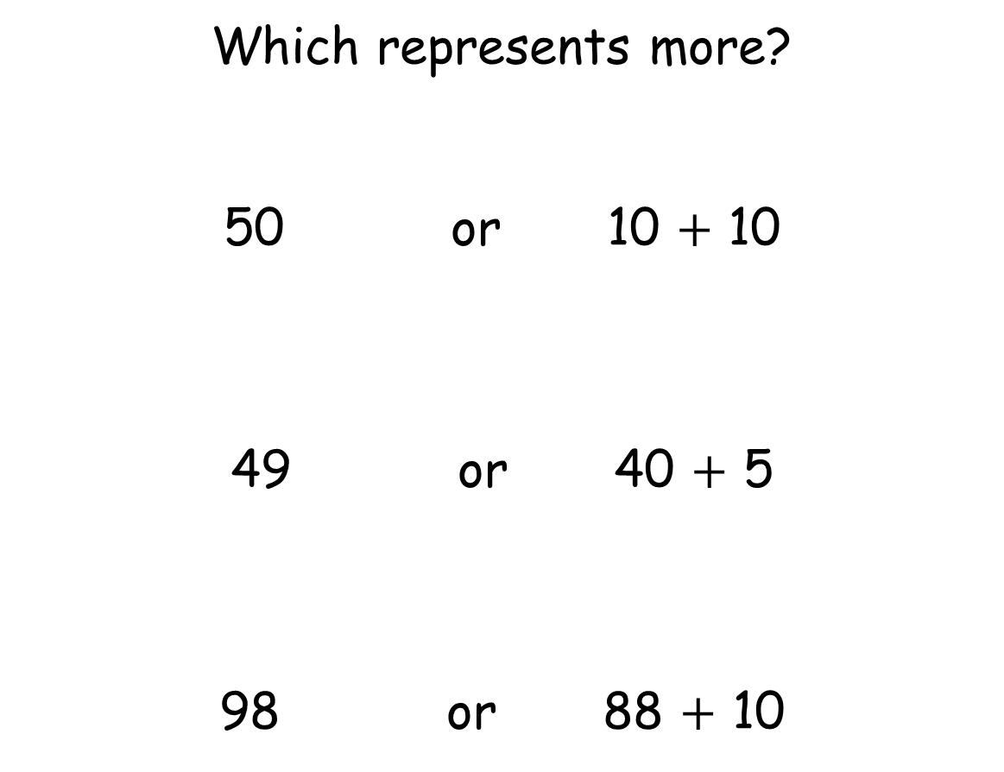
Which represents more?
50 or 10 $+$ 10
49 or 40 $+$ 5
98 $=$ 88 $+$ 10
Which represents more?
50 or 10 $+$ 10
49 or 40 $+$ 5
98 or 88 $+$ 10

Slide 6
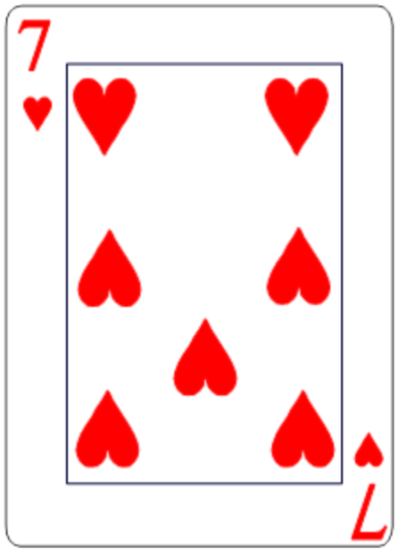
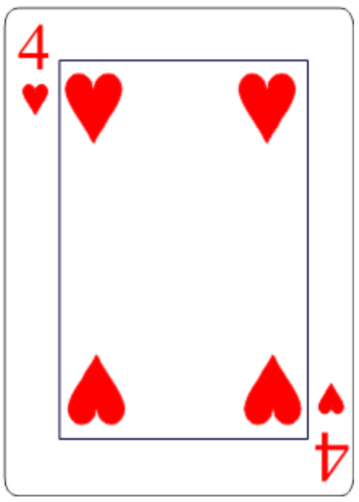





Slide 8
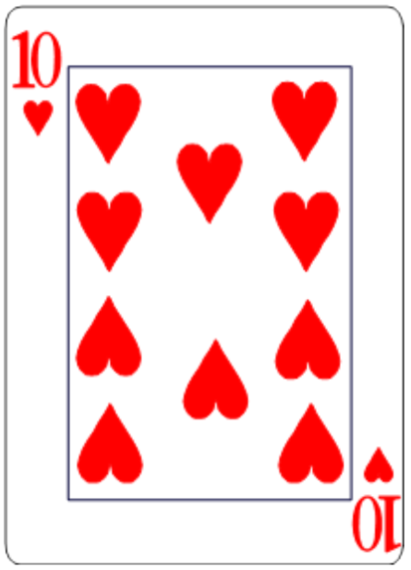
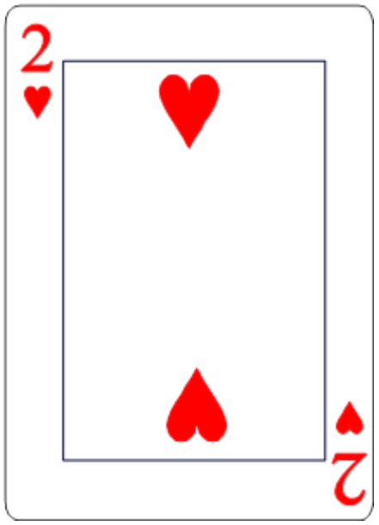

$$<$$
$$<$$

Slide 9






Slide 10

1
1
1
1

Slide 11
1
2
3
4
5
3
6
1
5
2
1
2
3
4
2
6
4
1
5

Slide 12
5
3
2
6
$$<$$

Slide 13

5
3
2
6
$$>$$

Slide 14
5
3
2
6

Slide 15



$$<$$
$$>$$
$$<$$

Slide 16


$$<$$
$$<$$
Have a think

Slide 17



5
3
2
6
$$<$$
$$<$$
$$<$$
Isn’t there another way?

Slide 18



5
3
2
6
$$<$$
$$>$$
$$>$$
$$>$$

Slide 19
5 balls each
Ones
Tens

Slide 20


5 balls each
23
$$>$$
5
40

Slide 21



5 balls each
$$>$$
$$<$$
23
$$<$$
5
$$<$$
31
40
32
30
Have a think

Slide 22




$$<$$
$$>$$
$$=$$

Slide 23
Have a go at the worksheet

