Slide 2


quick
Start Timer
Start Timer
Use Timer
Show Answer
Next

Slide 3
queff
Use Timer
Show Answer
Start Timer
Start Timer
Next

Slide 4
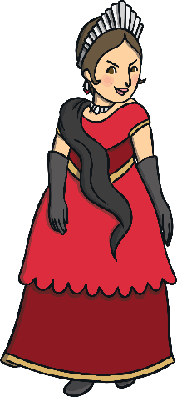
queen
Start Timer
Start Timer
Use Timer
Show Answer
Next

Slide 5
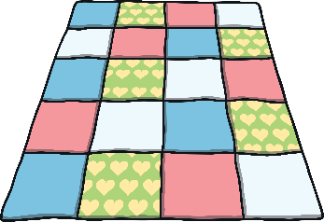
quilt
Start Timer
Start Timer
Use Timer
Show Answer
Next

Slide 6
quozz
Use Timer
Show Answer
Start Timer
Start Timer
Next

Slide 7
quish
Use Timer
Show Answer
Start Timer
Start Timer
Next

Slide 8
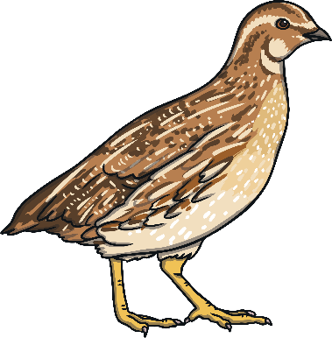
quail
Start Timer
Start Timer
Use Timer
Show Answer
Next

Slide 9
quep
Use Timer
Show Answer
Start Timer
Start Timer
Next

Slide 10
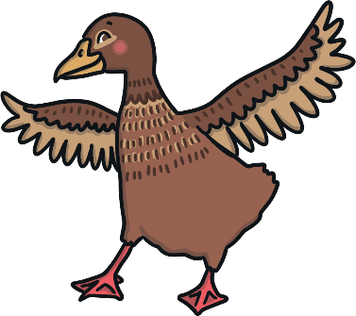
quack
Start Timer
Start Timer
Use Timer
Show Answer
Next

Slide 11
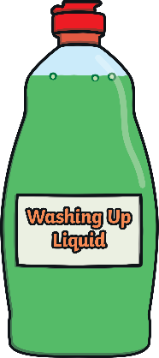
liquid
Start Timer
Start Timer
Use Timer
Show Answer
Next

