Slide 2


buzz
Start Timer
Start Timer
Use Timer
Show Answer
Next

Slide 3
juzz
Start Timer
Start Timer
Use Timer
Next
Show Answer

Slide 4
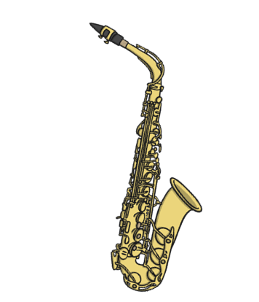
jazz
Start Timer
Start Timer
Use Timer
Show Answer
Next

Slide 5
lozz
Start Timer
Start Timer
Use Timer
Next
Show Answer

Slide 6
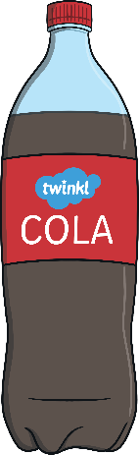
fizz
Start Timer
Start Timer
Use Timer
Show Answer
Next

Slide 7
kezz
Start Timer
Start Timer
Use Timer
Next
Show Answer

Slide 8
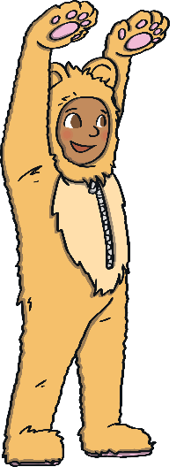
fuzz
Start Timer
Start Timer
Use Timer
Show Answer
Next

Slide 9
vizz
Start Timer
Start Timer
Use Timer
Next
Show Answer

Slide 10
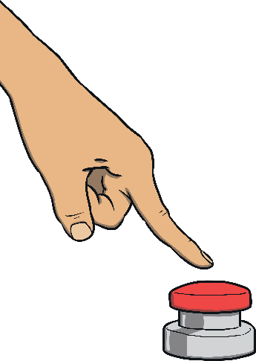
buzzer
Start Timer
Start Timer
Use Timer
Show Answer
Next

Slide 11
nuzz
Start Timer
Start Timer
Use Timer
Next
Show Answer

