Slide 2
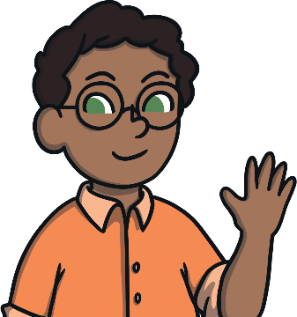

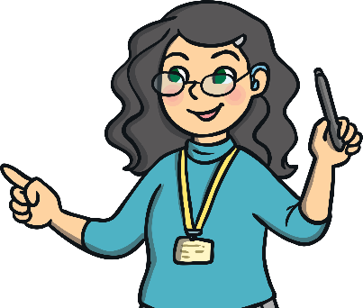


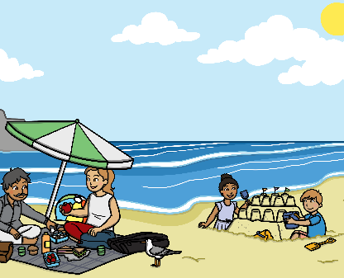
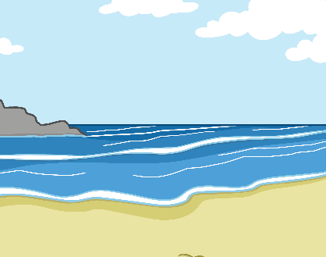
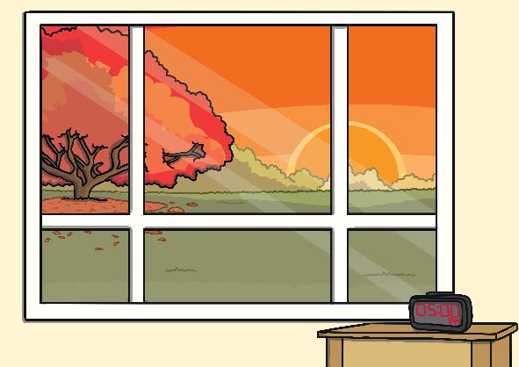

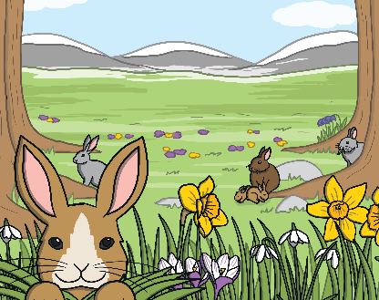
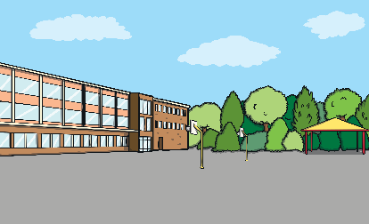
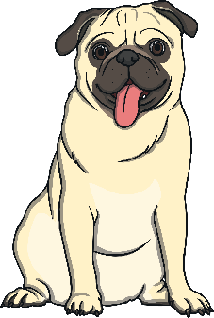

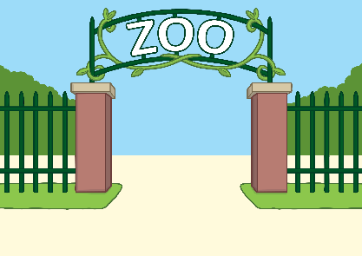
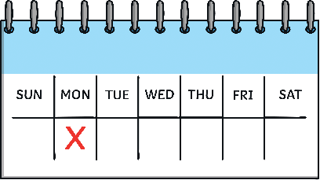

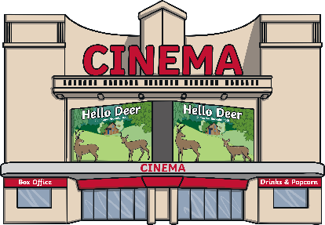
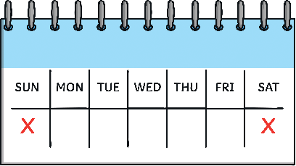


  Click on the buttons for new words
Who?
Doing What?
Where?
When?
Clear sentence
in the afternoon.
in the evening.
in the classroom
on the weekend.
is playing
in the zoo
is running
is sitting
is jumping
The dog
is writing
The tiger
The teacher
The frog
The boy
in the movies
on the beach
in the park
on Monday.
on vacation.
on the weekend.
in the afternoon.
in the evening.
in the classroom
The teacher
is sitting
in the park
The frog
is jumping
The boy
is writing
on the beach
The tiger
is running
in the zoo
on vacation.
The dog
is playing
in the movies
on Monday.

