Slide 2
Instructions
Just click on the pencil and it will show you how to form the letter that you have chosen.
Press the ‘menu’ button to return back to the letter choices.
Select which version of the alphabet that you would like.
Upper Case
Lower Case

Slide 3
Alphabet Upper Case
Click on the letter that you would like to practice.
A
B
C
D
E
F
G
H
I
J
K
L
M
N
O
P
Q
R
S
T
U
V
W
X
Y
Z
Back to Choices

Slide 4
Alphabet Lower Case
Click on the letter that you would like to practice.
a
b
c
d
e
f
g
h
i
j
k
l
m
n
o
p
q
r
s
t
u
v
w
x
y
z
Back to Choices

Slide 5


Watch and Copy the Pencil
Click on the pencil to see the letter formation.
A
Menu

Slide 6
Watch and Copy the Pencil
Click on the pencil to see the letter formation.
a
Menu

Slide 7
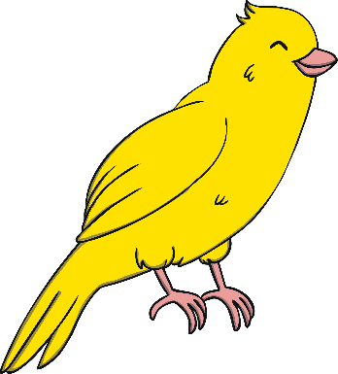
Watch and Copy the Pencil
Click on the pencil to see the letter formation.
B
Menu

Slide 8
Watch and Copy the Pencil
Click on the pencil to see the letter formation.
b
Menu

Slide 9

Watch and Copy the Pencil
Click on the pencil to see the letter formation.
C
Menu

Slide 10
Watch and Copy the Pencil
Click on the pencil to see the letter formation.
c
Menu

Slide 11
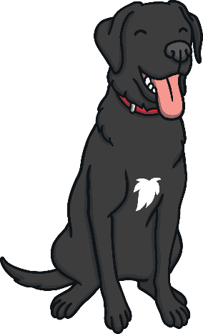
Watch and Copy the Pencil
Click on the pencil to see the letter formation.
D
Menu

Slide 12

Watch and Copy the Pencil
Click on the pencil to see the letter formation.
d
Menu

Slide 13

Watch and Copy the Pencil
Click on the pencil to see the letter formation.
E
Menu

Slide 14
Watch and Copy the Pencil
Click on the pencil to see the letter formation.
e
Menu

Slide 15

Watch and Copy the Pencil
Click on the pencil to see the letter formation.
F
Menu

Slide 16
Watch and Copy the Pencil
Click on the pencil to see the letter formation.
f
Menu

Slide 17

Watch and Copy the Pencil
Click on the pencil to see the letter formation.
G
Menu

Slide 18
Watch and Copy the Pencil
Click on the pencil to see the letter formation.
g
Menu

Slide 19

Watch and Copy the Pencil
Click on the pencil to see the letter formation.
H
Menu

Slide 20
Watch and Copy the Pencil
Click on the pencil to see the letter formation.
h
Menu

Slide 21

Watch and Copy the Pencil
Click on the pencil to see the letter formation.
I
Menu

Slide 22
Watch and Copy the Pencil
Click on the pencil to see the letter formation.
i
Menu

Slide 23
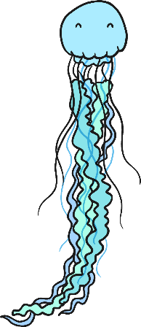
Watch and Copy the Pencil
Click on the pencil to see the letter formation.
J
Menu

Slide 24
Watch and Copy the Pencil
Click on the pencil to see the letter formation.
j
Menu

Slide 25

Watch and Copy the Pencil
Click on the pencil to see the letter formation.
K
Menu

Slide 26
Watch and Copy the Pencil
Click on the pencil to see the letter formation.
k
Menu

Slide 27

Watch and Copy the Pencil
Click on the pencil to see the letter formation.
L
Menu

Slide 28
Watch and Copy the Pencil
Click on the pencil to see the letter formation.
l
Menu

Slide 29

Watch and Copy the Pencil
Click on the pencil to see the letter formation.
M
Menu

Slide 30
Watch and Copy the Pencil
Click on the pencil to see the letter formation.
m
Menu

Slide 31

Watch and Copy the Pencil
Click on the pencil to see the letter formation.
N
Menu

Slide 32
Watch and Copy the Pencil
Click on the pencil to see the letter formation.
n
Menu

Slide 33

Watch and Copy the Pencil
Click on the pencil to see the letter formation.
O
Menu

Slide 34
Watch and Copy the Pencil
Click on the pencil to see the letter formation.
o
Menu

Slide 35

Watch and Copy the Pencil
Click on the pencil to see the letter formation.
P
Menu

Slide 36
Watch and Copy the Pencil
Click on the pencil to see the letter formation.
p
Menu

Slide 37

Watch and Copy the Pencil
Click on the pencil to see the letter formation.
Q
Menu

Slide 38
Watch and Copy the Pencil
Click on the pencil to see the letter formation.
q
Menu

Slide 39

Watch and Copy the Pencil
Click on the pencil to see the letter formation.
R
Menu

Slide 40
Watch and Copy the Pencil
Click on the pencil to see the letter formation.
r
Menu

Slide 41

Watch and Copy the Pencil
Click on the pencil to see the letter formation.
S
Menu

Slide 42
Watch and Copy the Pencil
Click on the pencil to see the letter formation.
s
Menu

Slide 43

Watch and Copy the Pencil
Click on the pencil to see the letter formation.
T
Menu

Slide 44
Watch and Copy the Pencil
Click on the pencil to see the letter formation.
t
Menu

Slide 45

Watch and Copy the Pencil
Click on the pencil to see the letter formation.
U
Menu

Slide 46
Watch and Copy the Pencil
Click on the pencil to see the letter formation.
u
Menu

Slide 47

Watch and Copy the Pencil
Click on the pencil to see the letter formation.
V
Menu

Slide 48
Watch and Copy the Pencil
Click on the pencil to see the letter formation.
v
Menu

Slide 49

Watch and Copy the Pencil
Click on the pencil to see the letter formation.
W
Menu

Slide 50
Watch and Copy the Pencil
Click on the pencil to see the letter formation.
w
Menu

Slide 51
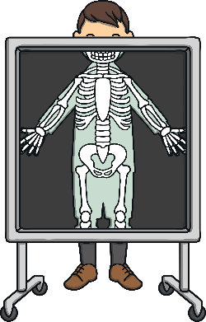
Watch and Copy the Pencil
Click on the pencil to see the letter formation.
X
Menu

Slide 52
Watch and Copy the Pencil
Click on the pencil to see the letter formation.
x
Menu

Slide 53
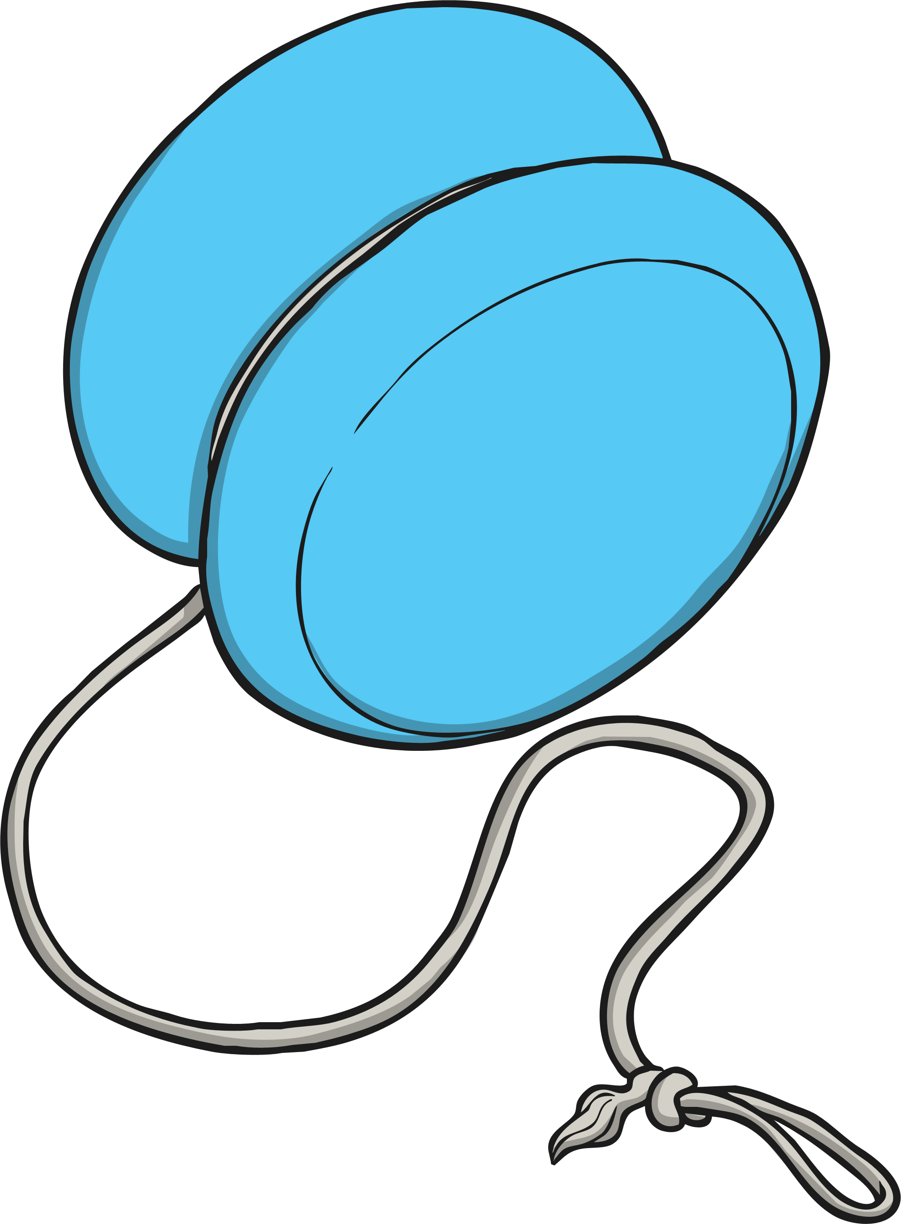
Watch and Copy the Pencil
Click on the pencil to see the letter formation.
Y
Menu

Slide 54
Watch and Copy the Pencil
Click on the pencil to see the letter formation.
y
Menu

Slide 55
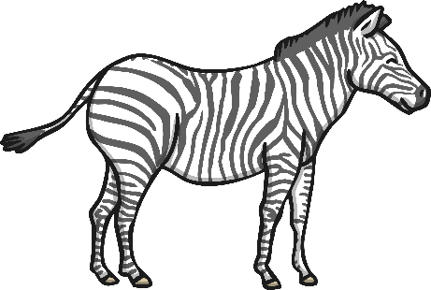
Watch and Copy the Pencil
Click on the pencil to see the letter formation.
Z
Menu

Slide 56
Watch and Copy the Pencil
Click on the pencil to see the letter formation.
z
Menu

