Slide 1
CVCC Words

Slide 2
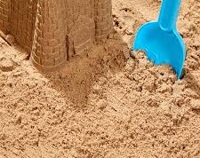
s-a-n-d
sand

Slide 3

p-i-n-k
pink

Slide 4
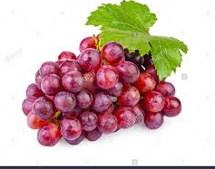
b-u-n-ch
bunch

Slide 5

h-a-n-d
hand

Slide 6
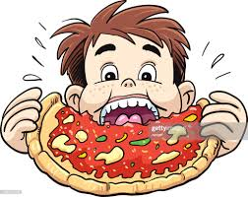
m-u-n-ch
munch

Slide 7
The End

