Slide 2
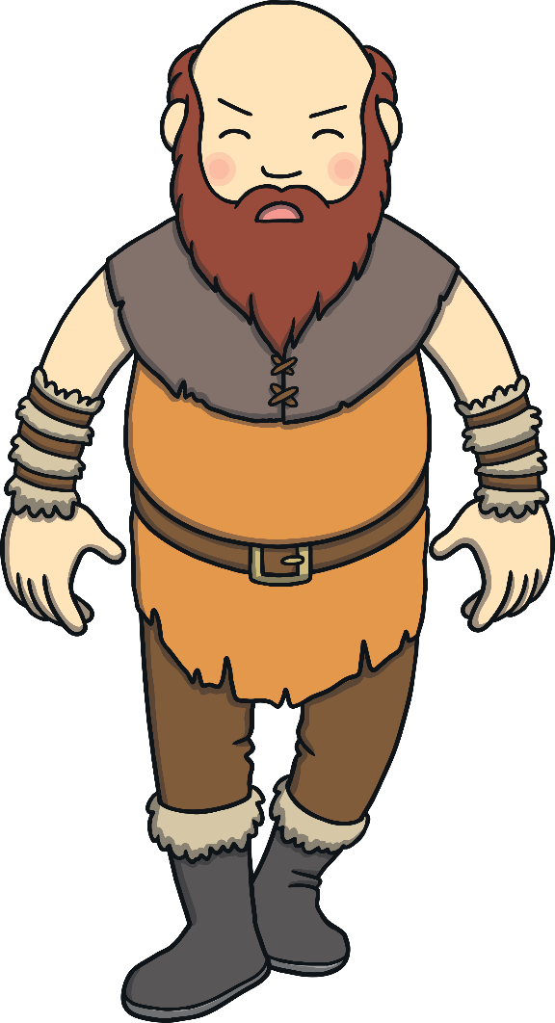
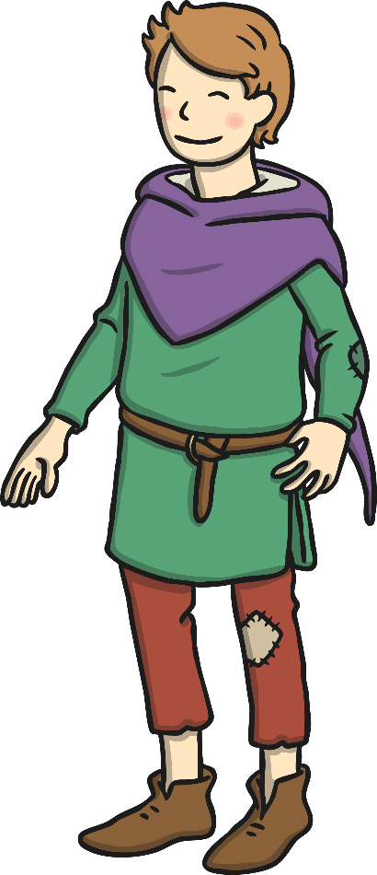
frightening
fierce
enormous
clever
scared
kind
greedy
angry
poor
brave
friendly
evil

