Slide 2
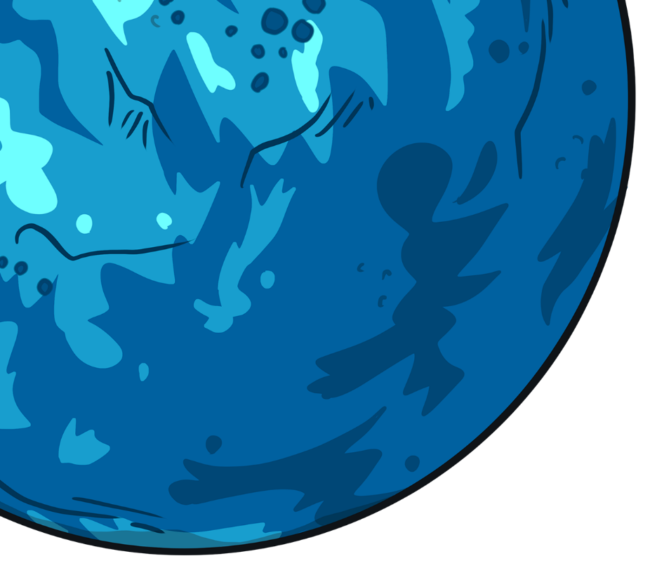
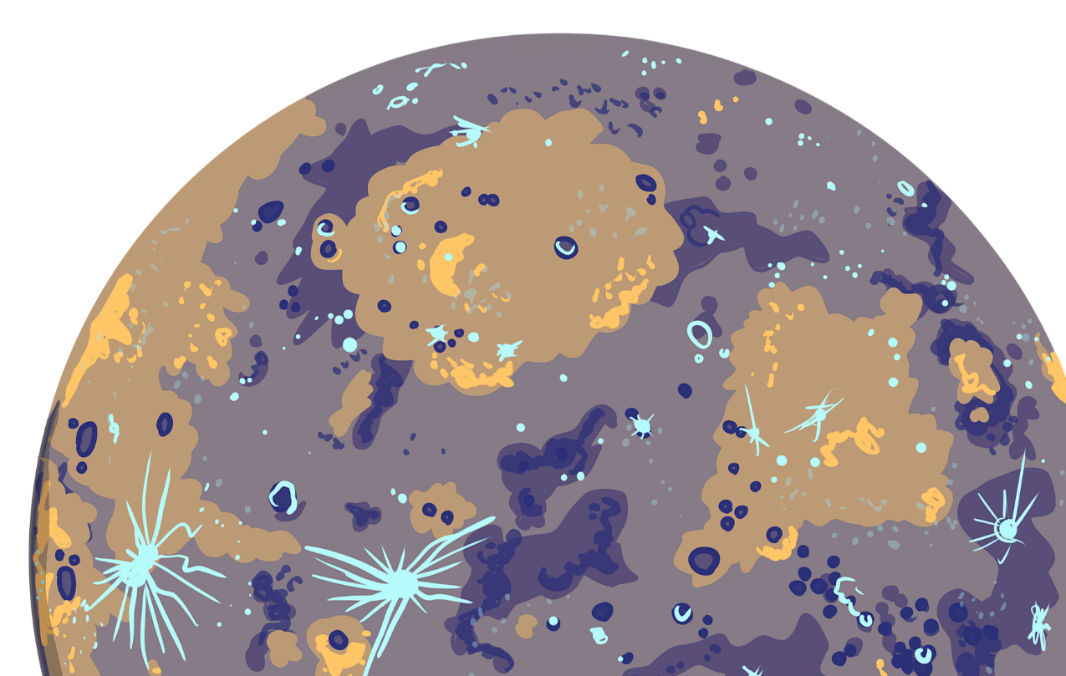
Start game

Slide 3
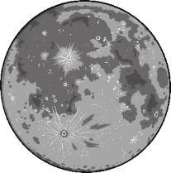
Click the moons to reveal the facts.
1
I am smaller than my neighbour, earth.
2
Robots from earth have landed on me.
3
I am known as the red planet.
Which planet am I?

Slide 4
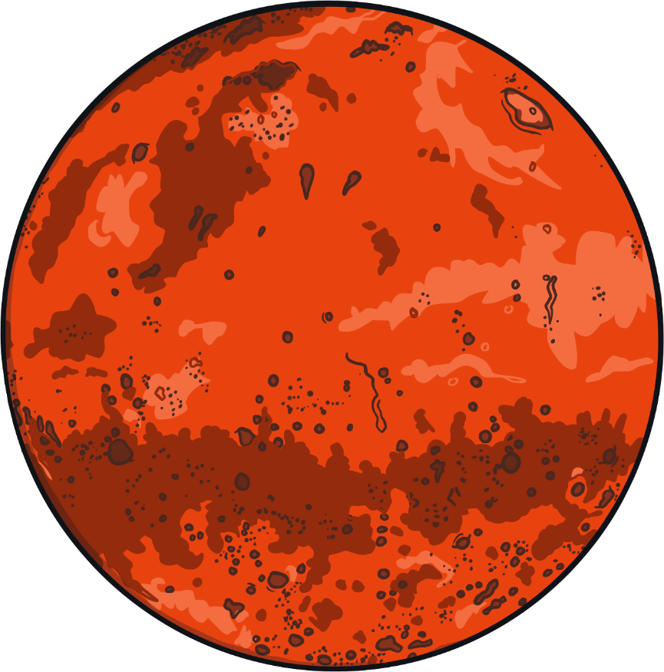
I am Mars!

Slide 5
Click the moons to reveal the facts.
1
My atmosphere contains oxygen.
2
I have earthquakes and volcanos.
3
Things are able to live in my atmosphere.
Which planet am I?

Slide 6
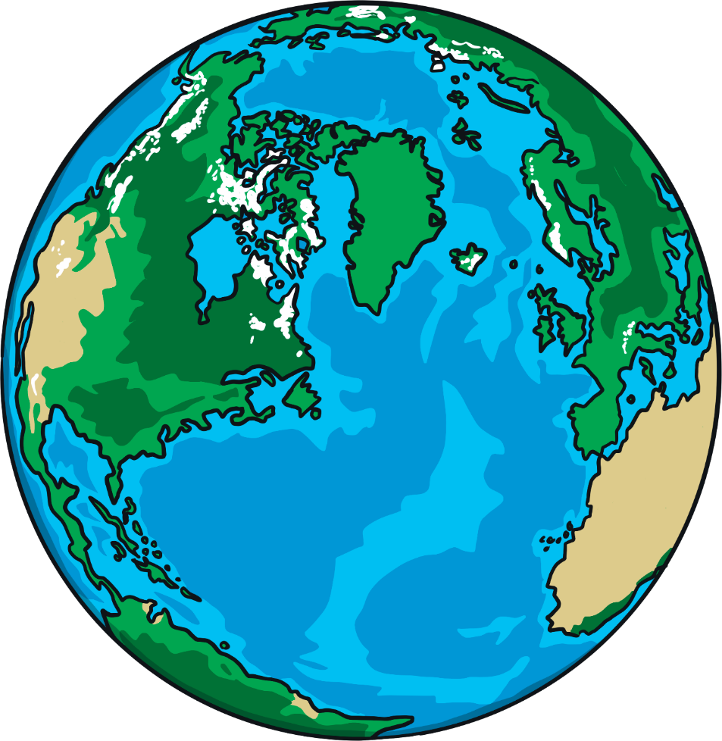
I am Earth!

Slide 7
Click the moons to reveal the facts.
1
I am named after the roman God of agriculture.
2
I am the second largest planet in the solar system.
3
I have seven flat rings which go around me.
Which planet am I?

Slide 8
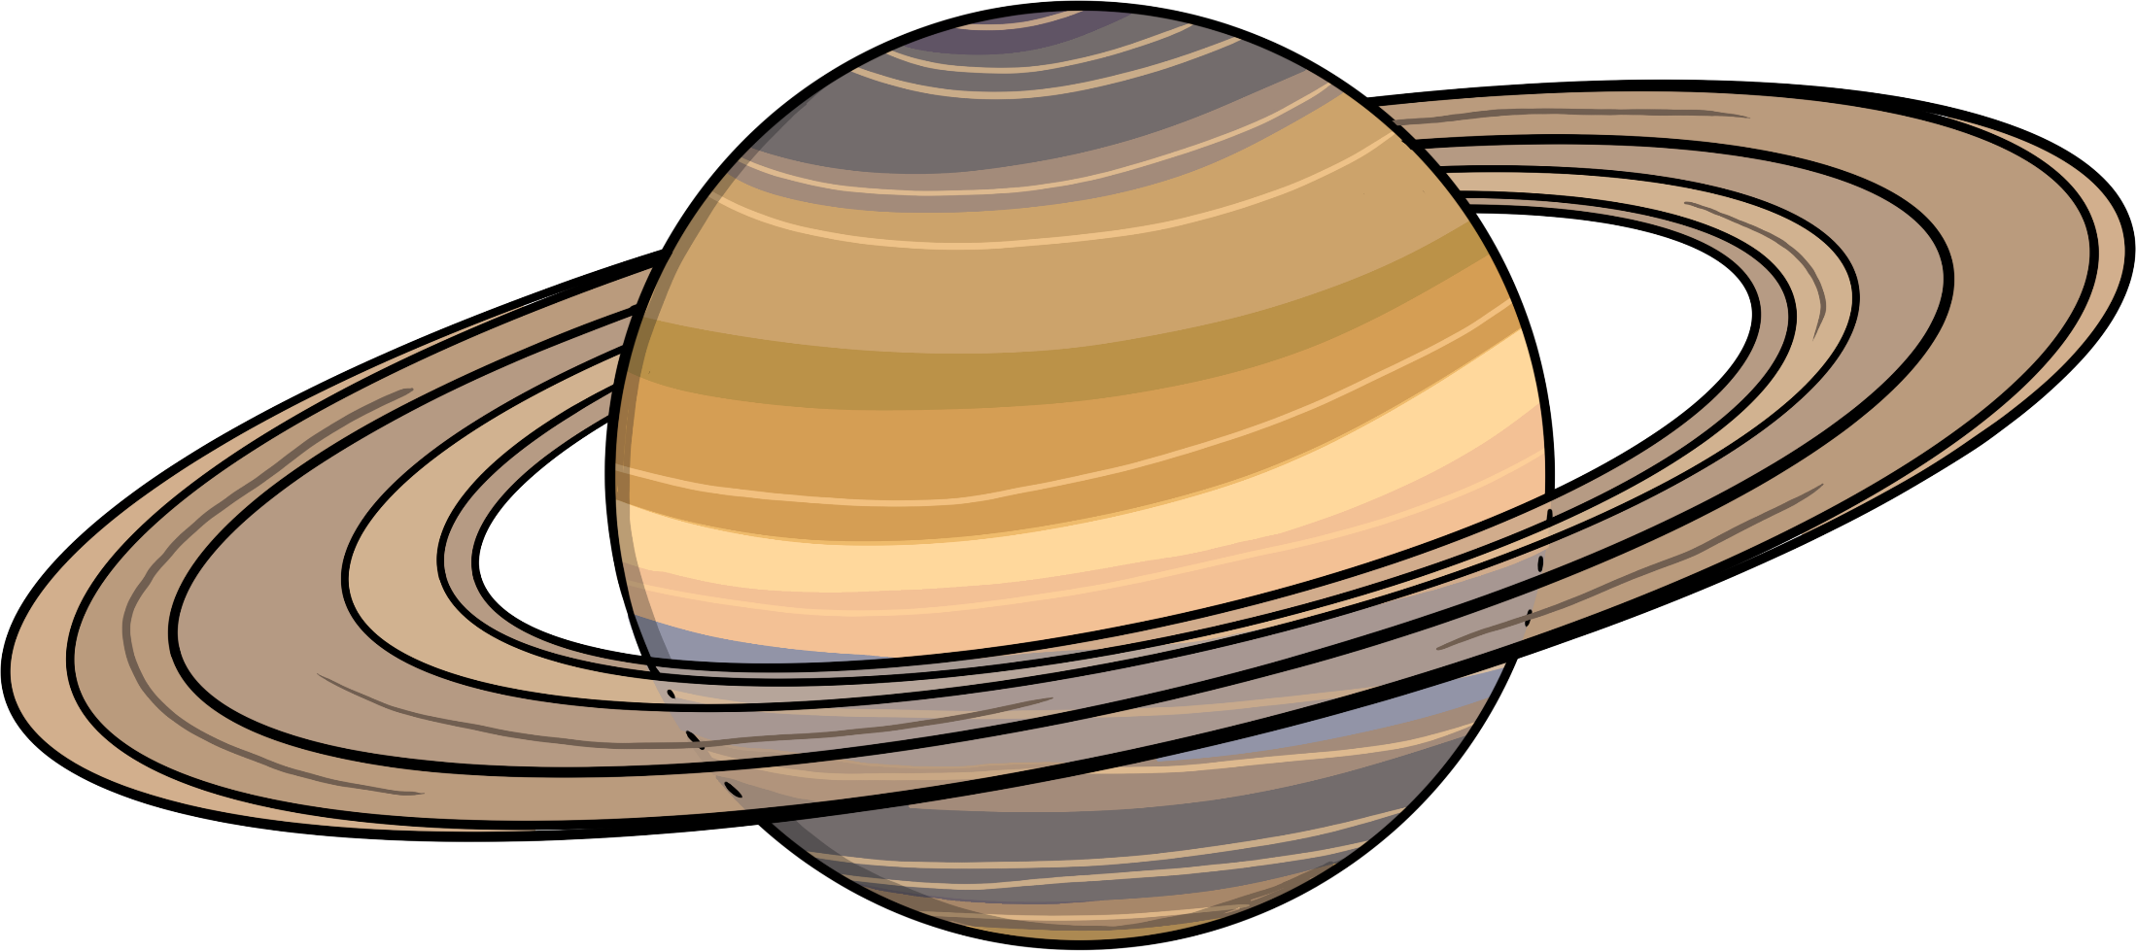
I am Saturn!

Slide 9
Click the moons to reveal the facts.
1
My weather is very extreme.
2
I am the outermost planet in the solar system.
3
I am blue in colour.
Which planet am I?

Slide 10
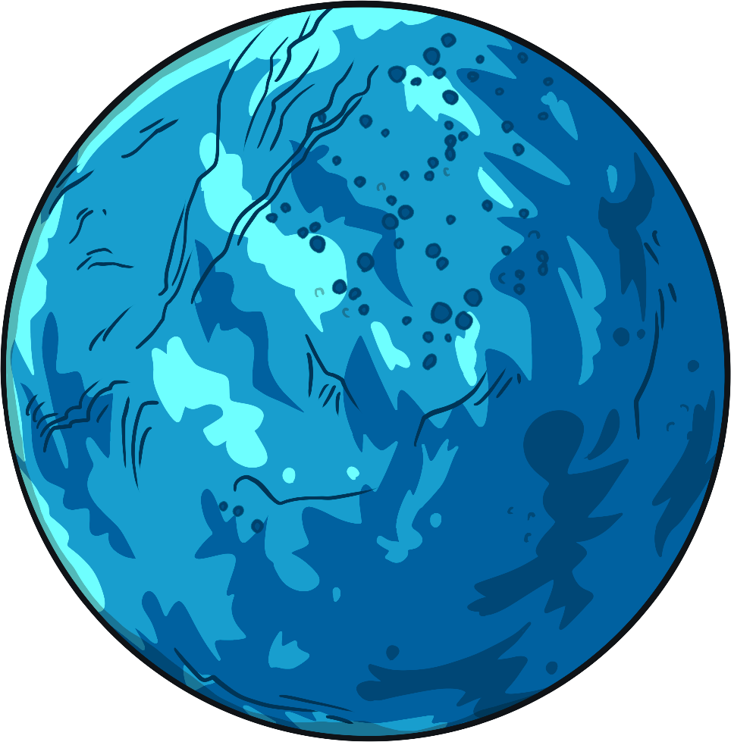
I am Neptune!

Slide 11
Click the moons to reveal the facts.
1
I am the smallest planet in the solar system.
2
I have lots of craters.
3
I am the closest planet to
the sun.
Which planet am I?

Slide 12
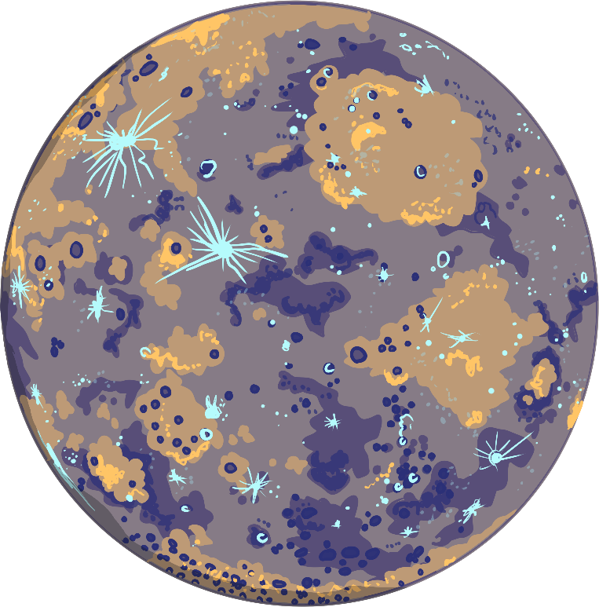
I am Mercury!

Slide 13
Click the moons to reveal the facts.
1
I am named after the Roman Goddess of love and beauty.
2
My atmosphere is hot and deadly.
3
I am the second planet from the sun.
Which planet am I?

Slide 14
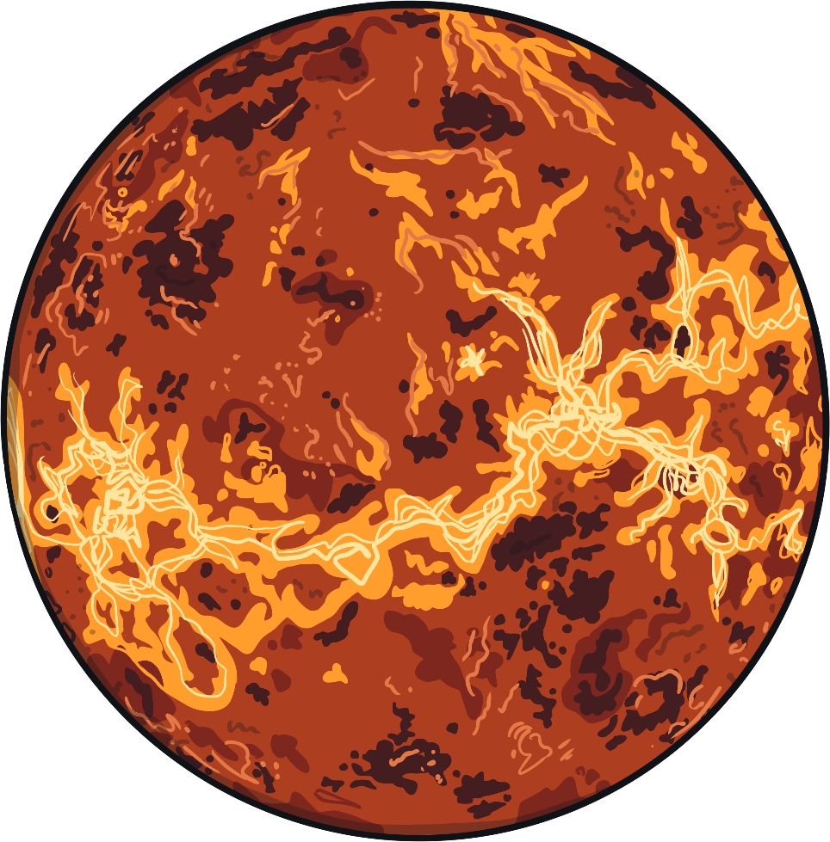
I am Venus!

Slide 15
Click the moons to reveal the facts.
1
I am named after the king of Roman Gods.
2
I have a large spot which is actually a storm that has been raging for many years.
3
I am the largest planet in the solar system.
Which planet am I?

Slide 16
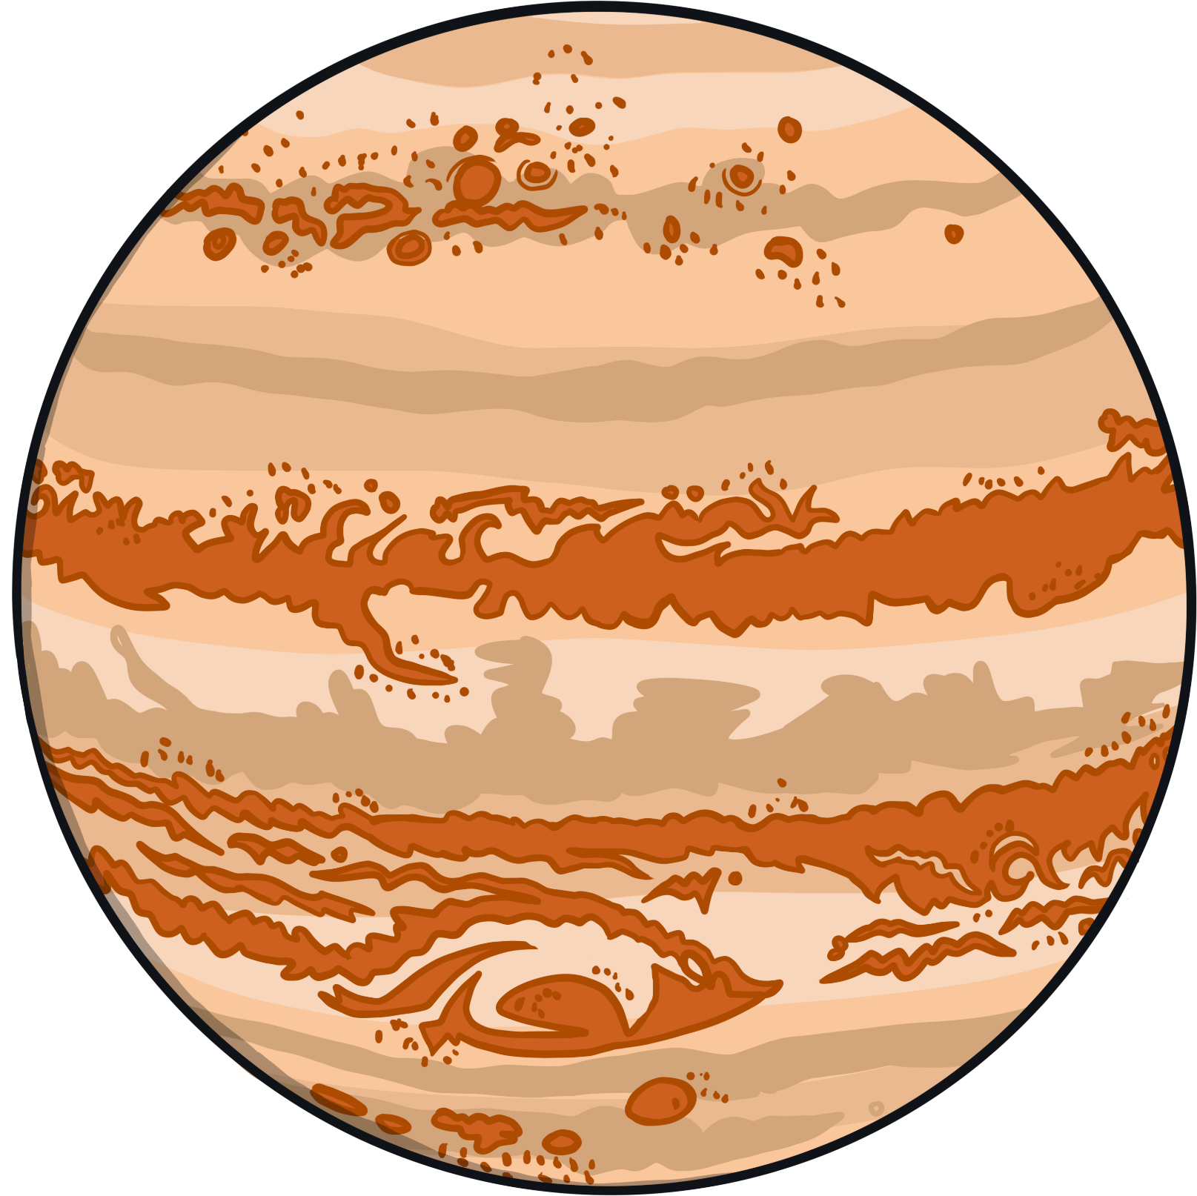
I am Jupiter!

Slide 17
Click the moons to reveal the facts.
1
I am named after the Greek God of the sky.
2
I spin on my side.
3
I am the coldest planet in the solar system.
Which planet am I?

Slide 18
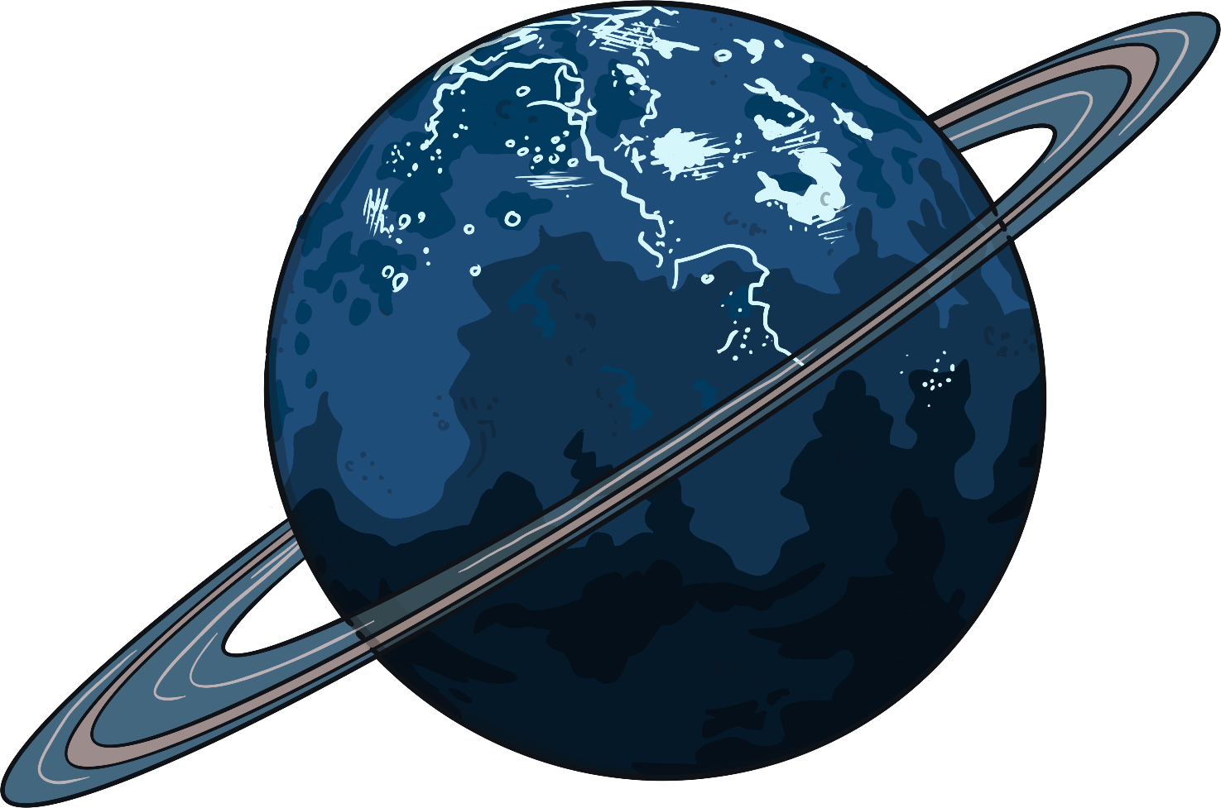
I am Uranus!

Slide 19
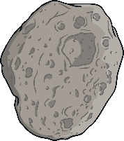




Well done for completing the game!

