Slide 1





Doubling
www.TheStorySeed.com

Slide 2




This is Dobby. He is a friendly alien. Dobby lives on a spaceship with lots of other aliens, including his best friend Kenny.
Wait for me, Kenny!

Slide 3

While Dobby was trying to catch up with Kenny, he saw colourful lights
flashing from one of the rooms.
Let’s go in and have a look.

Slide 4


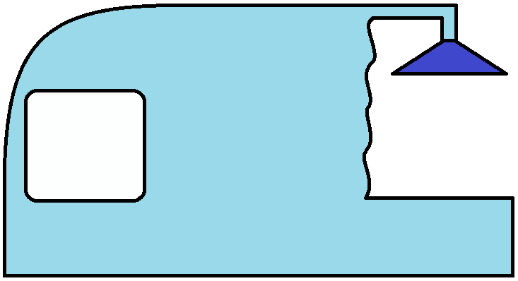

In the room was a huge machine.
What’s a ‘Doubling Machine’?
Let’s find out what this machine does!
Press on the red button that says ‘double’.
The Doubling Machine
double

Slide 5
How many apples do we have now?
2
The Doubling Machine
double

Slide 6
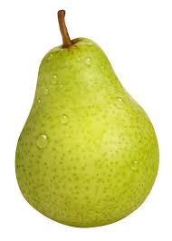
How many pears do you see?
If we press on the red button, how many pears do you think we’ll have?
The Doubling Machine
double

Slide 7
How many pears do we have now?
4
The Doubling Machine
double

Slide 8
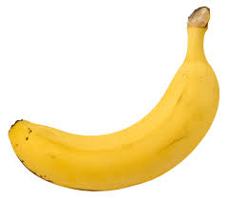
How many bananas do you see?
If we press on the red button, how many bananas do you think we’ll have?
The Doubling Machine
double

Slide 9
How many bananas do we have now?
6
The Doubling Machine
double

Slide 10
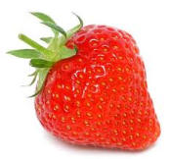
How many stawberries do you see?
If we press on the red button, how many bananas do you think we’ll have?
The Doubling Machine
double

Slide 11
How many bananas do we have now?
8
The Doubling Machine
double

Slide 12
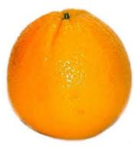
How many oranges do you see?
If we press on the red button, how many oranges do you think we’ll have?
The Doubling Machine
double

Slide 13
How many oranges do we have now?
10
The Doubling Machine
double

Slide 14
Dobby! I’ve been looking all over for you! Hey! What’s this machine?
Can you help Dobby explain what this machine does?
The Doubling Machine
double

